Slide 1
Lecture ten

Slide 2
A* algorithm
It is an advanced BFS algorithm that searches for shorter paths first rather than the longer paths. A* is optimal as well as a complete algorithm.
Optimal meaning that A* is sure to find the least cost from the source to the destination and Complete meaning that it is going to find all the paths that are available to us from the source to the destination.
in most cases A* the best algorithm. But A* is slow and also the space it requires is a lot as it saves all the possible paths that are available to us. This makes other faster algorithms have an upper hand over A* but it is nevertheless, one of the best algorithms out there.

Slide 3
A* Algorithm:
Add start node to list
For all the neighbouring nodes, find the least cost F node
Switch to the closed list
For 8 nodes adjacent to the current node
If the node is not reachable, ignore it. Else
If the node is not on the open list, move it to the open list and calculate f, g, h.
If the node is on the open list, check if the path it offers is less than the current path and change to it if it does so.
Stop working when
You find the destination
You cannot find the destination going through all possible points

Slide 4
Heuristic Function Is a function that maps from problem state descriptions to measures of desirability, usually represented as numbers.
The function F can be constructed as the sum of two terms:
f(n) = g(n) + h(n)
where g(n) measures the actual length of the path from any state n to the start state, and,
h(n) is the heuristic estimate of the distance from state n to a goal.

Slide 5
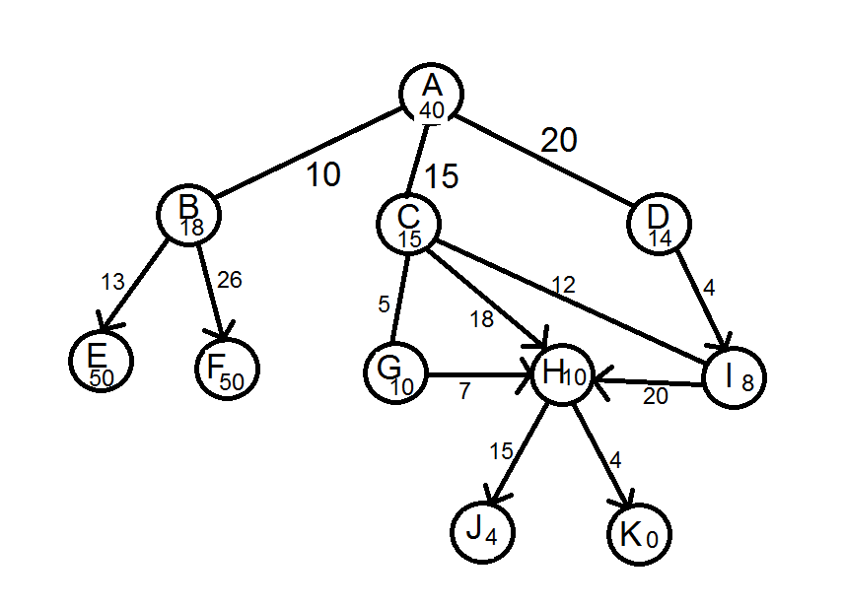
A* algorithm

Slide 6
Node n | Heuristic function h(n)
A | 40
B | 28
C | 30
D | 34
E | 73
F | 86
G | 30
H | 37
I | 35
J | 37
K | 31

Slide 7
Iteration | Node | OPEN | CLOSED
0 |  | [A₄₀] | [ ]
1 | A₄₀ | [B₂₈ C₃₀ D₃₄] | [A]
2 | B₂₈ | [C₃₀ D₃₄ E₇₃ F₈₆] | [A₄₀ B₂₈]
3 | C₃₀ | [D₃₄ E₇₃ F₈₆ G₃₀ H₄₃ I₃₅] | [A₄₀ B₂₈ C₃₀]
4 | G₃₀ | [D₃₄ E₇₃ F₈₆ H₃₇ I₃₅] | [A₄₀ B₂₈ C₃₀ G₃₀]
5 | D₃₄ | [E₇₃ F₈₆ H₃₇ I₃₂] | [A₄₀ B₂₈ C₃₀ G₃₀ D₃₄]
6 | I₃₂ | [E₇₃ F₈₆ H₃₇] | [A₄₀ B₂₈ C₃₀ G₃₀ D₃₄ I₃₂]
7 | H₃₇ | [E₇₃ F₈₆ J₄₆ K₃₁] | [A₄₀ B₂₈ C₃₀ G₃₀ D₃₄ I₃₂ H₃₇]
8 | K₃₁ | [E₇₃ F₈₆ J₄₆] | [A₄₀ B₂₈ C₃₀ G₃₀ D₃₄ I₃₂ H₃₇ K₃₁]
PATH solution: A →C → G → H → K.

