Slide 1
Lecture two

Slide 2
AI as Study and Design of Intelligent Agents
Intelligent agents: artifacts that act rationally in their environment
•Their actions are appropriate for their goals and circumstances
•They are flexible to changing environments and goals
•They learn from experience
•They make appropriate choices given perceptual limitations and limited resources

Slide 3
Robots vs. Other Intelligent Agents
•In AI, artificial agents that have a physical presence in the world are usually known as robots.
•Robotics is the field primarily concerned with the implementation of the physical aspects of a robot
✓I.e., perception of and action in the physical environment
✓Sensors and actuators
software agents : Agents without a physical presence They also interact with an environment, but not the physical world
•E.g. desktop assistants, decision support systems, web crawlers, text-based translation systems, intelligent tutoring systems, etc.
•Software agents and robots
•differ in their interaction with the environment
•share all other fundamental components of intelligent behaviour

Slide 5
An agent is anything that can be ENVIRONMENT viewed as perceiving its environment through sensors and SENSOR acting upon that environment through actuators.

Slide 6
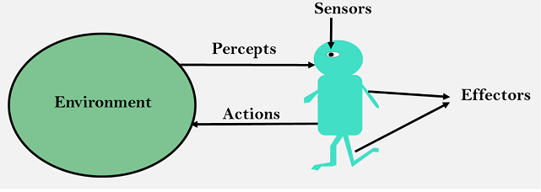

Slide 7
term percept to refer to the agent’s perceptual inputs at any given instant. An agent’s percept sequence is the complete history of everything the agent has ever perceived.
Mathematically speaking, we say that an agent’s behaviour is described by the agent function that maps any given percept sequence to an action.
the agent function for an artificial agent will be implemented by an agent program. It is important to keep these two ideas distinct. The agent function is an abstract mathematical description; the agent program is a concrete implementation, running within some physical system.

Slide 8
To illustrate these ideas, we use a very simple example—the vacuum-cleaner world shown in Figure (A). This world is so simple that we can describe everything that happens; it’s also a made-up world, so we can invent many variations. This particular world has just two locations: squares A and B. The vacuum agent perceives which square it is in and whether there is dirt in the square. It can choose to move left, move right, suck up the dirt, or do nothing. One very simple agent function is the following: if the current square is dirty, then suck; otherwise, move to the other square. A partial tabulation of this agent function is shown in Figure (B)

Slide 9
Figure (A) A vacuum-cleaner world with just two locations.
Figure (B)Partial tabulation of a simple agent function for the vacuum-cleaner world

