Slide 1
Lecture seven

Slide 2
State Space
The search tree A state can be reached just from one path in the search tree
The search graph A state can be reached from multiple paths in the search graph
We can evaluate an algorithm’s performance in four ways:
Completeness: Is the algorithm guaranteed to find a solution when there is one?
Optimality: Does the strategy find the optimal solution?
Time complexity: How long does it take to find a solution?
Space complexity: How much memory is needed to perform the search?

Slide 3
Uninformed Search Also called blinded search
Breadth First Search:
Breadth first search explores the space in a level by level manner. Only when there are no more states to be explored at a given level does the algorithm move to the next level.
Memory is a bigger problem than execution time in BFS

Slide 4
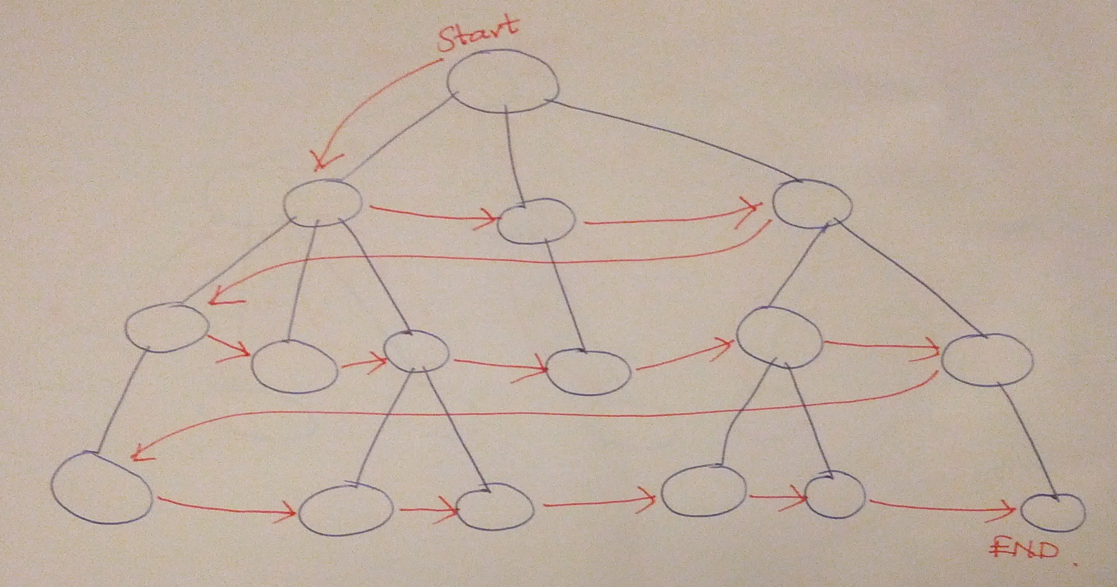

Slide 5
Procedure Breadth_first_search:
Initialize OPEN =[start], close= [ ];
While OPEN ≠ [ ] do
Begin
• Remove the left state from OPEN, call it X;
• If X is a goal, return (success);
• Generate all children of X;
• Put X on CLOSED;
• Eliminate any children of X already on either OPEN or CLOSED to prevent loops.
• Put the remaining descendents of X in order of discovering on the right of OPEN;
End;

Slide 6
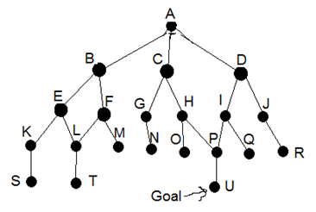
t S R Q P O N M L K J I H G F E D C B A
Soul=A B C D E F G H I J K L M N O P Q R S t

Slide 7
 | X | OPEN | CLOSE
1 |  | [A] | [ ]
2 | A | [B C D] C D | [A]
3 | B | [C D E F] D E F | [B A]
4 | C | [D E F G H] E F G H | [C B A]
5 | D | [E F G H I J] F G H I J | [D C B A]
6 | E | [F G H I J K L] G H I J K L | [E D C B A]
7 | F | [G H I J K L M] H I J K L M | [F E D C B A]
8 | G | [H I J K L M N] | [G F E D C B A]
9 | H | [I J K L M N O P] | [H G F E D C B A]
10 | I | [J K L M N O P Q] | [I H G F E D C B A]
11 | J | [K L M N O P Q R] | [J I H G F E D C B A]
12 | K | [L M N O P Q R S] | [K J I H G F E D C B A]
13 | L | [M N O P Q R S T] | [L K J I H G F E D C B A]
14 | M | [N O P Q R S T] | [M L K J I H G F E D C B A]
15 | N | [O P Q R S T] | [N M L K J I H G F E D C B A]
16 | O | [P Q R S T] | [O N M L K J I H G F E D C B A]
17 | P | [Q R S T U] | [P O N M L K J I H G F E D C B A]
 | Q | [R S T U] | [Q P O N M L K J I H G F E D C B A]
 | R | [S T U]

Slide 8
Depth-first search
always expands the deepest node in the current frontier of the search tree.
whereas breadth-first-search uses a FIFO queue, depth-first search uses a LIFO queue.

Slide 10
depth first search algorithm
Procedure depth_first_search:
Initialize OPEN =[start], close= [ ];
While OPEN ≠ [ ] do
Begin
• Remove the next state from the left of OPEN, call it X;
• If X is a goal, then quit;
• Generate all possible children of X already on either OPEN or CLOSED to prevent loops;
• Put the remaining children of X in order of discovering on the left of OPEN;
End;

Slide 11
[P O H N G C M F T L S K B A]

Slide 12
 | x | OPEN | CLOSE
1 |  | [A] | [ ]
2 | A | [B C D] | [A]
3 | B | [E F C D] | [B A]
4 | E | [K L F C D] | [E B A]
5 | K | [S L F C D] | [K E B A]
6 | S | [L F C D] | [S K B A]
7 | L | [T F C D] | [L S K B A]
8 | T | [F C D] | [T L S K B A]
9 | F | [M C D] | [F T L S K B A]
10 | M | [C D] | [M F T L S K B A]
11 | C | [G H D] | [C M F T L S K B A]
12 | G | [N H D] | [G C M F T L S K B A]
13 | N | [H D] | [N G C M F T L S K B A]
14 | H | [O P D] | [H N G C M F T L S K B A]
15 | O | [P D] | [O H N G C M F T L S K B A]
16 | P | [U D] | [P O H N G C M F T L S K B A]
17 | U

