Slide 1
Lecture eight

Slide 2
Heuristic Search:
In state space search, heuristics are formalized as rules for choosing those branches in a state space that are most likely to lead to acceptable problem solution.
A.I problem solves employ heuristics in two basic situations:
1- A problem may not have an exact solution because of inherent ambiguities in the problem statement or available data. Vision systems and medical diagnoses systems are of this kind.
2- A problem may have an exact solution, but the computational cost of finding it may be prohibitive.
Heuristics can lead a search algorithm to a suboptimal solution or fail to find any solution.

Slide 3
Heuristic search principle:
To implement the heuristic search we need:
1- Heuristic function.
2- Algorithm.
Heuristic Function may be defined as the time needed to reach the goal.
Heuristic Search Algorithms:
The strategy used for controlling a search is often critical in determining how effective are heuristic function is solving a particular problem.
Hill Climbing:
Hill-climbing strategies expand the current state in the search and evaluate its children. The best child is selected for further expansion. Search halts when it reaches a state that is better than any of its children.

Slide 4
Problems With Hill Climbing Search:
Hill Climbing may fail due to one or more of the following reasons:
1- A local maxima.
2- Plateau.
3- Ridge.
A local maxima is a state that is better than all of its neighbors but is not better than some other states father away. At local maxima all moves appear to make things worse.
A Plateau is a flat area of the search space in which a number of states have the same best value. On a plateau, it is not possible to determine the best direction in which to move.
A ridge is an area of the search space that is higher than surrounding areas, but that cannot be traversed by a single move in any one direction.

Slide 5
Possible Solution:
1- Backtrack to some earlier node and start the search from here. To implement this strategy, maintain a list of all visited nodes and take the next most promising.
2- Make a jump in some direction to try to get to a new section of the search space. This is a good strategy in dealing with a plateau. This can be done by applying a rule many times.
3- Apply two or more rules before doing the test. this corresponds to moving in several directions at once. This is a good strategy for dealing with ridges.

Slide 6
Best First Search:
In general, heuristic search requires more informed algorithms, this is provided by best_first search. Best_first search is away of combining the advantage of both depth_first and breadth_first search into a single method (breadth + evaluation function).

Slide 7
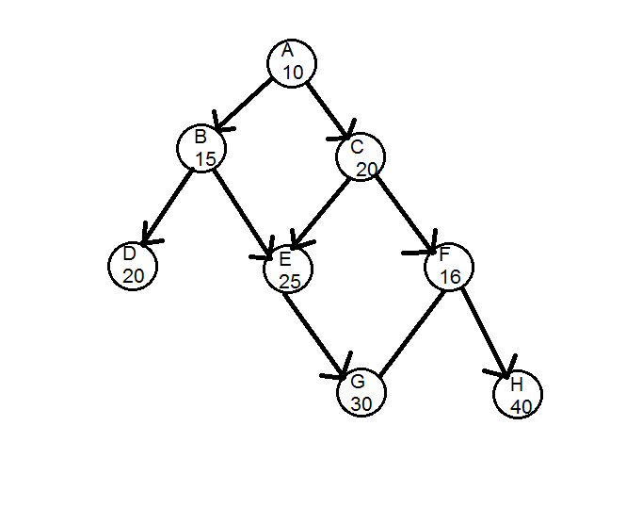

Best first search algorithm (with no cost function)
M 42
I 22

