Slide 1
Lecture nine

Slide 2
Best First Search(Informed search ):
In general, heuristic search requires more informed algorithms, this is provided by best first search. Best first search is away of combining the advantage of both depth first and breadth first search into a single method (breadth + evaluation function).
Informed search methods are more efficient, low in cost and high in performance as compared to the uninformed search methods.

Slide 3
Algorithm BFS
1- Start with open containing just the initial state.
2- if the list is empty ,stop and return failure.
3-remove the node n from open which has the lowest value of h(n),place it in the close.
4- expand the node n and generate the children of n.
5-check each child of node n and find whether any node is a goal node or not then return success and terminate the search.
6- for each child node algorithm checks for evaluation function f(n) and then check if the node has been in either open or close if the node has not been in both list add it o open list.
7-return to step 2.

Slide 4
Advantages: 1. Can switch between BFS and DFS, thus gaining the advantages of both. 2. More efficient when compared to DFS or BFS.
Disadvantages: 1. Chances of getting stuck in a loop are higher.
2. The algorithm is not optimal.
3. It can behave as an unguided DFS in the worst case scenario.

Slide 5
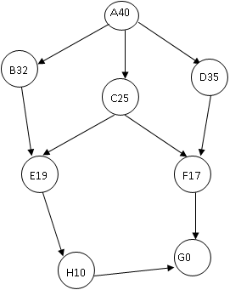
Best first search algorithm (with no cost function)

Slide 6
Node n | Heuristic function h(n)
A | 40
B | 32
C | 25
D | 35
E | 19
F | 17
G | 0
H | 10

Slide 7
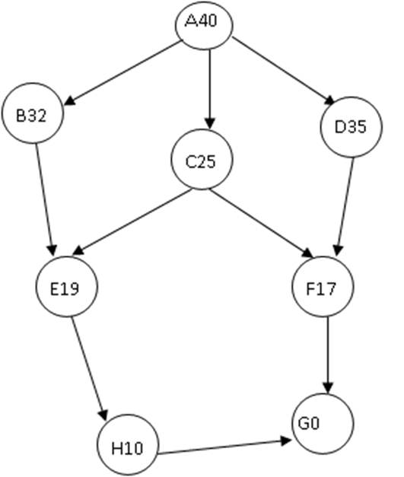
 | x | OPEN | CLOSE
1 |  | [A40] | [ ]
2 | A | [B32 ,C25,D35] | [A]
3 | C | [B32,D35,E19,F17] | [C, A]
4 | F | [B32,D35,E19,G0] | [F,C,A]
5 | G | [B32,D35,E19] | [G,F,C,A]
Start state=A
Goal state=G
Path solution :A C F G
Optimal solution=40+25+17+0
=82

