Slide 1
Prediction of Diabetes onset in women using Machine Learning and Artificial Neural Networks
Kaustubh sharma
Adarsh poddar
Kimaya ganveer
Simran singh

Slide 2
The Goal:
To build an accurate model that can predict the probability of being diabetic using as basic features as possible.
To build a user-friendly and efficient deployment on the web for public release.

Slide 3
Procedure followed:
Collection of data.
Data cleaning and handling missing data.
Exploratory data analysis.
Designing ML models and Neural Networks.
Hyper-parameter Tuning.
Encapsulating modules, models and data processors.
Building a deployment medium (website).

Slide 4
The Data:
PIMA INDIANS DIABETES DATASET (Source: Kaggle)
This dataset is originally from the National Institute of Diabetes and Digestive and Kidney Diseases. The objective is to predict based on diagnostic measurements whether a patient has diabetes. Several constraints were placed on the selection of these instances from a larger database. In particular, all patients here are females at least 21 years old of Pima Indian heritage.
Acknowledgements:
Smith, J.W., Everhart, J.E., Dickson, W.C., Knowler, W.C., & Johannes, R.S. (1988). Using the ADAP learning algorithm to forecast the onset of diabetes mellitus. In Proceedings of the Symposium on Computer Applications and Medical Care (pp. 261--265). IEEE Computer Society Press.

Slide 5
Key Features of the Data
9 columns including 8 features columns and 1 target variable.
Features: Pregnancies, Glucose, Blood Pressure, Skin Thickness, Insulin, BMI, Diabetes Pedigree Function, Age. (All numerical)
Target variable: Outcome (Binary)
768 rows.
Missing Data: Yes (in the form of 0 values).
Unbalanced: Yes.

Slide 6
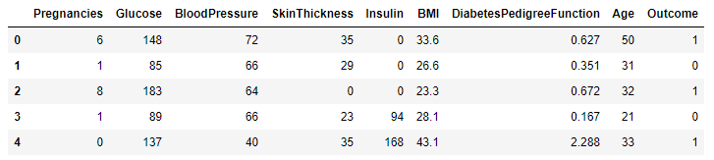
Sample:

Slide 7
Steps taken for cleaning the data:
Replacing missing values (0) with NumPy NaNs.
Filling missing values with respective medians.
Exploring correlation of variables.
Adding new Features. (14 new variables).
Checking correlation and selecting most important features.
Software used: Python 3.8, Pandas, NumPy, MatPlotLib, Plot.ly.

Slide 8
Approach For Classification:
As a team of 4, we divided the task of classification into 2 different approaches. Traditional Machine Learning and Deep Learning (Deep Neural Networks).
Traditional Machine Learning Models are useful as they have been used for several years and updated to the point of near perfection. They can produce reliable and robust results.
Neural Networks being a relatively new concept can be less robust than ML models if designed improperly but they give us the freedom and customizability to design every component of the model as required.

Slide 9
ML Classifiers:

Slide 10
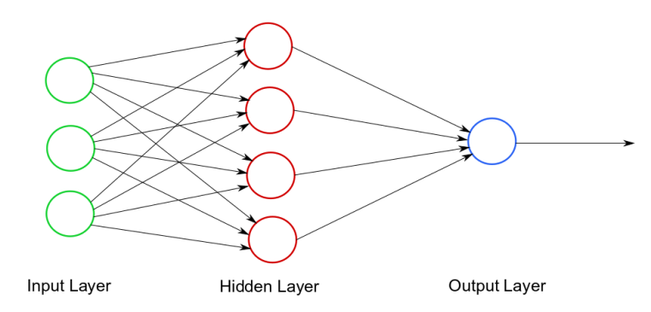
Deep Neural Networks
What is a Neural Network?
A neural network is a series of algorithms that endeavors to recognize underlying relationships in a set of data through a process that mimics the way the human brain operates. In this sense, neural networks refer to systems of neurons, either organic or artificial in nature. Neural networks can adapt to changing input; so the network generates the best possible result without needing to redesign the output criteria.
A Shallow Neural Network

Slide 11
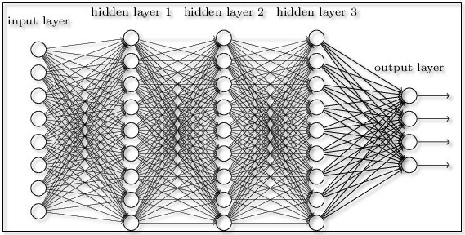
Deep Neural Network:
A Deep Neural Network is a Neural Network that consists of a large number of layers and neurons per layer.

Slide 12
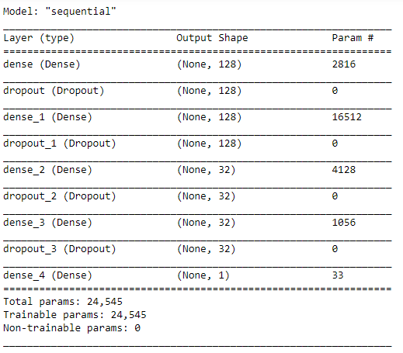
Our Neural Network

Slide 13
Summary:
Activation: ReLu for Hidden Layers, Sigmoid for Output Layer
Loss: Binary Cross-Entropy.
Optimizer: RMS Prop
Batch Size: 16
Trained over 200 epochs.
Training accuracy: 93%
Testing Accuracy: 90%

Slide 14
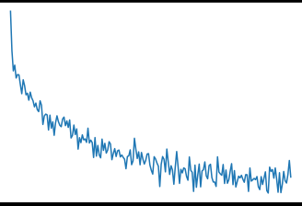
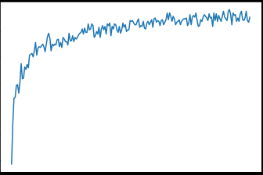
Results:
Loss Convergence
Accuracy Convergence

Slide 15
Software Used for Building the Models:
Python 3.6+
TensorFlow 2
Keras
SciKit Learn
Pandas
MatPlotLib
NumPy

Slide 16
Deployments
Since both models (ML and Neural Net) gave very accurate and fast predictions, instead of choosing one, we decided to build two separate deployments for both the models.
We split the team into 2 and assigned each sub-team with a deployment.
Further, each member was assigned either the back-end or front-end of the deployment.
The result was that we obtained 2 efficient working websites that can be used to predict diabetes accurately.

Slide 17
The Neural Network Deployment

Slide 18
Process Flow
Encapsulate
Save Model and Scaler
Create loadable interface
Build API
Load Model and Scaler
Build Website
Create a web form that sends data to the Flask API
Write the code for data processing and Prediction
Send prediction from Flask to Website

Slide 19
The Python API
We built the Python API using a python module called ‘Flask’. Flask is a lightweight WSGI web application framework. It is designed to make getting started quick and easy, with the ability to scale up to complex applications. It began as a simple wrapper around Werkzeug and Jinja and has become one of the most popular Python web application frameworks.
The function of this API is to render HTML templates on the server, receive data from the page, generate predictions using the saved neural network, and display the prediction on the page.

Slide 20
The Website
The website was created using HTML5, CSS and a CSS library called ‘Bootstrap 4’.
It follows a simple material color scheme and provides information on diabetes and provides a form where users can enter their information and receive a prediction based on this data.
The results are displayed on a separate page that is linked to the home page.
The result page is different for both classes of the result and displays information respective to the result.
If the prediction is that the user is diabetic, it displays recommended steps and treatment whereas if it is non diabetic, it displays precautions the user can take in order to prevent diabetes in the future.

Slide 21
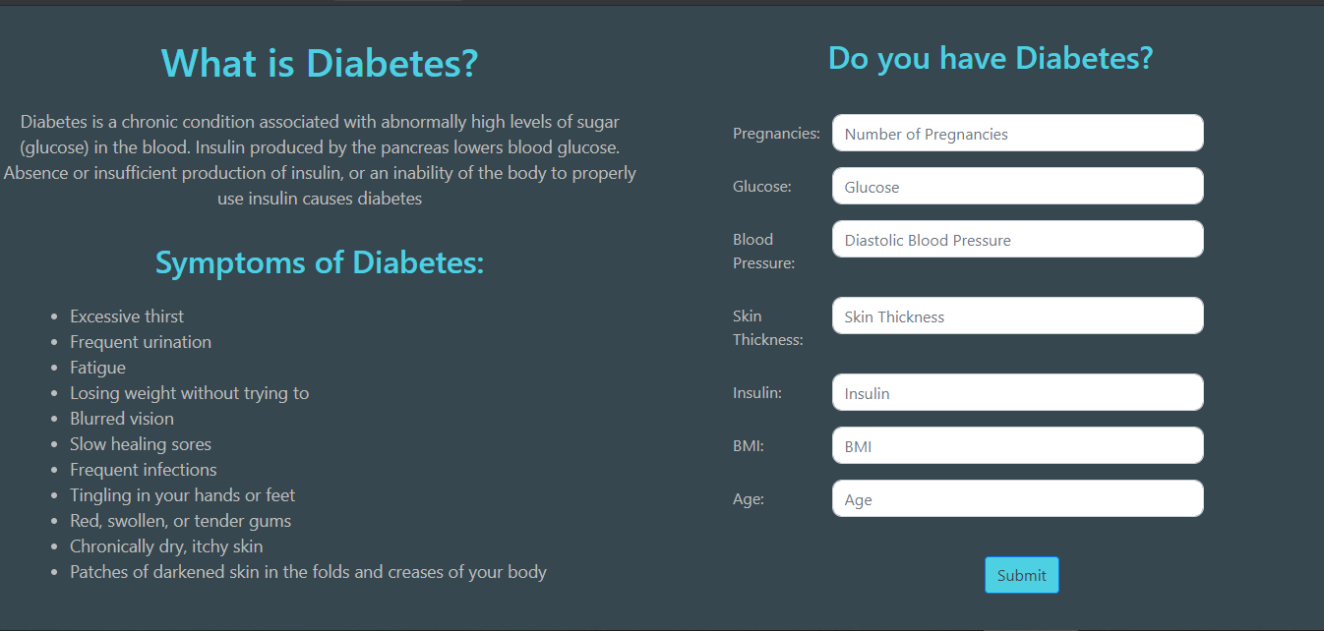

Slide 22
Conclusions
We have successfully designed, developed and tested a Machine Learning model and a Deep Neural Network that can accurately predict the onset of diabetes in a woman with high accuracy (90%).
We have created a working & efficient website where users can test themselves for diabetes and get instant results.
This project is particularly useful for doctors and pathology labs as they can receive instant probability and these results can be used to reduce the number of tests that are conducted.
This is also useful for general users who would like to measure the probability of diabetes onset in themselves and be more informed.

Slide 23
References:

