Slide 1
John Chen
NN with Multiple Outputs

Slide 2
Motivations
Want to solve many eigenstates, requires many integrals
Why Monte Carlo
More efficient than trapezoid integration in high dimensions
Currently solving one oscillator, later want to solve more

Slide 3
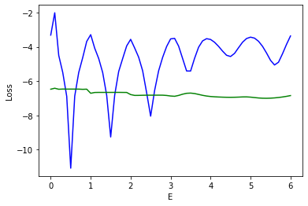
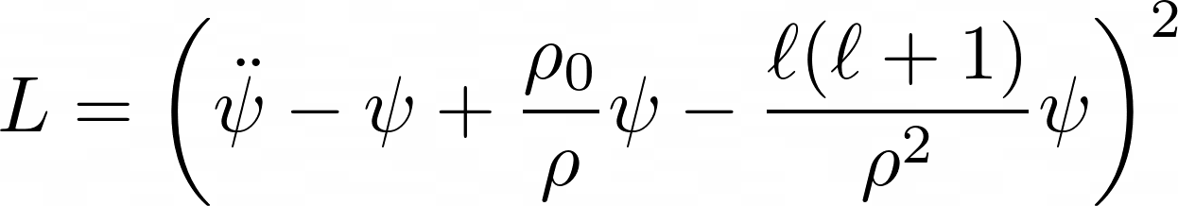
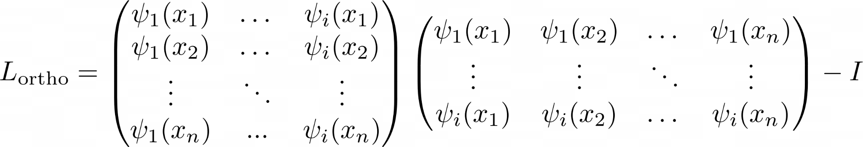
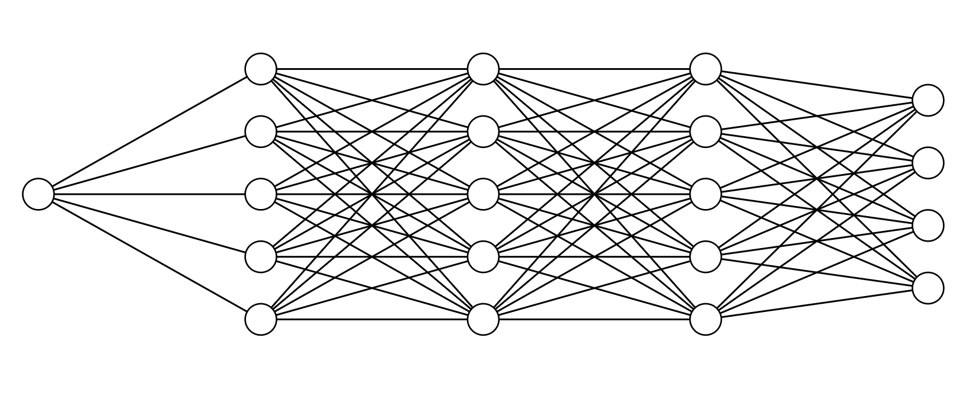

Previous Method Summary

Slide 4
Previous Method’s Problems
Slow
Requires manual intervention
Complex
Not precise

Slide 5
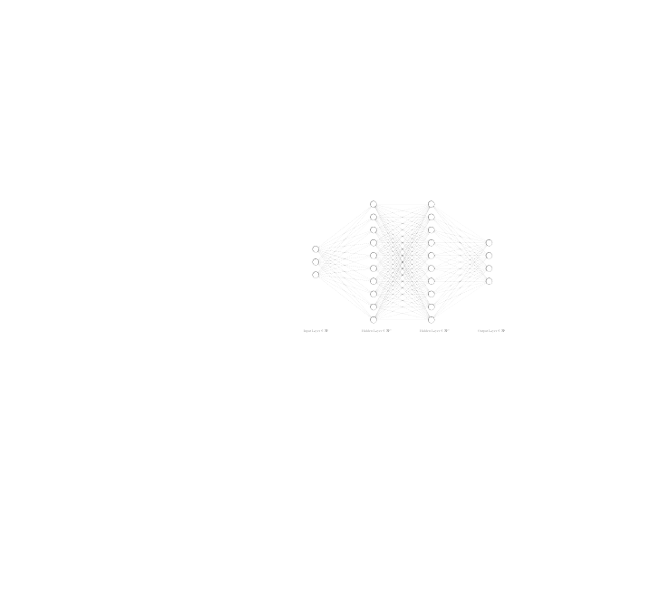
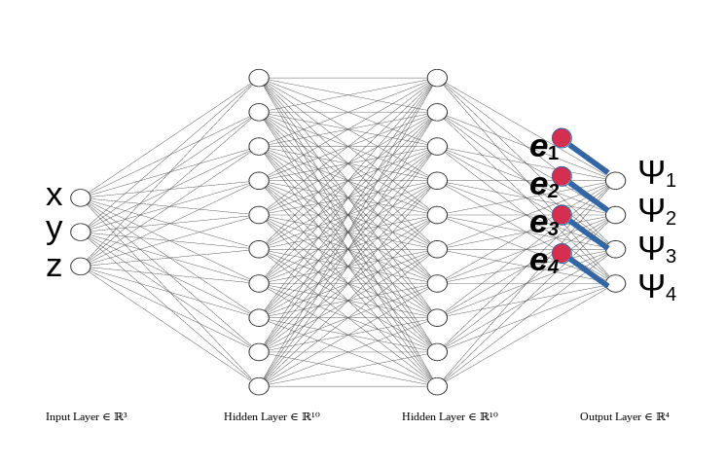
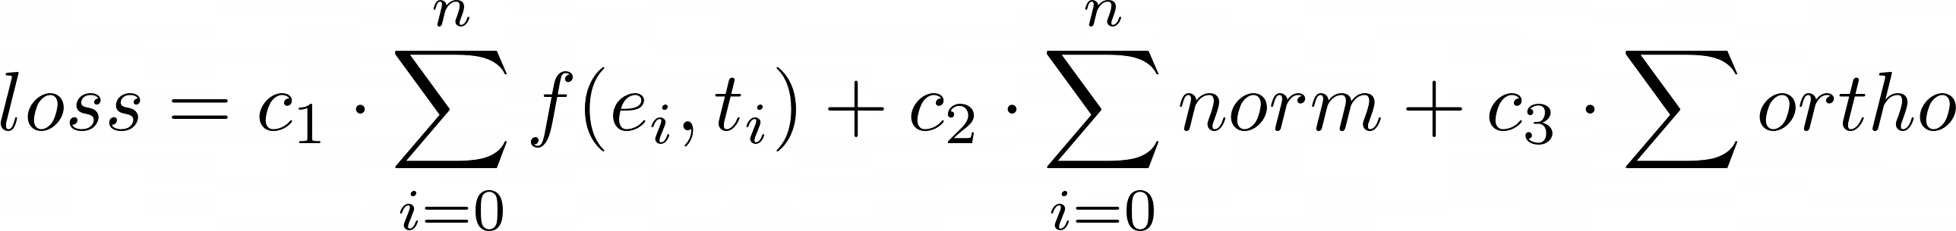
Energies as Network Parameters
Motivations:
1) Only need one network
2) Only need to back prop 1 layers
3) Intuitive/easy to add to existing solutions
4) Scaleable
f represents Schrodinger equation
e1
e2
Ψ1
x
Ψ2
y
e3
z
e4
Ψ3
Ψ4

Slide 6
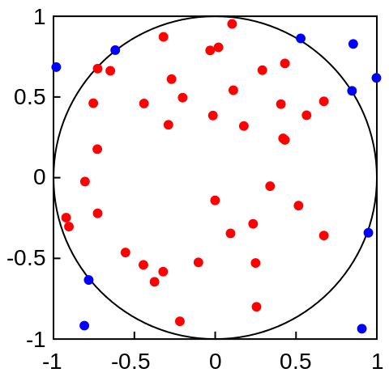
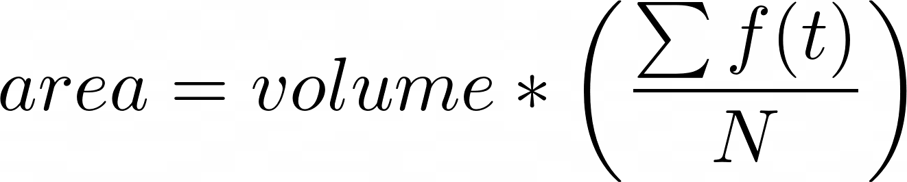
MC Integrator
Select N points per dimension, area is proportional to the number of points under the curve

Slide 7
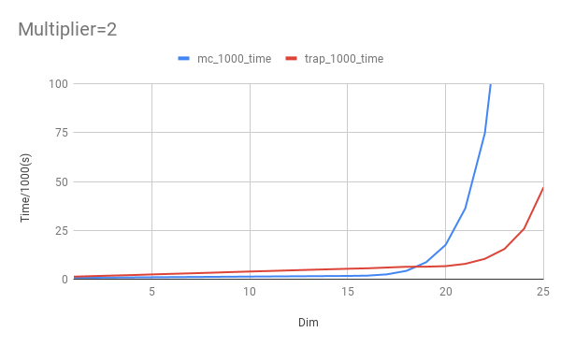
MC vs Trapezoid Integration
MC faster than Trapezoid
- This implementation requires an exponential number of points
- MC requires N sums, one multiplication, and one division
- Trap requires 2N sums, N multiplications, and N divisions
Need to explore effect on backprop

Slide 8
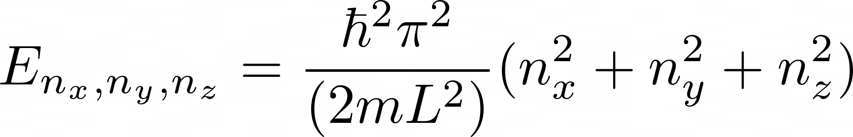
Particle in Box
Network Parameters:
4 layers, 100 neurons, 50,000 epochs, 500 N

Slide 9
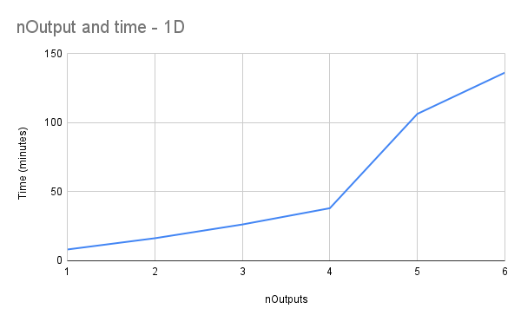
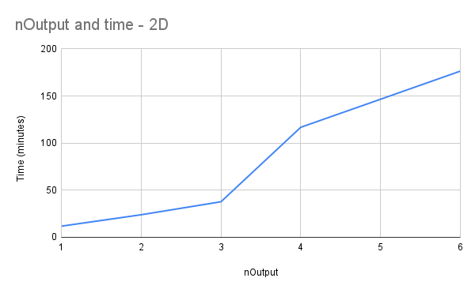
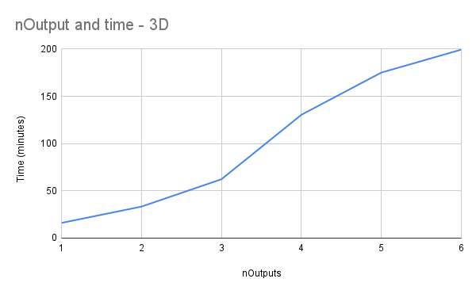
Num Outputs vs Training Time
Theoretically quadratic runtime,
Practically linear runtime for low outputs

Slide 10
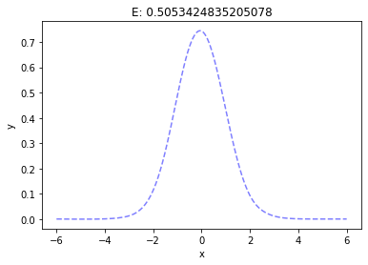
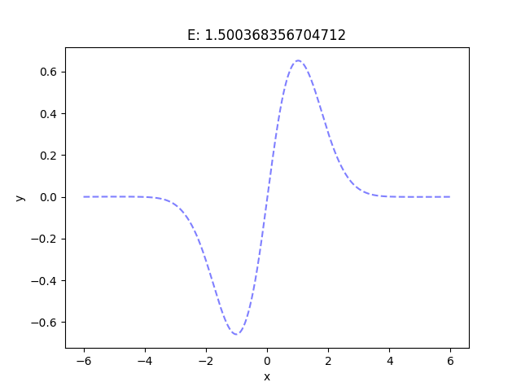
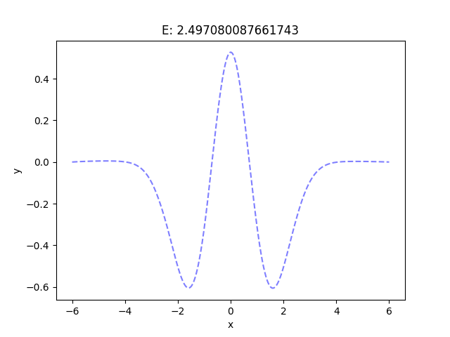
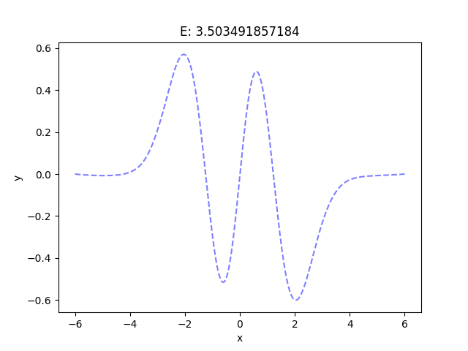
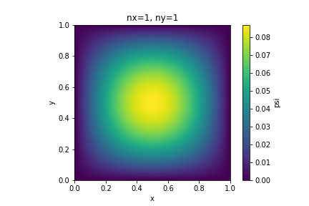
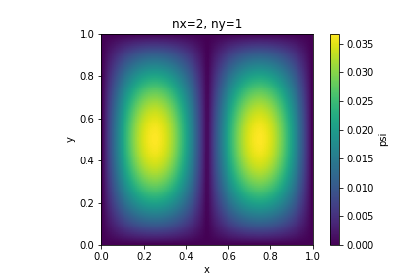
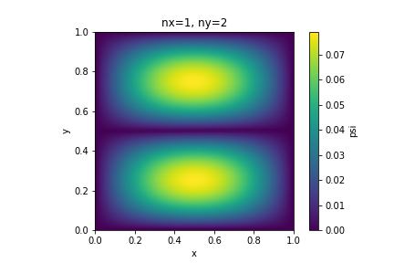
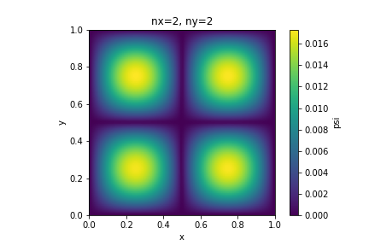
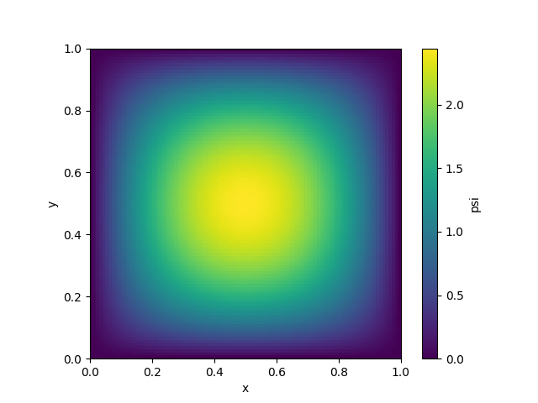


Network Outputs
1D
2D
3D

Slide 11
Conclusion
MC effective for 1 and 2 D with multiple outputs
Training more challenging for 3d
- Future: Examine dynamic loss constants

