Slide 1

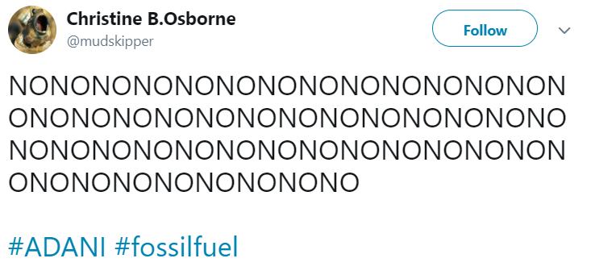

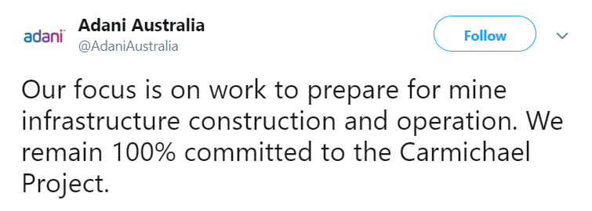
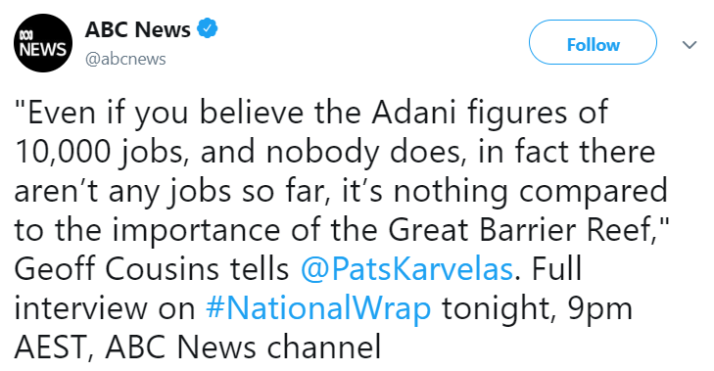
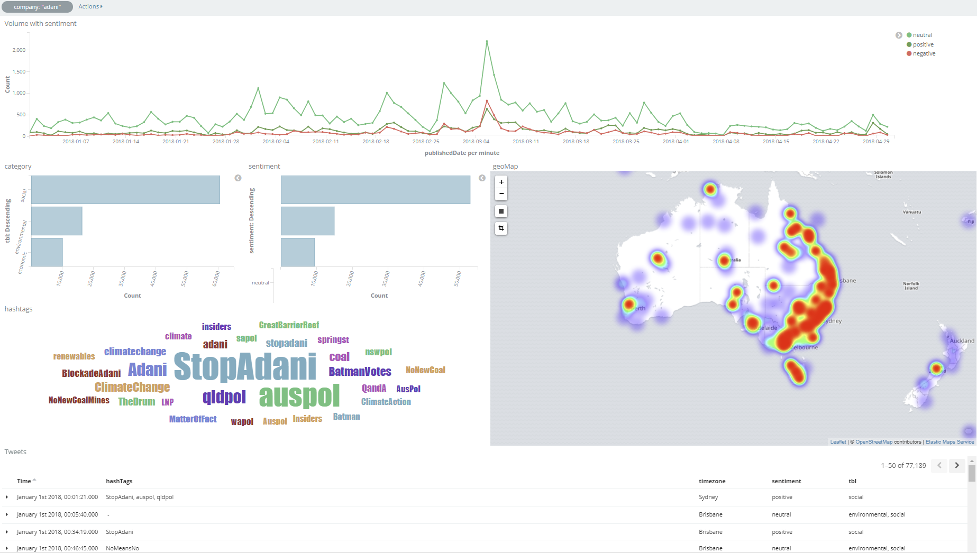
Monitoring Social Media using Machine Learning
Roy Adams, Professor Keith VanderLinden. Calvin College, Grand Rapids, Michigan
Introduction
Methods
Results
A company needs permission from the government to operate, but they also need “social permission” to operate from the community. This Social License to Operate (SLO) references a community’s level of approval towards a company’s operations. This community can contain stakeholders in the company, a geographic region within which a company operates, etc.
In the context of this project, we are analyzing data from the social media platform Twitter in order to determine the SLO for different mining companies in Australia. We use a machine learning model to predict whether or not a particular tweet is in favor, in opposition, or neutral to a given mining company.
We discovered that auto-coding tweets and including profile texts can be beneficial to stance classification of tweets.
Twitter API
We tested our models using the F1-score. It is a measure between zero and one, the closer to one the better the classifier. As seen in Figure 1, adding the profile text associated with a tweet’s author significantly improved the F1-score of the model, from a mean of 0.425 to a mean of 0.597.
We also discovered that an auto-coder can be useful in increasing the size of a training set, given that auto-coding rules can be determined through inspection of the domain.
The final system is now integrated into the CSIRO SLO demonstrator, see Figure 2.
Figure 1. Table of Comparing SVM Profile/No-Profile Results
Collect Regional Tweets/profiles
Location data no longer available.
Hand-Coded Tweets for Gold-Standard Testset.
Inter-coder agreement: 0.64
Raw Tweet Dataset
Example of a stance-against tweet, difficult to detect language.
Format, Regularize, Tokenize Tweets
Remove non-English/irrelevant tweets.
Dataset
 | Adani | BHP | Santos | RioTinto | Fortescue | Combined
No Profile
Mean | 0.42723077 | 0.36752159 | 0.33273892 | 0.54478625 | 0.4570619 | 0.42586788
Median | 0.41317123 | 0.36939203 | 0.33931624 | 0.55228758 | 0.46666667 | 0.42871629
Std. Dev. | 0.0508125 | 0.05449423 | 0.06944893 | 0.06322667 | 0.10025326 | 0.02941527
Profile
Mean | 0.74446146 | 0.60334734 | 0.52167726 | 0.66901135 | 0.44860725 | 0.59742093
Median | 0.75704413 | 0.60869018 | 0.51599512 | 0.66448802 | 0.42195767 | 0.59764535
Std. Dev. | 0.04475489 | 0.04016374 | 0.0345319 | 0.0878687 | 0.12450859 | 0.0429343
Auto-code to get more tweets into trainset.
Auto-code vs hand-code agreement: 0.71
Example of a stance-against tweet, with a positive sentiment,
“Gold” Testset
Trainset
Conclusions
Objectives
Test trained model on gold-standard testset
Example of an Adani sponsored tweet.
Twitter produces noisy data, but it is possible to discern patterns in the noise. Our project looks to channel that noise into a Social License to Operate. We discovered that Twitter profile text and use of auto-coders can be beneficial to the stance-detection problem.
Model
For This Summer:
Build two datasets, one for a training set and one for a testing set, finding the optimal features and balance for each.
Use a Support Vector Machine (SVM) to determine the effectiveness of auto-coding and of profile texts when conducting stance detection.
Run the new training and testing sets through three custom-built neural networks. These neural networks are CrossNet, MemoryNet, and Transformer.
Extension Goals:
Try Self-Training to expand the training set.
Train a relevance classifier to find only tweets that are relevant to the target.
Try topic analysis.
The rarest stance value constrains size of trainset, training model randomly samples other stance tags.
Results
Acknowledgements
Example of a news source tweeting about Adani, classified as stance-neutral.
Trainset
We built an trainset with only tweets about the mining company Adani. We used the following rules for our auto-coding process:
Stance For – #goadani, #stopstopadani
Stance Against – #stopadani
Stance Neutral – News Sources
We also built a trainset of tweets from all companies.
Testing
We also hand-coded 200 tweets to use as a “Gold-standard” testset when testing our model. We wanted to test whether an author’s profile text would help the models classify tweet stance.
I would like to thank Professor Keith VanderLinden, the Calvin College Science Division, and the Funding Source for supporting me in this research project.
References
Mohammad, S. M.; Kiritchenko, S.; Sobhani, P.; Zhu, X.; and Cherry, C. 2016. SemEval-2016 Task 6: Detecting stance in tweets. In Proceeds of the International Workshop on Semantic Evaluation, 31–41. ACM.
Figure 2. SLO Demonstrator
10548A calvingraphics@gmail.com

