Slide 1


CSA0624– Design And Analysis Of Algorithms Algorithm Comparison for Large Data Processing
SIMATS ENGINEERING
Saveetha Institute of Medical and Technical Sciences
Chennai-602105.
Presented by:
J Karthik
192472136

Slide 2
Introduction
An algorithm is a step-by-step procedure used to solve a problem or perform a task.
Different algorithms can solve the same problem, but their efficiency may differ.
As the size of the dataset increases, choosing an efficient algorithm becomes essential.
Time complexity measures how an algorithm's running time grows with the input size.
This presentation compares O(n log n) and O(n²) algorithms to determine which is more suitable for large data processing.
Example Input:
[45, 12, 89, 23, 67, 10, 34, 78, 56, 91]

Slide 3
Objectives
To compare the performance of O(n log n) and O(n²) algorithms.
To analyze how both algorithms behave with large datasets.
To evaluate their efficiency using time complexity.
To illustrate the performance differences using tables and graphs.
To identify and justify the most suitable algorithm for large data processing.

Slide 4
Assumptions and Constraints
Assumptions
Both algorithms process the same input dataset.
The same hardware and software environment is used.
Input data is processed under identical conditions.
Performance is evaluated based on time complexity.
Constraints
Large input sizes (100, 1,000, 10,000, 100,000 elements).
Limited memory and processing resources.
Execution time increases as the dataset grows.

Slide 5
Algorithm Comparison
Feature | O(n log n) | O(n²)
Example Algorithm | Merge Sort | Bubble Sort
Time Complexity | O(n log n) | O(n²)
Growth Rate | Slow | Fast
Performance | Efficient | Inefficient
Suitable For | Large datasets | Small datasets
Observation
O(n log n) performs efficiently even as data size increases.
O(n²) becomes significantly slower for large datasets

Slide 6
Performance Analysis
Input Size (n) | O(n log n) | O(n²)
100 | 664 | 10,000
1,000 | 9,966 | 1,000,000
10,000 | 132,877 | 100,000,000
100,000 | 1,660,964 | 10,000,000,000
Analysis
O(n log n) grows gradually as the input size increases.
O(n²) grows very rapidly and requires significantly more operations.
O(n log n) is faster and more scalable for large datasets.

Slide 7
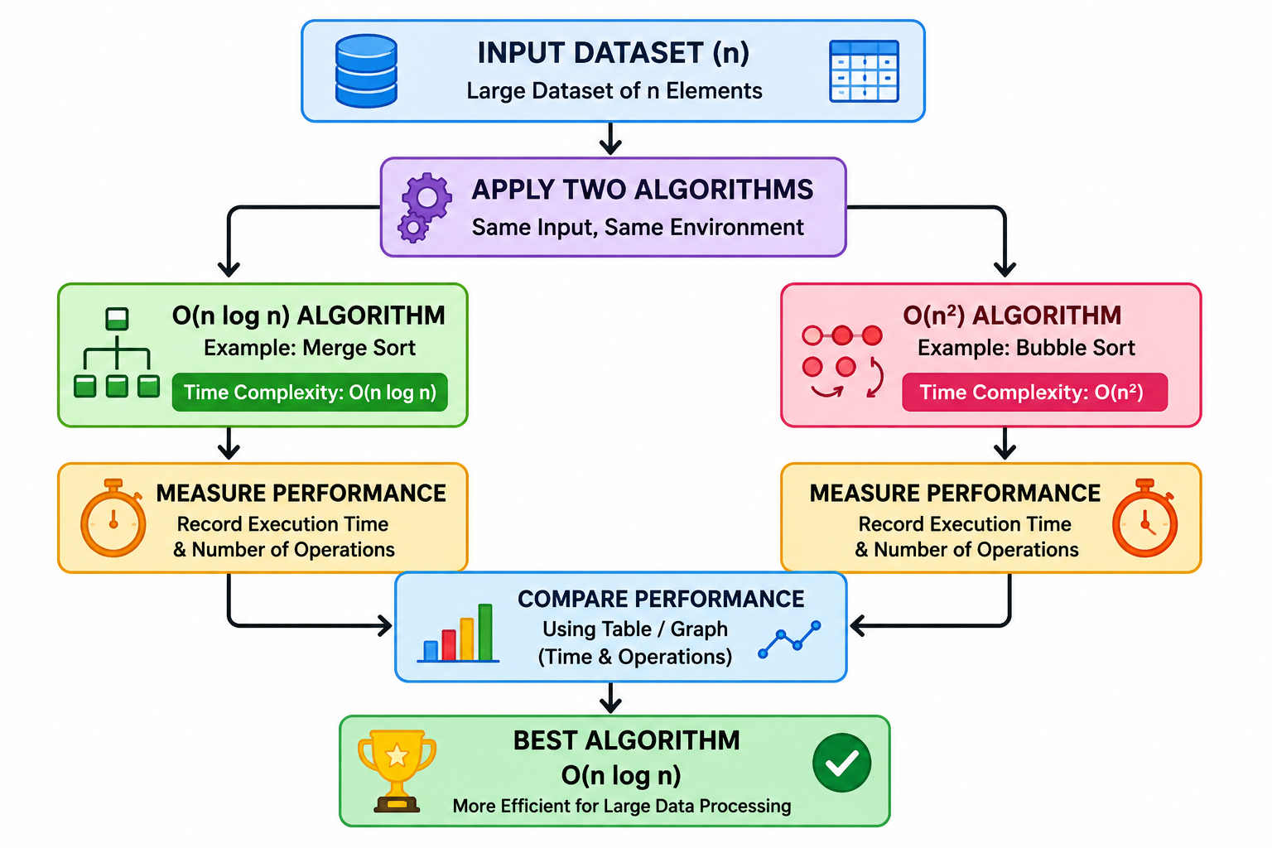
System Architecture

Slide 8
Conclusion
O(n log n) algorithms are more efficient for processing large datasets.
O(n²) algorithms are suitable only for small input sizes.
The comparison shows a significant performance difference as data size increases.
Therefore, O(n log n) is the preferred algorithm for large-scale data processing.

