Slide 1
Traceback Graphing: Identifying Information
Bottlenecks in LLM Attribution Circuits
Mechanistic Interpretability via Neuronpedia Circuit Tracer
J. Lawrence
Lab Meeting | February 10, 2026
CUNY Graduate Center / Hunter College
1 / 14
Notes:
Welcome everyone. Today I'll present our Traceback Graphing project, which is a new method for identifying information bottlenecks inside large language models. We use Neuronpedia's Circuit Tracer API to extract attribution graphs, then apply a novel backward-BFS algorithm to find the critical features that control model predictions. I'll walk through our pipeline, show key findings across two models, and discuss where we're headed next.

Slide 2
Bottleneck position determines what information survives to the output layer
The Big Question
WHY do LLMs fail on facts they 'know'?
GEMMA-2-2B: 'Paris is capital of' -> 'France' (85.7%)
GEMMA-2-2B: 'Capital of France is' -> 'a' (20.7%) -- same fact, wrong answer
Hypothesis: internal bottleneck features filter information
Early bottlenecks discard semantics, keeping only syntax
Late bottlenecks preserve more factual content
Approach: trace attribution paths backward from output
Identify WHERE convergence occurs = the bottleneck layer
Classify WHAT survives = syntax vs. semantics
2 / 14
Notes:
The central question is: why do language models fail on facts they clearly 'know'? GEMMA can answer 'Paris is capital of' correctly at 85.7%, but rephrase it as 'Capital of France is' and accuracy drops to 20.7%. Same factual knowledge, different syntactic frame. Our hypothesis is that information bottleneck features inside the network filter content at specific layers. If the bottleneck is too early, semantic information like geographic facts gets discarded. If it's later, facts survive. Our approach traces attribution paths backward from the output to find these bottlenecks.

Slide 3
Two models, 10+ prompts, automated end-to-end pipeline
Experimental Overview
Models
GEMMA-2-2B (26 layers, Google)
QWEN3-4B (36 layers, Alibaba)
Prompt Categories
Geographic: capitals, states, cities
Arithmetic: addition, temperature
Political: president, governor
Data Source
Neuronpedia Circuit Tracer API
SAE-decoded feature activations
Analysis Methods
Traceback BFS (novel -- our method)
Louvain clustering for supernodes
Betweenness centrality for bottlenecks
3 / 14
Notes:
We analyze two open-weight models: GEMMA-2-2B from Google with 26 layers and QWEN3-4B from Alibaba with 36 layers. We run the same prompts through both models and compare their internal circuits. Prompts span geography, arithmetic, and politics. Data comes from Neuronpedia's Circuit Tracer API, which returns SAE-decoded feature activations and edges. Our novel contribution is the Traceback BFS algorithm that traces paths backward from output nodes to find bottleneck features. We also use Louvain community detection for supernodes and betweenness centrality.

Slide 4
Fully automated: prompt in -> bottleneck analysis + visualizations out
End-to-End Pipeline
1. Generate Graph
2. Convert Graph
3a. Analyze Circuit
3b. Traceback Paths
4. Visualize
API call to Neuronpedia
Standardize format
Supernodes + bottlenecks
Backward BFS (NOVEL)
8 diagnostic plots
Outputs per prompt: raw_graph.json | converted_graph.json | circuit_analysis.json | traceback_paths.json | 8 PNGs
Runtime: ~30 seconds end-to-end per prompt (API-bound)
All artifacts version-controlled in data/prompts/<prompt-name>/
4 / 14
Notes:
Here's our end-to-end pipeline. Step 1 calls Neuronpedia's API with a text prompt and model selection, returning a raw attribution graph. Step 2 converts this to our standardized format. Step 3a applies Louvain clustering and betweenness centrality for supernode detection and initial bottleneck identification. Step 3b -- our novel contribution -- runs backward BFS from output nodes with geometric decay scoring. This traces all paths back to the input and identifies where they converge. Step 4 generates 8 diagnostic visualizations. The whole pipeline runs in about 30 seconds per prompt, limited by the API call. Every artifact is version-controlled.

Slide 5
Novel backward-BFS identifies convergence points = information bottlenecks
Traceback Algorithm (Novel Method)
Algorithm
Start from top-K output-layer nodes
BFS backward through edges
Score(child) = Score(parent) * |edge_weight|^0.8
Geometric decay prevents explosion
Key Metric: Convergence
100% of paths through 1 node = bottleneck
Convergence layer = decision point
Why Backward (not Forward)?
Forward: exponential branching
Backward: converges naturally
Finds minimal sufficient set
Validation
Top-5 vs bottom-5 output nodes
Both converge to SAME bottleneck
Confirms: shared universal circuit
[INSERT: Traceback path diagram showing convergence from 5 output nodes to 1 bottleneck]
5 / 14
Notes:
This is our core methodological contribution. Traditional interpretability asks 'which input tokens matter?' We ask 'which intermediate features control the output?' The algorithm starts from the top-K highest-activation output nodes and traces backward through all edges using BFS. Each step multiplies the parent score by edge weight raised to 0.8 -- this geometric decay prevents score explosion while preserving relative importance. The key insight is convergence: when ALL backward paths pass through a single node, that's your bottleneck. We validated by running traceback from both the top-5 AND bottom-5 output nodes -- they converge on the exact same bottleneck feature, confirming the model uses one shared circuit for all predictions, not separate per-token pathways.

Slide 6
Each step has clear inputs, QC checks, and versioned output artifacts
Pipeline Step Details
Step | Input | Method / QC | Output Artifact
1. Generate | Prompt + model ID | API call; verify node/edge counts | raw_graph.json + metadata.json
2. Convert | raw_graph.json | Normalize tokens; validate edge integrity | converted_graph.json
3a. Analyze | converted_graph.json | Louvain + centrality; fetch descriptions | circuit_analysis.json + supernodes.json
3b. Traceback | converted_graph.json | Backward BFS; decay=0.8; top-5 seeds | traceback_paths.json
4. Visualize | All analysis JSONs | 8 plot types; auto-layout | 8 PNG files
6 / 14
Notes:
Here's the detail for each pipeline step. Step 1 queries Neuronpedia's Circuit Tracer API. We validate the returned graph has expected node and edge counts. Step 2 normalizes the token format across models -- GEMMA uses raw tokens while QWEN prepends special tokens. We also validate edge integrity: every edge must connect existing nodes. Step 3a runs Louvain community detection for supernodes and betweenness centrality for initial bottleneck identification. It also fetches human-readable feature descriptions from Neuronpedia. Step 3b is our novel traceback -- backward BFS with geometric decay from the top-5 output nodes. Step 4 generates all 8 visualization types. Each step writes a versioned artifact to the prompt's data directory.

Slide 7
10+ prompts analyzed across 2 models with full artifact sets
Deliverables Produced So Far
Datasets (per prompt x model)
10+ prompt variations fully analyzed
2 models: GEMMA-2-2B, QWEN3-4B
80+ visualization PNGs generated
Traceback JSONs for key prompts
Code / Pipeline
5-script automated pipeline
Centralized PathManager for reproducibility
Cross-model comparison script
Research Documents
Full scientific paper draft (~6,800 words)
Southern State case study
Token Attribution validation report
Semantic Taxonomy methodology
Quantitative Tables
Prediction probabilities per model/prompt
Bottleneck positions (layer, feature ID)
Convergence rates (% paths through BN)
7 / 14
Notes:
Here's what we've produced. On the data side: 10+ prompt variations fully analyzed through both models, generating over 80 visualization PNGs and structured JSON artifacts. The code is a 5-script automated pipeline with a centralized PathManager that ensures consistent file organization and reproducibility. On the research side, we have a 6,800-word scientific paper draft ready for formatting, plus detailed case studies on the Southern State prompt, the Token Attribution validation, and our Semantic Taxonomy methodology for classifying features. Quantitative tables include prediction probabilities, bottleneck positions, and convergence rates across all experiments.

Slide 8
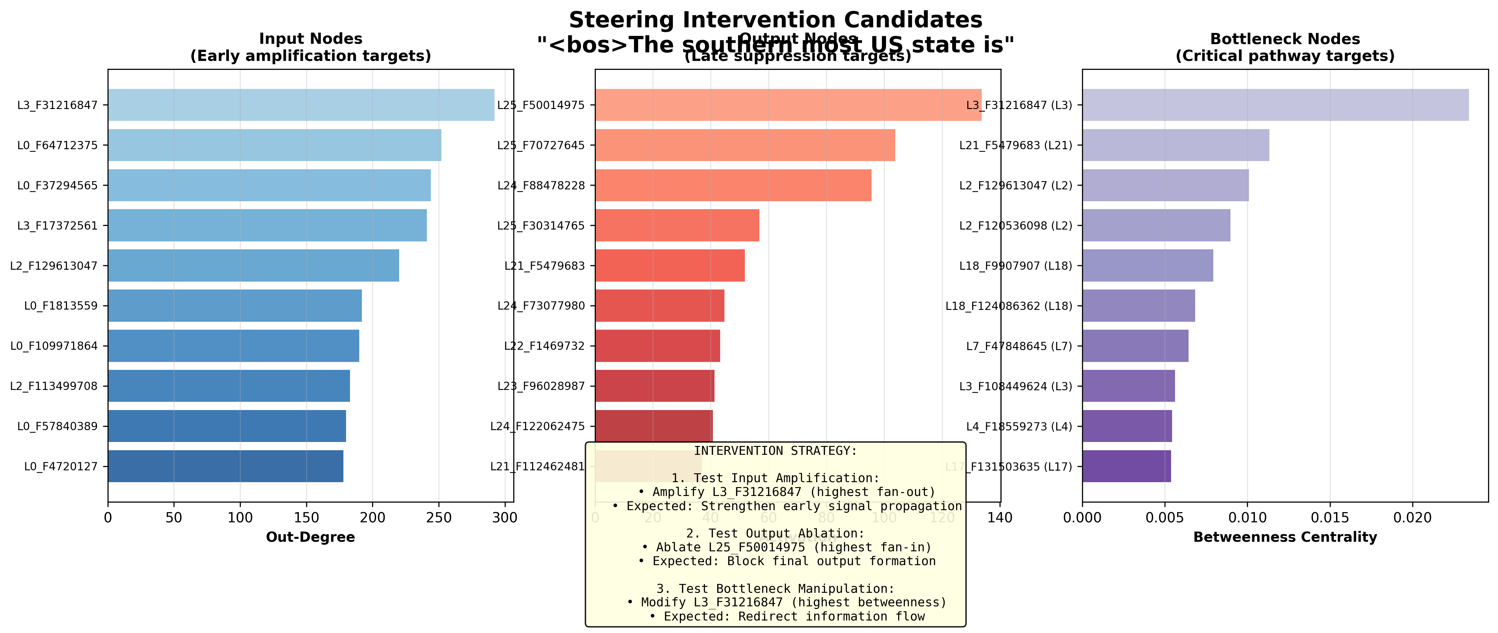
FINDING 1: Bottleneck at 19% depth (GEMMA) filters semantics; at 33% (QWEN) preserves them
Key Finding: Bottleneck Position Determines Accuracy
GEMMA-2-2B (26 layers)
Bottleneck: Layer 5 (19% depth)
'Southern most US state is' -> ' home' (10.5%)
Correct ' Hawaii' ranks 6th (2.9%)
Early compression discards geography
QWEN3-4B (36 layers)
Bottleneck: Layer 12 (33% depth)
'Southern most US state is' -> ' Florida' (78.1%)
27x higher probability than GEMMA
Later bottleneck preserves facts
[INSERT: QWEN summary dashboard for same prompt -- showing correct prediction]
8 / 14
Notes:
Our strongest finding. On the Southern State prompt, GEMMA's bottleneck occurs at Layer 5 -- only 19% into the network. All 5 traceback paths converge on a single feature at this layer with 100% convergence. This early compression filters out geographic semantic information, so the model predicts ' home' at 10.5% instead of the correct answer. QWEN's bottleneck is at Layer 12 -- 33% depth. This preserves enough factual content to predict ' Florida' at 78.1%, a 27x improvement. This strongly supports our hypothesis: bottleneck position is a key architectural parameter that determines factual accuracy. Models with later bottlenecks retain more semantic information through the critical compression point.

Slide 9
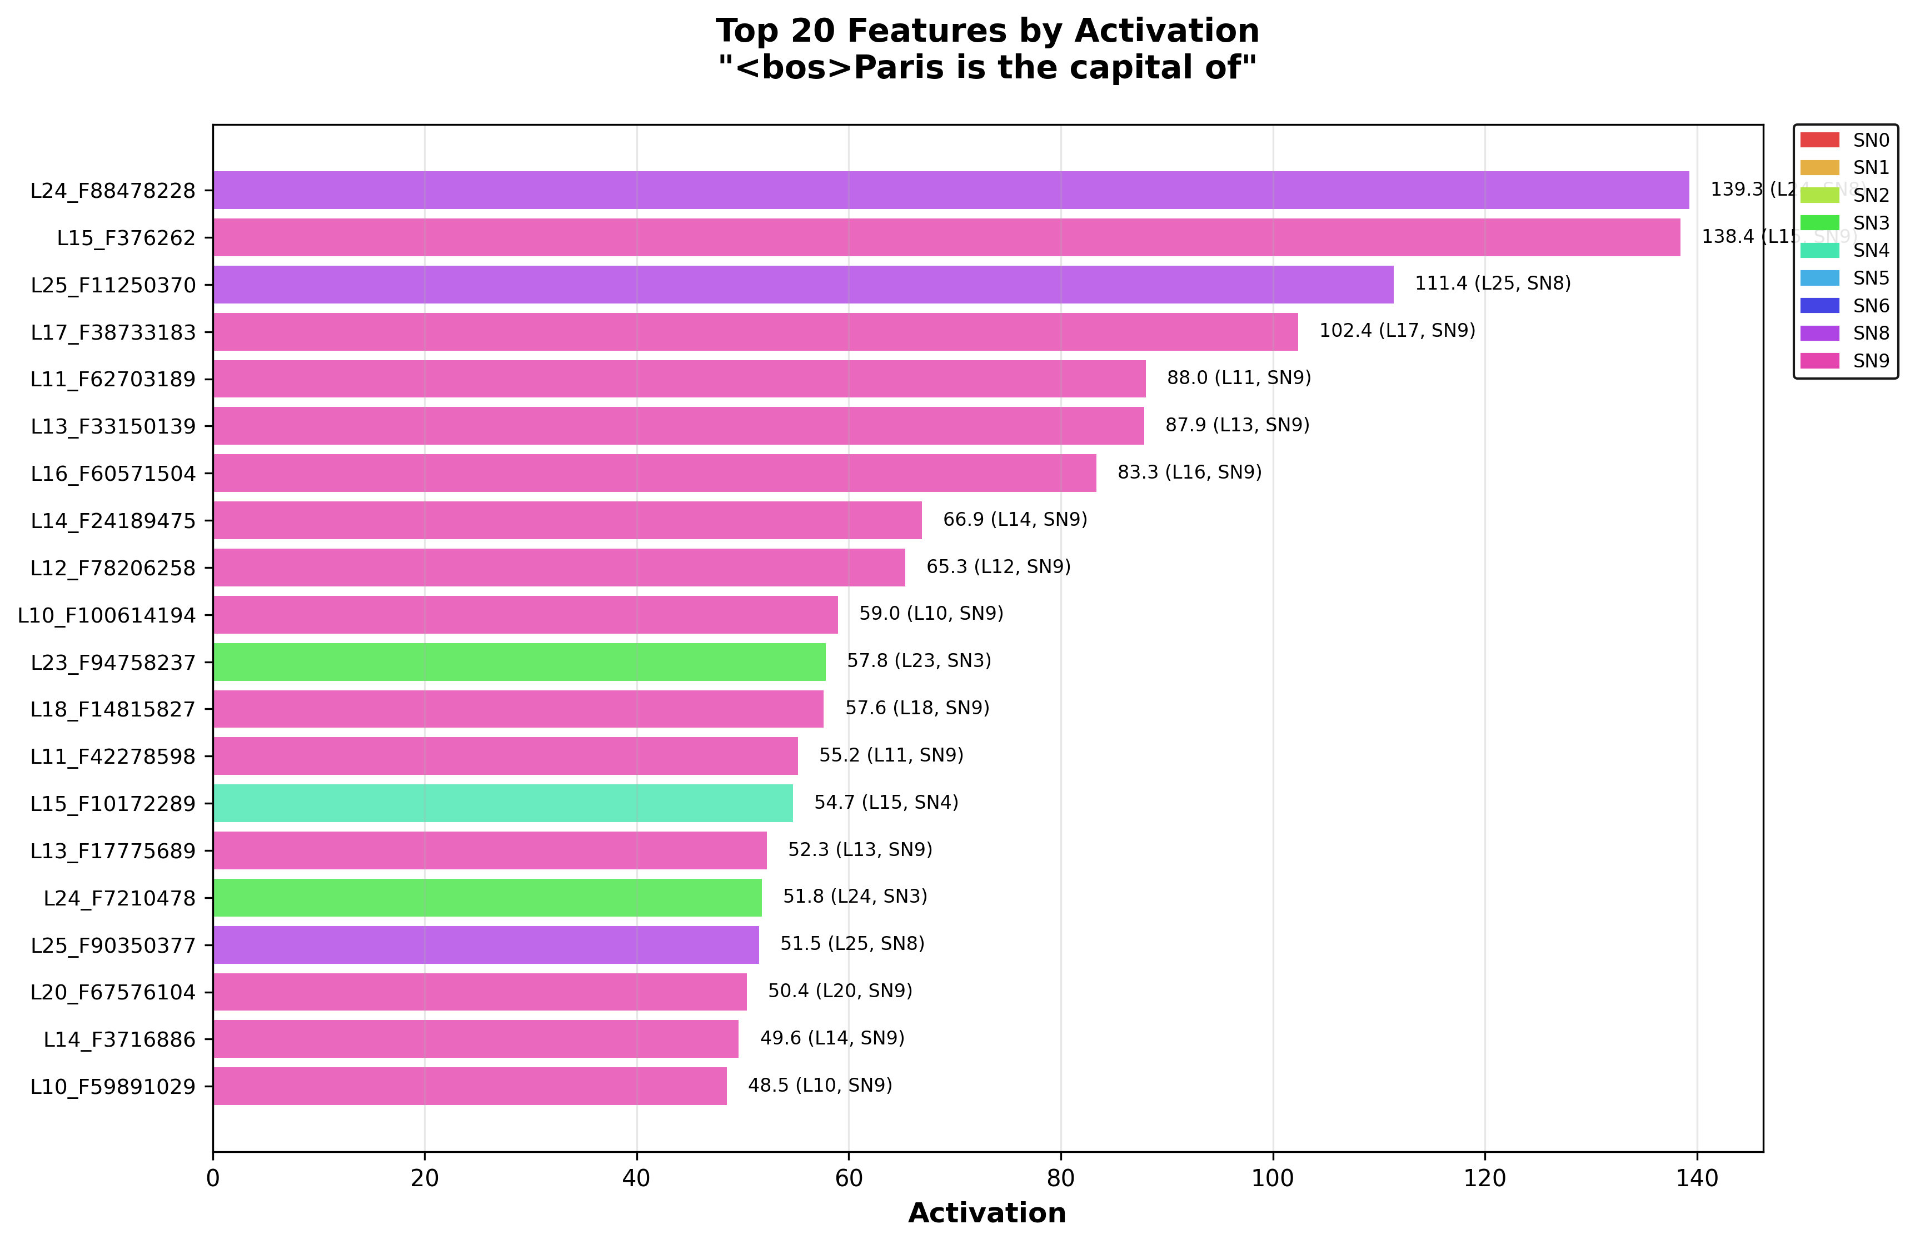
FINDING 2: 79/80 top features are syntactic -- models use template matching, not knowledge retrieval
Key Finding: Syntactic Pattern Matching Dominates
'Paris is the capital of' -- what features fire?
79/80 top features = syntax (articles, punctuation, connectors)
0/80 features directly encode 'Paris' or 'France'
Model uses template: 'X is capital of Y' -- not geographic knowledge
Prompt sensitivity confirms pattern matching:
'Paris is capital of' -> ' France' at 85.7% (matches template)
'Capital of France is' -> ' a' at 20.7% (template broken)
Same facts, but syntactic frame determines success
Implication: factual recall is fragile and syntax-dependent
9 / 14
Notes:
Our second major finding. When we examine which features fire for 'Paris is the capital of', 79 out of 80 top features are syntactic -- they encode articles, punctuation, connective structures. Zero features directly encode Paris or France as geographic entities. The model is doing template matching: it learns the syntactic frame 'X is capital of Y' and fills in the slot. This explains the prompt sensitivity: when you say 'Paris is capital of', it matches the template and gets 85.7%. But 'Capital of France is' breaks the template and accuracy drops to 20.7%. Same factual knowledge, but the syntactic frame determines whether it can be accessed. This is a fundamental insight about how factual recall works -- or fails -- in these models.

Slide 10
FINDING 3: All output tokens share ONE circuit -- token attribution hypothesis refuted
Key Finding: Universal Shared Circuit
Initial hypothesis: different tokens use different circuits
Top predictions -> top-ranked output nodes -> unique pathways?
Alternative predictions -> bottom-ranked nodes -> separate pathways?
Result: HYPOTHESIS REFUTED
Top-5 AND bottom-5 output nodes converge on SAME bottleneck
100% overlap -- zero unique pathways found
Model computes full probability distribution through ONE circuit
Implication: interventions target the whole circuit, not per-token
Cannot selectively boost one answer without affecting all
10 / 14
Notes:
We tested the Token Attribution Hypothesis: do different output tokens use different internal circuits? We ran traceback from the top-5 highest-activation output nodes -- which correspond to the model's top predictions -- and separately from the bottom-5. If the hypothesis were correct, they should trace back through different pathways. Instead, both sets converge on the exact same bottleneck feature with 100% overlap. This refutes the hypothesis and tells us the model uses a single shared universal circuit that computes the entire probability distribution. The practical implication is that you cannot selectively boost one prediction by targeting its 'unique' pathway -- there is no unique pathway. Any intervention affects the entire distribution.

Slide 11
Key limitations: linear attribution, SAE fidelity, limited prompt diversity
Caveats & What's Still Uncertain
Linear attribution assumption
Edges = linear contribution; non-linear interactions not captured
LayerNorm, attention softmax create non-linearities we approximate
SAE reconstruction fidelity (~90%)
~10% of information lost in sparse autoencoder decomposition
Some features may be polysemantic (encode multiple concepts)
Prompt diversity
Deep analysis on ~5 prompts per model; need broader coverage
Arithmetic prompts show both models fail (below emergence threshold)
Causal validation pending
Bottlenecks identified correlatively; ablation experiments needed
11 / 14
Notes:
Important caveats. First, our attribution is linear -- we trace edge weights that represent linear contributions. Non-linear interactions from LayerNorm and attention softmax are approximated, not captured exactly. Second, SAE reconstruction is about 90% faithful -- so roughly 10% of information isn't captured in the feature decomposition. Some features may also be polysemantic, encoding multiple concepts simultaneously. Third, while we've tested 10+ prompts, deep traceback analysis has been done on about 5 prompts per model. We need broader prompt diversity. Fourth, and most importantly, our bottleneck identification is correlational. We haven't yet done ablation experiments to prove these bottlenecks are causally necessary. That's what validation is addressing.

Slide 12
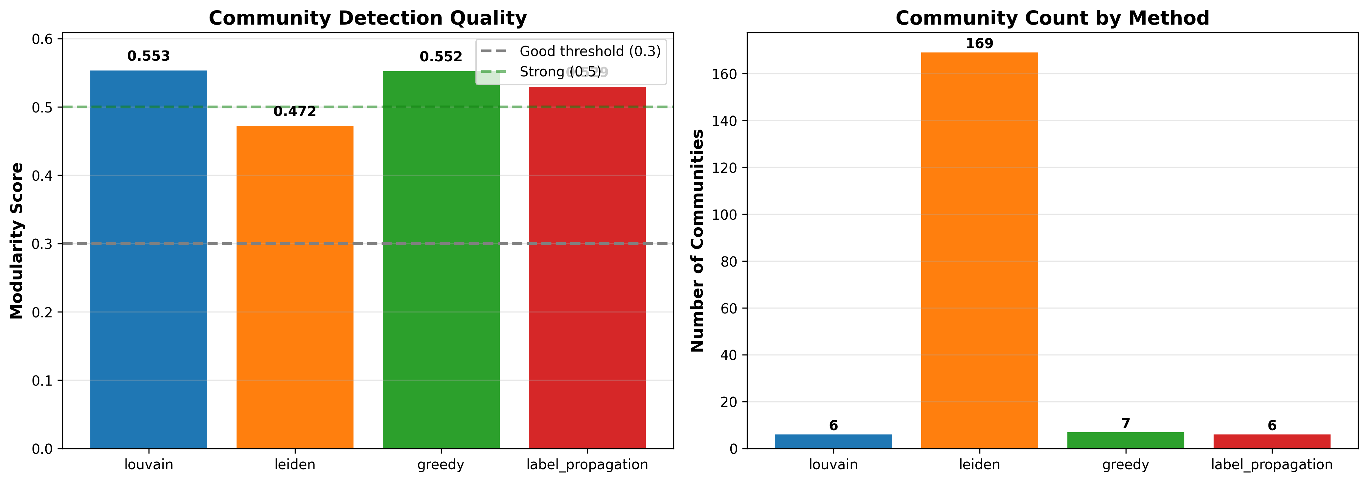
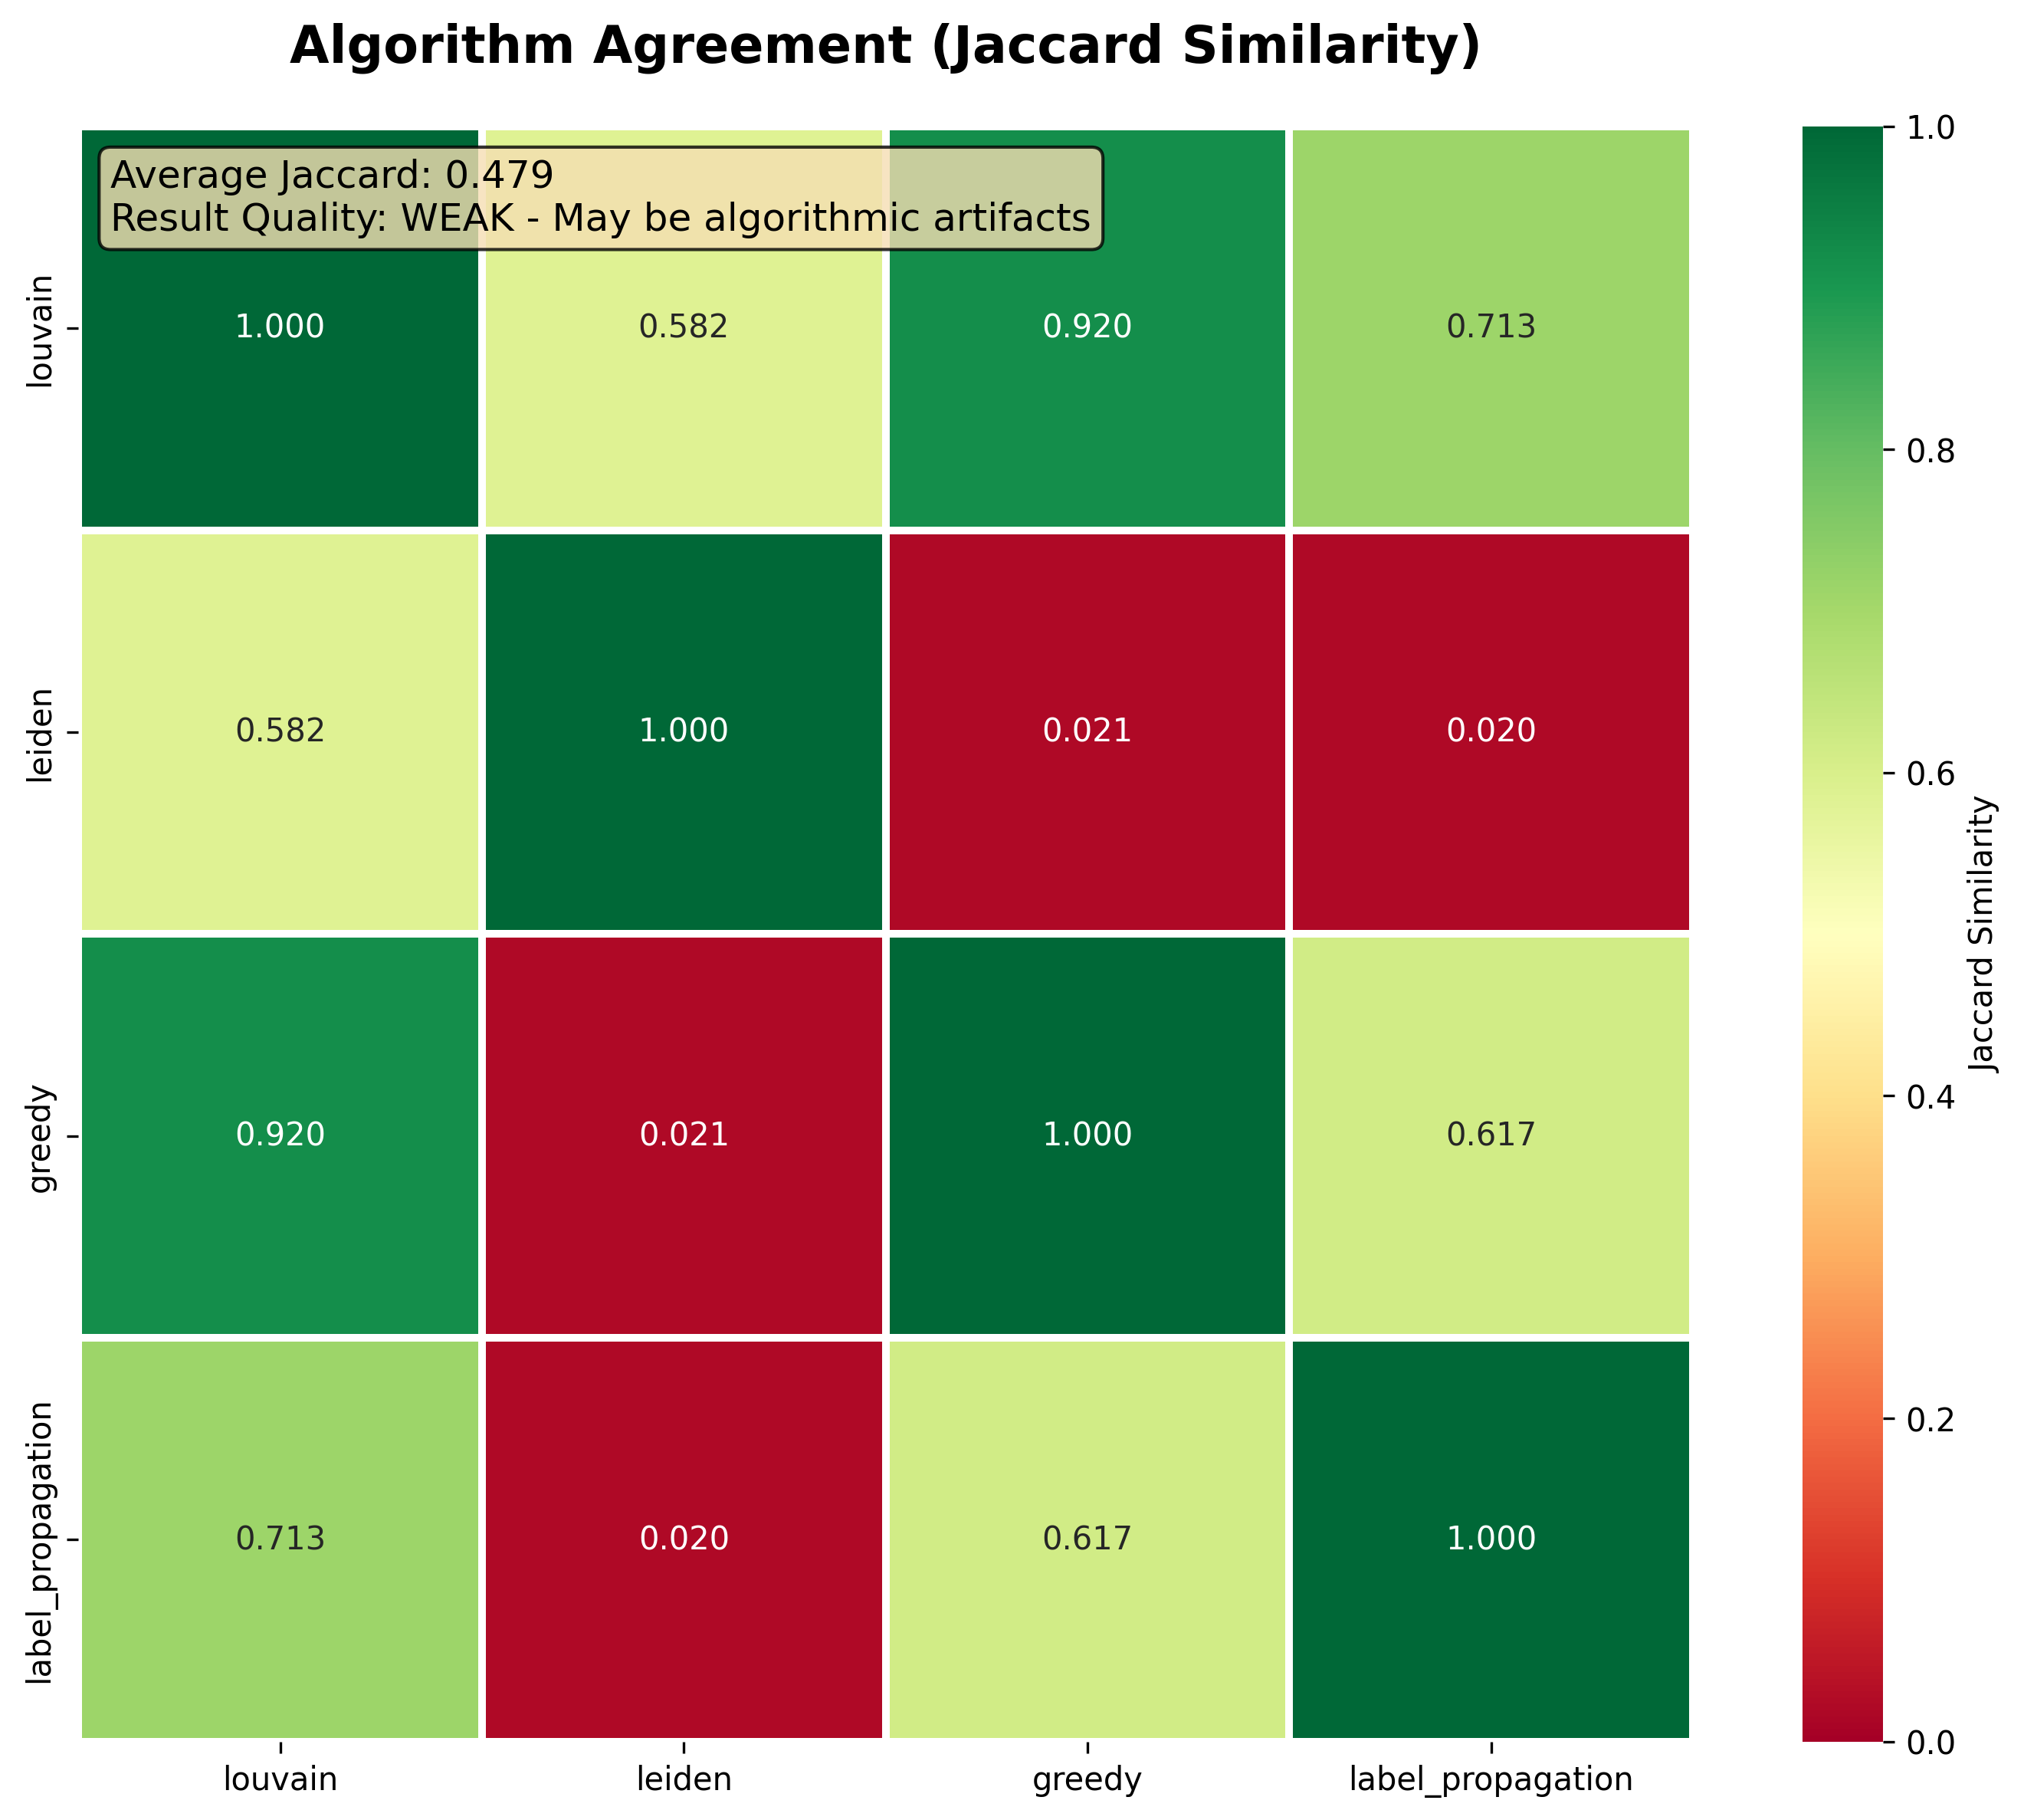
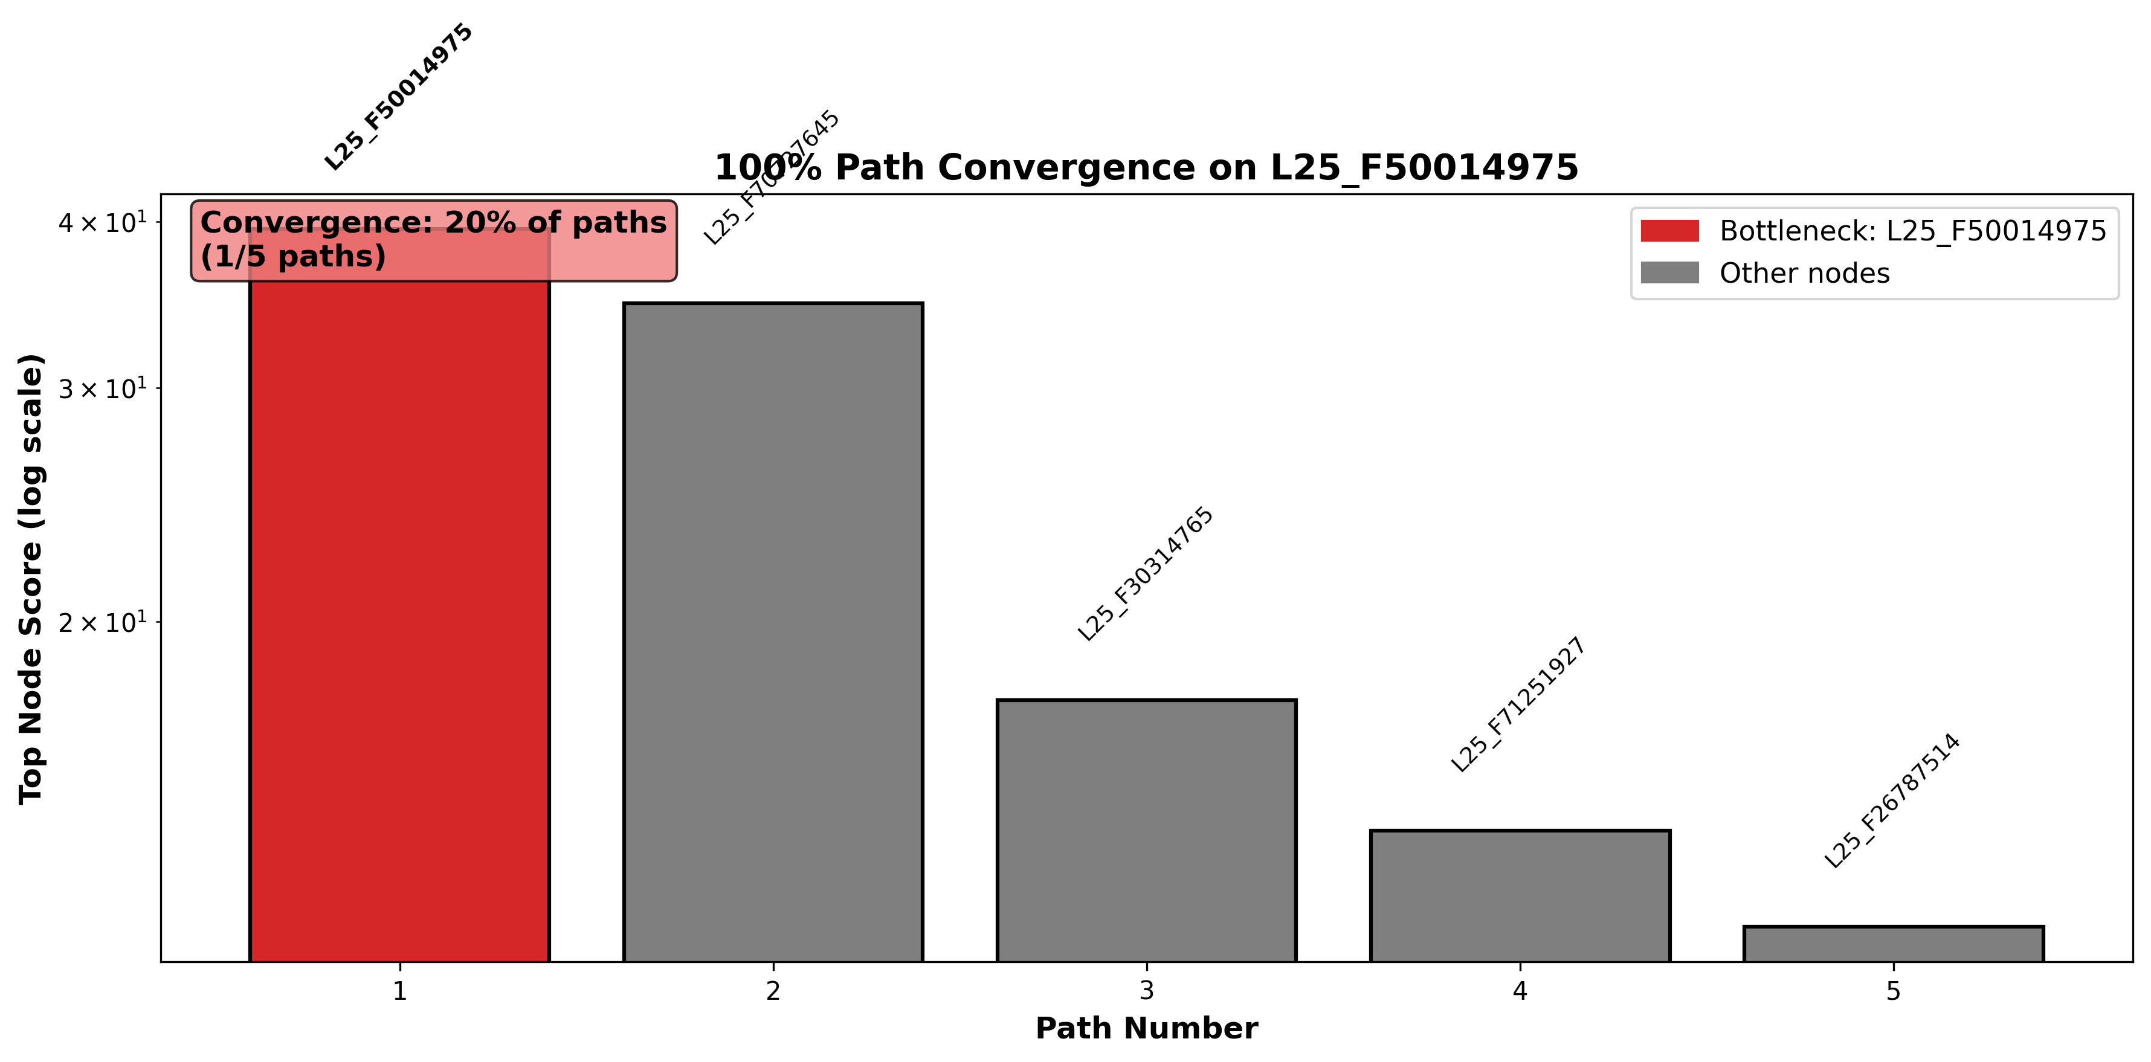
Validation in progress: multi-algorithm comparison + semantic taxonomy annotation
Validation Plan (In Progress)
Algorithm Validation
Multi-algorithm analysis: compare traceback
vs betweenness centrality vs PageRank
Jaccard similarity between methods
Convergence proof visualizations
Already completed for 3 prompts
Semantic Taxonomy
Classify top features: SYNTAX / SEMANTICS
Sub-categories: Geographic, Temporal, Entity
Inter-rater reliability target: kappa > 0.7
Track semantic flow through bottleneck
Annotation CSV in progress
12 / 14
Notes:
Here's what we're doing right now for validation. On the algorithm side, we're running multi-algorithm comparisons: our traceback BFS against betweenness centrality and PageRank. We compute Jaccard similarity between the critical node sets identified by each method. If traceback and centrality agree on the same bottlenecks, that's strong convergent evidence. We've already completed this for 3 prompts with visualizations. On the semantic side, we're building a taxonomy to classify features as SYNTAX vs SEMANTICS with sub-categories. The acceptance criterion is inter-rater reliability kappa above 0.7. This will let us quantify exactly what percentage of semantic vs syntactic information passes through each bottleneck layer. Annotation is in progress.

Slide 13
Next 4 weeks: complete validation, run ablations, expand to more models
Next Steps & Timeline
Weeks 1-2: Complete Validation
Finish semantic taxonomy annotation (top 100 features)
Complete QWEN traceback for remaining prompts
Generate cross-prompt bottleneck comparison table
Weeks 3-4: Causal Experiments
Ablation: zero out bottleneck features, measure accuracy change
Amplification: boost geographic features at layer before bottleneck
Quantify information loss with mutual information estimates
Ongoing: Extend Scope
Add 3+ prompt categories (code, reasoning, multi-hop)
Test on Llama-3 (8B) for larger model comparison
Format paper draft for workshop submission
13 / 14
Notes:
Here's the roadmap. Weeks 1-2: finish validation. Complete the semantic taxonomy for the top 100 features so we can quantify what passes through bottlenecks. Finish QWEN traceback analysis on remaining prompts. Build a comprehensive cross-prompt comparison table showing bottleneck positions across all experiments. Weeks 3-4: causal experiments. The critical test: ablate the bottleneck feature -- zero it out -- and measure whether accuracy on geographic prompts actually changes. Also try amplifying geographic features at the layer just before the bottleneck. And estimate mutual information to quantify how much information is lost at each bottleneck. Ongoing: expand to more prompt categories -- code generation, multi-hop reasoning. Test a larger model like Llama-3 8B. And format the paper draft for a workshop submission.

Slide 14
I need feedback on: validation criteria, ablation priorities, and submission target
Asks & Decisions Needed
1. Validation acceptance criteria
Is kappa > 0.7 for semantic taxonomy sufficient?
What Jaccard threshold confirms algorithm agreement?
2. Ablation experiment priority
Should we prioritize single-feature ablation or path ablation?
Which prompts are highest priority for causal testing?
3. Submission target
Workshop paper (NeurIPS MechInterp) vs full paper (ICLR)?
Timeline implications: workshop = 4 weeks, full = 8-12 weeks
4. Compute needs
Ablation experiments need model inference -- GPU access?
Extend to Llama-3 8B requires additional API access
14 / 14
Notes:
I have four asks for the group. First, validation criteria: is inter-rater kappa above 0.7 sufficient for the semantic taxonomy? And what Jaccard similarity threshold should we require for algorithm agreement? Second, when we move to ablation experiments, should we focus on single-feature ablation -- zeroing out one bottleneck node -- or full path ablation where we knock out the entire bottleneck pathway? And which prompts should we test first? Third, submission target: we could aim for a workshop paper at NeurIPS Mechanistic Interpretability workshop in about 4 weeks, or a full paper at ICLR which would take 8-12 weeks. The paper draft is at 6,800 words, close to workshop length already. Fourth, ablation experiments need GPU access for model inference. And extending to Llama-3 may require additional API access. I'd appreciate guidance on all four points. Thank you!

Slide 15
EXECUTIVE SUMMARY: Bottleneck position is a key architectural parameter for factual accuracy
Executive Summary (Backup Slide)
What: automated pipeline to find information bottlenecks in LLMs
How: novel backward-BFS traceback through Neuronpedia attribution graphs
Finding 1: Bottleneck at 19% depth (GEMMA) vs 33% (QWEN) -> 27x accuracy diff
Finding 2: 79/80 top features are syntactic -- template matching, not knowledge
Finding 3: All outputs share ONE circuit -- shared universal architecture
Status: validating with multi-algorithm comparison + semantic taxonomy
Next: causal ablation experiments in weeks 3-4
Ask: validation criteria, ablation priorities, submission target, GPU access
B / 14
Notes:
If you're short on time, this one slide captures everything. We built an automated pipeline that identifies information bottlenecks inside language models. Our novel traceback algorithm finds where attribution paths converge. Three key findings: bottleneck position determines accuracy with a 27x difference between models, factual recall is dominated by syntactic template matching not semantic knowledge, and all output tokens share a single universal circuit. We're currently validating these findings with multi-algorithm comparison and semantic feature classification. Next we'll run causal ablation experiments. I need the group's input on validation criteria, experiment priorities, submission target, and compute resources.

