Slide 1
Improving customer satisfaction at SFO
Team Western skies

Slide 2
Problem statement
Improve customer satisfaction for the communities of San Francisco International Airport by identifying the areas where it can improve.

Slide 3
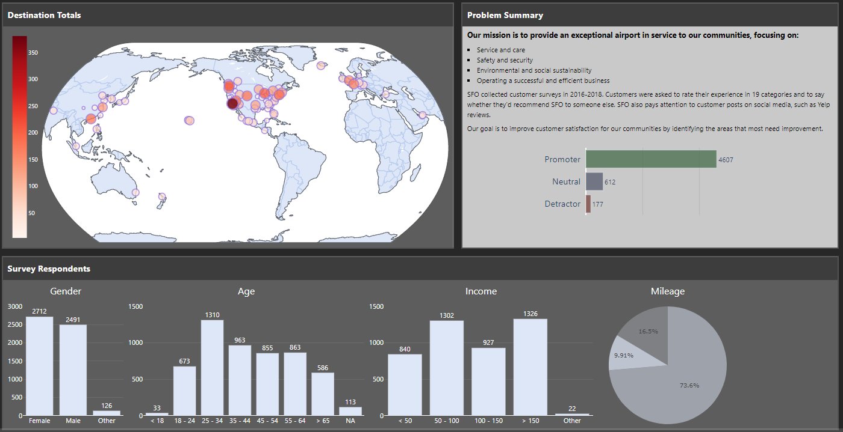
Survey respondents
Data source: https://www.flysfo.com/media/customer-survey-data
Live dashboard: https://sfo-survey.herokuapp.com/

Slide 4
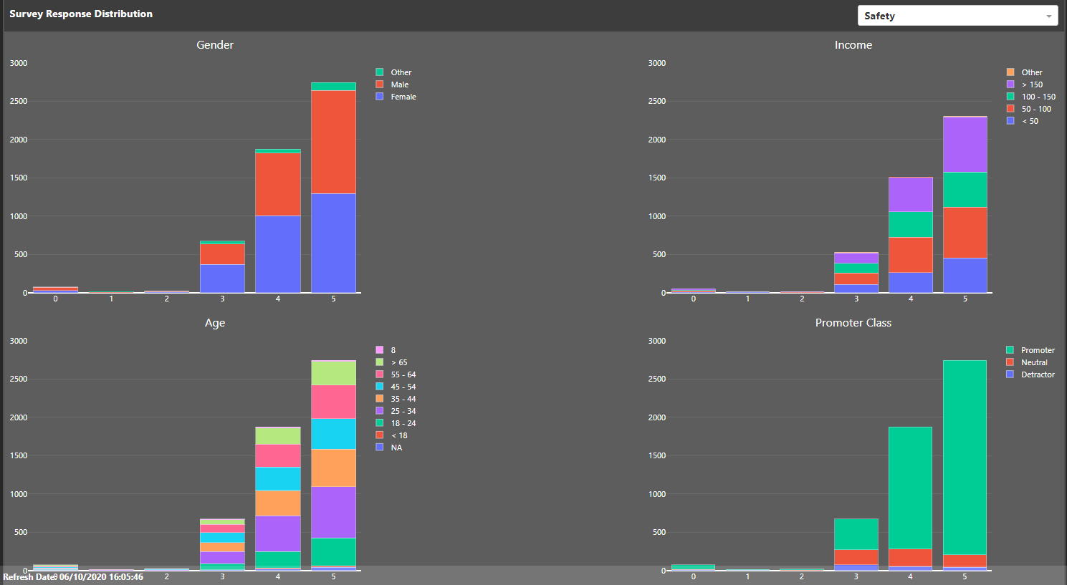
Common survey topics: food, security, signs, cleanliness, safety

Slide 5
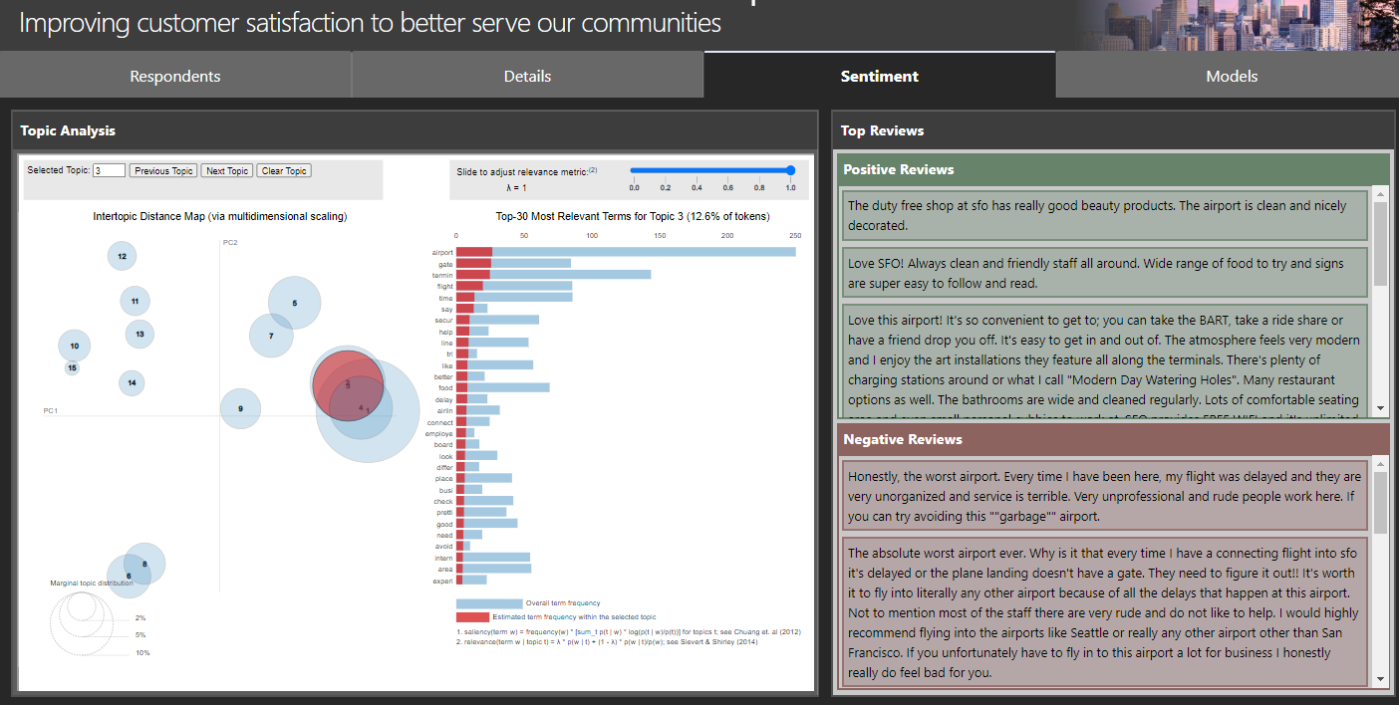
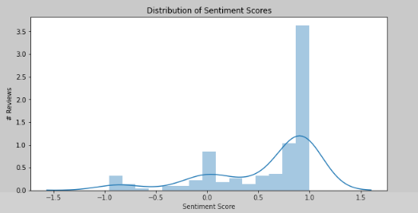
Common topics: cleanliness, food, staff, parking, charging stations, art, delays
Data source: yelp.com

Slide 6
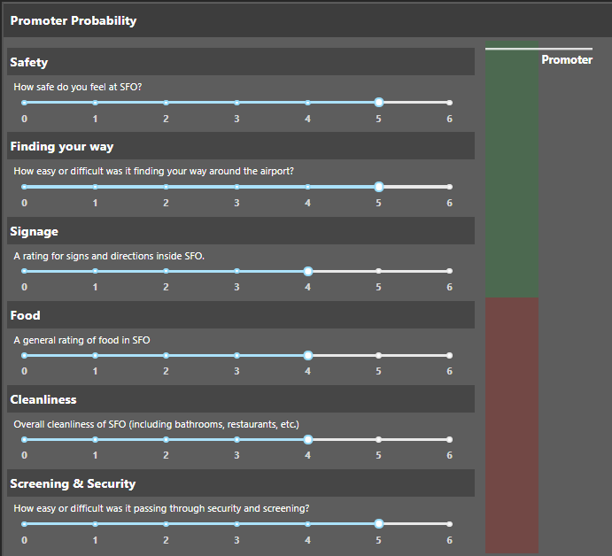
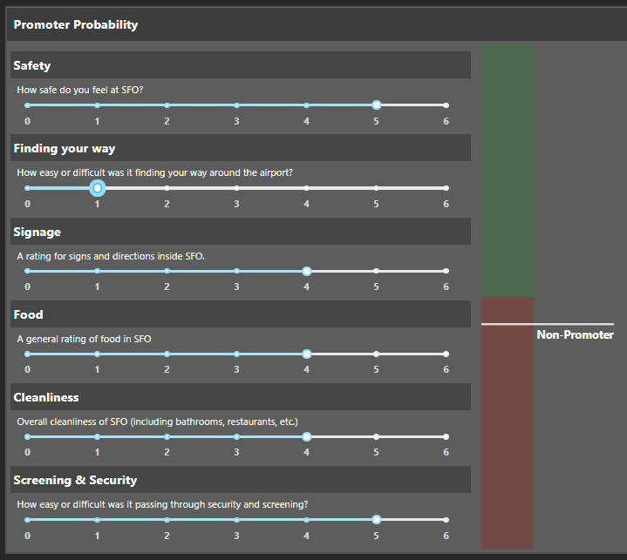
Six factors impact most of customer ratings safety, finding your way, signage, food, cleanliness, security
The median ratings (4&5) lead to a customer being a promoter
A single 0 or 1 rating is enough to turn a customer to non-promoter

Slide 7
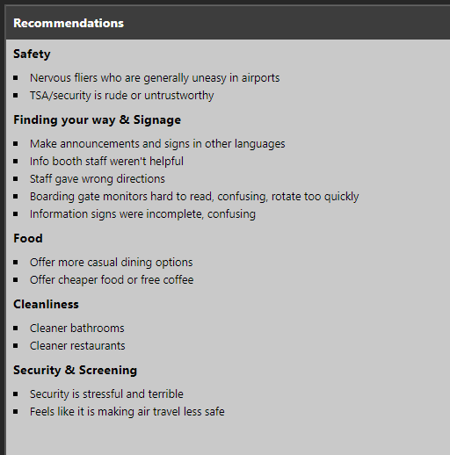
recommendations
Address the issues that customers identified in the survey and in social media.
Continue innovating options like the yoga room, garden, museum, and Wag Brigade.

Slide 8

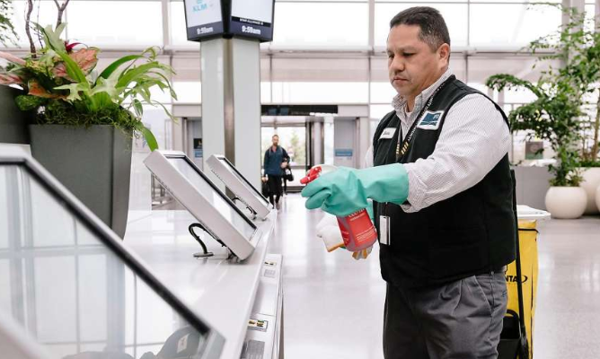
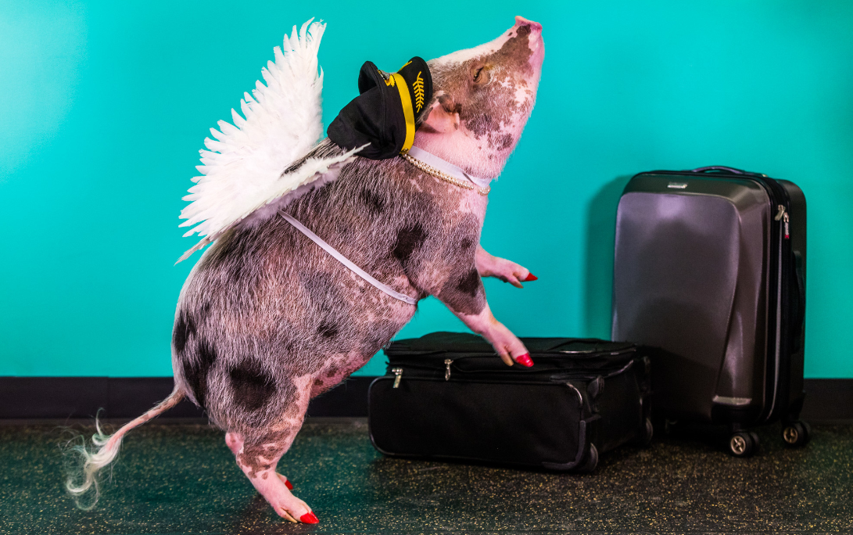
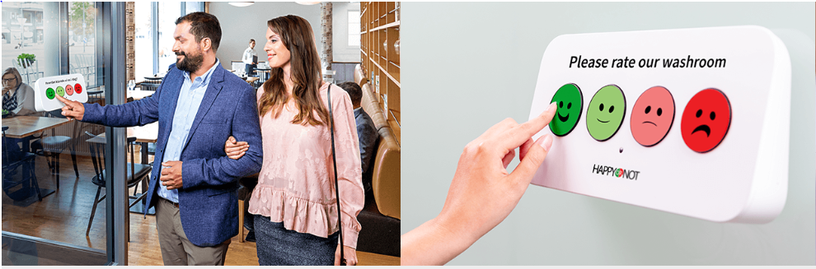
recommendations
Address the issues that customers identified in the survey and in social media.
Continue innovating programs like the yoga room, garden, museum, and Wag Brigade.
Create a shorter survey that can be given on the spot through smiley buttons or an app.
Set alerts in Yelp, Twitter, and Facebook for #sfo to catch trends faster.
https://www.flysfo.com/media/images-video-maps
https://www.sfchronicle.com/business/article/Coronavirus-cleaning-Bay-Area-businesses-ramp-up-15112667.php
https://www.happy-or-not.com/en/smiley-wall/

