Slide 1
Hidden Layer
Joint angle 1
Location_X
Joint angle 2
Joint angle 3
Location_Y
Joint angle 4
Location_Z
Joint angle 5
Joint angle 6
Hidden Layer 1
(1024 node)
Hidden Layer 2
(1024 node)
Hidden Layer 3
(64 node)

Slide 2



Location (x, y)
Joint3 angle $θ_{3}$
Joint2 angle $θ_{2}$
Joint1 angle $θ_{1}$

Slide 3
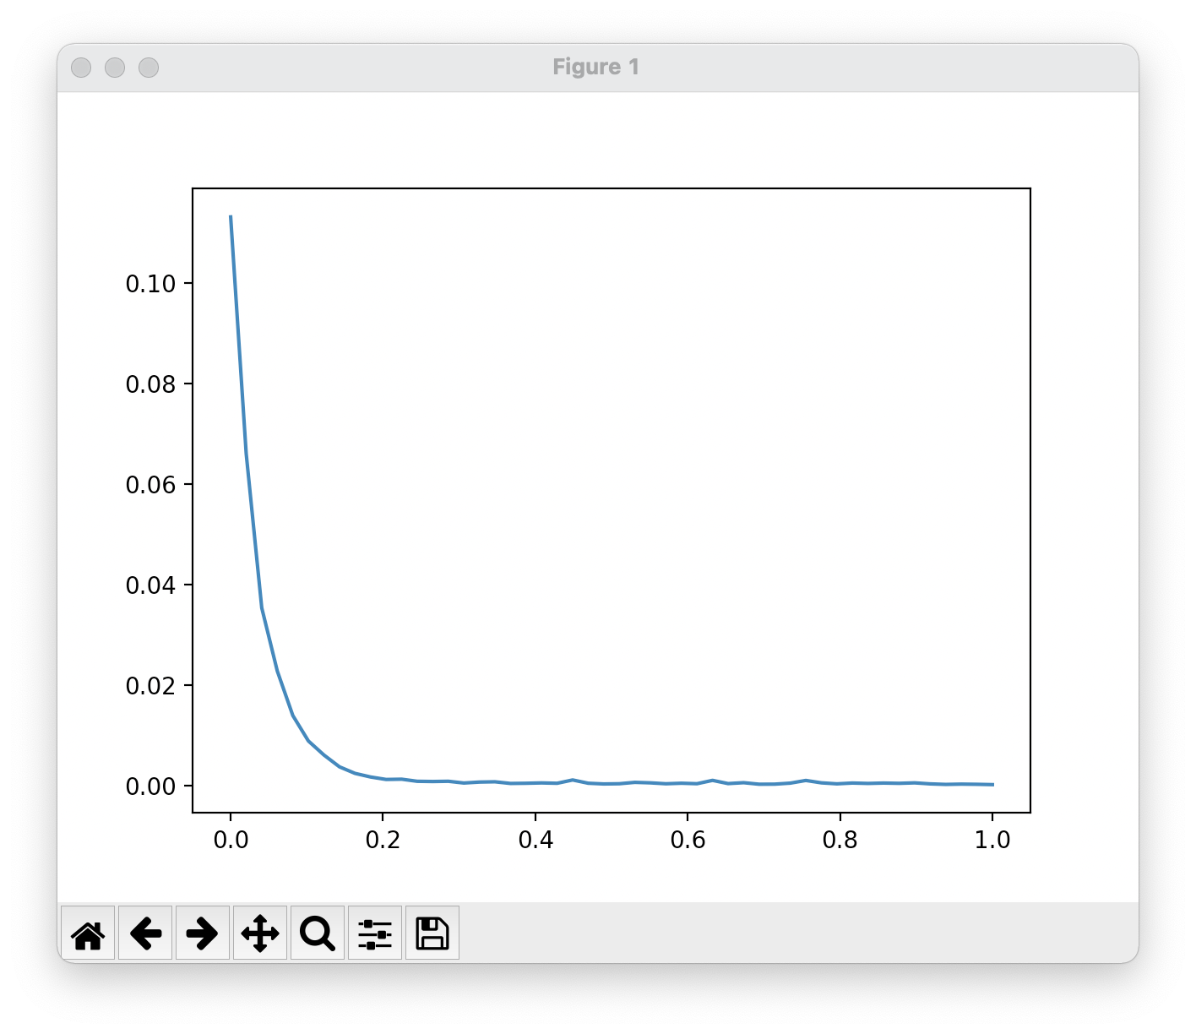
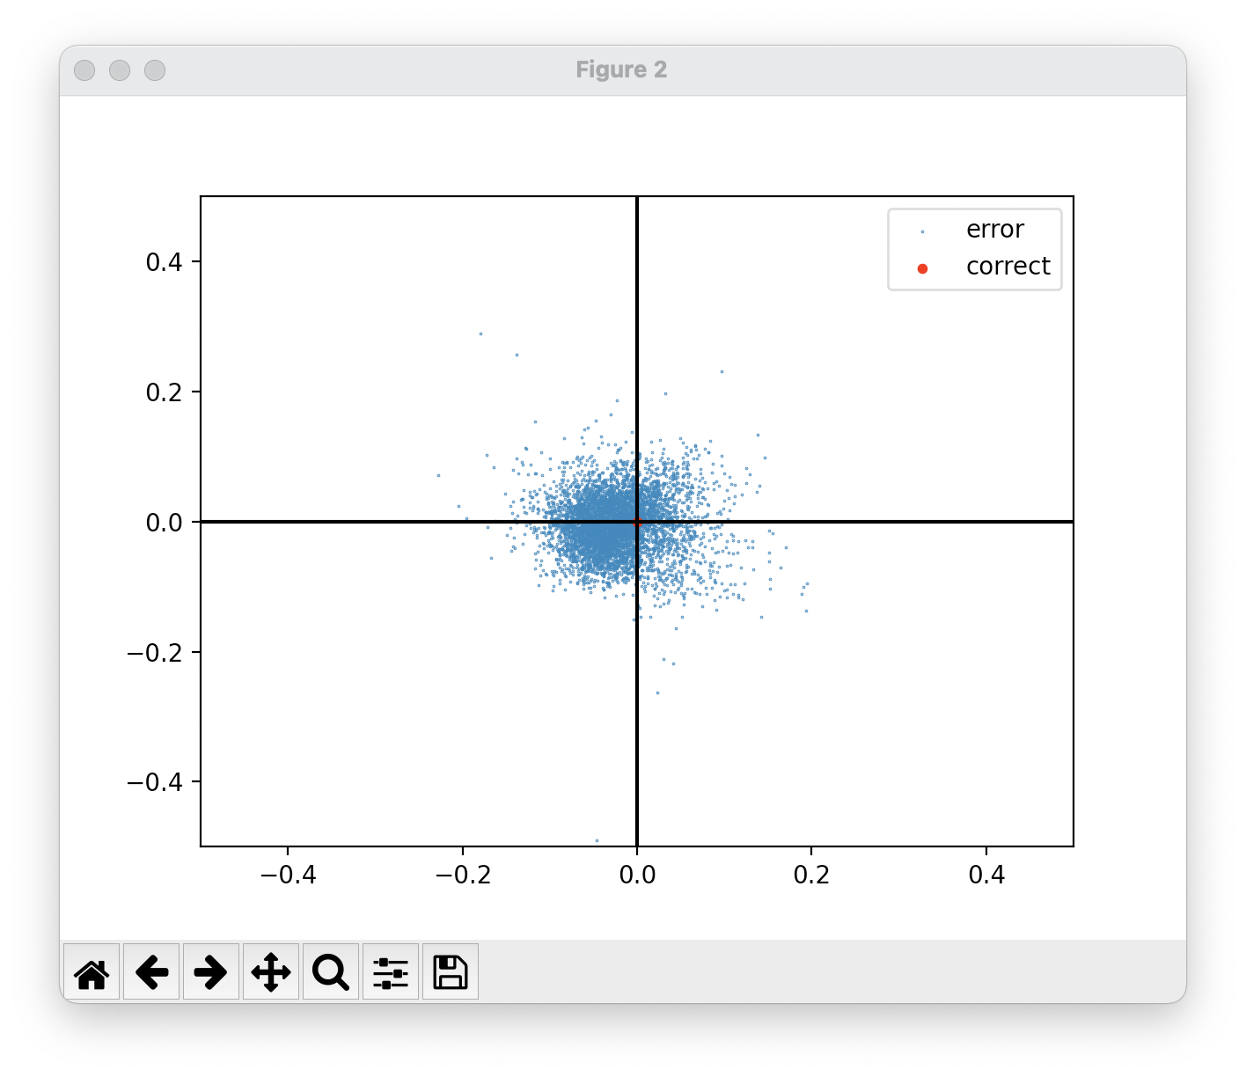

Slide 4
$$x=l_{1}cos{θ_{1}}+l_{2}cos{(θ_{1}+θ_{2})}+l_{2}cos⁡(θ_{1}+θ_{2}+θ_{3})$$
$$y=l_{1}sin{θ_{1}}+l_{2}sin{(θ_{1}+θ_{2})}+l_{3}\sin{(θ_{1}+θ_{2}+θ_{3})}$$

