Slide 1
Project Management
I 3330

Slide 2
References
Revised Guide to the PMD Pro. Version 1.7 April 2013
Schwalbe, Kathy. Information technology project management. Cengage Learning, Seventh Edition. 2015.

Slide 3
Introduction to project management
Chapter I

Slide 4
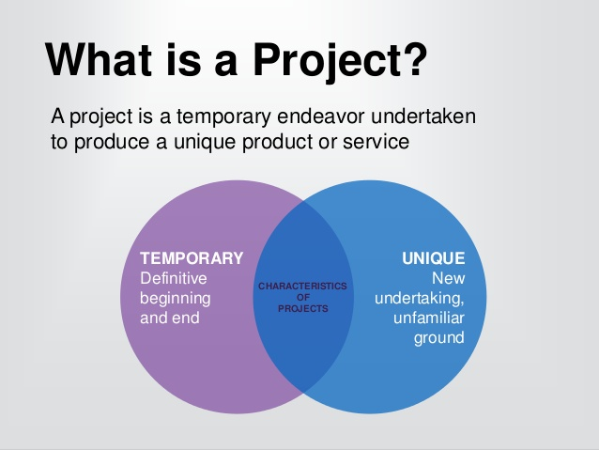
What’s a project

Slide 5
Project attributes
A project has a unique purpose
A project is temporary. A project has a definite beginning and end.
A project is developed using progressive elaboration. Projects are often defined broadly when they begin, and as time passes, the specific details of the project become clearer. Therefore, projects should be developed in increments. A project team should develop initial plans and then update them with more detail based on new information.
A project requires resources, often from various areas. Resources include people, hardware, software, and other assets.
A project should have a primary customer or sponsor. Most projects have many interested parties or stakeholders, but for a project to succeed someone must take the primary role of sponsorship.
A project involves uncertainty. Because every project is unique, it is sometimes difficult to define its objectives clearly, estimate how long it will take to complete, or determine how much it will cost.

Slide 6
Software development project
A software development project is a set of activities that starts and ends at identifiable points in time.
It produces quantifiable and qualifiable software deliverables

Slide 7
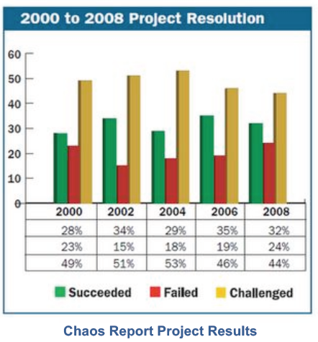
"challenged": by cost overruns, calendar delays, and/or failed to deliver all the
project products or services

Slide 8
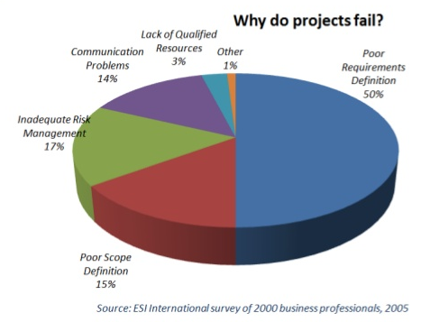

Slide 9
Lack of Clear, Understandable Specifications
If the specifications or requirements, in user's terms, are not clear and understandable or do not even exist,
the poor system developer has little chance to develop a system that meets the user's needs.
the system never becomes fully satisfactory to the user because the user never fully defines what the specifications are.
systems will suffer from the "never-ending development" and "perpetual maintenance" syndromes.

Slide 10

Lack of Clear, Understandable Specifications
Many of the modem system development tools provide easy mechanized procedures for creating system and program specifications.
Examples: object-oriented development, CASE (Computer-Aided Systems Engineering), prototyping, fourth-generation languages (4GLs), and application generators

Slide 11
Example : UML modeling
UML 2.0 comprises of thirteen diagram types split into:
structure,
behavior
and interaction.

Slide 12
Structure Diagrams
Class diagram gives an overview of a system by showing its classes and the relationships between them
Component diagram depicts how a software system is split up into physical components and shows the dependencies among these components
Object diagram shows a complete or partial view of the structure of a modelled system at a particular point in time
Composite structure diagram shows the internal structure of a class and the collaborations that this structure makes possible
Deployment diagram shows the physical configurations of software and hardware
Package diagram depicts how a system is split up into logical groupings and shows the dependencies among these groupings

Slide 13
Behavior Diagrams
Activity diagram shows the overall flow of control, essentially a flowchart
Use Case diagram describes what a system does from the standpoint of an external observer
State Machine diagram shows the dynamic behaviour of an entity based on its response to events, showing how the entity reacts to various events depending on the current state that it is in.

Slide 14
Interaction Diagrams
Sequence diagram an interaction diagram that shows how operations are carried out, what messages are sent and when
Communication diagram (UML 2.0) models the interactions between objects or parts in terms of sequenced messages
Interaction Overview diagram (UML 2.0) defines interactions and is a variant of the activity diagram, which emphasizes the high-level control flow
Timing diagram (UML 2.0) a form of interaction diagram, where the focus is on timing constraints

Slide 15
UML use case diagrams
Usually referred to as behavior diagrams used to describe a set of actions (use cases) that some system or systems (subject) should or can perform in collaboration with one or more external users of the system (actors). Each use case should provide some observable and valuable result to the actors or other stakeholders of the system.

Slide 16
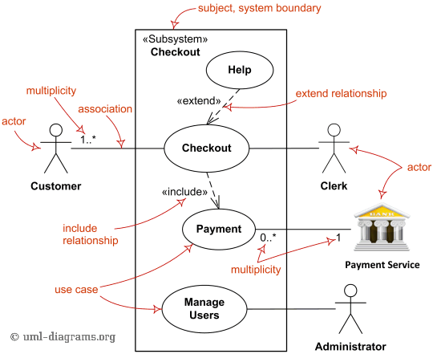

Slide 17
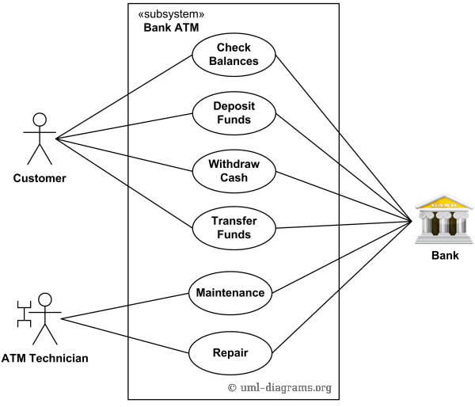
Bank ATM
Customer Authentication use case is required for every ATM transaction

Slide 18
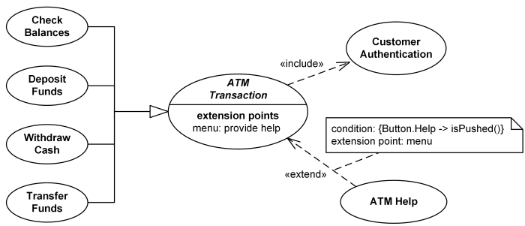

Slide 19
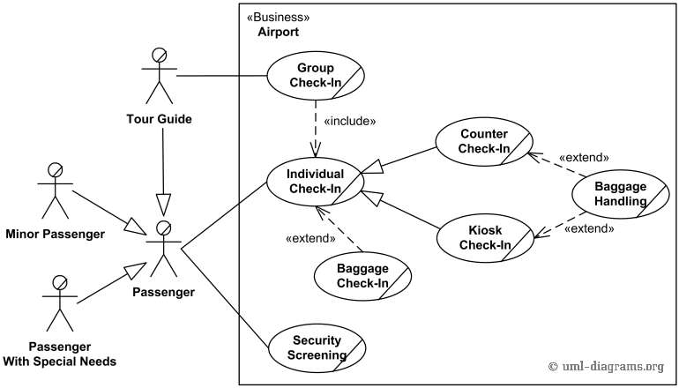
Airport Check-In and Security Screening

Slide 20
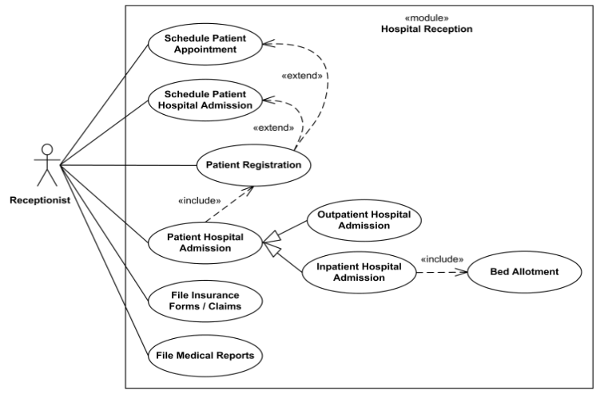

Slide 21
Exercise : vending machine
Propose a use case diagram for a vending machine that sells beverages and snacks. Make use of inclusion and extension associations, mark multiplicities and remember that a vending machine may need technical assistance from time to time.

Slide 22
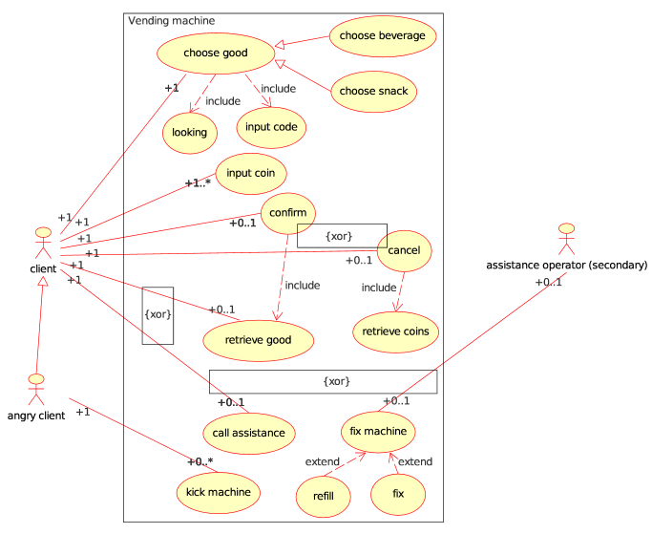

Slide 23
Activity diagram
shows flow of control or object flow with emphasis on the sequence and conditions of the flow
Activity is a parameterized behavior represented as coordinated flow of actions

Slide 24
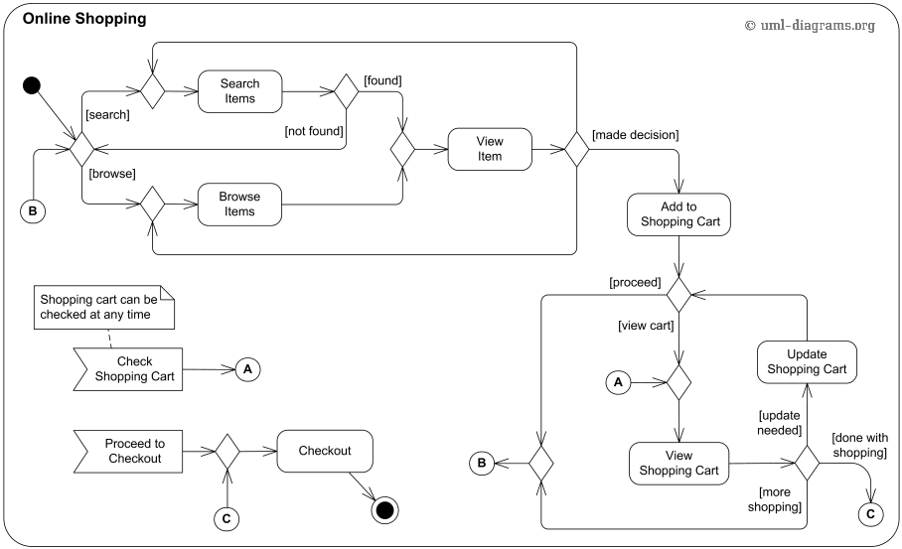
Example: Online shopping

Slide 25
Poor Documentation
This problem is akin to the first one of lack of adequate specifications.
Most of the deliverables throughout the system development life cycle are composed of documentation.
Poor documentation at any stage will still cause a poor-quality product to be delivered because of the resultant poor communication between developers and users.

Slide 26
Poor Documentation
With the advent of structured analysis, design, and programming, and with the introduction of a controlled development life cycle, the production of the required documentary deliverables became much more streamlined, as did the documents themselves.

Slide 27
Poor Communication
Successful system development will always depend on the successful interaction among various diverse groups within an enterprise.
If good communication is not maintained among all the involved groups, misunderstandings will inevitably occur.
When large projects require interaction among large numbers of people and organizations, good communication becomes paramount in importance, and some formalized, regular communication on the project's progress becomes essential.

Slide 28
Inadequate risk management
One should ask him/herself:
what can get out of no way?
what are we going to do about it before it happens?
or this might happen because this person might not support the project ?
and so how are we going to round them up?
this can might as well happen because this supplier may be always late and so how are going to get rid of them?
one more thing may be this person might change what they want and so what can we do to find the change sooner than later?
These are the questions that need to be in mind all the time when working on project and you can definitely say this is very empowering, very uplifting and even very exciting, so whenever starting a project it is very advisable to have a project plan

Slide 29
Poor scope definition
Defining scope is perhaps the most important part of the upfront process of defining a project. The purpose of defining scope is to clearly describe and gain agreement on the logical boundaries of your project.
Define scope of proposed system:
-Functions - Dimensions
-Users -Constraints

Slide 30
Purpose of project management
The purpose of project management is to plan, organize and manage resources to bring about the successful completion of specific project goals, outcomes and outputs.
High-­quality, comprehensive project management practices are indispensable to helping organizations manage focused, effective and efficient projects.

Slide 31
Responsibility of project manager
The responsibility of the project manager is to work closely with an array of stakeholders to complete the work of the project.
Stakeholders -­ including members of the project team, implementing organizations, contractors, community groups and others -­ must work together to design, implement and control all aspects of the project

Slide 32
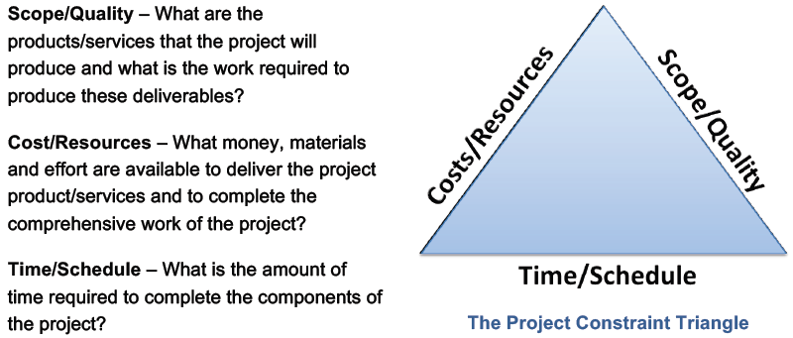
Project constraints
The job of the project manager is to ensure that the triple constraint triangle stays in balance

Slide 33
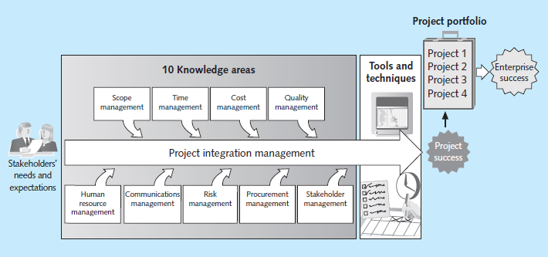
Key elements of the project management framework

Slide 34
Project Stakeholders
Stakeholders are the people involved in or affected by project activities, and include the project sponsor, project team, support staff, customers, users, suppliers, and even opponents of the project.

Slide 35






Example: Home construction
contractor
$
homeowner
Project manager :
contractor
??
opponent
??
suppliers
workers

Slide 36
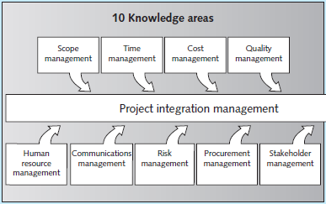
key competencies that project managers must develop
10- Project integration management is an overarching function that affects and is affected by all of the other knowledge areas
2- estimating how long it will take to complete the work, developing an acceptable project schedule, and ensuring timely completion of the project.
1- defining and managing all the work
required to complete the project successfully
4- ensuring that the project will satisfy the stated or
implied needs for which it was undertaken
3- preparing and managing the budget for the project
5- making effective use of the people involved with the project.
9- identifying and analyzing stakeholder needs while managing and controlling their engagement throughout
the life of the project
7- identifying, analyzing, and responding to risks related to the project
6-generating, collecting, disseminating, and storing project information.
8- acquiring or procuring goods and services for a project from outside the performing organization

Slide 37
Skills For project manager
Chapter II

Slide 38
Suggested Skills for Project Managers (1)
Project managers need to have a wide variety of skills and be able to decide which skills are more important in different situations. A Guide to the Project Management Body of Knowledge—the PMBOK® Guide—recommends that the project management team understand and use expertise in the following areas:

Slide 39
Suggested Skills for Project Managers (2)
The Project Management Body of Knowledge
Application area knowledge, standards, and regulations : general tools and techniques project managers use.
Project environment knowledge
General management knowledge and skills
Soft skills or human relations skills

Slide 40
Project environment knowledge
differs from organization to organization and project to project
but some skills will help in almost all project environments:
understanding change and
understanding how organizations work within their social, political, and physical environments

Slide 41
General management knowledge and skills
Project managers should understand important topics related to financial management, accounting, procurement, sales, marketing, contracts, manufacturing, distribution, logistics, the supply chain, strategic planning, tactical planning, operations management, organizational structures and behavior, personnel administration, compensation, benefits, career paths, and health and safety practices.
On some projects, the project manager can delegate detailed responsibility for some of these areas to a team member, support staff, or even a supplier.
Even so, the project manager must be intelligent and experienced enough to know which of these areas are most important and who is qualified to do the work.

Slide 42
Soft skills, or human relations skills
To understand, navigate, and meet stakeholders’ needs and expectations, project managers need:
to lead, (Leaders determine the vision, and managers achieve the vision)
communicate,
negotiate,
solve problems,
and influence the organization at large.
They need to be able to listen actively to what others are saying, help develop new approaches for solving problems, and then persuade others to work toward achieving project goals.
Project managers need to be able to cope with criticism and constant change.

Slide 43
concepts involved in Understanding the project environment
Chapter III

Slide 44
concepts involved in understanding the project environment
systems approach,
understanding organizations,
managing stakeholders,
matching product life cycles to the project environment,
Understanding the context of IT projects,
and reviewing recent trends that affect IT project management.

Slide 45
Systems Approach
Describe a holistic and analytical approach to solving complex problems that includes using
a systems philosophy,
systems analysis,
and systems management.

Slide 46
Systems philosophy
An overall model for thinking about things as systems : Systems are sets of interacting components that work within an environment to fulfill some purpose.

Slide 47
Systems analysis
A problem-solving approach that requires defining the scope of the system, dividing it into components, and then identifying and evaluating its problems, opportunities, constraints, and needs.
Once this is completed, the systems analyst then examines alternative solutions for improving the current situation; identifies an optimum, or at least satisfactory, solution or action plan; and examines that plan against the entire system

Slide 48
Systems management
Addresses the business, technological, and organizational issues associated with creating, maintaining, and modifying a system.
IT students often overlook systems management.
Many IT professionals become captivated with the technology and day-to-day problem solving involved in working with information systems.
They tend to become frustrated with many of the “people problems” or politics involved in most organizations.
In addition, many IT professionals ignore important business questions, such as “Does it make financial sense to pursue this new technology?” or “Should the company develop this software in-house or purchase it off the shelf?”
Using a more holistic approach helps project managers integrate business and organizational issues into their planning.
It also helps them look at projects as a series of interrelated phases

Slide 49
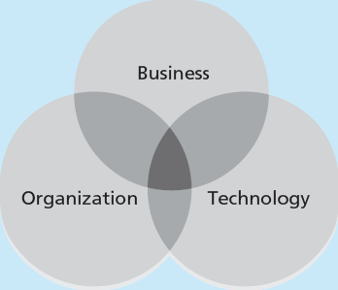
The Three-Sphere Model for Systems Management

Slide 50
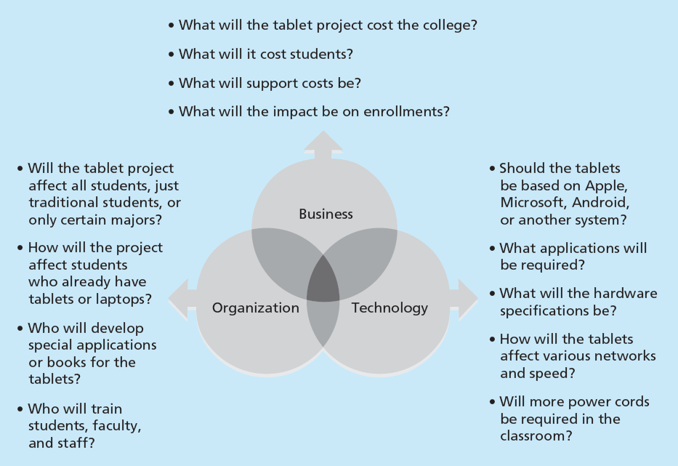
Example: tablet project

Slide 51
concepts involved in understanding the project environment
systems approach,
understanding organizations,
managing stakeholders,
matching product life cycles to the project environment,
Understanding the context of IT projects,
and reviewing recent trends that affect IT project management.

Slide 52
UNDERSTANDING ORGANIZATIONS
The systems approach requires that project managers always view their projects in the context of the larger organization.
Organizational issues are often the most difficult part of working on and managing projects.
In fact, many people believe that most projects fail because of organizational issues like company politics.
Project managers often do not spend enough time identifying all the stakeholders involved in projects, especially the people opposed to the projects.
Also, project managers often do not spend enough time considering the political context of a project or the culture of the organization.
To improve the success rate of IT projects, it is important for project managers to develop a better understanding of people as well as organizations.

Slide 53
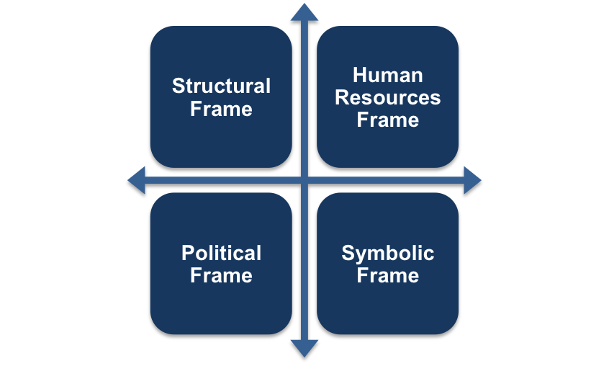
The Four Frames of Organizations

Slide 54
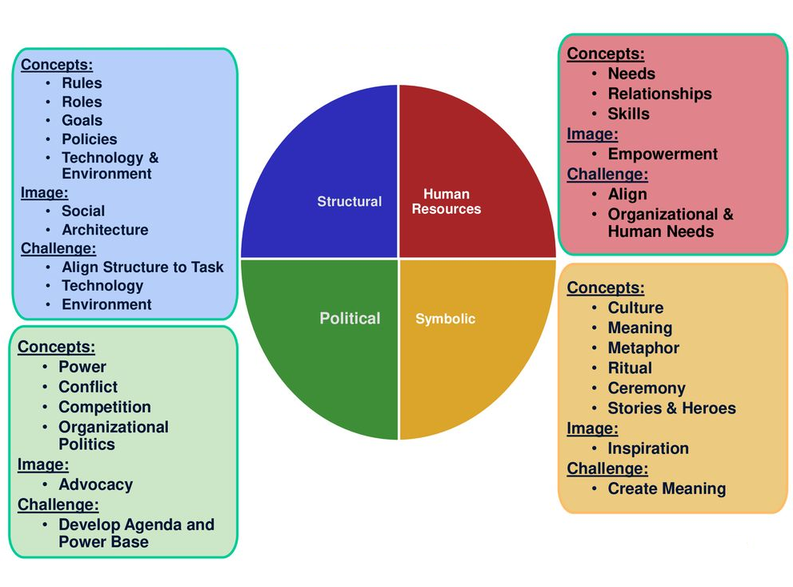

Slide 55
concepts involved in understanding the project environment
systems approach,
understanding organizations,
managing stakeholders,
matching product life cycles to the project environment,
Understanding the context of IT projects,
and reviewing recent trends that affect IT project management.

Slide 56
project stakeholders
project stakeholders are the people involved in or affected by project activities.
Stakeholders can be internal or external to the organization, directly involved in the project, or simply affected by the project.
Internal project stakeholders include the project sponsor, project team, support staff, and internal customers of the project. Other internal stakeholders include top management, other functional managers, and other project managers. Projects affect these additional internal stakeholders because they use the organization's limited resources.
External project stakeholders include the project’s customers (if they are external to the organization), competitors, suppliers, and other external groups potentially involved in the project or affected by it, such as government officials or concerned citizens.

Slide 57
Project life cycle
A project life cycle is a collection of phases. Phases break projects down into smaller, more manageable pieces, which will reduce uncertainty.
Project life cycles define what work will be performed in each phase, what deliverables will be produced and when, who is involved in each phase, and how management will control and approve work produced in each phase.
A deliverable is a product or service, such as a technical report, a training session, a piece of hardware, or a segment of software code, produced or provided as part of a project.

Slide 58
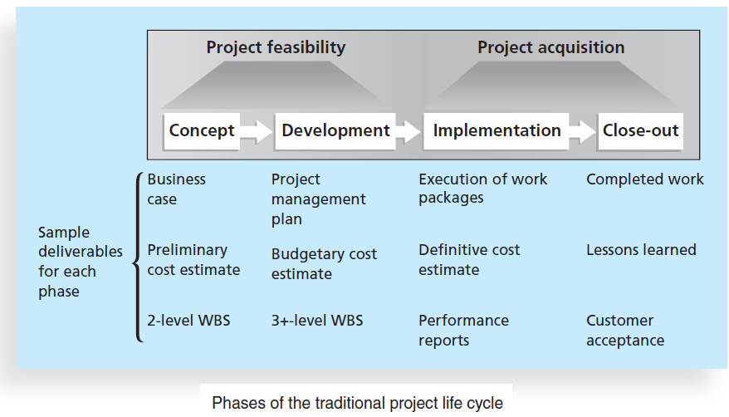
Work Breakdown Structure

Slide 59
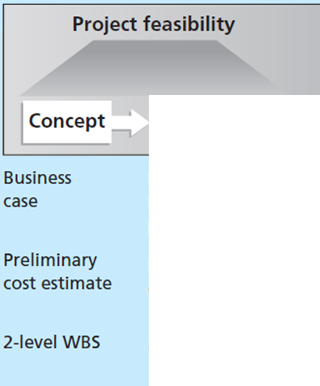
Example : Tablet project
Create a committee of faculty and staff to study the concept of increasing the use of technology on campus
develop a business case and plan that include initial, smaller project to investigate alternative ways of increasing the use of technology
estimated that it would take six months and $20,000 to conduct a detailed technology study
partition the work to include a competitive analysis of what five similar campuses were doing; a survey of local students, staff, and faculty; and a rough assessment of how using more technology would affect costs and enrollments.

Slide 60
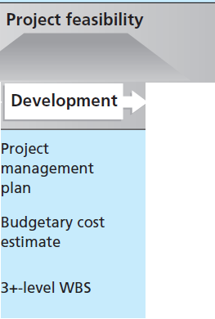
The team would have to decide if students would purchase or lease the tablets, what type of hardware and software
the tablets would require,
how much to charge students,
how to handle training and maintenance, and how to integrate the use of the new technology with current courses

Slide 61
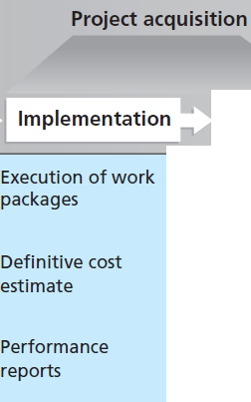
the project team would need to obtain the required hardware and
software, install the necessary network equipment, deliver the tablets to the students, create a process for collecting fees, and provide training to students, faculty, and staff
The project team usually spends the bulk of its efforts and money during the implementation phase of projects

Slide 62
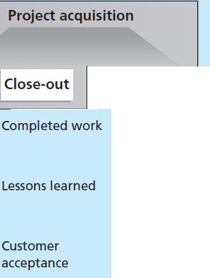
customers should accept the entire project
the project team would close out any related activities.
Team members might administer a survey to students, faculty, and staff to gather opinions on how the project fared.
They would ensure that any contracts with suppliers were completed and that appropriate payments were made.
They would transition future work related to the tablet project to other parts of the organization.
The project team could also share its lessons learned report with other colleges that are considering a similar program.

Slide 63
Popular models of an SDLC (systems development life cycle)
the waterfall model,
the spiral model,
the incremental build model,
the prototyping model,
the Rapid application development (RAD) model

Slide 64
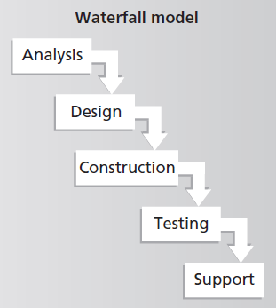
linear stages of systems analysis,
design, construction, testing, and support.
assumes that requirements will remain stable after they are defined.
used when risk must be tightly controlled and when changes must be restricted after the requirements are defined.
used in many large-scale systems projects where complexity and cost are so high that
the more rigid steps of the approach help to ensure careful completion of all deliverables

Slide 65
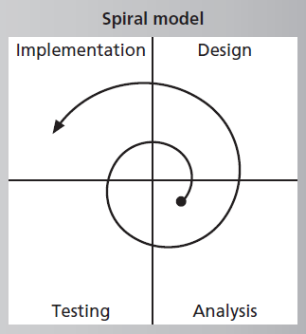
developed based on refinements of the
waterfall model as applied to large government software projects.
It recognizes the fact that most software is developed using an iterative or spiral
approach rather than a linear approach.
The project team is open to changes
and revisions later in the project life cycle, and returns to the requirements phase to more carefully clarify and design the revisions.
suitable for projects in which changes can be incorporated with reasonable cost increases or with acceptable time delays.

Slide 66
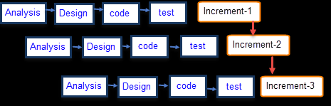
incremental build model
provides for progressive development of operational software, with each release providing added capabilities.
This type of approach is often used by organizations like Microsoft, which issues a
specific release of a software package while working on future revisions that
will be distributed later in another release with a higher “build” or version
number.
This approach helps to stage the priorities of the features and functions
with user priorities or the costs, time, and scope of the revisions.

Slide 67
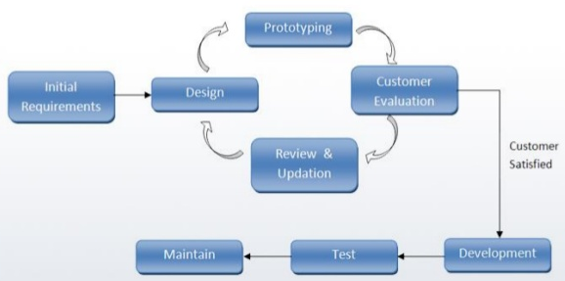
Prototyping life cycle
used for developing software prototypes
to clarify user requirements for operational software.
requires heavy user involvement, and developers use a model to generate functional requirements and physical design specifications simultaneously. Developers can throw away or keep prototypes, depending on the project.
This approach is often used in systems that involve a great deal of user interface design, such as website projects, in systems that automate previously manual functions, or in systems that change the nature of how something is done, such as mobile applications.

Slide 68
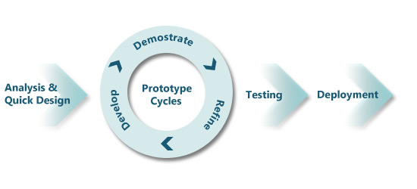
Rapid application development model
developers work with an evolving prototype.
requires heavy user involvement and helps produce systems quickly without sacrificing quality.
Developers use RAD tools such as computer-aided software engineering (CASE), joint requirements planning (JRP), and joint application design (JAD) to facilitate rapid
prototyping and code generation.
These tools are often used in reporting systems in which programmers enter parameters into software to generate reports for user approval.
When approved, the same parameters will generate the final production system without further modification by the programmer.

Slide 69
THE CONTEXT OF INFORMATION TECHNOLOGY PROJECTS
several issues unique to the IT industry have a critical impact on managing IT projects. These include :
the nature of projects,
the characteristics of project team members,
and the diverse nature of technologies involved.

Slide 70
The Nature of IT Projects
Unlike projects in many other industries, IT projects are diverse.
Some involve a small number of people installing off-the-shelf hardware and associated software.
Others involve hundreds of people analyzing several organizations’ business processes and then developing new software in a collaborative effort with users to meet business needs.
Even for small hardware-oriented projects, a wide diversity of hardware types can be involved personal computers, mainframe computers, network equipment, kiosks, laptops, tablets, or smartphones.
The network equipment might be wireless, cellular based, or cable-based, or might require a satellite connection.
The nature of software development projects is even more diverse than hardware-oriented projects.
A software development project might include creating a simple, stand-alone Microsoft Excel or Access application or a sophisticated, global e-commerce system that uses state-of-the-art programming languages and runs on multiple platforms.
IT projects also support every possible industry and business function.
Managing an IT project for a film company’s animation department requires different knowledge and skills than a project to improve a federal tax collection system or to install a communication infrastructure in a third-world country.
Because of the diversity of IT projects and the newness of the field, it is important to develop and follow best practices in managing these varied projects. Developing best practices gives IT project managers a common starting point and method to follow with every project.

Slide 71
Characteristics of IT Project Team Members
Because IT projects are diverse, the people involved come from diverse backgrounds and possess different skills. The resulting diverse project teams provide a significant advantage because they can analyze project requirements from a more robust systems view.
Many companies purposely hire graduates with degrees in other fields such as business, mathematics, or the liberal arts to provide different perspectives on IT projects. Even with these different educational backgrounds, however, there are common job titles for people working on most IT projects, such as business analyst, programmer, network specialist, database analyst, quality assurance expert, technical writer, security specialist, hardware engineer, software engineer, and system architect.
Within the category of programmer, several other job titles describe the specific technologies used, such as Java programmer, PHP programmer, and C/C++/C# programmer.
Some IT projects require the skills of people in just a few job functions, but some require inputs from many or all of them.
Occasionally, IT professionals move between these job functions, but more often people become technical experts in one area or they decide to move into a management position.

Slide 72
Diverse Technologies
Many of the job titles for IT professionals reflect the different technologies required to hold those positions. Differences in technical knowledge can make communication between professionals challenging. Hardware specialists might not understand the language of database analysts, and vice versa. Security specialists may have a hard time communicating with business analysts.
People within the same IT job function often do not understand each other because they use different technology. For example, someone with the title of programmer can often use several different programming languages. However, if programmers are limited in their ability to work in multiple languages, project managers might find it more difficult to form and lead more versatile project teams.
Another problem with diverse technologies is that many of them change rapidly. A project team might be close to finishing a project when it discovers a new technology that can greatly enhance the project and better meet long-term business needs.
New technologies have also shortened the time frame many businesses have to develop, produce, and distribute new products and services. This fast-paced environment requires equally fast-paced processes to manage and produce IT projects and products

Slide 73
RECENT TRENDS AFFECTING INFORMATION TECHNOLOGY PROJECT MANAGEMENT
Recent trends such as increased globalization, outsourcing, virtual teams, and agile project management are creating additional challenges and opportunities for IT project managers and their teams.

Slide 74
globalization
Globalization has significantly affected the field of IT. It is important for project managers to address several key issues when working on global projects:
Communications: Because people work in different time zones, speak different languages, have different cultural backgrounds, and celebrate different holidays, it is important to address how people will communicate in an efficient and timely manner. A communications management plan is vital
Trust: Trust is an important issue for all teams, especially when they are global teams. It is important to start building trust immediately by recognizing and respecting others’ differences and the value they add to the project
Common work practices: It is important to align work processes and develop a modus operandi with which everyone agrees and is comfortable. Project managers must allow time for the team to develop these common work practices. Using special tools can facilitate this process.
Tools: Many project management software tools include their own communications and collaboration features in an integrated package. IBM continues to be the leader in providing collaboration tools to businesses in over 175 companies, followed by Oracle in 145 countries, SAP in 130 countries, and Microsoft in 113 countries.18 Work groups must investigate options and decide which tools will work best for their projects. Security is often a key factor in deciding which tools to use.

Slide 75
Outsourcing
Outsourcing is an organization’s acquisition of goods and services from an outside source. The term offshoring is sometimes used to describe outsourcing from another country.
Many organizations have found ways to reduce costs by outsourcing, even though the practice can be unpopular in their home countries.
Because of the increased use of outsourcing for IT projects, project managers need to become more familiar with many global and procurement issues, including working on and managing virtual teams.

Slide 76
Virtual teams
A virtual team is a group of people who work together despite time and space boundaries using communication technologies.
The main advantages of virtual teams include:
Lowering costs because many virtual workers do not require office space or support beyond their home offices.
Providing more expertise and flexibility or increasing competitiveness and responsiveness by having team members across the globe working any time of day or night.
Improving the balance between work and life for team members by eliminating fixed office hours and the need to travel to work.
Disadvantages of virtual teams include:
Isolating team members who may not adjust well to working in a virtual environment.
Increasing the potential for communications problems because team members cannot use body language or other nonverbal communications to understand each other and build relationships and trust.
Reducing the ability for team members to network and transfer information informally.
Increasing the dependence on technology to accomplish work.

Slide 77
Agile Project Management
Agile means being able to move quickly and easily,
but some people feel that project management does not allow people to work quickly or easily.
Early software development projects often used a waterfall approach, but as technology and businesses became more complex, the approach often became difficult to use because requirements were unknown or continuously changing.
Agile today means using a method based on iterative and incremental development, in which requirements and solutions evolve through collaboration.
Agile can be used for software development or in any environment in which the requirements are unknown or change quickly. In terms of the triple constraint, an agile approach sets time and cost goals but leaves scope goals flexible so the project sponsors or product owners can prioritize and reprioritize the work they want done.
An agile approach makes sense for some projects, but not all of them.

Slide 78
agile development method
In February 2001, a group of 17 people that called itself the Agile Alliance developed and agreed on the Manifesto for Agile Software Development, as follows:
We are uncovering better ways of developing software by doing it and helping others do it. Through this work we have come to value:
Individuals and interactions over processes and tools
Working software over comprehensive documentation
Customer collaboration over contract negotiation
Responding to change over following a plan

Slide 79
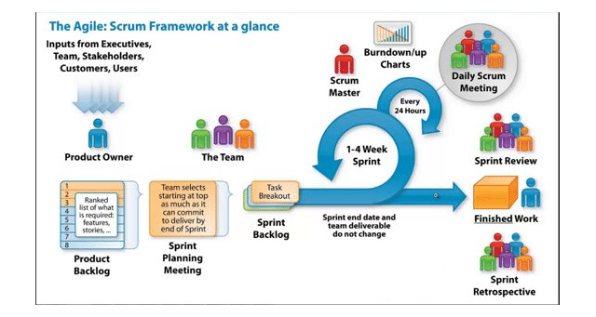
Scrum: leading agile development method for completing projects with a complex, innovative scope of work
Team
Cross-functional: Programmers, testers, user experience designers, etc.
Members should be full-time
Teams are self-organizing
Scrum Master
Responsible for enacting Scrum values and practices
Ensure that the team is fully functional and productive
Enable close cooperation across all roles and functions
Product Owner
Defines features and release plans
Prioritize features every iteration as needed
Accept or reject work results

Slide 80
Scrum: leading agile development method for completing projects with a complex, innovative scope of work
Daily scrum meeting
Daily review meeting for 10-15 mins
Status review and not for problem solving
All sprint team members participate
Sprint review
Demo of new features to customer/product owner
Team presents work accomplished during the sprint
All major stakeholders participate
Sprint retrospective
Periodic post mortem to review what’s working and what’s not
Done after every sprint
All major stakeholders participate

Slide 81
THE PROJECT MANAGEMENT PROCESS GROUPS
Chapter IV

Slide 82
project management as a number of related processes
Recall: project management consists of 10 knowledge areas:
integration, scope, time, cost, quality, human resources, communications, risk,
procurement, and stakeholder management
Decisions and actions taken in one knowledge area at a certain time usually affect other knowledge areas
you can view project management as a number of related processes.
Process: a series of actions directed toward a particular result

Slide 83
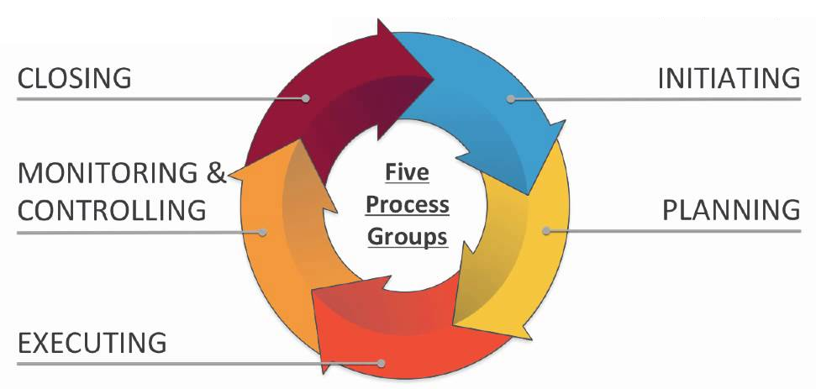
Project management process groups
Initiating processes include defining and authorizing a project or project
phase. Initiating processes take place during each phase of a project. For
example, in the close-out phase, initiating processes are used to ensure that
the project team completes all the work, that someone documents lessons
learned, and that the customer accepts the work
All projects and all project phases need to include all five process groups:
Planning processes include devising and maintaining a workable scheme to ensure that the project addresses the organization’s needs. Projects include
several plans, such as the scope management plan, schedule management plan, cost management plan, and procurement management plan. These
plans define each knowledge area as it relates to the project at a particular point in time.

Slide 84
Project management process groups
All projects and all project phases need to include all five process groups:
Closing processes include formalizing acceptance of the project or project
phase and ending it efficiently. Administrative activities are often involved in this process group, such as archiving project files, closing out contracts, documenting lessons learned, and receiving formal acceptance of the delivered
work as part of the phase or project A common monitoring and controlling process is reporting performance, where project stakeholders can identify any necessary changes that may be required to keep the project on track.
Monitoring and controlling processes include regularly measuring and monitoring
progress to ensure that the project team meets the project objectives.
The project manager and staff monitor and measure progress against the plans and take corrective action when necessary.
A common monitoring and controlling process is reporting performance, where project stakeholders can identify any necessary changes that may be required to keep the project on track.
Executing processes include coordinating people and other resources to carry out the various plans and create the products, services, or results of the project or phase. Examples of executing processes include acquiring and developing the project team, performing quality assurance, distributing information, managing stakeholder expectations, and conducting procurements

Slide 85
A Guide to the PMD Pro
Chapter V: Project Management for Development Professionals

Slide 86
PHASES IN THE LIFE OF A DEVELOPMENT PROJECT
Many development organizations have developed Project Life Cycle diagrams which they use to identify the phases through which their projects pass from beginning to end.
Together, these project life cycle phases identify the logical sequence of activities that accomplish the project’s goals or objectives
the PMD Pro subscribes to its own six-­step project phase model.
The PMD Pro’s Project Phase Model is not meant to replace any specific project life cycle model, nor is it intended to serve as a standard for the sector.
Instead, its purpose is to provide a balanced and comprehensive project phase model that covers the entire life of the project

Slide 87
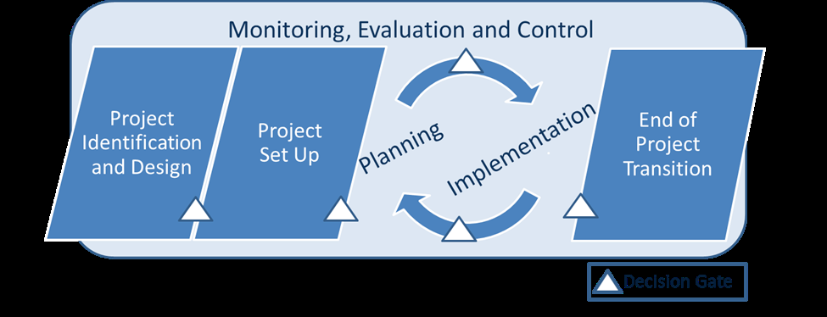
The PMD Pro Project Phase Model

Slide 88
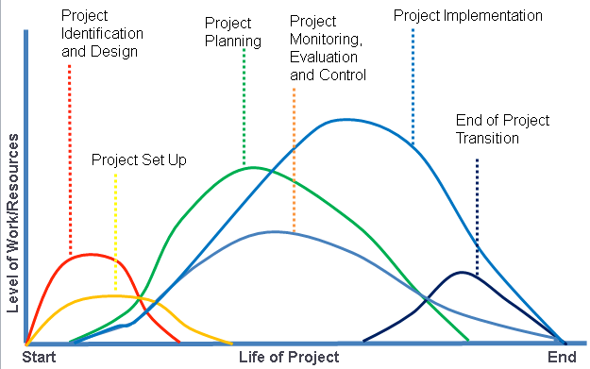
Project Phase Interactions

Slide 89
PROJECT IDENTIFICATION AND DESIGN
PHASE I

Slide 90
PHASE 1: PROJECT IDENTIFICATION AND DESIGN
In the development sector, the project life more commonly begins with a Project Identification and Design Phase.
During the Project Identification and Design Phase, time/resources/effort are invested to define needs, explore opportunities, analyze the project environment, cultivate relationships, build trust, develop partnerships and design alternatives for project design.
The decisions made during this phase connect to existing strategies and determine the overall framework within which the project will subsequently evolve.
it provides the most cost-­effective opportunity to answer fundamental questions about the project parameters
the easiest time to make changes to a project is at the beginning of its life.
If a project team wants to change the objectives, the calendar or the budget, it is easier to do this before the project is underway (spending money, using up the calendar and investing resources to complete its work).

Slide 91
PHASE 1: PROJECT IDENTIFICATION AND DESIGN
in general terms the work completed during this phase can be rolled up into three overarching categories:
1. Collecting data;
2. Analyzing data; and
3. Identifying the project intervention logic.

Slide 92
PHASE 1: PROJECT identification AND DESIGN
1-Collecting data

Slide 93
Are you doing the right project?
The first step in determining whether you are “doing the right project” is to collect data.
The purpose of this data collection is to broadly explore a wide number and variety of issues, providing information which, when analyzed, will inform priorities and identify interventions that will address the challenges in a target area.
As part of this broad exploration process, the project team will need to collect data that identifies community needs in the potential intervention area.
To fully understand the project context, the project team will need to collect data regarding a number of areas related to the project environment. What types of data the team must collect?

Slide 94
Identifying Project Needs
The need definition process in a single location can result in significantly different results depending on who is consulted and what approach is employed.
An approach to limit the subjectivity of problem definition and to work through differing perspectives of “real” needs is through the triangulation of assessment data.
By using three methods/perspectives to answer a question, the hope is that the results of at least two of the three will reinforce each other.
On the other hand, if three conflicting answers are produced, the investigator knows that the question needs to be reframed, methods reconsidered, or both
American sociologist, Jonathan Bradshaw, believed that needs assessments should explore four types of need in a community and that the presence of all types of needs would indicate a “real” need.

Slide 95
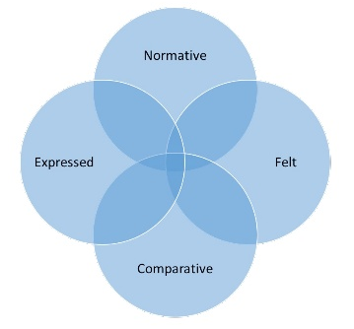
Bradshaw’s four categories of social need
Compare the current situation to a set of professional or expert standards. Often, these needs are identified by a professional or expert – physicians, engineers, public
health professionals
inferred by observation of the community’s actions. At times, the expressed needs are consistent with what the community
has expressed (their felt need)
focus on the thoughts and dreams of the community itself. What the people
themselves believe should be the priority. A felt need is likely to be subjective and could be
better described as a ‘want’
Compare the current situation with the situation of others. One of the most common uses of this approach has been the comparison of people’s access to resources

Slide 96
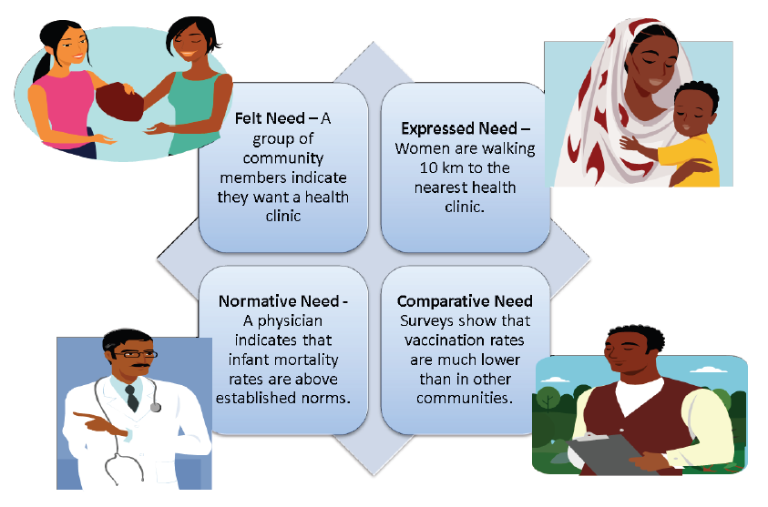
example

Slide 97
Types of Data
To fully understand the project context, the project team will need to collect data regarding a number of areas related to the project environment, including, but not limited to data related to:
• Project stakeholders
• Community strengths, opportunities and vision
• Successes and capacity
• Biological/physical environment
• Organizational networks
• Infrastructure
• Legal, policy and political institutions
• Social and cultural conditions
In each of these areas, there are three types of data that may be collected:
Secondary data
Primary quantitative data
Primary qualitative data

Slide 98
Secondary data
Information available through published and unpublished sources, including literature reviews, surveys, evaluations, assessments, reports from NGOs, UN agencies, international organizations and government offices.
Secondary data can be very cost effective and should be the first sources accessed for assessment data.
Unfortunately, access to secondary documents is often limited and care is needed when interpreting secondary data.
Sometimes selective primary data collection will be necessary to verify the reliability and relevance of secondary data to the specific context, or to obtain deeper, more specific information.

Slide 99
Primary quantitative data
In situations where secondary sources do not provide sufficient assessment information, organizations can collect data via quantitative assessment approaches (surveys, questionnaires, tests, standardized observation instruments) that focus on information that can be counted and subjected to statistical analysis.
The strengths of quantitative data collection methods include:
Scalability -­ Processing results from a great number of subjects and permit a generalization of results
Objectivity and accuracy of results -­ Less personal bias in the collection and interpretation of data;
Standardization – Data collectors use standard approaches whose results can be compared to other data.
The shortcomings of quantitative data are that this approach sometimes misses the depth of the situation and it can be difficult to collect essential contextual information.

Slide 100
Primary qualitative data
In contrast to quantitative data approaches, qualitative approaches seek to capture participants’ experiences using words, pictures and objects (and even non-­verbal cues provided by data providers).
The strengths of qualitative data collection include:
Depth and detail: Qualitative data often provides detailed descriptions of situations, providing the richness of context that is missing from quantitative data. If qualitative techniques are used alongside quantitative data collection, it can explain why a particular response was given;
Creates openness: encouraging people to expand on their responses can open up new topic areas not initially considered;
Simulates people's individual experiences: a detailed picture can be built up about why people act in certain ways and their feelings about these actions.
Qualitative data is most often collected as an open-­ended narrative, unlike the typical question and answer format of surveys, questionnaires or tests.

Slide 101
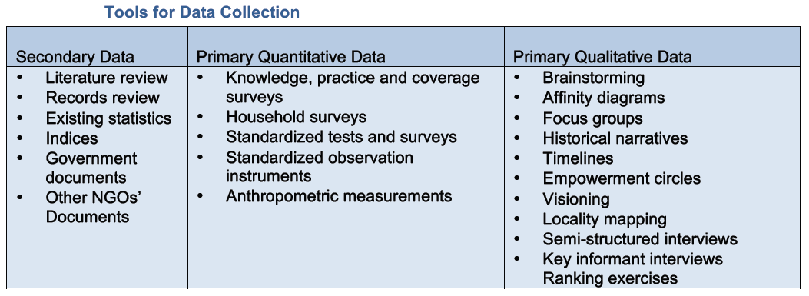

Slide 102
What is the most appropriate (and cost-­effective) tools and approaches to collect information?
Conventional wisdom sometimes indicates that some data collection approaches are better than others.
For example, primary data is often perceived as preferable to secondary data. However, in practice it is clear that there is a place for multiple data sources and mixed methods in almost every assessment process.
While primary data collection can be specifically targeted to the precise needs of a proposed project, collecting primary data can also take a lot of time and money and involve many people.
For this reason, many organizations recommend that the first round of assessment rely on secondary data, and that subsequent rounds use primary data collection approaches to fill in the gaps which are not covered by secondary data.
Qualitative data assessments, in turn, can be rigorous if planned and implemented with expertise, and can uncover revealing insights into the reasons behind the trends that are identified through secondary and quantitative approaches.
A combination of secondary and primary methods (including both qualitative and quantitative tools) in the same data collection process can provide a more comprehensive, integrated picture from which to make decisions. And, in the end, it is all about making decisions.

Slide 103
PHASE 1: PROJECT identification AND DESIGN
2-Analysing data

Slide 104
purpose of data analysis
While the purpose of data collection is to broadly explore a wide number and variety of issues, the purpose of data analysis is to order and organize the raw data so that useful information can be extracted from it.
More specifically, development projects tend to focus on two broad categories of analysis:
1. Current State Analysis.
2. Future State Analysis.

Slide 105
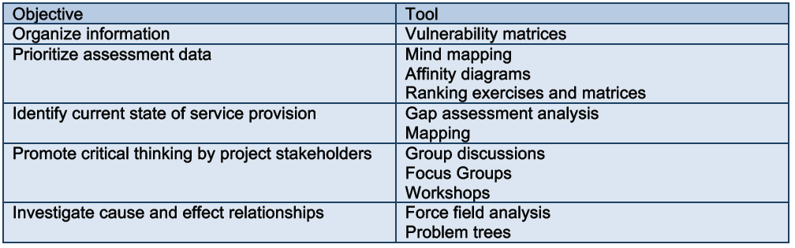
Current State Analysis
Current state analysis is the starting point for good project design. It is the process of understanding the status, condition, trends and key issues affecting people and people’s livelihoods, ecosystems or institutions in a given geographic context.
A variety of tools exist to conduct data analysis. Each is designed for a specific purpose and the project team should select their techniques/tools based on the intended objective of the analysis exercise.

Slide 106
Use of Current state analysis Tools
Each of the analysis tools in the previous slide is important and all of them can be used to process the information gathered through data collection process.
In practice, however, it is unlikely that a project team will use all of the analysis tools in each and every project it implements.
While it is not within the scope of the PMD Pro to examine all of the analysis techniques and tools in depth, project managers should feel comfortable:
Identifying the different tools that exist that can be used to accomplish the different objectives that are a part of problem analysis;
Choosing the best tool for each problem analysis objective;
Developing (over time) the skills and behaviors needed to use the different problem analysis tools with a variety of groups.

Slide 107
Future State Analysis
Once current state analysis is complete, the next step will be to analyze the future state of the project.
Future state analysis helps to develop a picture or description of where the project will lead:
What will be different in the future if this project is successful at meeting expectations?
What will project beneficiaries be able to do that you can’t do now?
What social change will be enabled?

Slide 108
Identifying the Project Intervention Logic
One of the principle tools used to establish the logic of development projects is the logical framework (logframe) matrix.
The logical framework is an analytical tool used to plan, monitor and evaluate projects.
Some organizations subscribe to a four-­level matrix, others have five.
while there are variations between logical framework models with regard to the terms they use and their structure, they are all intended to serve the same underlying objectives, serving as:
• A systematic tool for organizing the project thinking and identifying relationships between resources, activities, and project results;
• A visual way of presenting and sharing the project intervention logic;
• A tool to identify and assess risks inherent in the proposed project design;
• A tool for measuring progress through indicators and means of verification.

Slide 109
Interpreting the Logical Framework Matrix
The logical framework matrix identifies and communicates the logical relationships in a project by tracking the vertical and horizontal reasoning that connects the levels of the matrix
the PMD Pro subscribes to a four-­level logical framework model that includes the following deliverables:
1. Activities are actions taken through which inputs (financial, human, technical, material and
time resources) are mobilized to produce the deliverables (training, constructing, etc.) of a
project for which staff can be held accountable and which, when aggregated, produce
outputs.
2. Outputs are tangible deliverables resulting from project activities. They include products,
goods, services and changes (e.g. people trained with increased knowledge and skill;; quality
roads built) that aggregate and contribute to outcomes.
3. Outcomes are what the project expects to accomplish at the beneficiary level (e.g. use of
knowledge and skills in actual practice over time; transportation of goods on constructed
roads over time) and contribute to population-­level changes (reduced malnutrition, improved
incomes, improved yields, etc.) that aggregate and help bring about accomplishment of goals
and impact over time.
4. Goals are the highest level desired end results or impacts (transformation, sustainability,
livelihood, well-­being etc.) to which the project contributes (the ultimate objective in many
logical frameworks).

Slide 110
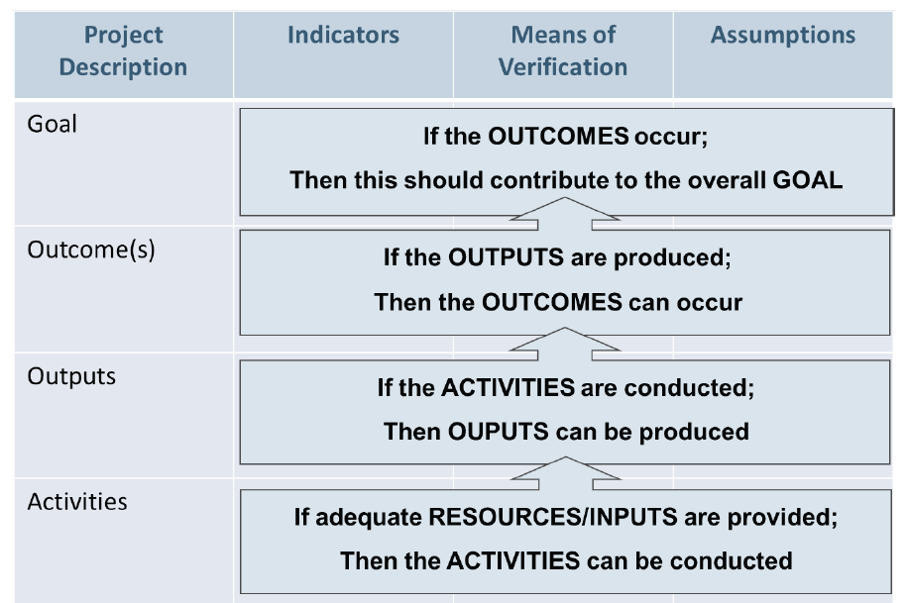
Vertical logic of logframe

Slide 111
Assumptions and external factors
At each level of the logical framework, there are external factors that may affect the success of the project. if children are getting diarrhea because of poor drinking water, they may eat more, but they will remain malnourished.
These important external factors should be noted under the Assumptions column. You may not be able to do anything about some of the risks (it is unlikely that a local NGO could stop a war from breaking out), but it is important to anticipate possible problems.
The list of risks and assumptions may also help to explain why a project did not achieve all of its objectives.

Slide 112
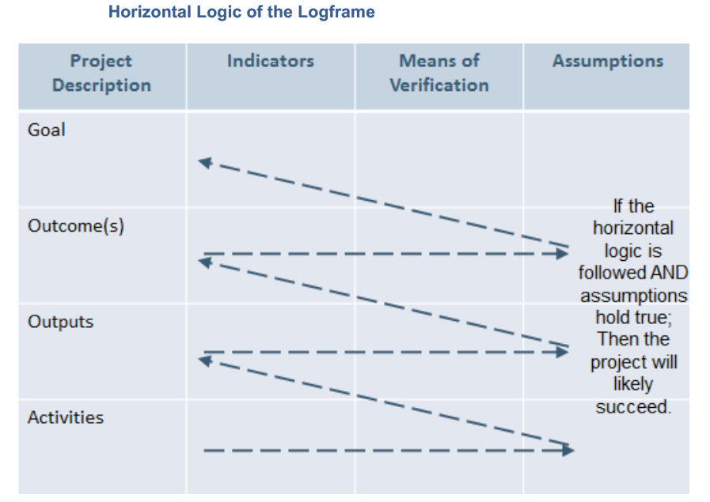
assumptions
The assumptions define the horizontal logic of the matrix, creating an ‘if-­then’ relationship that maintains that if the assumptions in each level of the framework hold true then the project’s vertical development pathway is likely to succeed

Slide 113
indicators
An indicator is a quantitative measure or qualitative observation used to describe change
For the indicator to measure change it must have a baseline (a measure or description of current performance of the entity and/or a comparator) as an initial reference point. Baselines must be defined at or near the beginning of a project.
When developing indicators, the norm is to use SMART criteria to guide performance indicator conceptualization.

Slide 114
SMART criteria
SMART is an acronym with the following meaning:
• Specific – Indicators must be quantifiable and measurable? What does the project intend to change? Do the indicators provide detailed parameters regarding:
o Quantity – the expected numerical representations of what is to be achieved;
o Quality – the narrative or pictorial description of the expected achievements;
o Location – the geographic boundary of the expected achievements.
• Measureable – The indicator must be quantifiable and measurable. Can the indicator be assessed objectively and independently?
• Achievable – Indicators must be attainable within the constraints of the project triangle (budget/resources, time/budget, and scope/quality).
• Relevant – Indicators must accurately measure the change the project aspires to generate. Does the indicator practical and cost-­effectively measure what the project team needs to know?
• Time-­bound – The indicator should identify a specific time and date. By when will the indicator be achieved? Can the indicator be achieved within the established timeframe?

Slide 115
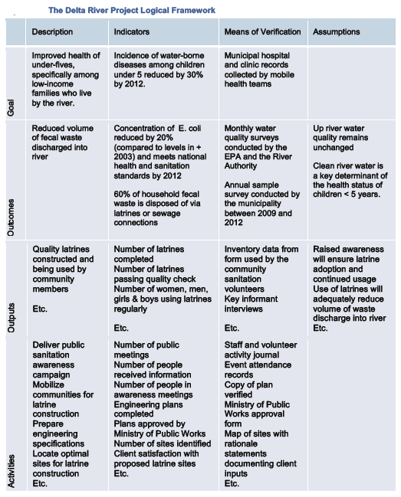

Slide 116
Project Decision Gates
By using decision gates, organizations identify a series of points in the project that require a decision to either proceed with the next phase of the project, modify the Scope, Schedule or Budget of the project or end the project outright.
Each successive decision gate builds on the work that was developed in the previous stage.
the number of decision gates in a project will vary according to the project, its complexity, and the key stakeholders.
For that reason, the Project Phase Model is intended to serve as an illustrative model of where decision gates might be placed

Slide 117
Project Decision Gates
Placing decision gates at regular intervals (for example, at the beginning of each year of the project’s implementation) helps to:
• Keep the project focused on the need that the project was originally undertaken to address;
• Ensure that the context and assumptions that initially led to the approval of the project still exist;
• Provide an opportunity for the project team and key stakeholders to decide whether to:
o Continue the project as it is presently conceived;
o Modify the project plan;
o Terminate a project (which is not necessarily a failure if the intervention is no longer appropriate, feasible, or necessary).

Slide 118
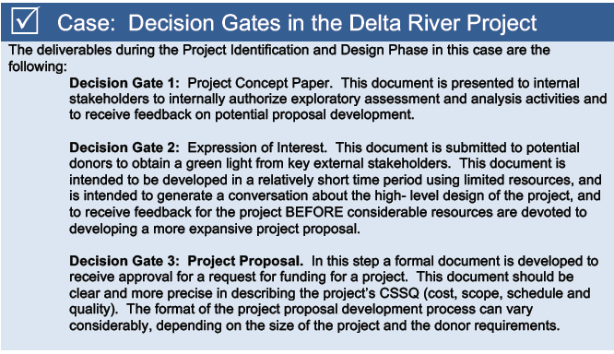

Slide 119
Project set up
Phase II

Slide 120
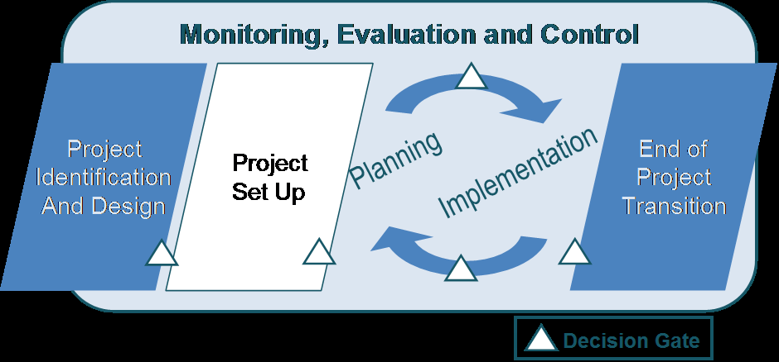

Slide 121
objectives
Every successful project begins with a thoroughly planned and implemented Set Up phase. The objectives of the Project Set Up Phase include:
1. Establishing the Project Governance Structure.
2. Officially authorizing the start of the project.
3. Communicating the project launch.

Slide 122
Establishing the Project Governance Structure
In the context of project management, governance defines the management framework within which project decisions are made. A robust governance structure clarifies:
Authority: Who has the power to make decisions and within what tolerance levels;
Accountability: Who is accountable for the success of the project? With no clear accountability for project success, there is no one moving agendas to resolve project issues.

Slide 123
Set up development project
Development projects are seldom simple.
The project team must manage agendas with multiple stakeholders, including (but not limited to) the project donor, the implementing organization(s), the beneficiary communities, and project suppliers.
In these complex contexts, a single project sponsor will not provide the support the project team requires to succeed. Instead, a more effective governance structure would be a project board which includes representatives from multiple stakeholders involved in the project.

Slide 124
Project board : size
There is no single, definitive norm for establishing project boards. However, the following guidance provides insights into how they can be structured and managed:
Size: There is no standard size for project boards. At minimum, there should be two people and it is common to find boards comprised of three, four or five representatives. Smaller group size facilitates efficient collaboration and decision-­making. However, it is often helpful to expand the size of the Board when stakeholder management is complex. For example, if there are multiple donors, multiple beneficiaries groups, or multiple organizations working on the same project

Slide 125
Project board : composition
Composition Board members should represent the following distinct knowledge/ management/ experience perspectives:
An Executive perspective -­ assessing whether the project is providing value as a whole, and providing the funding and resources necessary to obtain that value. There is only one representative with Executive Perspective on the Board.
A Senior User perspective -­ establishing that the project is meeting the needs of the people who will be directly working with the project's outputs. There can be more than one representative with Senior User Perspective on the Board. Another alternative would be to establish a “senior user group” for the project, which in turn identifies a single representative on the board to represent the opinions of all group members.
A Senior Supplier perspective -­ providing confidence that the project's outputs (from which value will be derived) can be achieved with available resources, and at the required level of quality. There can be more than one representative with Senior Supplier Perspective on the Board. Another alternative would be to establish a “senior supplier group” for the project, which in turn identifies a single representative on the board to represent the opinions of all group members.

Slide 126
Project board: responsibilities
Decide on proposed project changes (scope, budget, calendar or others) that extend beyond the project manager’s agreed tolerances;
Oversee the project, providing resources, direction and insight as necessary;
Monitor the ongoing viability of the project, making decisions to terminate the project if necessary;
Represent the interest of the perspective they represent;
Support and advise the Project Manager on the management of the project, especially on issues that extend beyond the span of control of a project manager; and
Advocate for necessary support and resources for the project.

Slide 127
Meetings
It is recommended that Project Boards conduct regularly scheduled meetings where the agenda is set by the Project Manager in cooperation with the Executive Perspective representative.
Important items on the agenda include the review of the Risks Log and Issue Log (to be discussed later).
In addition, a Project Board meeting is also necessary at all decision gates.

Slide 128
Officially Authorizing the Start of the Project
During the Project Set Up Phase it is important to ensure that the project is formally authorized by the project governing body
This approval should be documented through the development of a project charter: a document that provides a high-­level description of the project and which is signed by the project governing body.

Slide 129
Project charter
• Project Purpose – including a statement of the need the project will address.
• Project Deliverables – articulating the scope of the project, including the project goal, outcomes, and major outputs.
• High-­level Project Estimates – including a high-­level statement of:
o The project activities;
o The project schedule;
o The project budget; and
o A preliminary list of the roles and skills required to perform the necessary work.
• Project Risks – identifying potential problems/risks that the project might encounter.
• Project Tolerances – articulating project tolerances regarding project deliverables,
schedule, cost and risk.
• Project Change Control – establishing an exception handling process for when the
project exceeds a tolerance in any of these areas.
the project charter should be considered a living document. If the project governing body approves major changes to the project (scope, budget, calendar or otherwise), the project charter should be updated and signed to reflect the new project parameters.

Slide 130
Communicating the Project Launch
One of the principle objectives of the Project Set Up Phase is to communicate the launch of the project activities to the many stakeholders who have interests in the intervention.
These stakeholders might include the beneficiary communities, NGOs working in the intervention area, representatives of government ministries, the general public and many more.
There are multiple communications tools that can be used to announce the project launch to the community of stakeholders. However, regardless of the mechanism employed, the purpose of the project launch communications activities remains unchanged:
• To formally acknowledge the beginning of project;
• To ensure that key stakeholders have a consistent understanding of the project;
• To introduce stakeholders to the project.
In many ways, the signed project charter is an ideal document, in which to officially communicate the launch of the project to the broad project audience. Because of its brief, concise format.

Slide 131
Risk management
Risks are managed through a four-­step process:
• Risk identification -­ identifying and documenting all the risks that can affect the project.
• Risk assessment -­ determining the probability that risks will occur and estimating their potential impact, and prioritizing risks.
• Risk response planning -­ deciding what actions are needed to reduce or remove threats, particularly those with high-­probability and high-­impact.
• Risk monitoring and control -­ responding to risks as they occur and ensuring proper risk management procedures are being followed.

Slide 132
Risk identification
There are two steps within risk identification process:
1. Define project risk categories.
2. Identify specific risks that fit into each of the risk categories.

Slide 133
Risk categories
It isn't possible to develop a single set of risk categories that would fit all organizations and project.
Project teams must survey the context of their specific project develop a set of risk categories that is appropriate to their unique needs.

Slide 134
Some potential categories of project risk
Strategic/commercial
• Failure of suppliers to meet contractual commitments
• Fraud/theft
• Implementing Partners failing to deliver the desired outcome
Economic/financial/market
• Exchange rate fluctuation
• Interest rate instability
• Inflation
• Market developments adversely affect plans.
Legal and regulatory
• New or changed legislation invalidates project assumptions
• Failure to obtain appropriate approval (e.g. planning, consent)
• Unsatisfactory contractual arrangements
Organizational/management/human factors
• Poor leadership
• Inadequate authority of key personnel to fulfill roles
• Poor staff selection procedures
• Lack of clarity over roles and responsibilities
• Personality clashes
• Lack of operational support
Political
• Change of government or government policies
• War and disorder
• Adverse public opinion/media intervention
• Interference by politicians in development decisions
Environmental
• Natural disasters
• Sudden changes in weather patterns
Technical/operational/infrastructure
• Inadequate design
• Scope creep
• Unclear expectations
Project Management Risk
• Lack of planning, risk analysis, contingencies
• Inadequate tracking and control response
• Unrealistic schedules
• Poorly managed logistics
• Delays in the approval of project documents

Slide 135
Identify Specific Risks from the Categories
When identifying risks, care should be taken to write the risk in such a way that three factors are
apparent to a future reader. These are:
• The cause, or the origin of the risk;
• The risk event or situation itself;
• The impact of the risk on the project.
Example:
Because transport of materials into this area can be affected by flooding,
There is a risk that cement deliveries will not be made in a timely manner,
Which would mean that latrine bases would not be completed on schedule.
Many of the initial risks will be identified during the Project Identification and Design Phase.
The risk identification process, however, needs to continue through the entire life of the project

Slide 136
RISK ASSESSMENT
Risk assessment is the process of quantifying the risks documented in the risk identification stage.
Risk assessment addresses two especially difficult challenges when managing project risk:
• Prioritizing Risks: Using criteria agreed upon by the project team and key stakeholders, risks are ranked according to their probability and impact.
• Identifying Risk Tolerances: Next, the project team needs to work with key stakeholders to identify their risk tolerance levels to identify which risks are acceptable, and which fall outside of acceptable tolerance levels and need to be actively managed.

Slide 137
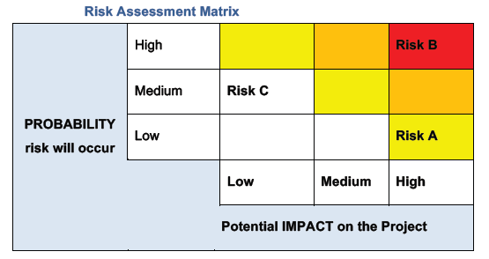
Risk Assessment Matrix
High risk
Serious risk
Medium risk
Low risk
A helpful tool for assessing risk is the Risk Assessment Matrix.

Slide 138
RISK RESPONSE
the goal of the risk management is to recognize when to respond if risk exceeds the project tolerance levels
Once a risk has been identified as being above the project risk tolerance line, the project team must identify a strategy to best respond to the risk.

Slide 139
RISK RESPONSE
If the project decides to actively manage a risk, response strategies include the following options (or a combination of options):
• Risk Avoidance – Do not do (or do in a different way) some portion of the scope that carries high-­impact and/or a high probability of risk. For example, a project might choose not to work in a geographic area because there is too much insecurity.
• Risk Transference – Shift (or share) the risk for some aspect of the project to (or with) another party. The most common example of risk transference is insurance. For example, insurance policies transfer the risk of vehicle damage and loss to the insurance company.
• Risk Reduction/Mitigation – Act to reduce the probability and/or impact of a potential risk. Take, for example, a project that is concerned about the risk of commodity theft.
o The probability of potential theft can be reduced by increasing the security systems for the building (guards, new doors, barred windows).
o The impact of potential theft can be reduced by instituting a policy whereby only the commodities required for the next seven days are safeguarded in the warehouse.
• Risk Acceptance – If the perceived probability and impact risk is assessed as reasonable, an organization can choose not to take action. For example, a project may acknowledge that it faces the possibility of a late rainy season onset interrupting its agricultural cycle, but the team chooses to live with the risk, and does not act to avoid, transfer, or mitigate it.

Slide 140
Risk management document
The risk management document will need to accomplish the following:
• Develop an organized and comprehensive risk management plan (should be documented);
• Determine the methods to be used to implement the risk responses;
• Plan for adequate resources for risk response.

Slide 141
Risk management document
The risk management document will need to accomplish the following:
• Develop an organized and comprehensive risk management plan (should be documented);
• Determine the methods to be used to implement the risk responses;
• Plan for adequate resources for risk response.

Slide 142
Project with minimal uncertainties
A red flag item list is created at the earliest stages of the project design and is maintained as a checklist through the life of the project.
By listing the items that can potentially impact a project’s cost, schedule, scope and quality (or other factors which the stakeholders have agreed are of specific priority), and by keeping the list current, the project team has a better perspective for setting proper contingencies and controlling risk.

Slide 143
Projects with more uncertainties
A risk register document provides a more formal and more detailed identification of risks and the plan for addressing them.
Similar to a red flag list, the project register provides project managers with a list of significant risks.
However, the risk register also contains information about the magnitude of probability and impact of risk occurrence. It may also include proposed mitigation responses, “owners” of the risk, and current status of the risk.
The risk register can also include information about the cost and schedule impacts of these risks.
The format of the risk register can vary by organization or by the project.

Slide 144
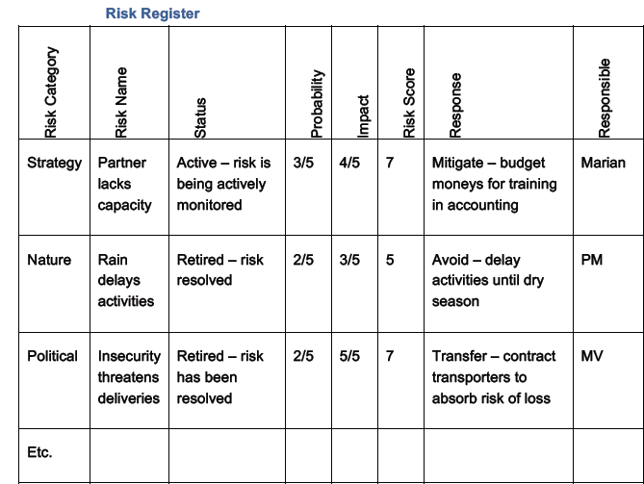
Example of risk register

Slide 145
RISK MONITORING AND CONTROL
The final step in the risk management process is to continually monitor risks to identify any change in their status, or if they turn into an issue. It is best to hold regular risk reviews to identify actions outstanding, risk probability and impact, remove risks that have passed, and identify new risks.
It is recommended that the risk register be established as early in the life of the project as possible.
Then, the risk register should be maintained throughout the remainder of the project, because risks are dynamic.
The list of risks and associated risk management strategies will likely change as the project matures and new risks develop or anticipated risks disappear.
Regularly scheduled project risk reviews can be used to ensure that project risk is an agenda item at all project management meetings.
If unanticipated risks emerge or a risk's impact is greater than expected, the planned response or risk allocation may not be adequate. At this point, the project team must perform additional response planning to control the risk.

