Slide 1
Chapter 1- Introduction
Lecture 1

Slide 2

Software engineering
The economies of ALL developed nations are dependent on software.
More and more systems are software controlled.
Software engineering is concerned with theories, methods and tools for professional software development.
Notes:
Gross national product (GNP) is the market value of all the products and services produced in one year by labor and property supplied by the citizens of a country.

Slide 3
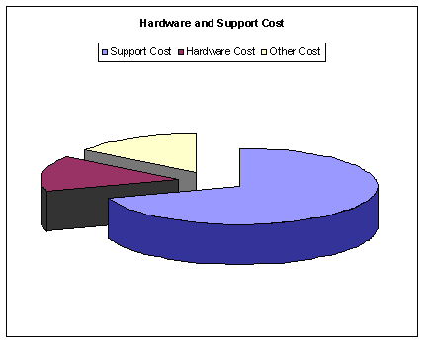
Software costs
Software costs often dominate computer system costs.
The costs of software on a PC are often greater than the hardware cost.
Software costs more to maintain than it does to develop.
For systems with a long life, maintenance costs may be several times development costs.

Slide 4

Software products
Generic products
Stand-alone systems that are marketed and sold to any customer who wishes to buy them.
Examples – PC software such as graphics programs, project management tools.
Customized products
Software that is commissioned by a specific customer to meet their own needs.
Examples – embedded control systems, air traffic control software, traffic monitoring systems.
Notes:
CAD technology is used in the design of tools and machinery and in the drafting and design of all types of buildings, from small residential types (houses)

Slide 5
Product specification
Generic products
The specification of what the software should do is owned by the software developer and decisions on software change are made by the developer.
Customized products
The specification of what the software should do is owned by the customer for the software and they make decisions on software changes that are required.

Slide 6
Frequently asked questions about software engineering
Question | Answer
What is software? | Computer programs and associated documentation. Software products may be developed for a particular customer or may be developed for a general market.
What are the attributes of good software? | Good software should deliver the required functionality and performance to the user and should be maintainable, dependable and usable.
What is software engineering? | Software engineering is an engineering discipline that is concerned with all aspects of software production.
What are the fundamental software engineering activities? | Software specification, software development, software validation and software evolution.
What is the difference between software engineering and computer science? | Computer science focuses on theory and fundamentals; software engineering is concerned with the practicalities of developing and delivering useful software.
What is the difference between software engineering and system engineering? | System engineering is concerned with all aspects of computer-based systems development including hardware, software and process engineering. Software engineering is part of this more general process.

Slide 7
Frequently asked questions about software engineering
Question | Answer
What are the key challenges facing software engineering? | Coping with increasing diversity, demands for reduced delivery times and developing trustworthy software.
What are the costs of software engineering? | Roughly 60% of software costs are development costs, 40% are testing costs. For custom software, evolution costs often exceed development costs.

Slide 8
Essential attributes of good software
Product characteristic | Description
Maintainability | Software should be written in such a way so that it can evolve to meet the changing needs of customers. This is a critical attribute because software change is an inevitable requirement of a changing business environment.
Dependability and security | Software dependability includes a range of characteristics including reliability, security and safety. Dependable software should not cause physical or economic damage in the event of system failure. Malicious users should not be able to access or damage the system.
Efficiency | Software should not make wasteful use of system resources such as memory and processor cycles. Efficiency therefore includes responsiveness, processing time, memory utilisation, etc.
Acceptability | Software must be acceptable to the type of users for which it is designed. This means that it must be understandable, usable and compatible with other systems that they use.

Slide 9
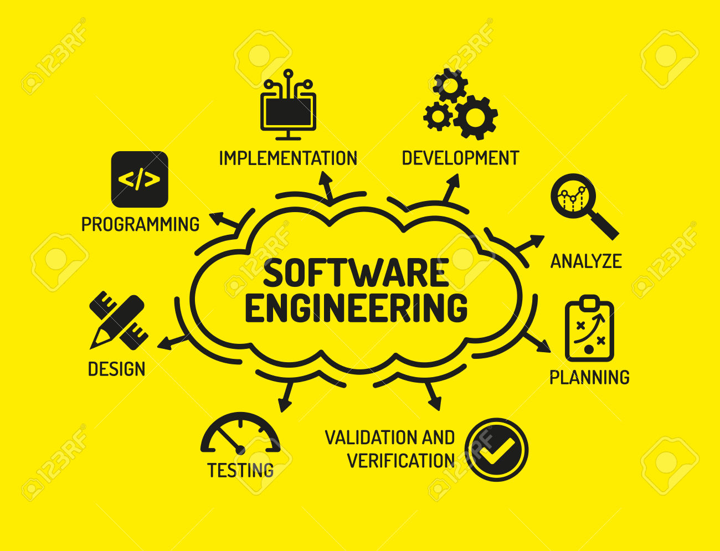
Software engineering
Software engineering is an engineering discipline that is concerned with all aspects of software production.
from the early stages of system specification through to maintaining the system after it has gone into use.
Notes:
Engineering discipline
Using appropriate theories and methods to solve problems bearing in mind organizational and financial constraints.
All aspects of software production
Not just technical process of development. Also project management and the development of tools, methods etc. to support software production

Slide 10
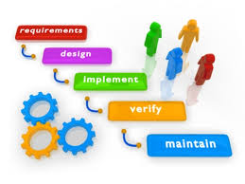
Software process activities
Software specification, where customers and engineers define the software that is to be produced and the constraints on its operation.
Software development, where the software is designed and programmed.
Software validation, where the software is checked to ensure that it is what the customer requires.
Software evolution, where the software is modified to reflect changing customer and market requirements.
Notes:
Life Cycle Model

Slide 11
General issues that affect most software
Heterogeneity
Increasingly, systems are required to operate as distributed systems across networks that include different types of computer and mobile devices.
Business and social change
Business and society are changing incredibly quickly as emerging economies develop and new technologies become available. They need to be able to change their existing software and to rapidly develop new software.
Security and trust
As software is intertwined with all aspects of our lives, it is essential that we can trust that software.

Slide 12
Application types
Stand-alone applications
These are application systems that run on a local computer, such as a PC. They include all necessary functionality and do not need to be connected to a network.
Interactive transaction-based applications
Applications that execute on a remote computer and are accessed by users from their own PCs or terminals. These include web applications such as e-commerce applications.
Embedded control systems
These are software control systems that control and manage hardware devices. Numerically, there are probably more embedded systems than any other type of system.

Slide 13
Application types
Batch processing systems
These are business systems that are designed to process data in large batches. They process large numbers of individual inputs to create corresponding outputs.
Entertainment systems
These are systems that are primarily for personal use and which are intended to entertain the user (games).
Systems for modelling and simulation
These are systems that are developed by scientists and engineers to model physical processes or situations, which include many, separate, interacting objects.
Notes:
Btach processing systems: salary billing systems
Batch: Collection
Entertain: amuse

Slide 14
Application types
Data collection systems
These are systems that collect data from their environment using a set of sensors and send that data to other systems for processing.
Systems of systems
These are systems that are composed of a number of other software systems.

Slide 15
Software engineering fundamentals
Some fundamental principles apply to all types of software system:
Systems should be developed using a managed and understood development process.
Dependability and performance are important for all types of system.
Understanding and managing the software specification and requirements (what the software should do) are important.
Where appropriate, you should reuse software that has already been developed rather than write new software.

Slide 16
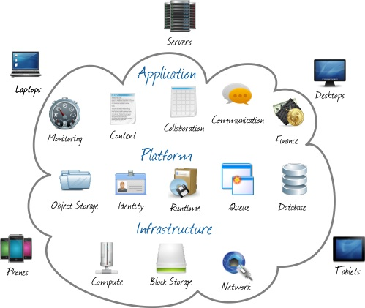
Software engineering and the web
The Web is now a platform for running application and organizations are increasingly developing web-based systems rather than local systems.
Cloud computing is an approach to the provision of computer services where applications run remotely on the ‘cloud’.
Notes:
Users do not buy software but pay according to how much the software is used.

Slide 17
Web software engineering
Software reuse is the dominant approach for constructing web-based systems.
When building these systems, you think about how you can assemble them from pre-existing software components and systems.
Web-based systems should be developed and delivered incrementally.
User interfaces are constrained by the capabilities of web browsers.
Technologies such as AJAX allow rich interfaces to be created within a web browser but are still difficult to use. Web forms with local scripting are more commonly used.

Slide 18
Key points
Software engineering is an engineering discipline that is concerned with all aspects of software production.
Essential software product attributes are maintainability, dependability and security, efficiency and acceptability.
The high-level activities of specification, development, validation and evolution are part of all software processes.
The fundamental notions of software engineering are universally applicable to all types of system development.

Slide 19
Key points
There are many different types of system and each requires appropriate software engineering tools and techniques for their development.
The fundamental ideas of software engineering are applicable to all types of software system.

Slide 20
Software engineering ethics (Self-Reading)
Software engineering involves wider responsibilities than simply the application of technical skills.
Software engineers must behave in an honest and ethically responsible way if they are to be respected as professionals.
Ethical behaviour is more than simply upholding the law but involves following a set of principles that are morally correct.

Slide 21
Issues of professional responsibility (Self-Reading)
Confidentiality
Engineers should normally respect the confidentiality of their employers or clients irrespective of whether or not a formal confidentiality agreement has been signed.
Competence
Engineers should not misrepresent their level of competence. They should not knowingly accept work which is outside their competence.

Slide 22
Issues of professional responsibility (Self-Reading)
Intellectual property rights
Engineers should be aware of local laws governing the use of intellectual property such as patents, copyright, etc. They should be careful to ensure that the intellectual property of employers and clients is protected.
Computer misuse
Software engineers should not use their technical skills to misuse other people’s computers. Computer misuse ranges from relatively trivial (game playing on an employer’s machine, say) to extremely serious (dissemination of viruses).

Slide 23
ACM/IEEE Code of Ethics (Self-Reading)
The professional societies in the US have cooperated to produce a code of ethical practice.
Members of these organisations sign up to the code of practice when they join.
The Code contains eight Principles related to the behaviour of and decisions made by professional software engineers, including practitioners, educators, managers, supervisors and policy makers, as well as trainees and students of the profession.

Slide 24
Rationale for the code of ethics (Self-Reading)
Computers have a central and growing role in commerce, industry, government, medicine, education, entertainment and society at large. Software engineers are those who contribute by direct participation or by teaching, to the analysis, specification, design, development, certification, maintenance and testing of software systems.
Because of their roles in developing software systems, software engineers have significant opportunities to do good or cause harm, to enable others to do good or cause harm, or to influence others to do good or cause harm. To ensure, as much as possible, that their efforts will be used for good, software engineers must commit themselves to making software engineering a beneficial and respected profession.

Slide 25
The ACM/IEEE Code of Ethics (Self-Reading)
Software Engineering Code of Ethics and Professional Practice
ACM/IEEE-CS Joint Task Force on Software Engineering Ethics and Professional Practices
PREAMBLE
The short version of the code summarizes aspirations at a high level of the abstraction; the clauses that are included in the full version give examples and details of how these aspirations change the way we act as software engineering professionals. Without the aspirations, the details can become legalistic and tedious; without the details, the aspirations can become high sounding but empty; together, the aspirations and the details form a cohesive code.
Software engineers shall commit themselves to making the analysis, specification, design, development, testing and maintenance of software a beneficial and respected profession. In accordance with their commitment to the health, safety and welfare of the public, software engineers shall adhere to the following Eight Principles:

Slide 26
Ethical principles (Self-Reading)
1. PUBLIC - Software engineers shall act consistently with the public interest.
2. CLIENT AND EMPLOYER - Software engineers shall act in a manner that is in the best interests of their client and employer consistent with the public interest.
3. PRODUCT - Software engineers shall ensure that their products and related modifications meet the highest professional standards possible.
4. JUDGMENT - Software engineers shall maintain integrity and independence in their professional judgment.
5. MANAGEMENT - Software engineering managers and leaders shall subscribe to and promote an ethical approach to the management of software development and maintenance.
6. PROFESSION - Software engineers shall advance the integrity and reputation of the profession consistent with the public interest.
7. COLLEAGUES - Software engineers shall be fair to and supportive of their colleagues.
8. SELF - Software engineers shall participate in lifelong learning regarding the practice of their profession and shall promote an ethical approach to the practice of the profession.

Slide 27
Ethical dilemmas (Self-Reading)
Disagreement in principle with the policies of senior management.
Your employer acts in an unethical way and releases a safety-critical system without finishing the testing of the system.
Participation in the development of military weapons systems or nuclear systems.

