Slide 1
Chapter 4 – Requirements Engineering

Slide 2
Topics covered
Functional and non-functional requirements
The software requirements document
Requirements specification
Requirements engineering processes
Requirements elicitation and analysis
Requirements validation
Requirements management

Slide 3
Requirements engineering
The process of establishing
the services that the customer requires from a system
the constraints under which it operates and is developed.
The requirements themselves are the descriptions of the system services and constraints that are generated during the requirements engineering process.

Slide 4
Requirements abstraction (Davis)
If a company wishes to let a contract for a large software development project
it must define its needs in a sufficiently abstract way that a solution is not pre-defined.
The requirements must be written so that several contractors can bid for the contract.
Once a contract has been awarded, the contractor must write a system definition for the client in more detail so that the client understands and can validate what the software will do.
Both of these documents may be called the requirements document for the system.

Slide 5
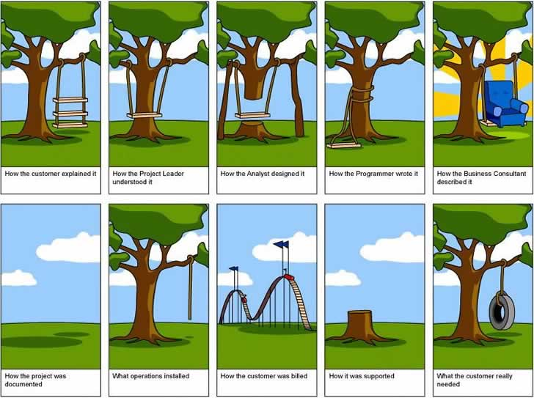
From spec…to delivery ??

Slide 6
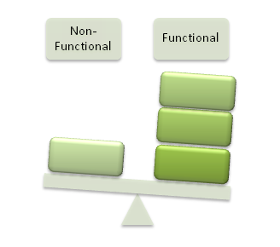
Functional and non-functional requirements
Functional requirements
Statements of services the system should provide, how the system should react to particular inputs and how the system should behave in particular situations.
May state what the system should not do.
Non-functional requirements
Constraints on the services or functions offered by the system such as timing constraints, constraints on the development process, standards, etc.
Often apply to the system as a whole rather than individual features or services.

Slide 7
Functional requirements
Describe functionality or system services.
Depend on the type of software, expected users and the type of system where the software is used.
Functional user requirements may be high-level statements of what the system should do.
Functional system requirements should describe the system services in detail.

Slide 8
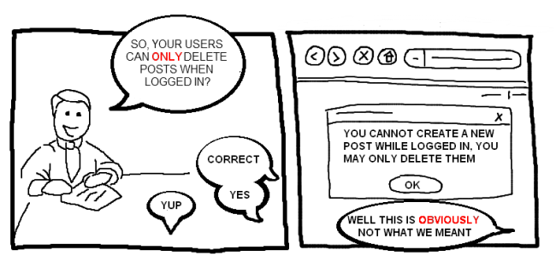
Requirements imprecision
Problems arise when requirements are not precisely stated.
Ambiguous requirements may be interpreted in different ways by developers and users.

Slide 9
Requirements completeness and consistency
In principle, requirements should be both complete and consistent.
Complete
They should include descriptions of all facilities required.
Consistent
There should be no conflicts or contradictions in the descriptions of the system facilities.
In practice, it is impossible to produce a complete and consistent requirements document for large, complex systems.
Notes:
In practice, for large, complex systems, it is practically impossible to achieve requirements consistency and completeness.
One reason for this is that it is easy to make mistakes and omissions when writing specifications for complex systems. Another reason is that there are many stakeholders in a large system. A stakeholder is a person or role that is affected by the system in some way. Stakeholders have different— and often inconsistent—needs.
These inconsistencies may not be obvious when the requirements are first specified, so inconsistent requirements are included in the specification. The problems may only emerge after deeper analysis or after the system has been delivered to the customer.

Slide 10
Non-functional requirements
These define system properties and constraints
reliability, response time and storage requirements
I/O device capability, system representations, etc.
Non-functional requirements may be more critical than functional requirements. If these are not met, the system may be useless.

Slide 11
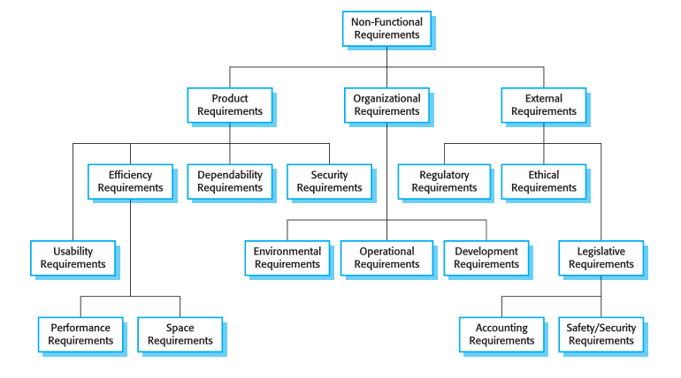
Types of non functional requirement

Slide 12
Non-functional classifications
Product requirements
Requirements which specify that the delivered product must behave in a particular way e.g. execution speed, reliability, etc.
Organisational requirements
Requirements which are a consequence of organisational policies and procedures e.g. process standards used, implementation requirements, etc.
External requirements
Requirements which arise from factors which are external to the system and its development process e.g. interoperability requirements, legislative requirements, etc.

Slide 13
Non-functional requirements implementation
Non-functional requirements may affect the overall architecture of a system rather than the individual components.
For example, to ensure that performance requirements are met, you may have to organize the system to minimize communications between components.
A single non-functional requirement, such as a security requirement, may generate a number of related functional requirements that define system services that are required.
It may also generate requirements that restrict existing requirements.

Slide 14
Goals and requirements
Non-functional requirements may be very difficult to state precisely
imprecise requirements may be difficult to verify.
Goal
A general intention of the user such as ease of use.
Verifiable non-functional requirement
A statement using some measure that can be objectively tested.
Goals are not helpful to developers as they leave scope for interpretation.
Notes:
For example, the following system goal is typical of how a manager might express usability requirements: The system should be easy to use by medical staff and should be organized in such a way that user errors are minimized. I have rewritten this to show how the goal could be expressed as a ‘testable’ non- functional requirement. It is impossible to objectively verify the system goal, but in the description below you can at least include software instrumentation to count the errors made by users when they are testing the system. Medical staff shall be able to use all the system functions after four hours of training. After this training, the average number of errors made by experienced users shall not exceed two per hour of system use. Whenever possible, you should write non-functional requirements quantitatively so that they can be objectively tested. rors each hour

Slide 15
Usability requirements - Example
The system should be easy to use by medical staff and should be organized in such a way that user errors are minimized. (Goal)
Medical staff shall be able to use all the system functions after four hours of training. After this training, the average number of errors made by experienced users shall not exceed two per hour of system use. (Testable non-functional requirement)

Slide 16
Metrics for specifying non functional requirements
Property | Measure
Speed | Processed transactions/second User/event response time Screen refresh time
Size | Mbytes Number of ROM chips
Ease of use | Training time Number of help frames
Reliability | Probability of unavailability Rate of failure occurrence Availability
Robustness | Time to restart after failure Percentage of events causing failure Probability of data corruption on failure
Portability | Number of target systems

Slide 17

The software requirements document
The software requirements document is the official statement of what is required of the system developers.
Should include both a definition of user requirements and a specification of the system requirements.
It is NOT a design document. As far as possible, it should set of WHAT the system should do rather than HOW it should do it.

Slide 18
Agile methods and requirements
Many agile methods argue that producing a requirements document is a waste of time as requirements change so quickly.
The document is therefore always out of date.
This is practical for business systems but problematic for systems that require a lot of pre-delivery analysis (e.g. critical systems) or systems developed by several teams.

Slide 19
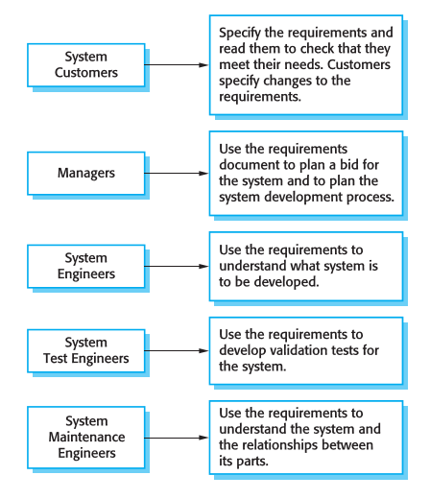
Users of a requirements document

Slide 20
Requirements document variability (Self Reading)
Information in requirements document depends on type of system and the approach to development used.
Systems developed incrementally will, typically, have less detail in the requirements document.
Requirements documents standards have been designed e.g. IEEE standard. These are mostly applicable to the requirements for large systems engineering projects.

Slide 21
The structure of a requirements document (Self Reading)
Chapter | Description
Preface | This should define the expected readership of the document and describe its version history, including a rationale for the creation of a new version and a summary of the changes made in each version.
Introduction | This should describe the need for the system. It should briefly describe the system’s functions and explain how it will work with other systems. It should also describe how the system fits into the overall business or strategic objectives of the organization commissioning the software.
Glossary | This should define the technical terms used in the document. You should not make assumptions about the experience or expertise of the reader.
User requirements definition | Here, you describe the services provided for the user. The nonfunctional system requirements should also be described in this section. This description may use natural language, diagrams, or other notations that are understandable to customers. Product and process standards that must be followed should be specified.
System architecture | This chapter should present a high-level overview of the anticipated system architecture, showing the distribution of functions across system modules. Architectural components that are reused should be highlighted.

Slide 22
The structure of a requirements document (Self Reading)
Chapter | Description
System requirements specification | This should describe the functional and nonfunctional requirements in more detail. If necessary, further detail may also be added to the nonfunctional requirements. Interfaces to other systems may be defined.
System models | This might include graphical system models showing the relationships between the system components and the system and its environment. Examples of possible models are object models, data-flow models, or semantic data models.
System evolution | This should describe the fundamental assumptions on which the system is based, and any anticipated changes due to hardware evolution, changing user needs, and so on. This section is useful for system designers as it may help them avoid design decisions that would constrain likely future changes to the system.
Appendices | These should provide detailed, specific information that is related to the application being developed; for example, hardware and database descriptions. Hardware requirements define the minimal and optimal configurations for the system. Database requirements define the logical organization of the data used by the system and the relationships between data.
Index | Several indexes to the document may be included. As well as a normal alphabetic index, there may be an index of diagrams, an index of functions, and so on.

Slide 23
Requirements specification
The process of writing the user and system requirements in a requirements document.
User requirements have to be understandable by end-users and customers who do not have a technical background.
System requirements are more detailed requirements and may include more technical information.
The requirements may be part of a contract for the system development
It is therefore important that these are as complete as possible.

Slide 24
Guidelines for writing requirements
Invent a standard format and use it for all requirements.
Use language in a consistent way. Use shall for mandatory requirements, should for desirable requirements.
Use text highlighting to identify key parts of the requirement.
Avoid the use of computer jargon.
Include an explanation of why a requirement is necessary.

Slide 25
Requirements engineering processes
The processes used for RE vary widely depending on the application domain, the people involved and the organisation developing the requirements.
However, there are a number of generic activities common to all processes
Requirements elicitation;
Requirements analysis;
Requirements validation;
Requirements management.
In practice, RE is an iterative activity in which these processes are interleaved.

Slide 26
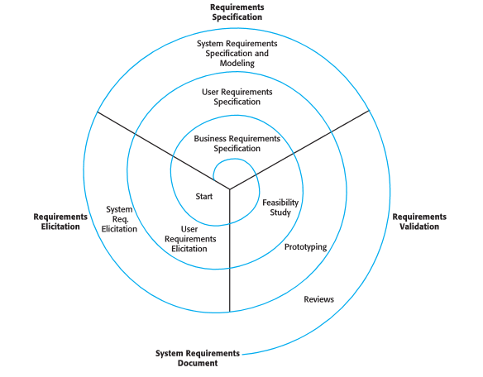
A spiral view of the requirements engineering process

Slide 27
Requirements elicitation and analysis
Sometimes called requirements elicitation or requirements discovery.
Involves technical staff working with customers to find out about
the application domain, the services that the system should provide and the system’s operational constraints.
May involve end-users, managers, engineers involved in maintenance, domain experts, trade unions, etc. These are called stakeholders.

Slide 28
Problems of requirements elicitation and analysis
Stakeholders don’t know what they really want.
Stakeholders express requirements in their own terms.
Different stakeholders may have conflicting requirements.
Organisational and political factors may influence the system requirements.
The requirements change during the analysis process.
New stakeholders may emerge and the business environment may change.

Slide 29
Interviewing
Formal or informal interviews with stakeholders are part of most RE processes.
Types of interview
Closed interviews based on pre-determined list of questions
Open interviews where various issues are explored with stakeholders.
Effective interviewing
Be open-minded, avoid pre-conceived ideas about the requirements and are willing to listen to stakeholders.
Prompt the interviewee to get discussions going using a requirements proposal or by working together on a prototype system.

Slide 30
Interviews in practice
Normally a mix of closed and open-ended interviewing.
Interviews are good for getting an overall understanding of what stakeholders do and how they might interact with the system.

Slide 31
Scenarios
Scenarios are real-life examples of how a system can be used.
They should include
A description of the starting situation;
A description of the normal flow of events;
A description of what can go wrong;
Information about other concurrent activities;
A description of the state when the scenario finishes.

Slide 32
Requirements validation
Concerned with demonstrating that the requirements define the system that the customer really wants.
Requirements error costs are high so validation is very important
Fixing a requirements error after delivery may cost up to 100 times the cost of fixing an implementation error.

Slide 33
Requirements checking
Validity. Does the system provide the functions which best support the customer’s needs?
Consistency. Are there any requirements conflicts?
Completeness. Are all functions required by the customer included?
Realism. Can the requirements be implemented given available budget and technology
Verifiability. Can the requirements be checked?

Slide 34
Requirements validation techniques
Requirements reviews
Systematic manual analysis of the requirements.
Prototyping
Using an executable model of the system to check requirements.
Test-case generation
Developing tests for requirements to check testability.

Slide 35
Requirements reviews (Self Reading)
Regular reviews should be held while the requirements definition is being formulated.
Both client and contractor staff should be involved in reviews.
Reviews may be formal (with completed documents) or informal. Good communications between developers, customers and users can resolve problems at an early stage.

Slide 36
Requirements management
Requirements management is the process of managing changing requirements during the requirements engineering process and system development.
You need to keep track of individual requirements and maintain links between dependent requirements so that you can assess the impact of requirements changes.

Slide 37
Changing requirements
The business and technical environment of the system always changes after installation.
New hardware may be introduced, it may be necessary to interface the system with other systems, business priorities may change (with consequent changes in the system support required), and new regulations may be introduced that the system must necessarily abide by.
The people who pay for a system and the users of that system are rarely the same people.
System customers impose requirements because of organizational and budgetary constraints. These may conflict with end-user requirements and, after delivery, new features may have to be added for user support if the system is to meet its goals.

Slide 38
Key points
Requirements for a software system set out what the system should do and define constraints on its operation and implementation.
Functional requirements are statements of the services that the system must provide or are descriptions of how some computations must be carried out.
Non-functional requirements often constrain the system being developed and the development process being used.
They often relate to the emergent properties of the system and therefore apply to the system as a whole.

Slide 39
Key points
The software requirements document is an agreed statement of the system requirements. It should be organized so that both system customers and software developers can use it.
The requirements engineering process is an iterative process including requirements elicitation, specification and validation.
Requirements elicitation and analysis is an iterative process that can be represented as a spiral of activities – requirements discovery, requirements classification and organization, requirements negotiation and requirements documentation.

Slide 40
Key points
You can use a range of techniques for requirements elicitation including interviews, scenarios, use-cases and ethnography.
Requirements validation is the process of checking the requirements for validity, consistency, completeness, realism and verifiability.
Business, organizational and technical changes inevitably lead to changes to the requirements for a software system. Requirements management is the process of managing and controlling these changes.

