Slide 1
Object-Oriented Software Engineering
Practical Software Development using UML and Java
Modelling with Classes

Slide 2
What is UML?
The Unified Modelling Language is a standard graphical language for modelling object oriented software
  At the end of the 1980s and the beginning of 1990s, the first object-oriented development processes appeared
  The proliferation of methods and notations tended to cause considerable confusion
  Two important methodologists Rumbaugh and Booch decided to merge their approaches in 1994.
    They worked together at the Rational Software Corporation
  In 1995, another methodologist, Jacobson, joined the team
    His work focused on use cases
  In 1997 the Object Management Group (OMG) started the process of UML standardization

Slide 3
UML diagrams
  Class diagrams
    describe classes and their relationships
  Interaction diagrams
    show the behaviour of systems in terms of how objects interact with each other
  State diagrams and activity diagrams
    show how systems behave internally
  Component and deployment diagrams
    show how the various components of systems are arranged logically and physically

Slide 4
UML features
  It has detailed semantics
  It has extension mechanisms
  It has an associated textual language
    Object Constraint Language (OCL)
The objective of UML is to assist in software development
    It is not a methodology

Slide 5
What constitutes a good model?
A model should
  use a standard notation
  be understandable by clients and users
  lead software engineers to have insights about the system
  provide abstraction
Models are used:
  to help create designs
  to permit analysis and review of those designs.
  as the core documentation describing the system.

Slide 6
Essentials of UML Class Diagrams
The main symbols shown on class diagrams are:
  Classes
      represent the types of data themselves
  Associations
      represent linkages between instances of classes
  Attributes
      are simple data found in classes and their instances
  Operations
      represent the functions performed by the classes and their instances
  Generalizations
      group classes into inheritance hierarchies

Slide 7
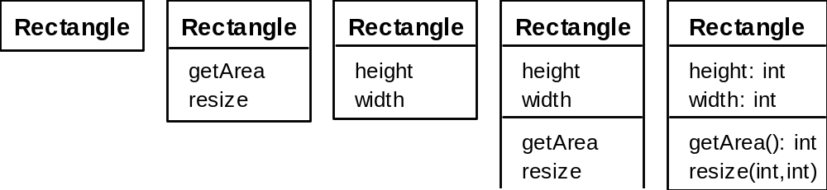
Classes
A class is simply represented as a box with the name of the class inside
  The diagram may also show the attributes and operations
  The complete signature of an operation is:
    operationName(parameterName: parameterType …): returnType

Slide 8
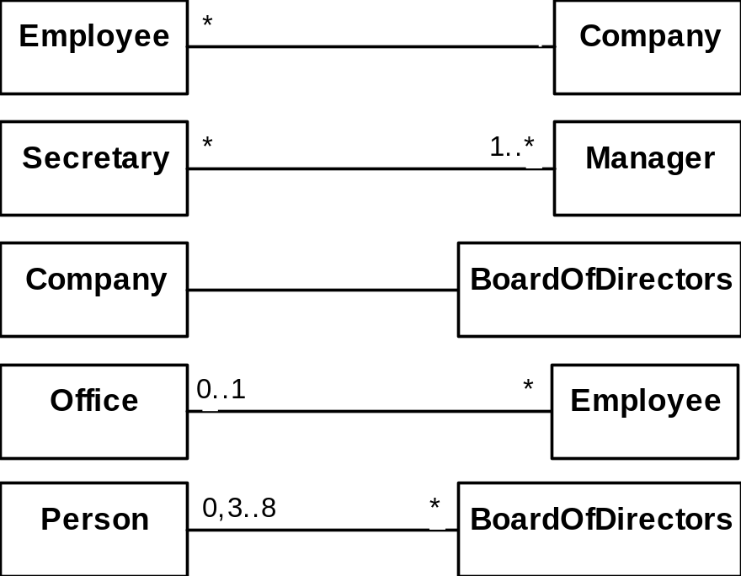
Associations and Multiplicity
An association is used to show how two classes are related to each other
  Symbols indicating multiplicity are shown at each end of the association

Slide 9
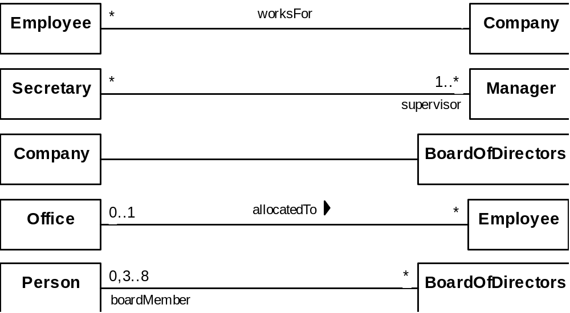
Labelling associations
  Each association can be labelled, to make explicit the nature of the association

Slide 10
Analyzing and validating associations
  Many-to-one
    A company has many employees,
    An employee can only work for one company.
      This company will not store data about the moonlighting activities of employees!
    A company can have zero employees
      E.g. a ‘shell’ company
    It is not possible to be an employee unless you work for a company

Slide 11
Analyzing and validating associations
  Many-to-many
    A secretary can work for many managers
    A manager can have many secretaries
    Secretaries can work in pools
    Managers can have a group of secretaries
    Some managers might have zero secretaries.

Slide 12
Analyzing and validating associations
  One-to-one
    For each company, there is exactly one board of directors
    A board is the board of only one company
    A company must always have a board
    A board must always be of some company

Slide 13
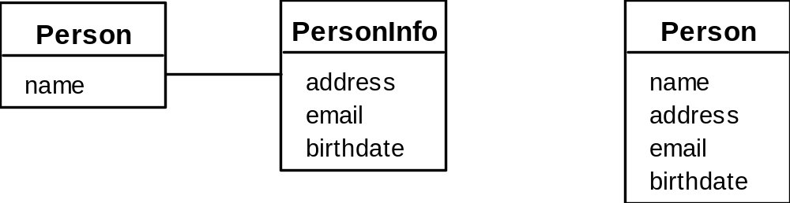
Analyzing and validating associations
Avoid unnecessary one-to-one associations
Avoid this do this

Slide 14
A more complex example
  A booking is always for exactly one passenger
    no booking with zero passengers
    a booking could never involve more than one passenger.
  A Passenger can have any number of Bookings
    a passenger could have no bookings at all
    a passenger could have more than one booking

Slide 15
Association classes
  Sometimes, an attribute that concerns two associated classes cannot be placed in either of the classes
  The following are equivalent
*
*
*
*
*
*
Student
*
CourseSection
Registration
grade
Student
*
Registration
*
CourseSection
grade

Slide 16
Reflexive associations
  It is possible for an association to connect a class to itself
successor
*
*
Course
isMutuallyExclusiveWith
*
*
prerequisite

Slide 17
Directionality in associations
  Associations are by default bi-directional
  It is possible to limit the direction of an association by adding an arrow at one end
*
Day
*
Note

Slide 18
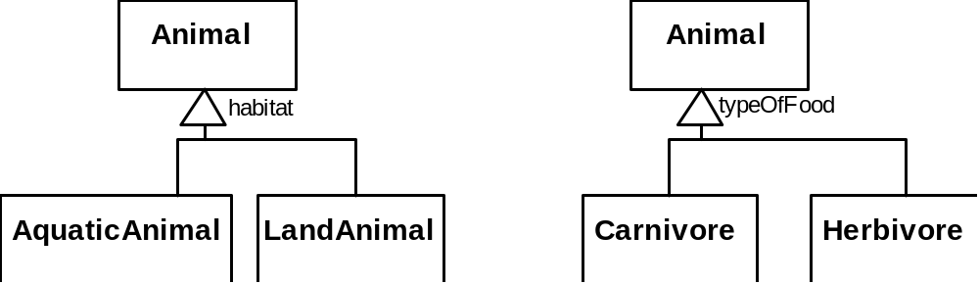
Generalization
Specializing a superclass into two or more subclasses
  The discriminator is a label that describes the criteria used in the specialization

Slide 19
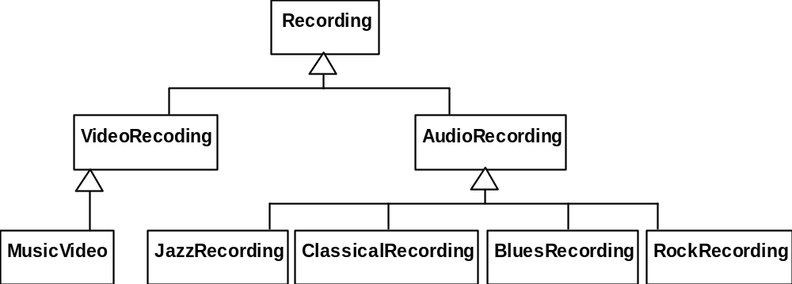
Avoiding unnecessary generalizations
Inappropriate hierarchy of
classes, which should be
instances
Recording
*
hasCategory
RecordingCategory
Improved class diagram,
with its corresponding
instance diagram
title
description
*
subcategory
artist
:RecordingCategory
:RecordingCategory
video
audio
subcategory
subcategory
subcategory
subcategory
subcategory
:RecordingCategory
:RecordingCategory
:RecordingCategory
:RecordingCategory
:RecordingCategory
music video
jazz
classical
blues
rock
:Recording
:Recording
9th Symphony
Let it be
Beethoven
The Beatles

Slide 20
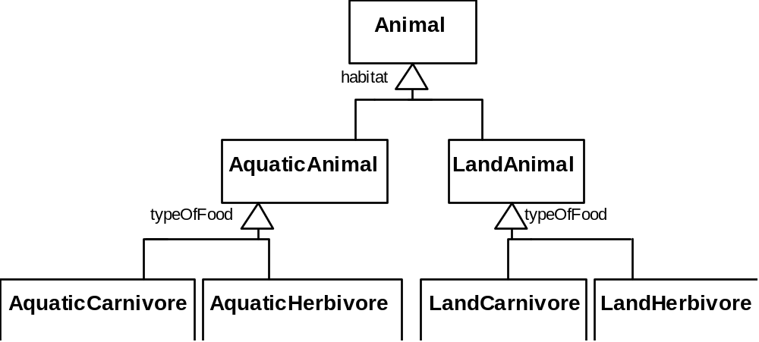
Handling multiple discriminators
  Creating higher-level generalization

Slide 21
Handling multiple discriminators
  Using multiple inheritance
  Using the Player-Role pattern (in Chapter 6)
Animal
habitat
typeOfFood
AquaticAnimal
LandAnimal
Carnivore
Herbivore
AquaticCarnivore
AquaticHerbivore
LandCarnivore
LandHerbivore

Slide 22
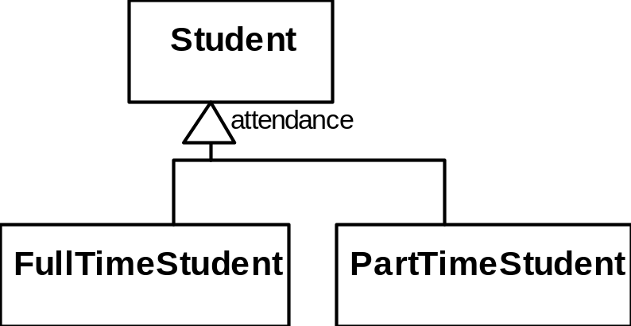
Avoiding having instances change class
  An instance should never need to change class

Slide 23
Instance Diagrams
  A link is an instance of an association
    In the same way that we say an object is an instance of a class
Pat:Employee
Wayne:Employee
OOCorp:Company
OOCorp's Board:
Ali:Employee
Carla:Employee
UML inc:Company
UML inc's Board
Terry:Employee

Slide 24
Associations versus generalizations in instance diagrams
  Associations describe the relationships that will exist between instances at run time.
    When you show an instance diagram generated from a class diagram, there will be an instance of both classes joined by an association
  Generalizations describe relationships between classes in class diagrams.
    They do not appear in instance diagrams at all.
    An instance of any class should also be considered to be an instance of each of that class’s superclasses

Slide 25
More Advanced Features: Aggregation
  Aggregations are special associations that represent ‘part-whole’ relationships.
    The ‘whole’ side is often called the assembly or the aggregate
    This symbol is a shorthand notation association named isPartOf
*
*
*
Vehicle
*
VehiclePart
*
*
*
*
*
Country
*
Region

Slide 26
When to use an aggregation
As a general rule, you can mark an association as an aggregation if the following are true:
  You can state that
    the parts ‘are part of’ the aggregate
    or the aggregate ‘is composed of’ the parts
  When something owns or controls the aggregate, then they also own or control the parts

Slide 27
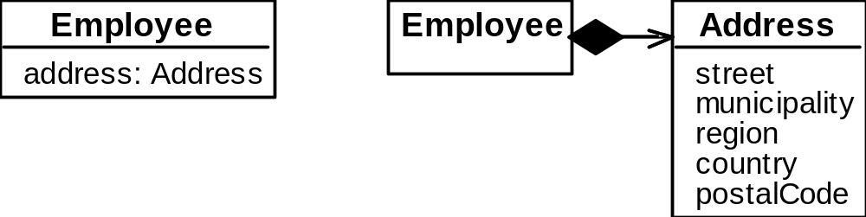
Composition
  A composition is a strong kind of aggregation
    if the aggregate is destroyed, then the parts are destroyed as well
  Two alternatives for addresses
*
*
*
*
Building
*
Room

Slide 28
Aggregation hierarchy
Vehicle
*
*
Chassis
BodyPanel
Door
*
Frame
Engine
Transmission
Wheel

Slide 29
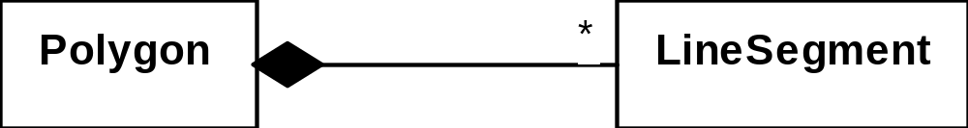
Propagation
  A mechanism where an operation in an aggregate is implemented by having the aggregate perform that operation on its parts
  At the same time, properties of the parts are often propagated back to the aggregate
  Propagation is to aggregation as inheritance is to generalization.
    The major difference is:
      inheritance is an implicit mechanism
      propagation has to be programmed when required

Slide 30
Interfaces
An interface describes a portion of the visible behaviour of a set of objects.
  An interface is similar to a class, except it lacks instance variables and implemented methods
Person
«interface»
Machine
Person
Machine
Cashier
withdraw
Cashier
Cashier
deposit
Employee
ATM
Employee
ATM

Slide 31
Notes and descriptive text
  Descriptive text and other diagrams
    Embed your diagrams in a larger document
    Text can explain aspects of the system using any notation you like
    Highlight and expand on important features, and give rationale
  Notes:
    A note is a small block of text embedded in a UML diagram
    It acts like a comment in a programming language

Slide 32
Suggested sequence of activities
  Identify a first set of candidate classes
  Add associations and attributes
  Find generalizations
  List the main responsibilities of each class
  Decide on specific operations
  Iterate over the entire process until the model is satisfactory
    Add or delete classes, associations, attributes, generalizations, responsibilities or operations
    Identify interfaces
    Apply design patterns (Later on..)
Don’t be too disorganized. Don’t be too rigid either.

Slide 33
Identifying classes
  When developing a domain model you tend to discover classes
  When you work on the user interface or the system architecture, you tend to invent classes
    Needed to solve a particular design problem
  Reuse should always be a concern
    Frameworks
    System extensions
    Similar systems

Slide 34
A simple technique for discovering domain classes
  Look at a source material such as a description of requirements
  Extract the nouns and noun phrases
  Eliminate nouns that:
    are redundant
    represent instances
    are vague or highly general
    not needed in the application
  Pay attention to classes in a domain model that represent types of users or other actors

Slide 35
Identifying associations and attributes
  Start with classes you think are most central and important
  Decide on the clear and obvious data it must contain and its relationships to other classes.
  Work outwards towards the classes that are less important.
  Avoid adding many associations and attributes to a class
    A system is simpler if it manipulates less information

Slide 36
Tips about identifying and specifying valid associations
  An association should exist if a class
      possesses
      controls
      is connected to
      is related to
      is a part of
      has as parts
      is a member of, or
      has as members
  some other class in your model
  Specify the multiplicity at both ends
  Label it clearly.

Slide 37
Actions versus associations
  A common mistake is to represent actions as if they were associations
LibraryPatron
*
*
*
*
*
*
LibraryPatron
borrow
return
Loan
*
borrowedDate
*
*
dueDate
*
CollectionItem
CollectionItem
returnedDate
Better: The
borrow
operation creates a
Loan
, and
Bad, due to the use of associations
the
return
operation sets the
returnedDate
that are actions
attribute.

Slide 38
Identifying attributes
  Look for information that must be maintained about each class
  Several nouns rejected as classes, may now become attributes
  An attribute should generally contain a simple value
    E.g. string, number

Slide 39
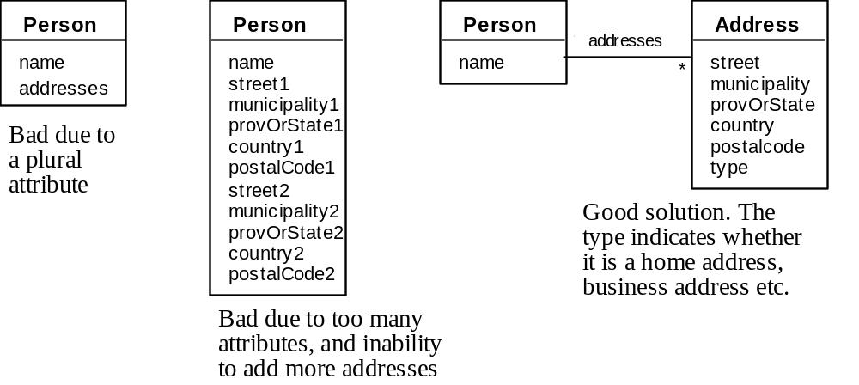
Tips about identifying and specifying valid attributes
  It is not good to have many duplicate attributes
  If a subset of a class’s attributes form a coherent group, then create a distinct class containing these attributes

Slide 40
An example (attributes and associations)
Employee
Passenger
RegularFlight
name
*
name
employeeNumber
time
number
jobFunction
supervisor
flightNumber
*
*
*
*
*
*
*
*
*
*
*
*
*
*
*
*
*
*
*
Booking
*
*
*
*
*
*
SpecificFlight
seatNumber
date

Slide 41
Identifying generalizations and interfaces
  There are two ways to identify generalizations:
    bottom-up
      Group together similar classes creating a new superclass
    top-down
      Look for more general classes first, specialize them if needed
  Create an interface, instead of a superclass if
    The classes are very dissimilar except for having a few operations in common
    One or more of the classes already have their own superclasses
    Different implementations of the same class might be available

Slide 42
An example (generalization)
0..2
Person
0..2
0..2
0..2
0..2
PersonRole
0..2
name
idNumber
RegularFlight
*
EmployeeRole
time
PassengerRole
jobFunction
supervisor
flightNumber
*
*
*
*
*
*
*
*
*
*
*
*
*
*
*
*
*
*
*
Booking
*
*
*
*
*
*
SpecificFlight
seatNumber
date

Slide 43
Allocating responsibilities to classes
A responsibility is something that the system is required to do.
  Each functional requirement must be attributed to one of the classes
    All the responsibilities of a given class should be clearly related.
    If a class has too many responsibilities, consider splitting it into distinct classes
    If a class has no responsibilities attached to it, then it is probably useless
    When a responsibility cannot be attributed to any of the existing classes, then a new class should be created
  To determine responsibilities
    Perform use case analysis
    Look for verbs and nouns describing actions in the system description

Slide 44
Categories of responsibilities
  Setting and getting the values of attributes
  Creating and initializing new instances
  Loading to and saving from persistent storage
  Destroying instances
  Adding and deleting links of associations
  Copying, converting, transforming, transmitting or outputting
  Computing numerical results
  Navigating and searching
  Other specialized work

Slide 45
An example (responsibilities)
    Creating a new regular flight
    Searching for a flight
    Modifying attributes of a flight
    Creating a specific flight
    Booking a passenger
    Canceling a booking
*
*
*
*
*
Person
*
Airline
0..2
0..2
0..2
0..2
0..2
PersonRole
0..2
name
idNumber
*
*
*
*
*
*
RegularFlight
EmployeeRole
*
PassengerRole
time
jobFunction
supervisor
flightNumber
*
*
*
*
*
*
*
*
*
*
*
*
*
*
*
*
*
*
*
Booking
*
*
*
*
*
*
SpecificFlight
seatNumber
date

Slide 46
Prototyping a class diagram on paper
  As you identify classes, you write their names on small cards
  As you identify attributes and responsibilities, you list them on the cards
    If you cannot fit all the responsibilities on one card:
      this suggests you should split the class into two related classes.
  Move the cards around on a whiteboard to arrange them into a class diagram.
  Draw lines among the cards to represent associations and generalizations.

Slide 47
Identifying operations
Operations are needed to realize the responsibilities of each class
  There may be several operations per responsibility
  The main operations that implement a responsibility are normally declared public
  Other methods that collaborate to perform the responsibility must be as private as possible

Slide 48
An example (class collaboration)
EmployeeRole
+ getName [e2]
crewMember
*
*
*
*
*
*
*
Booking
SpecificFlight
0..1
Airplane
*
*
*
*
*
*
Booking [c2]
*
addLinkToSpecificFlight [a2, d3]
+ specifyAirplane [a1]
deleteLinkToSpecificFlight [d2]
*
+ createFlightLog [b1]
+ changeAirplane [d1]
+ findCrewMember [e1]
0..1
FlightLog
PassengerRole
addLinkToBooking [c3]
+ makeBooking [c1]
FlightLog [b2]
addLinkToBooking [c4]

Slide 49
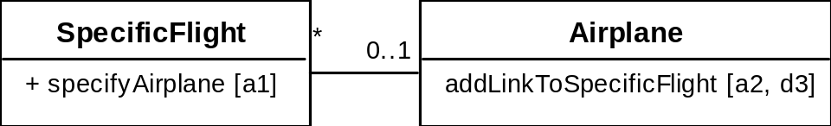
Class collaboration ‘a’
Making a bi-directional link between two existing objects;
e.g. adding a link between an instance of SpecificFlight and an instance of Airplane.
1. (public) The instance of SpecificFlight
    makes a one-directional link to the instance of Airplane
    then calls operation 2.
2. (non-public) The instance of Airplane
    makes a one-directional link back to the instance of SpecificFlight

Slide 50
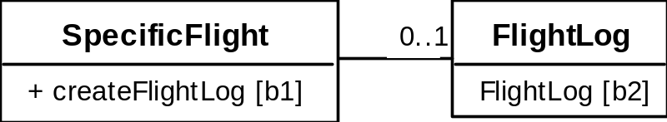
Class collaboration ‘b’
Creating an object and linking it to an existing object
e.g. creating a FlightLog, and linking it to a SpecificFlight.
1. (public) The instance of SpecificFlight
    calls the constructor of FlightLog (operation 2)
    then makes a one-directional link to the new instance of FlightLog.
2. (non-public) Class FlightLog’s constructor
    makes a one-directional link back to the instance of SpecificFlight.

Slide 51
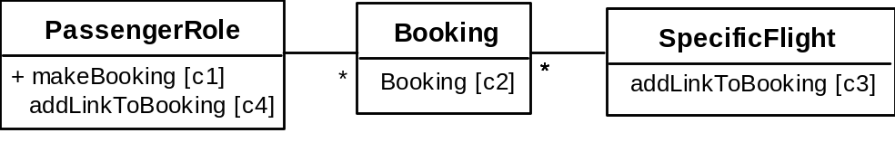
Class collaboration ‘c’
Creating an association class, given two existing objects
e.g. creating an instance of Booking, which will link a SpecificFlight to a PassengerRole.
1. (public) The instance of PassengerRole
    calls the constructor of Booking (operation 2).
2. (non-public) Class Booking’s constructor, among its other actions
    makes a one-directional link back to the instance of PassengerRole
    makes a one-directional link to the instance of SpecificFlight
    calls operations 3 and 4.
3. (non-public) The instance of SpecificFlight
    makes a one-directional link to the instance of Booking.
4. (non-public) The instance of PassengerRole
    makes a one-directional link to the instance of Booking.

Slide 52
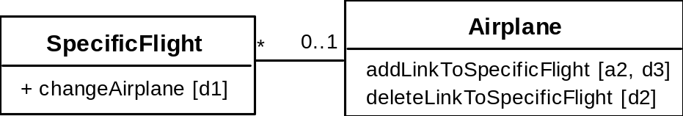
Class collaboration ‘d’
Changing the destination of a link
e.g. changing the Airplane of to a SpecificFlight, from airplane1 to airplane2
1. (public) The instance of SpecificFlight
    deletes the link to airplane1
    makes a one-directional link to airplane2
    calls operation 2
    then calls operation 3.
2. (non-public) airplane1
    deletes its one-directional link to the instance of SpecificFlight.
3. (non-public) airplane2
    makes a one-directional link to the instance of SpecificFlight.

Slide 53
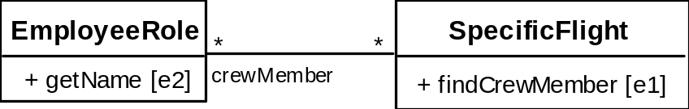
Class collaboration ‘e’
Searching for an associated instance
e.g. searching for a crew member associated with a SpecificFlight that has a certain name.
1. (public) The instance of SpecificFlight
    creates an Iterator over all the crewMember links of the SpecificFlight\
    for each of them call operation 2, until it finds a match.
2. (may be public) The instance of EmployeeRole returns its name.

