Slide 1
Object-Oriented Software Engineering
Practical Software Development using UML and Java
Modelling Interactions and Behaviour

Slide 2
Interaction Diagrams
Interaction diagrams are used to model the dynamic aspects of a software system
  They help you to visualize how the system runs.
  An interaction diagram is often built from a use case and a class diagram.
    The objective is to show how a set of objects accomplish the required interactions with an actor.

Slide 3
Interactions and messages
  Interaction diagrams show how a set of actors and objects communicate with each other to perform:
    The steps of a use case, or
    The steps of some other piece of functionality.
  The set of steps, taken together, is called an interaction.
  Interaction diagrams can show several different types of communication.
    E.g. method calls, messages send over the network
    These are all referred to as messages.

Slide 4
Elements found in interaction diagrams
  Instances of classes
    Shown as boxes with the class and object identifier underlined
  Actors
    Use the stick-person symbol as in use case diagrams
  Messages
    Shown as arrows from actor to object, or from object to object

Slide 5
Creating interaction diagrams
You should develop a class diagram and a use case model before starting to create an interaction diagram.
  There are two kinds of interaction diagrams:
    Sequence diagrams
    Collaboration diagrams

Slide 6
Sequence diagrams – an example
:CourseSection
:Student
requestToRegister
:Registration
<<create>>
addToSchedule
addToRegistrationList
*
*
*
*
*
Course
*
CourseSection
*
*
*
*
*
*
Registration
Student
getPrerequisite
requestToRegister
addToSchedule
addToRegistrationList
hasPassedCourse

Slide 7
Sequence diagrams
A sequence diagram shows the sequence of messages exchanged by the set of objects performing a certain task
  The objects are arranged horizontally across the diagram.
  An actor that initiates the interaction is often shown on the left.
  The vertical dimension represents time.
  A vertical line, called a lifeline, is attached to each object or actor.
  The lifeline becomes a broad box, called an activation box during the live activation period.
  A message is represented as an arrow between activation boxes of the sender and receiver.
    A message is labelled and can have an argument list and a return value.

Slide 8
Sequence diagrams – same example, more details
GUI
:CourseSection
aStudent:
:Course
Student
requestToRegister
requestToRegister
(aStudent)
prereq :=
hasPrerequisite :=
getPrerequisite
hasPassedCourse(prereq)
[hasPrerequisite]
<<create>>
:Registration
addToRegistrationList
addToSchedule

Slide 9
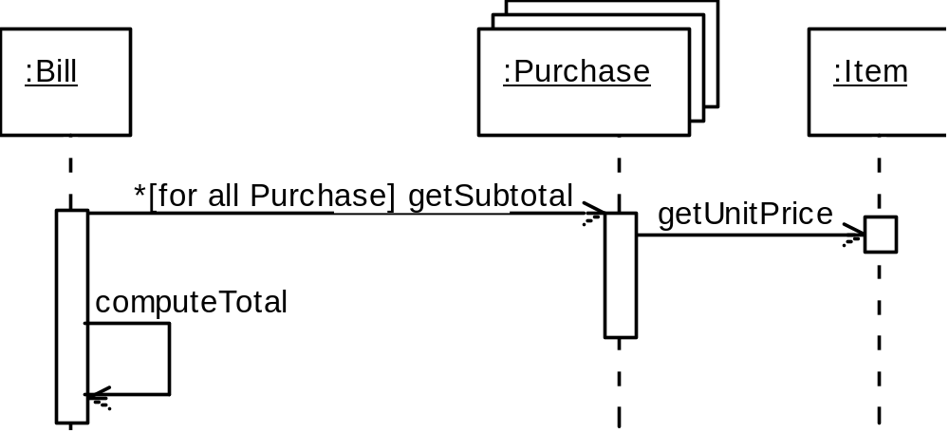
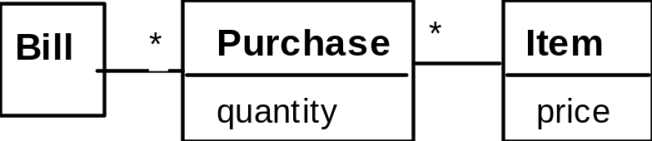
Sequence diagrams – an example with replicated messages
  An iteration over objects is indicated by an asterisk preceding the message name

Slide 10
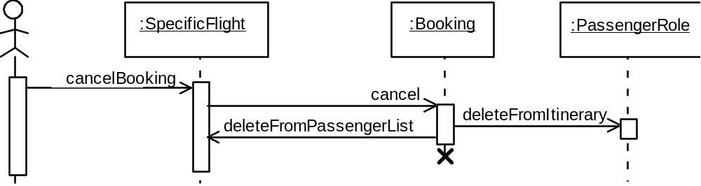
Sequence diagrams – an example with object deletion
  If an object’s life ends, this is shown with an X at the end of the lifeline

Slide 11
State Diagrams
A state diagram describes the behaviour of a system, some part of a system, or an individual object.
  At any given point in time, the system or object is in a certain state.
    Being in a state means that it is will behave in a specific way in response to any events that occur.
  Some events will cause the system to change state.
    In the new state, the system will behave in a different way to events.
  A state diagram is a directed graph where the nodes are states and the arcs are transitions.

Slide 12
State diagrams – an example
  tic-tac-toe game
XWin
XTurn
Tie
OWin
OTurn

Slide 13
States
  At any given point in time, the system is in one state.
  It will remain in this state until an event occurs that causes it to change state.
  A state is represented by a rounded rectangle containing the name of the state.
  Special states:
    A black circle represents the start state
    A circle with a ring around it represents an end state

Slide 14
Transitions
  A transition represents a change of state in response to an event.
    It is considered to occur instantaneously.
  The label on each transition is the event that causes the change of state.

Slide 15
State diagrams – an example of transitions with time-outs and conditions
GreenLightNoTrigger
vehicleWaitingToTurn
GreenLight
GreenLightChangeTriggered
after(25s since exit from
after(25s)
state RedLight)
YellowLight
after(30s)
YellowLight
after(30s)
after(5s)
after(5s)
RedLight
RedLight

Slide 16
State diagrams – an example with conditional transitions
Planned
openRegistration
closeRegistration
requestToRegister
(aStudent)
Cancelled
OpenNotEnoughStudents
cancel
/createRegistration
cancel
classSize >= minimum
closeRegistration
Closed
OpenEnoughStudents
requestToRegister
(aStudent)
classSize >= maximum
/createRegistration

Slide 17
Activities in state diagrams
  An activity is something that takes place while the system is in a state.
    It takes a period of time.
    The system may take a transition out of the state in response to completion of the activity,
    Some other outgoing transition may result in:
      The interruption of the activity, and
      An early exit from the state.

Slide 18
State diagram – an example with activity
press button
ProposeSelection
MusicPlaying
do:
play chosen
selection

Slide 19
Actions in state diagrams
  An action is something that takes place effectively instantaneously
    When a particular transition is taken,
    Upon entry into a particular state, or
    Upon exit from a particular state
  An action should consume no noticeable amount of time

Slide 20
State diagram – an example with actions
Closed
Opening
Enter /
pressButton
Enter /
stop motor
run motor forwards
closingCompleted
openingCompleted
pressButton
Closing
pressButton
Open
Enter /
Enter /
run motor in reverse
stop motor

Slide 21
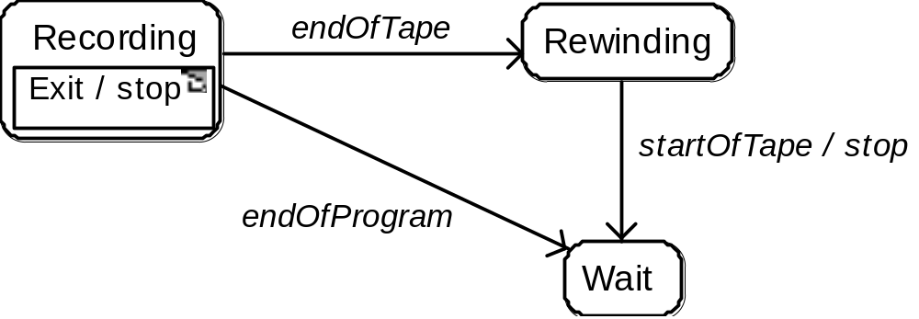
State diagrams – another example

Slide 22
Nested substates and guard conditions
A state diagram can be nested inside a state.
  The states of the inner diagram are called substates.
selectReverse
Neutral
Reverse
selectNeutral
selectFirst
selectDrive
selectSecond
selectNeutral
reachSecondSpeed
reachThirdSpeed
[driveSelected]
[driveSelected]
First
Second
Third
dropBelowSecondSpeed
dropBelowThirdSpeed
[driveSelected]
selectFirst
selectSecond

Slide 23
State diagram – an example with substates
Planned
openRegistration
Cancelled
Open
requestToRegister
(aStudent)
do:
cancel
unregister
NotEnoughStudents
/createRegistration
students
closeRegistration
classSize >= minimum
classSize >= maximum
Closed
EnoughStudents
closeRegistration

Slide 24
Implementing Classes Based on Interaction and State Diagrams
  You should use these diagrams for the parts of your system that you find most complex.
    I.e. not for every class
  Interaction, activity and state diagrams help you create a correct implementation.
  This is particularly true when behaviour is distributed across several use cases.
    E.g. a state diagram is useful when different conditions cause instances to respond differently to the same event.

Slide 25
Example: The CourseSection class
States:
  ‘Planned’:
    closedOrCancelled == false && open == false
  ‘Cancelled’:
    closedOrCancelled == true && registrationList.size() == 0
  ‘Closed’ (course section is too full, or being taught):
    closedOrCancelled == true && registrationList.size() > 0

Slide 26
Example: The CourseSection class
States:
  ‘Open’ (accepting registrations):
    open == true
  ‘NotEnoughStudents’ (substate of ‘Open’):
    open == true && registrationList.size() < course.getMinimum()
  ‘EnoughStudents’ (substate of ‘Open’):
    open == true && registrationList.size() >= course.getMinimum()

Slide 27
Example: The CourseSection class
Class diagram
*
*
*
Course
*
CourseSection
*
*
*
*
*
*
Registration
Student
getPrerequisite
requestToRegister
addToSchedule
addToRegistrationList
hasPassedCourse

Slide 28
Example: The CourseSection class
public class CourseSection
{
// The many-1 abstraction-occurence association
private Course course;
// The 1-many association to class Registration
private List registationList;
// The following are present only to determine
// the state
// The initial state is ‘Planned’
private boolean open = false;
private boolean closedOrCancelled = false;
...
}

Slide 29
Example: The CourseSection class
public CourseSection(Course course)
{
this.course = course;
RegistrationList = new LinkedList();
}
public void cancel()
{
// to ‘Cancelled’ state
open = false;
closedOrCancelled = true;
unregisterStudents();
}

Slide 30
Example: The CourseSection class
public void openRegistration()
{
if(!closedOrCancelled)
// must be in ‘Planned’ state
{
open = true;
// to 'OpenNotEnoughStudents' state
}
}

Slide 31
Example: The CourseSection class
public void closeRegistration()
{
// to 'Cancelled' or 'Closed' state
open = false;
closedOrCancelled = true;
if (registrationList.size() <
course.getMinimum())
{
unregisterStudents();
// to ‘Cancelled’ state
}
}

Slide 32
Example: The CourseSection class
public void requestToRegister(Student student)
{
if (open) // must be in one of the two 'Open' states
{
// The interaction specified in the sequence diagram
Course prereq = course.getPrerequisite();
if (student.hasPassedCourse(prereq))
{
// Indirectly calls addToRegistrationList
new Registration(this, student);
}
// Check for automatic transition to 'Closed' state
if (registrationList.size() >= course.getMaximum())
{
// to ‘Closed’ state
open = false;
closedOrCancelled = true;
}
}
}

Slide 33
Example: The CourseSection class
// Activity associated with ‘Cancelled’ state.
private void unregisterStudents()
{
Iterator it = registrationList.iterator();
while (it.hasNext())
{
Registration r = (Registration)it.next();
r.unregisterStudent();
it.remove();
}
}
// Called within this package only, by the
// constructor of Registration
void addToRegistrationList(
Registration newRegistration)
{
registrationList.add(newRegistration);
}
}

Slide 34
Difficulties and Risks in Modelling Interactions and Behaviour
Dynamic modelling is a difficult skill
  In a large system there are a very large number of possible paths a system can take.
  It is hard to choose the classes to which to allocate each behaviour:
    Ensure that skilled developers lead the process, and ensure that all aspects of your models are properly reviewed.
    Work iteratively:
      Develop initial class diagrams, use cases, responsibilities, interaction diagrams and state diagrams;
      Then go back and verify that all of these are consistent, modifying them as necessary.
    Drawing different diagrams that capture related, but distinct, information will often highlight problems.

