Slide 1
Software Testing
Software Engineering
Lebanese University
Kamal Beydoun
References:
Software Engineering 9th Ed - Somerville - 2011
CSE 403 - University of Washington Marty Stepp 2007

Slide 2
Software reliability
Reliability: how closely the system conforms to expected behavior
Software reliability: probability that a software system will not cause failure for the specified time under specified conditions
Rreliability measured by MTTF (mean time till failure), program crash data
Notes:
Definition - What does Mean Time to Failure (MTTF) mean?
Mean time to failure (MTTF) is the length of time a device or other product is expected to last in operation. MTTF is one of many ways to evaluate the reliability of pieces of hardware or other technology.
Techopedia explains Mean Time to Failure (MTTF)
Mean time to failure is extremely similar to another relatebetween these terms is that while MTBF is used for products than that can be repaired and returned to use, MTTF is used for non-repairable products. When MTTF is used as d term, mean time between failures (MTBF). The difference a measure, repair is not an option.
As a metric, MTTF represents how long a product can reasonably be expected to perform in the field based on specific testing. It is important to note, however, that the mean time to failure metrics provided by companies regarding specific products or components may not have been collected by running one unit continuously until failure. Instead, MTTF data is often collected by running many units, even many thousands of units, for a specific number of hours.
One of the main situations where terms like MTTF are extremely important is when hardware pieces or other products are used in mission-critical systems. Here it becomes valuable to know about general reliability for these items. For non-repairable items, MTTF is a statistic that is of great interest to engineers and others assessing these pieces as parts of larger systems.

Slide 3
Fault vs Error
Error: incorrect software behavior
example: message box text said "Welcome null."
Fault: algorithmic cause of error
example: account name field is not set properly.
A fault is not an error, but it can lead to it

Slide 4
Quality control techniques
Any large system is bound to have faults.
What are some quality control techniques we can use to deal with them?
Fault Avoidance: prevent errors by finding faults before the system is released
Fault Detection: find existing faults without recovering from the errors
Fault Tolerance: when system can recover from failure by itself

Slide 5
Fault avoidance techniques
Development Methodologies: use requirements and design to minimize introduction of faults
Get clear requirements
Minimize coupling
Review: manual inspection of system
Walkthrough: developer presents code to team
Inspection: team looks at code without dev's guidance

Slide 6
Fault detection techniques
Debugging: move through steps to reach erroneous state
Testing: tries to expose errors in planned way
A good test model has test cases and test data that identify errors
Ideally, every possible input to a system should be tested
This is expensively time-consuming

Slide 7
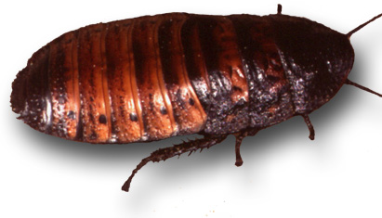
Bugs
Bugs are inevitable in any complex software system
A bug can be very visible or can hide in your code until a much later date
But how do we discover all of the bugs in our system, even those with low visibility?
ANSWER: testing and Quality Assurance practices

Slide 8
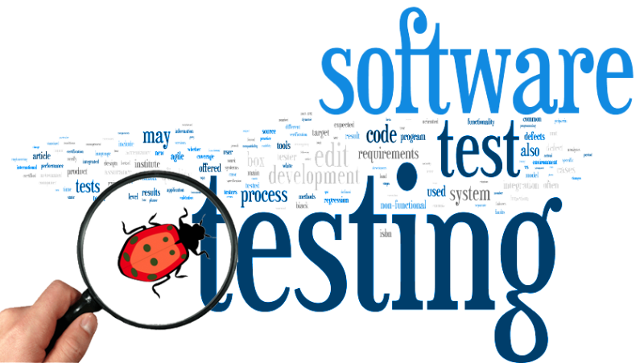
Software testing
Testing is intended to :
show that a program does what it is intended to do
to discover program defects before it is put into use.
When you test software, you execute a program using artificial data.

Slide 9
Verification vs Validation
Verification: "Are we building the product right”.
The software should conform to its specification.
Validation: "Are we building the right product”.
The software should do what the user really requires.

Slide 10
Inspections and testing
Software inspections: Concerned with analysis of the static system representation to discover problems (static verification)
May be supplement by tool-based document and code analysis.
Software testing: Concerned with exercising and observing product behaviour (dynamic verification)
The system is executed with test data and its operational behaviour is observed.

Slide 11
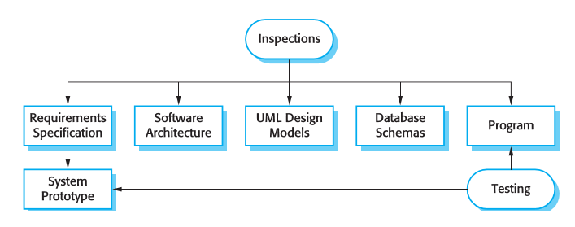
Inspections and testing

Slide 12
Software inspections
These involve people examining the source representation with the aim of discovering anomalies and defects.
Inspections not require execution of a system so may be used before implementation.
They may be applied to any representation of the system (requirements, design, configuration data, test data, etc.).
They have been shown to be an effective technique for discovering program errors.

Slide 13
Advantages of inspections
During testing, errors can mask (hide) other errors. Because inspection is a static process, you don’t have to be concerned with interactions between errors.
Incomplete versions of a system can be inspected without additional costs. If a program is incomplete, then you need to develop specialized test couples to test the parts that are available.

Slide 14
Inspections and Testing
Inspections and testing are complementary and not opposing verification techniques.
Both should be used during the V & V process.
Inspections can check conformance with a specification but not conformance with the customer’s real requirements.
Inspections cannot check non-functional characteristics such as performance, usability, etc.

Slide 15
Stages of testing
Development testing, where the system is tested during development to discover bugs and defects.
Release testing, where a separate testing team test a complete version of the system before it is released to users.
User testing, where users or potential users of a system test the system in their own environment.

Slide 16
Development testing
Unit Testing: looks for errors in objects or subsystems
Integration Testing: find errors with connecting subsystems together
System Structure Testing: integration testing all parts of system together
System Testing: test entire system behavior as a whole, with respect to scenarios and requirements
Functional Testing: test whether system meets requirements
Performance Testing: non-functional requirements, design goals
Acceptance / Installation Testing: done by client

Slide 17
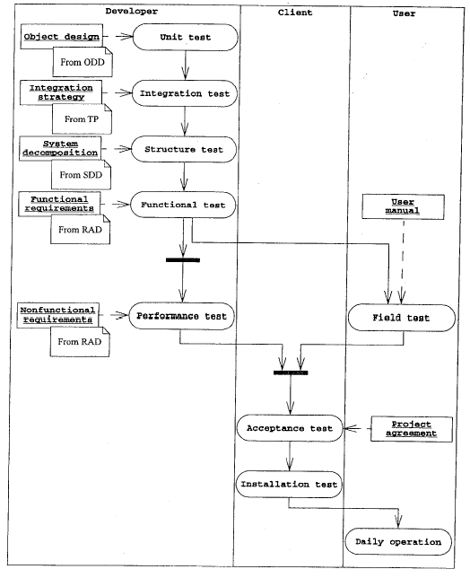
Types of testing

Slide 18
Black and white box testing
What is the difference between "black-box" and "white-box" testing?
Black-box Test: focuses on input/output of each component
White-box Test: focuses on internal states of objects
Requires internal knowledge of the component to craft input data
Notes:
(test case example: Microsoft Web Excel)

Slide 19
Regression testing
What is regression testing, and why is it important?
Regression Testing: re-executing all prior tests after a code change
often done by scripts, automated testing
used to ensure that old fixed bugs are still fixed
a new feature or a fix for one bug can cause a new bug or reintroduce an old bug
especially important in evolving object-oriented systems

Slide 20
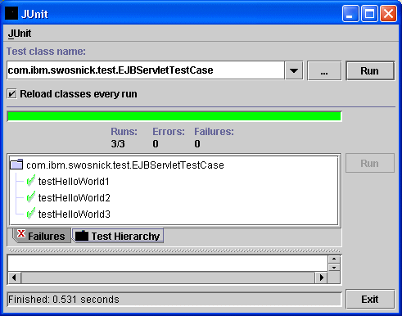
Testing concepts
What is a test case? What is a failure? How are they related?
Failure: particular instance of a general error, which is caused by a fault
Test Case: set of inputs and outputs to cause failures

Slide 21
Unit testing
Unit testing looks for errors in individual objects or subsystems in isolation
Benefits of isolating one object/component:
1. reduces number of things to test
2. easier to find faults when errors occur
3. can test all components in parallel
In principle, test all objects; because of time, test important ones involved in use cases

Slide 22
Types of integration testing
Big Bang: no stubs; do unit testing, then throw all parts together
Bottom-Up: integrate upward into double, triple, quadruple test
Top-Down: test top layer (UI) first, then add layers to replace underlying stubs
What are some pros and cons of each?
big bang: + faster - can be costly, error-prone
bottom-up: + fewer stubs needed - tests UI last; UI is important!
top-down: + focuses on user experience - needs many stubs

Slide 23

The sandwich ☺
Sandwich integration testing:
bread (UI)
meat (major subsystems)
bread (ground layer)
perform top-down and bottom-up testing at same time
might miss bugs in middle "target" layer
Modified sandwich: test each layer individually, then do the sandwich

Slide 24
Difficulties of testing
Testing is seen as a beginner's job, often assigned to the least experienced team members
It is impossible to completely test a system

Slide 25
JUnit and Eclipse
Adding JUnit to an Eclipse project:
click Project -> Properties -> Add External JARs... -> eclipse folder/plugins/org.junit_x.x.x/junit.jar
Create the test case
click File -> New -> JUnit Test Case
or right-click a file and choose New Test

Slide 26
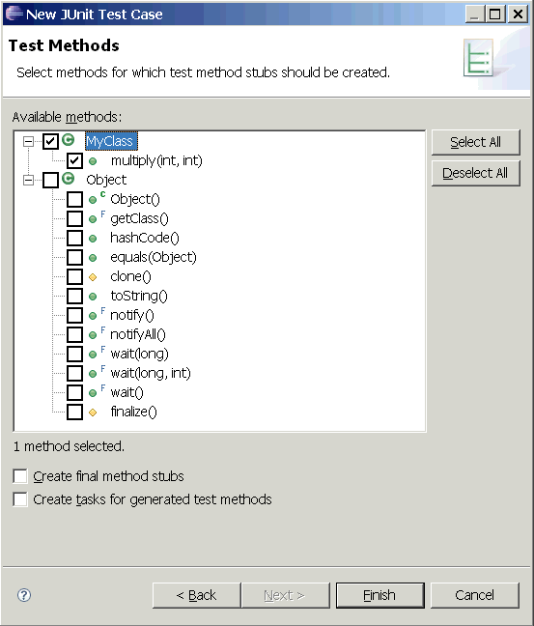
Creating tests in Eclipse
File -> New -> JUnit Test Case
Specify class you're testing
Eclipse can create stubs of tests for each method for you

Slide 27
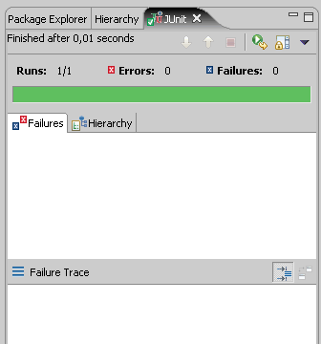
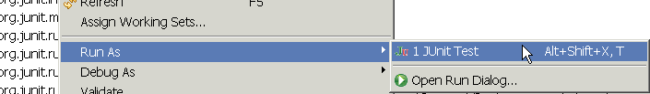
Running a test
Right click its file in the Package Explorer, choose:
Run As -> JUnit Test
JUnit bar will show green if all tests pass, red if any fail
Failure Trace shows which tests failed, if any, and why

Slide 28
Junit 3⁻ (Old Style)
public YourClassName extends TestCase
Class must inherit a specific super class called TestCase
public YourClassName () // constructor
run once at start of ALL tests (when testing object is created)
public void setUp()
run at start of each test
public void tearDown()
run at end of each test
public void testXYZ()
All test methods should start with “test”

Slide 29
Junit 4⁺
import org.junit.*;
import static org.junit.Assert.*;
public class <name> {
...
@Test
public void <name>() {
....
}
}
Methods with an @Test annotation are flagged as JUnit test cases, run when JUnit runs your class (any class!)

Slide 30
Junit 4⁺ Setup and teardown
import org.junit.*;
import static org.junit.Assert.*;
public class <name> {
...
@Before
public void <name>() {
....
}
@After
public void <name>() {
....
}
}
methods to be run before or after all test cases

Slide 31
Junit 5⁺
class <name> {
...
@Test
void succeedingTest() {
.... // executed
}
@Test
@Disabled("for demo purposes")
void <name> () {
.... // not executed
}
}
Neither test classes nor test methods need to be public!
We can also disable
a whole test class
& we can use:
@DisabledOnOs(WINDOWS)
@EnabledOnOs({ LINUX, MAC })
@EnabledOnJre(JAVA_8)

Slide 32
Junit 5⁺ Setup and teardown
import org.junit.*;
import static org.junit.Assert.*;
class <name> {
...
@BeforeAll
void <name>() {
....
}
@AfterAll
void <name>() {
....
}
}
methods to be run before or after all/each test case(s)
@BeforeEach
void <name>() {
....
}
@AfterEach
void <name>() {
....
}

Slide 33
JUnit 4⁻ assertions
public void assertTrue(boolean condition) public void assertTrue(String message, boolean condition)
public void assertFalse(String message, boolean condition)
public void assertEquals(String message, Object expected, Object actual) public void assertNotEquals(String message, Object expected, Object actual)
public void assertSame(String message, Object expected, Object actual) public void assertNotSame(String message, Object expected, Object actual) these methods compare using ==, not .equals
public void assertNull(String message, Object obj) public void assertNotNull(String message, Object obj)
assert <condition>;
public void fail(String message) forcibly causes the test to fail

Slide 34
JUnit 5⁺ assertions
public void assertTrue(boolean condition) Junit 4⁻ public void assertTrue(String message, boolean condition)
public void assertTrue(boolean condition) Junit 5⁺ (only 1st is still accepted)
public void assertTrue(boolean condition, String message)
public void assertTrue(boolean condition, Supplier<String> messageSupplier)
public void assertTrue(BooleanSupplier conditionSupplier)
public void assertTrue(BooleanSupplier conditionSupplier, String message)
public void assertTrue(BooleanSupplier conditionSupplier, Supplier<String> messageSupplier)

Slide 35
JUnit 5⁺ assertions
@Test
void standardAssertions() {
assertEquals(2, 2);
assertEquals(4, 4, "The optional assertion message is now the last parameter.");
assertTrue('a' < 'b', () -> "Assertion messages can be lazily evaluated -- "
+ "to avoid constructing complex messages unnecessarily.");
}

Slide 36
Junit 5⁺
@Test
void dependentAssertions() {
// Within a code block, if an assertion fails the
// subsequent code in the same block will be skipped.
assertAll("properties",
() -> {
String firstName = person.getFirstName();
assertNotNull(firstName);
// Executed only if the previous assertion is valid.
assertAll("first name",
() -> assertTrue(firstName.startsWith("J")),
() -> assertTrue(firstName.endsWith("n"))
);
},
() -> {
// Grouped assertion, so processed independently
// of results of first name assertions.
String lastName = person.getLastName();
assertNotNull(lastName);
// Executed only if the previous assertion is valid.
assertAll("last name",
() -> assertTrue(lastName.startsWith("D")),
() -> assertTrue(lastName.endsWith("e"))
);
}
);
}
Assertions
Grouped Assertions
=>
Hierarchy of Dependent tests

Slide 37
Performance Test - JUnit 3^{-/+}
long expectedTimeout = 5000; // 5s
long start = System.currentTimeInMillis();
callMethodToTestPerformance(…);
long end = System.currentTimeInMillis();
assertTrue(end-start < expectedTimeout);
The above method will be considered a failure if it doesn't finish running within 5000ms=5s
We may use a separate thread to interrupt when timeout exceeded

Slide 38
Performance Test - JUnit 4⁺
import org.junit.*;
import static org.junit.Assert.*;
public class <name> {
...
@Test(timeout = 5000)
public void <name>() {
....
}
}
The above method will be considered a failure if it doesn't finish running within 5000ms = 5s

Slide 39
Performance Test - JUnit 5⁺
assertTimeout(ofSeconds(5),
() -> {
// ... Code that may take so long
} , () -> "The above code took more than 5secs");
assertTimeoutPreemptively(ofSeconds(5),
() -> {
// ... Code that may take so long
} , () -> "The above code took more than 5secs & was aborted");
The above method will be considered a failure if it doesn't finish running within 5s
Requires Java 8⁺

Slide 40
Testing for exceptions - JUnit 3^{-/+}
try{
callMethodThatShouldMakeAnExceptionWithTheGivenValue(exceptionalValue); // ☺
fail("Impossible to reach this statement!!"); // or assertTrue("…", 1==2)
} catch(AbcXyzException e){
assertTrue("It is normal to reach this statement ;)", 1==1);
}
The above method will PASS if it does throw the exception, and FAIL if it doesn't
use this for cases meant to test for expected errors

Slide 41
Testing for exceptions - JUnit 4
import org.junit.*;
import static org.junit.Assert.*;
public class <name> {
...
@Test(expected = AbcXyzException.class)
public void <name>() {
callMethodThatShouldMakeAnExceptionWithTheGivenValue(
exceptionalValue);
}
}
The above method will PASS if it does throw the exception, and FAIL if it doesn't
use this for cases meant to test for expected errors

Slide 42
Testing for exceptions - JUnit 5⁺
public class <name> {
...
@Test
public void <name>() {
assertThrows(AbcXyzException.class,
()-> {
callMethodCausingAnExceptionWith(exceptionalVal);
});
}
}

Slide 43
Testing for exceptions - JUnit 5⁺
public class <name> {
...
@Test
public void <name>() {
assertThrows(AbcXyzException.class,
()-> {
callMethodCausingAnExceptionWith(exceptionalVal);
});
}
}

Slide 44
Test suites
import org.junit.runner.*;
import org.junit.runners.*;
@RunWith(Suite.class)
@Suite.SuiteClasses({
<test class name>.class,
<test class name>.class
})
public class <name> {}
Suites are groups of tests that can be run together

Slide 45
What tests should I make?
Metrics for whether we have enough tests:
code coverage
path coverage
We can't cover all possible inputs, so:
need to pick tests for which we can know/verify correct output
equivalence partitioning
boundary cases (e.g. min, middle, max)
check common expected error cases
randomized data?
count statement branching/complexity to count test cases needed to test it

Slide 46
JUnit exercise
Given a Date class with the following methods:
public Date(int year, int month, int day)
public Date() // constructs today
public void addDays(int days) // advances by days
public boolean equals(Object o)
public int getDay(), getMonth(), getYear()
public int getDaysInMonth()
public String getDayOfWeek()
public boolean isLeapYear()
public void nextDay() // advances by 1 day
public String toString()
Come up with unit tests to check the following:
That no Date object can ever get into an invalid state.
That the addDays method works properly.
It should also be efficient enough to add 1,000,000 days in a call.
Notes:
a good equals method has some initial checks like checking for null, checking whether this == that, check instanceof, etc... then it calls compareTo

Slide 47
Test-driven development
Imagine that we'd like to add a method subtractWeeks to our Date class, that shifts this Date backward in time by the given number of weeks.
Write JUnit test code to test this method before it has been written.
This way, once we do implement the method, we'll know whether it works.

