Slide 1
Chapter 3 – Agile Software Development
Lecture 1

Slide 2
Topics covered
Agile methods
Plan-driven and agile development

Slide 3
Rapid software development
Rapid development and delivery is now often the most important requirement for software systems
Software has to evolve quickly to reflect changing business needs.
Rapid software development
Specification, design and implementation are inter-leaved
System is developed as a series of versions with stakeholders involved in version evaluation
User interfaces are often developed using an IDE and graphical toolset.

Slide 4
Agile manifesto
We are uncovering better ways of developing software by doing it and helping others do it. Through this work we have come to value:
Working software over comprehensive documentation
Customer collaboration over contract negotiation
Responding to change over following a plan

Slide 5
The principles of agile methods
Principle | Description
Customer involvement | Customers should be closely involved throughout the development process. Their role is provide and prioritize new system requirements and to evaluate the iterations of the system.
Incremental delivery | The software is developed in increments with the customer specifying the requirements to be included in each increment.
People not process | The skills of the development team should be recognized and exploited. Team members should be left to develop their own ways of working without prescriptive processes.
Embrace change | Expect the system requirements to change and so design the system to accommodate these changes.
Maintain simplicity | Focus on simplicity in both the software being developed and in the development process. Wherever possible, actively work to eliminate complexity from the system.

Slide 6
Agile method applicability
Product development where a software company is developing a small or medium-sized product for sale.
Custom system development within an organization, where there is a clear commitment from the customer to become involved in the development process.
Because of their focus on small, tightly-integrated teams, there are problems in scaling agile methods to large systems.

Slide 7
Problems with agile methods
It can be difficult to keep the interest of customers who are involved in the process.
Team members may be unsuited to the intense involvement that characterizes agile methods.
Prioritizing changes can be difficult where there are multiple stakeholders.
Large companies, have spent years changing their culture so that processes are defined and followed.
It is difficult for them to move to a working model in which processes are informal and defined by development teams.

Slide 8
Agile methods and software maintenance
Most organizations spend more on maintaining existing software than they do on new software development.
So, if agile methods are to be successful, they have to support maintenance as well as original development.
Two key issues:
Are systems that are developed using an agile approach maintainable, given the emphasis in the development process of minimizing formal documentation?
Can agile methods be used effectively for evolving a system in response to customer change requests?

Slide 9
Plan-driven and agile development
Plan-driven development
A plan-driven approach to software engineering is based around separate development stages with the outputs to be produced at each of these stages planned in advance.
Iteration occurs within activities.
Agile development
Specification, design, implementation and testing are inter-leaved and the outputs from the development process are decided through a process of negotiation during the software development process.

Slide 10
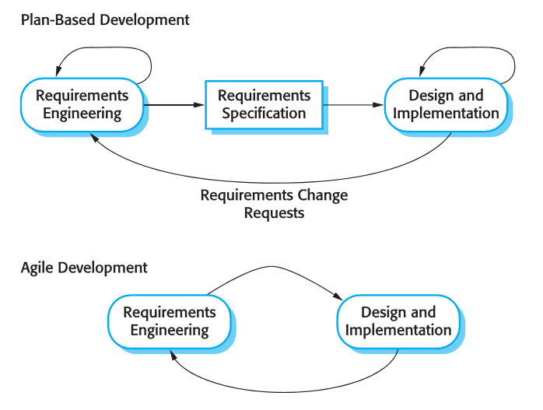
Plan-driven and agile specification
Notes:
No tests in Agile ….

Slide 11
Technical, human, organizational issues
Most projects include elements of plan-driven and agile processes. Deciding on the balance depends on:
Is it important to have a very detailed specification and design before moving to implementation? If so, you probably need to use a plan-driven approach.
Is an incremental delivery strategy, where you deliver the software to customers and get rapid feedback from them, realistic? If so, consider using agile methods.
How large is the system that is being developed? Agile methods are most effective when the system can be developed with a small co-located team who can communicate informally.
This may not be possible for large systems that require larger development teams so a plan-driven approach may have to be used.

Slide 12
Technical, human, organizational issues
What type of system is being developed?
Plan-driven approaches may be required for systems that require a lot of analysis before implementation (e.g. real-time system with complex timing requirements).
What is the expected system lifetime?
Long-lifetime systems may require more design documentation to communicate the original intentions of the system developers to the support team.
What technologies are available to support system development?
Agile methods rely on good tools to keep track of an evolving design.
How is the development team organized?
If the development team is distributed or if part of the development is being outsourced, then you may need to develop design documents to communicate across the development teams.

Slide 13
Technical, human, organizational issues
Are there cultural or organizational issues that may affect the system development?
Traditional engineering organizations have a culture of plan-based development, as this is the norm in engineering.
How good are the designers and programmers in the development team?
It is sometimes argued that agile methods require higher skill levels than plan-based approaches in which programmers simply translate a detailed design into code
Is the system subject to external regulation?
If a system has to be approved by an external regulator (e.g. the FAA approve software that is critical to the operation of an aircraft) then you will probably be required to produce detailed documentation as part of the system safety case.

Slide 14
Key points
Agile methods are incremental development methods that focus on rapid development, frequent releases of the software, reducing process overheads and producing high-quality code. They involve the customer directly in the development process.
The decision on whether to use an agile or a plan-driven approach to development should depend on the type of software being developed, the capabilities of the development team and the culture of the company developing the system.

