Slide 1
ASP.Net Core –Authentication: adding users to your application with Identity
Kamal Beydoun
Lebanese University – Faculty of Sciences I
Kamal.beydoun@ul.edu.lb

Slide 2
Introduction
One of the selling points of a web framework like ASP.NET Core is the ability to provide a dynamic app, customized to individual users.
When you think about adding users to your application, you typically have two aspects to consider:
Authentication—The process of creating users and letting them log in to your app
Authorization—Customizing the experience and controlling what users can do, based on the current logged-in user
Notes:
ASP.NET Core 2.1, in preview at the time of writing, hides much of the UI code from you by default. You can generate the UI code again, if required, using the scaffolder described in the following post http://mng.bz/tZZz.

Slide 3
Introducing authentication and authorization
When you add sign-in functionality to your app and control access to certain functions based on the currently-signed-in user, you’re using two distinct aspects of security:
Authentication—The process of determining who you are
Authorization—The process of determining what you’re allowed to do

Slide 4
Understanding users and claims in ASP.NET Core
HTTP server, Kestrel, creates an HttpContext object for every request it receives.
This object is responsible for storing all of the details related to that request, such as the request URL, any headers sent, the body of the request, and so on.
The HttpContext object also exposes the current principal for a request as the User property.
This is ASP.NET Core’s view of which user made the request.
Any time your app needs to know who the current user is, or what they’re allowed to do, it can look at the HttpContext.User principal.
Notes:
You can think of the
Claims can also be indirectly related to permissions and authorization, so you could have a claim called HasAdminAccess or IsVipCustomer. These would be stored in exactly the same way—as claims associated with the user principal. principal as the user of your app.

Slide 5
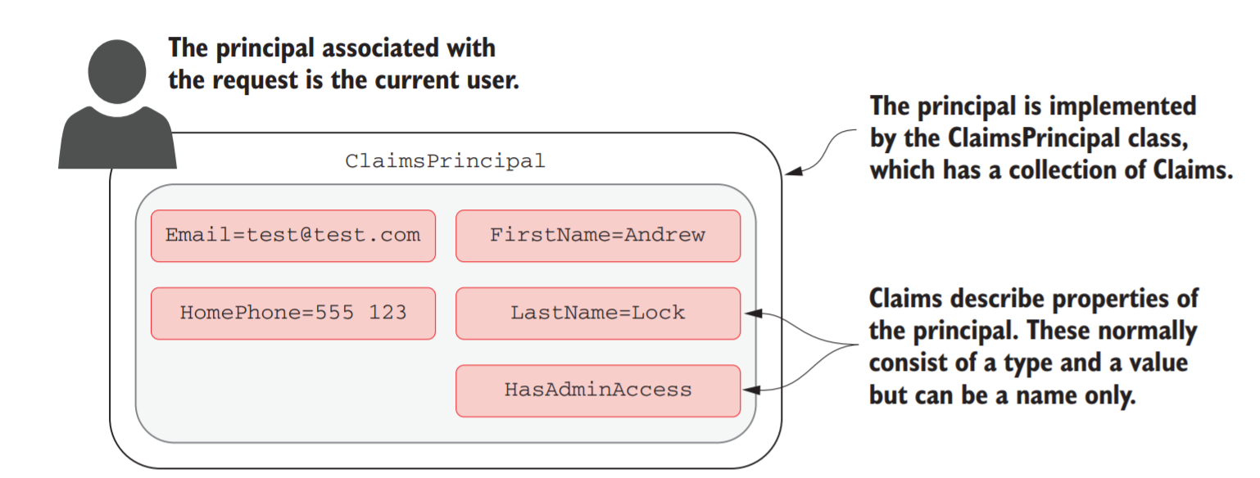
ClaimsPrincipals
A claim is a single piece of information about a principal, which consists of a claim type and an optional value.
Notes:
Earlier versions of ASP.NET used a role-based approach to security, rather than claims-based. The ClaimsPrincipal used in ASP.NET Core is compatible with this approach for legacy reasons, but you should use the claims-based approach for new apps.

Slide 6
Authentication in ASP.NET Core: services and middleware
Typical flow for most web apps:
The client sends an identifier and a secret to the app, which identify the current user. For example, you could send an email (identifier) and a password (secret).
The app verifies that the identifier corresponds to a user known by the app and that the corresponding secret is correct.
If the identifier and secret are valid, the app can set the principal for the current request, but it also needs a way of storing these details for subsequent requests.
For traditional web apps, this is typically achieved by storing an encrypted version of the user principal in a cookie.

Slide 7
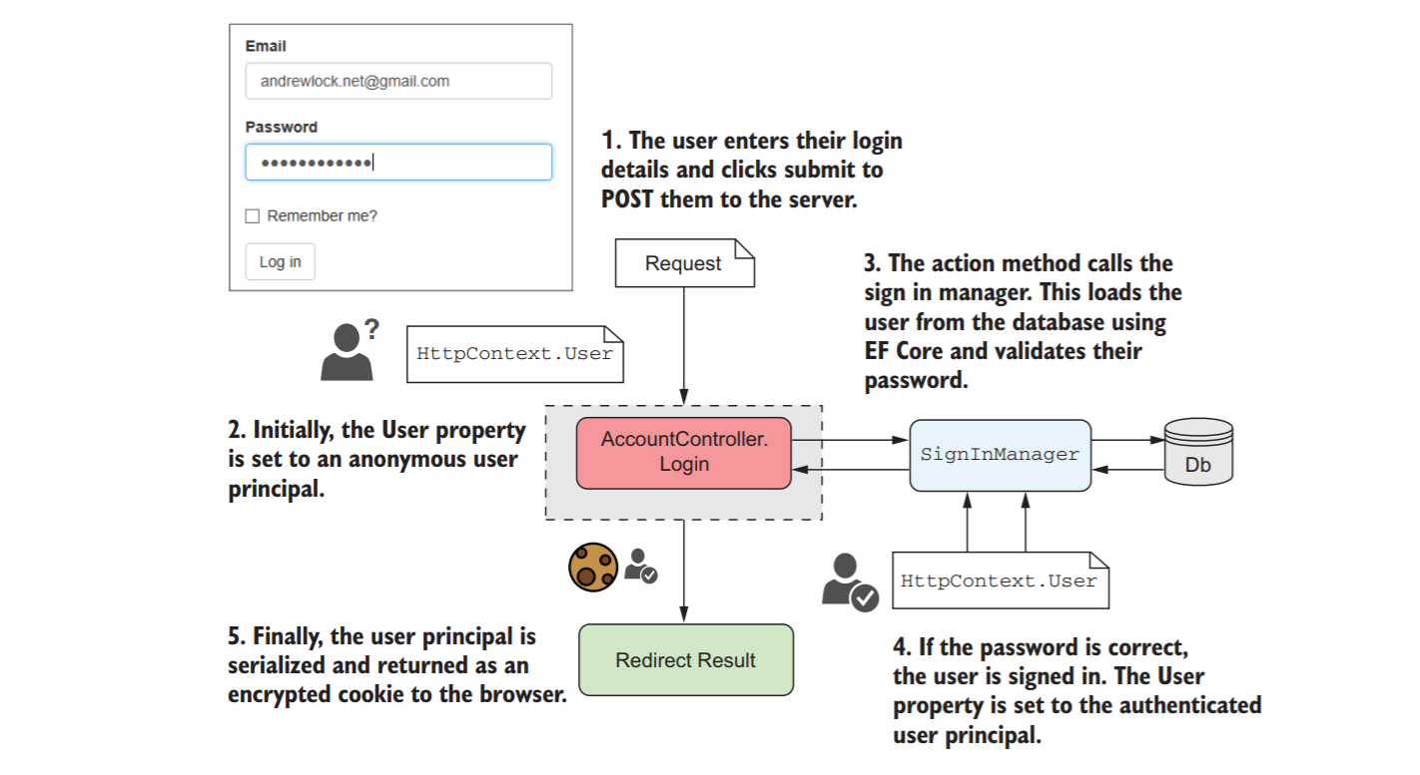
Signing in To an Asp.Net Core Application
Notes:
If the password is correct, SignInManager creates a new ClaimsPrincipal from the user entity it loaded from the database and adds the appropriate claims, such as the email. It then replaces the old, anonymous, HttpContext.User principal with the new, authenticated principal.
Finally, SignInManager serializes the principal, encrypts it, and stores it as a cookie. A cookie is a small piece of text that’s sent back and forth between the browser and your app along with each request, consisting of a name and a value.

Slide 8
Authenticating Users for Subsequent Requests
Browsers will automatically send this cookie with all requests made to your app, so you don’t need to provide your password with every request.
ASP.NET Core uses the authentication cookie sent with the requests to rehydrate ClaimsPrincipal and set the HttpContext.User principal for the request
The important thing to note is when this process happens—in AuthenticationMiddleware
Notes:
ASP.NET Core uses the authentication cookie sent with the requests to rehydrate ClaimsPrincipal and set the HttpContext.User principal for the request, as shown in figure 14.3. The important thing to note is when this process happens—in AuthenticationMiddleware

Slide 9
