Slide 1
Data Mining to find factors that contribute to seeking treatment for mental health
An Analysis of Workplace Mental Health Factors
Jason Noble
https://github.com/J-Nobull/Noble_ANA-680_Final

Slide 2
Database Basics
Data obtained from
https://www.kaggle.com/datasets/osmi/mental-health-in-tech-survey
Raw Data shape [1259, 27], no duplicates
Final Cleaned Datafile shape [1259, 24]

Slide 3
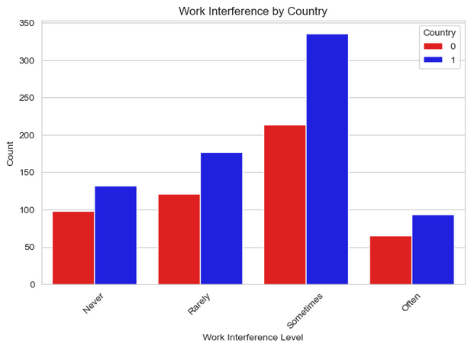

Problem statement
Improve American mental health and reduce workplace impact by identifying the most successful mitigation factors.
USA
USA
USA
USA

Slide 4
Null Hypothesis (H₀):
“No significant difference in factors influencing those that do seek mental health treatment."
Alternative Hypothesis (H₁):
“Different factors can be used to predict which employees will seek mental health treatment."

Slide 5
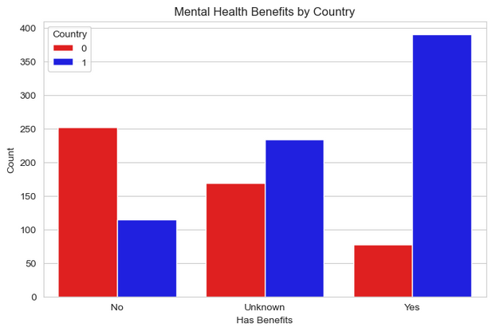
Exploratory data analysis – Resources
USA
USA
USA
The USA has more available mental health resources
Extra resources and availability has not translated into effectiveness.

Slide 6
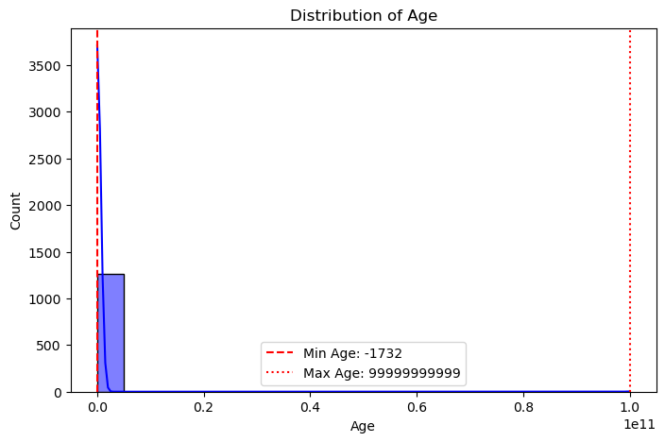
EDA – Numerical distributions
Age is the only numerical feature -
There in an age recorded over 320, the highest age is almost 100 Billion, additionally there are three negative ages.
In total, there are 8 ages that will be replaced with the mean age of 32 to clean the Age variable
Outliers are errors

Slide 7
Data Wrangling and Pre-Processing
Age requires cleaning of the outliers
Replacing any value below 18 or above 72 with Age_mean
Gender has 50 options in the original data
Combined into: Male, Female, Other
State: This should not influence outcome, will keep for now
Drop
Timestamp – An identifier based on when they did the survey
Comments – Few commented (13%), and they do not add to the dataset
Dummy Encoding (Objects to Category)
All remaining 22 variables will be converted to categorical
Most are already Yes/No, some have a third option
Some will be added to Yes
Unsure will be added to No
Maybe will be kept as third option

Slide 8
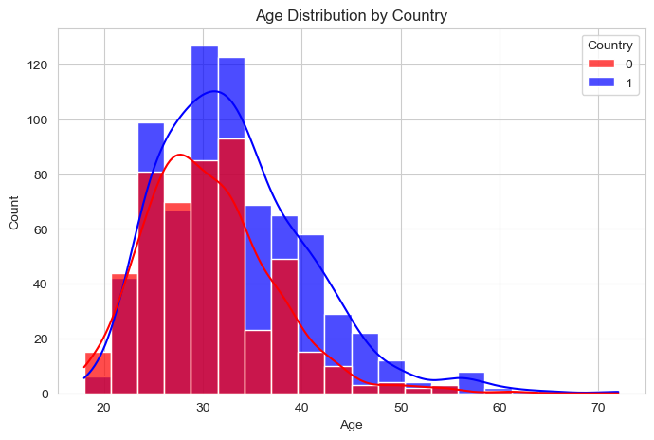
Numerical distributions
After cleaning, Age is left-skewed and closer to evenly distributed with a mean of 32

Slide 9
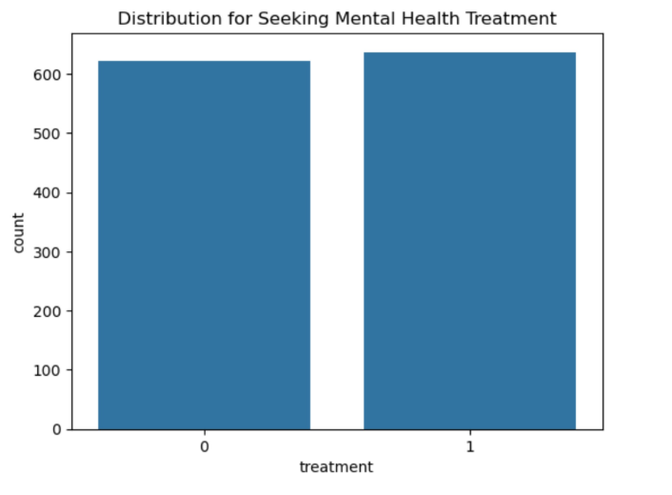
Target Variable is well balanced

Slide 10
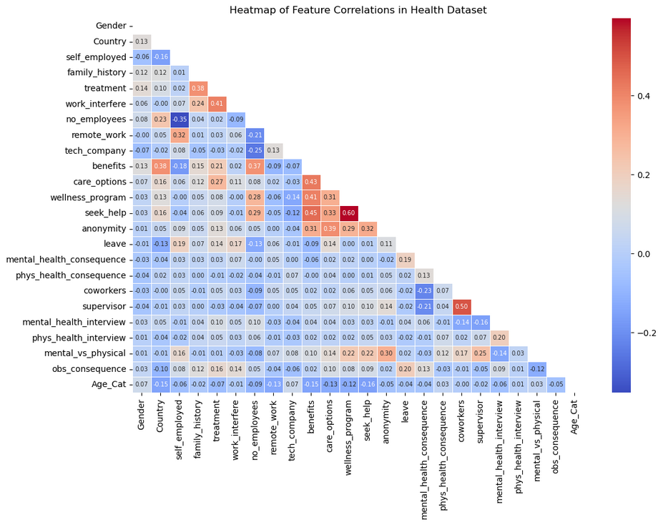
Heatmap of Feature Correlations in Health Dataset
Heatmap shows a few strong work influences:
#employees x self_employed
Seek_help x care_options
Supervisor x coworkers

Slide 11
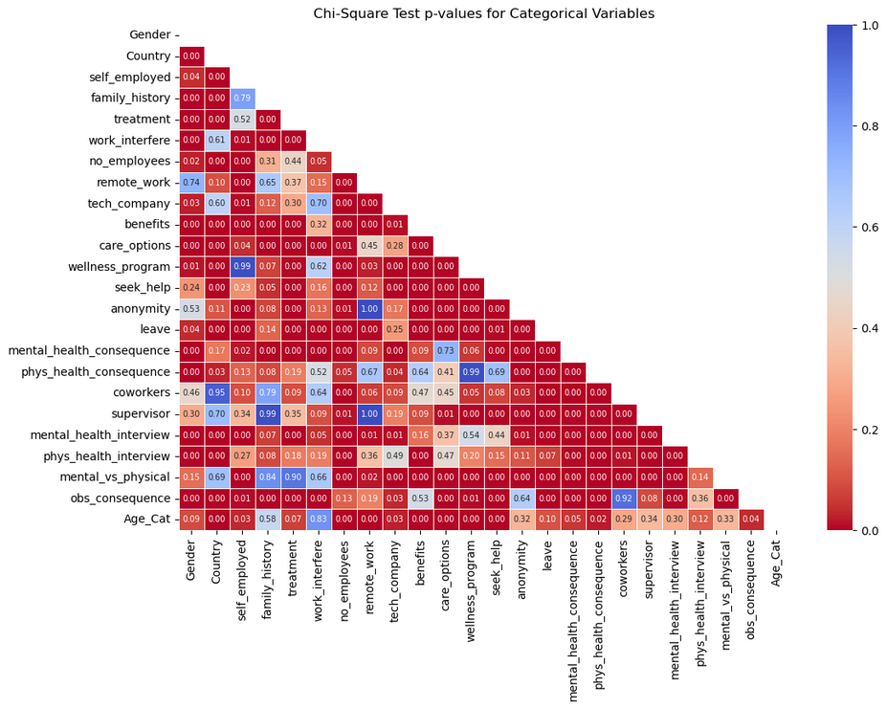
Chi-Square Test p-values for Categorical Variables
A handful of extremely high P-values:
Remote_work
Wellness_program

Slide 12
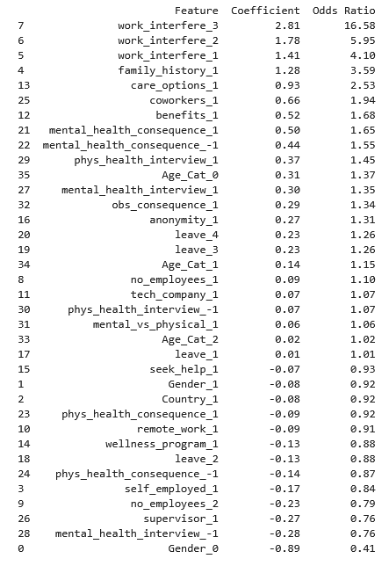
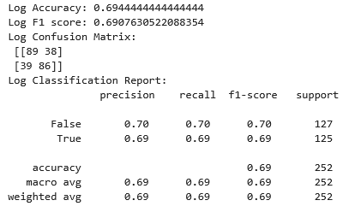
Logistic Regression

Slide 13
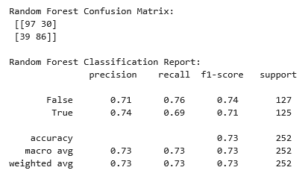
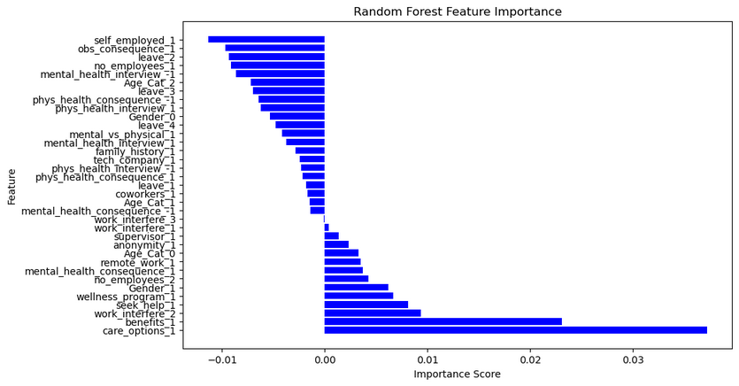
Random Forest

Slide 14
Thank You
Questions & Discussion

