Slide 1
Indexers
By Justin M, Naseem, daniel

Slide 2
What is a Indexer?
In object-orientated programming, an indexer allows instances of a particular class, struct or interface to be indexed just like arrays.
Indexers are most popular in types whose main purpose is to encapsulate internal collections or arrays.
Indexers can be used on a class with multiple arrays as long as they don’t have conflicting (same) types.
An indexer value is not classified as a variable.

Slide 3
What is an Indexers use?
Indexers provide a syntactic convenience. Instead of calling the variable within a class, we can call the class itself at a indexed value.
The indexer notation simplifies the syntax for the user, but makes the class and its purpose more intuitive for other developers.

Slide 4
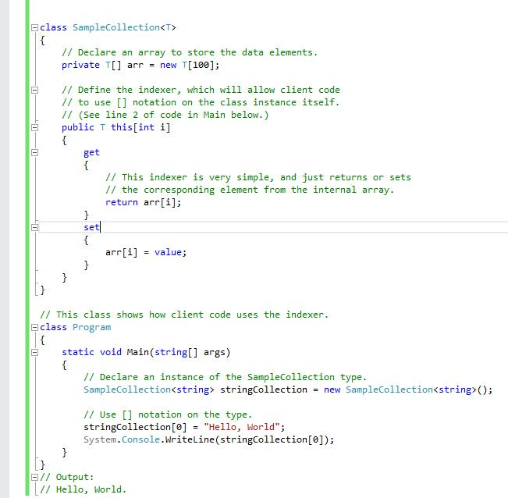
Example: Class Instance

Slide 5
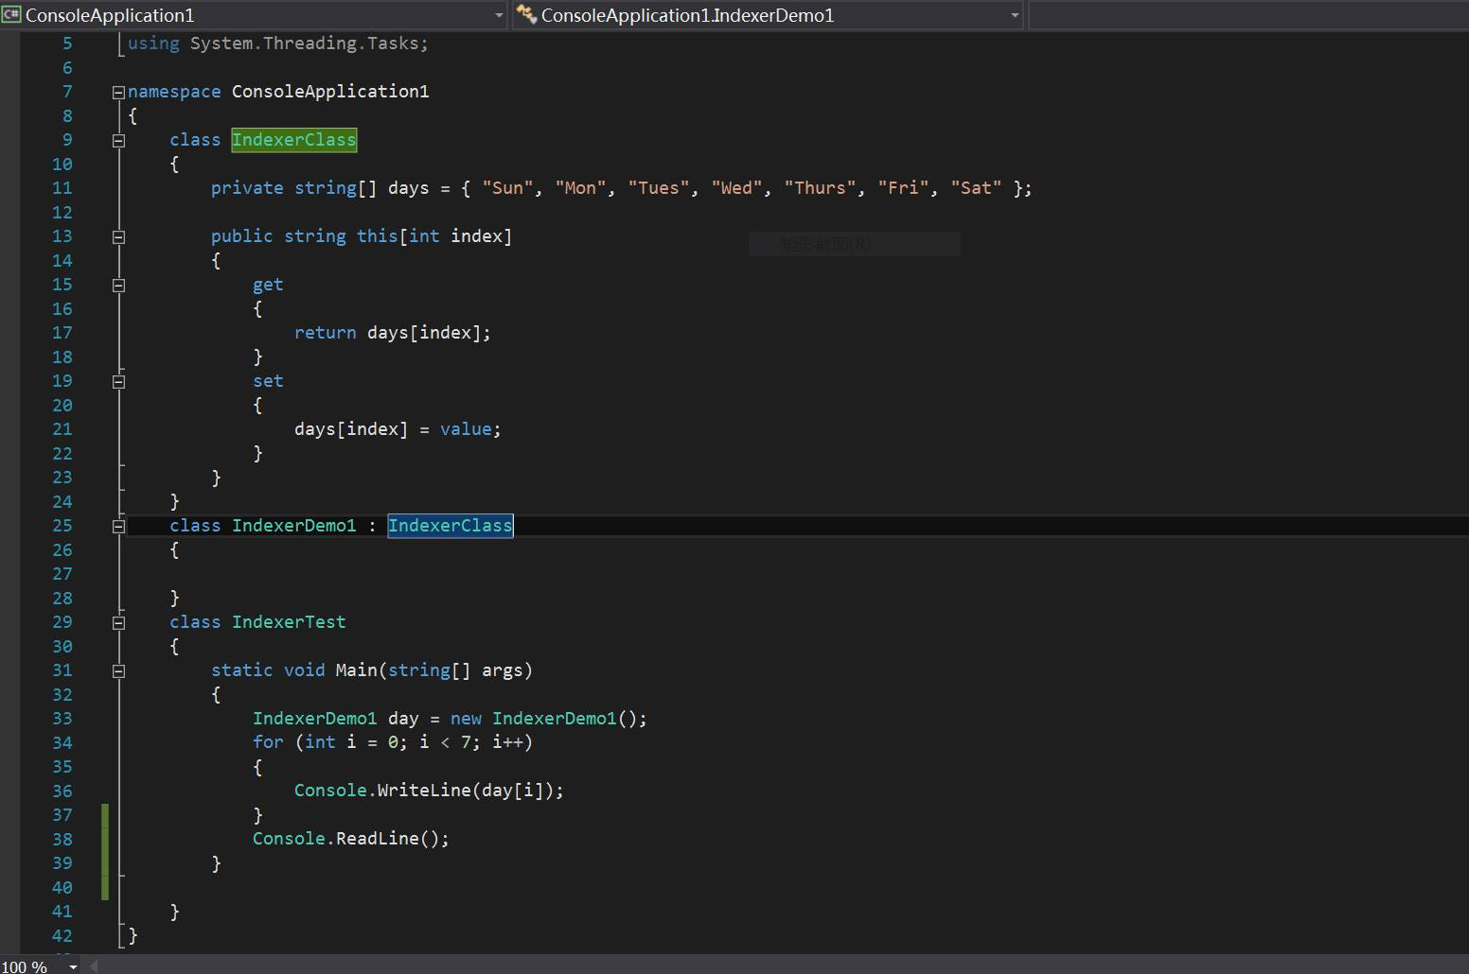
Example: String values

Slide 6
Activity
Question: Can you pass an indexer value as a reference or parameter?
Question: Do indexers have to be indexed by an integer value?
Question: Can indexers access two-dimensional arrays?
Challenge: Can you override an indexer?

Slide 7
