Slide 1
ID based Signature
Design project by J.Ravi Kiran ME_33

Slide 2
Contents
What’s ID based encryption
PKG-Public/Private Key Generator
RSA-Rivest Shamir Adleman
Encrypt
Sign
Client
Decrypt
Server

Slide 3
ID based encryption
In ID encryption or signature the ID’s of sender are receiver are the important factors
Because these ID’s work as an index to search for their corresponding public and private keys
The msg from sender will be encrypted using corresponding receiver’s public key which will be acquired using reciever’s ID
And the encrypted msg will be signed i.e., encrypted by default with sender’s public key
This signing will be undone by the reciever using sender’s public key i.e, Encrypted msg will be acquired
This encrypted msg will be Decrypted using receiver’s private key since it designed to encrypt using reciever’s public key itself
And the verification part will be done with reference to their ID’s

Slide 4
PKG-Public / Private Key Generator
PKG will get public and private keys from RSA which are numericals
And convert them into string then appending hat text to the file
This will be accomplished by using “Buffer Writer”
The key appending will be done to the corresponding ID’s
Which means if given ID is already registered the existing keys will be assigned
If not registered in server then new private key will be assigned

Slide 5
RSA-Rivest Shamir Adleman
RSA is a public – key cryptosystem (i.e.,a set of algorithm that converts plaintext to chipertext for encode or decode messages) that is widely used for data – transmission
In this algorithm it generate public and private keys for ID’s
This will accomplished by getting random primes p and q
Then we secret parameter n = p * q.
phi = (p-1)*(q-1) , and e is temporary public key made of “Math.abs(ID.hashcode())”
public key = e / gcd(phi, e) and the public key is generated
And the private key is generated using Extented Euclidean Algorithm

Slide 6
Encrypt
The Encryption of the message will be done by using both the “public key” and and the secret parameter “n” from PKG
First the message to be encrypted will be turned into bytes
Then Encrypted_message = msg ^ (public_key mod n) i.e.,turning the msg into Cipher
This will be done to each byte and added to array in encrypted_msg
Where mod is a math operator that finds the remainder when one integer is divided by another

Slide 7
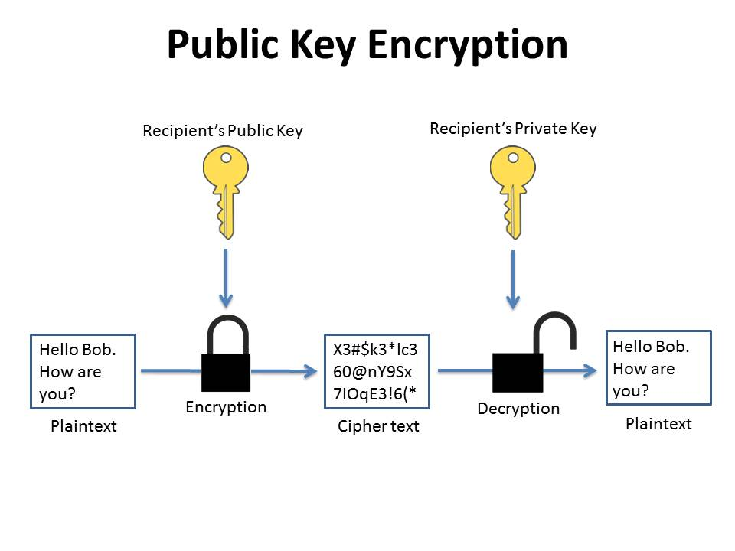
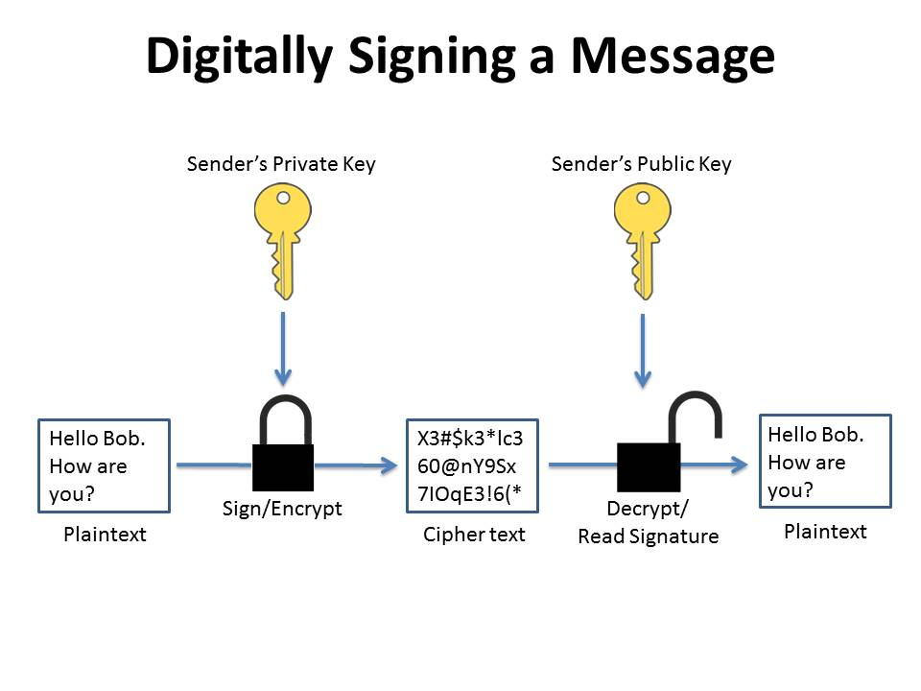
Sign
Encryption uses a key to ensure the ciphertext cannot be deciphered by anyone but the authorized recipient.
Signing of data works to authenticate the sender of the data and tends to implement a form of encryption in its process

Slide 8
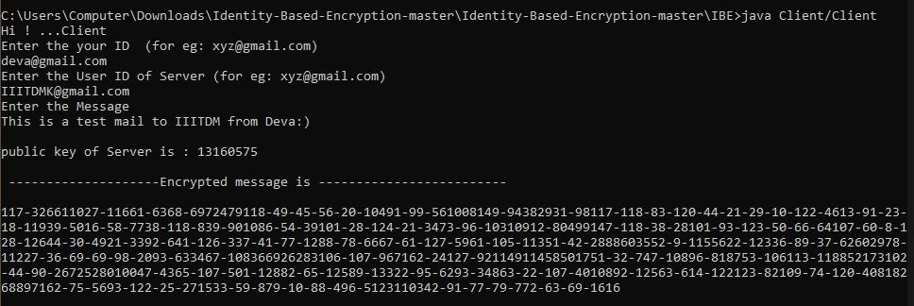
Client
The client will take the ID’s of sender and reciver
Then it gets the public key for the revicier’s ID from PKG
And use the recivers public key to encrypt the msg
After encryption is done the msg will be appended to Encrypted Message text file using Buffer Writer to the corresponding ID’s

Slide 9
Decrypt
This like Decipher the encrypted msg that is received.
After confirmation of ID the corresponding private key
Using the private key and secret parameter n from PKG;
Decrpy_msg = Encrypt_msg ^ (private_key mod n)
Like encryption, decryption also is accomplished by convert the encrypted msg into bytes
And decrypt byte by byte and append them to decrypted_msg array

Slide 10
Server
Upon given ID to the server it will give the private key that is generated in PKG
And uses that private key to decrypt the message if received any
Then displays the msg and with the sender’s ID
If there are no messages it’ll show there are no messages
Like in the following picture first we check wrong ID of “IIITDM@gmail.com”
Then it shows there are no messages
But if check for correct ID “IIITDMK@gmail.com” it will show message that that has been send to it

Slide 11
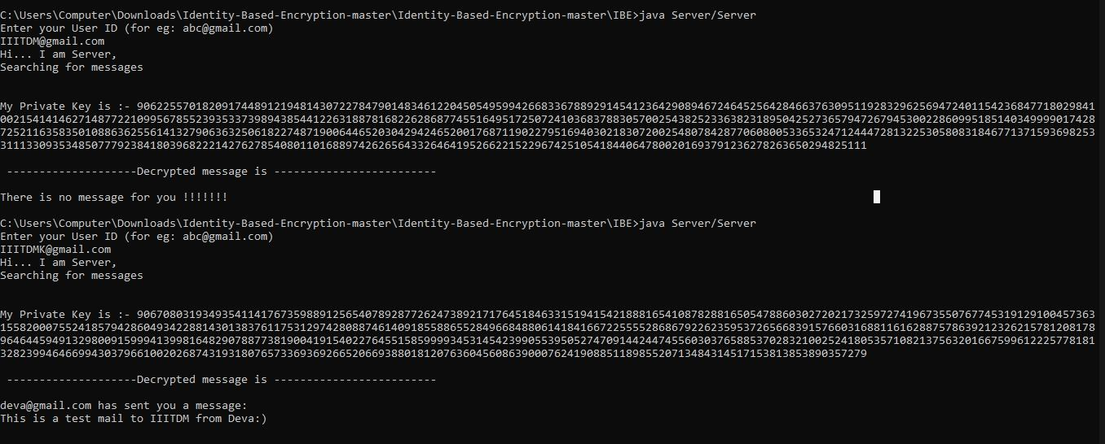
Server execution

Slide 12
Conclusion
Hence a ID bases encryption is made using java
Public & Private keys are generated using in PKG which uses RSA
Where the message will be taken and encrypted uing the recievers public key
Then sends the msg to the recievers uisng sender general public key which will be consideres as signing
And the recievers sends a request to the server to show the messages received to his/her ID
And the msg will be opened using sender’s public key i.e, sender’s signing
Then opened msg will be Decrypted using receiver’s private key and displayed

Slide 13
References
https://blog.mdaemon.com/encrypting-vs-signing-with-openpgp-whats-the-difference
https://www.geeksforgeeks.org/euclidean-algorithms-basic-and-extended/amp/
https://www.geeksforgeeks.org/rsa-algorithm-cryptography/amp/
https://math.stackexchange.com/questions/1146082/how-to-find-inverse-of-2-modulo-7-by-inspection
https://asecuritysite.com/ibe/ibe

