Slide 1
SIC-Individual Project
Hotel cancellation prediction
By 119me0033

Slide 2
ProblemStatement
Predict the probability of Hotel cancellations to be taken place based on the dataset on its history
url: https://raw.githubusercontent.com/Premalatha-success/Datasets/main/hotel_bookings.csv

Slide 3
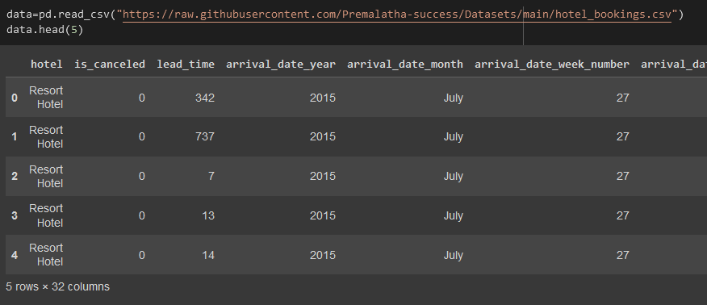
Loading dataset
With the help of pandas the dataset is read
Syntax:
Data=pd.read_csv(“url.csv”)

Slide 4
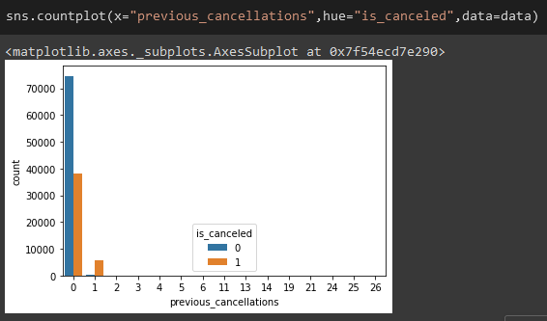
Plotting
After loading the dataset using seaboarn “prev_cancel” vs “is_cancel” is plotted
Syntax: sns.coutplot(x=‘’,hue=‘’,data=df)

Slide 5
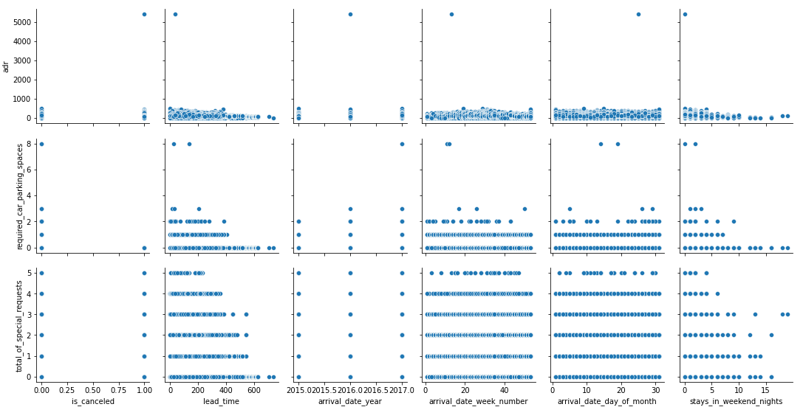
sns.pairplot(data) plt.show()

Slide 6
Finding the missing values
With the help of “data.info” command and “data.isnull().sum()” command
The columns are identified as object and numerical types
And the missing values are filled with mode() & median() for object&numerical type respectively
Syntax:
df[a]=df[a].fillna(df[a].mode()[0])
df[a]=df[a].fillna(df[a].median())

Slide 7
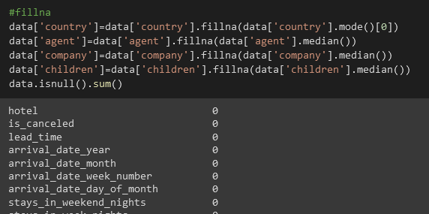
Filling

Slide 8
Removing Duplicates
The duplicated will be dropped from the dataset with the below commands
Syntax:
#check for duplicate data
duplicate = data.duplicated()
print(duplicate.sum())
#drop the duplicates
data.drop_duplicates(inplace=True)

Slide 9
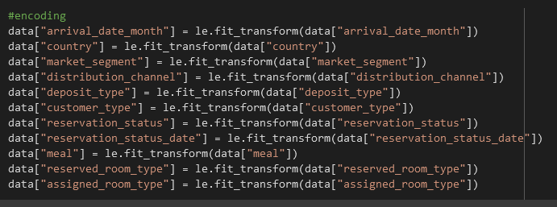
Encoding

Slide 10
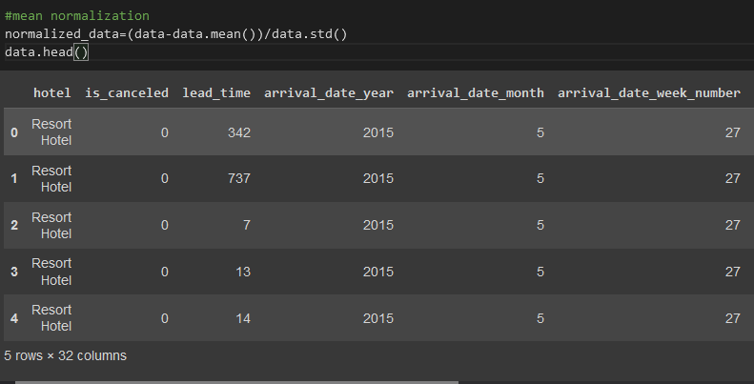
Normalization

Slide 11
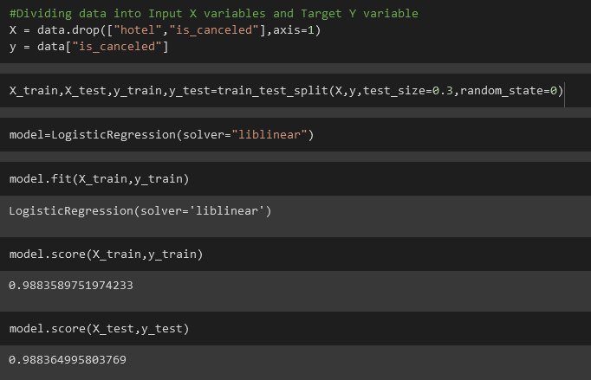
LogisticRegression

Slide 12
Various score
For various regressions got various score
KNN – train:0.89 test:0.84
SVM – train:0.8022 test:0.8027
NaiveBayes – train: 0.80 test:0.80
DecisionTree – train:1.0 test:1.0
Bagging – train:0.98 test:0.98
AdaBoost – train:0.274 test:0.276

Slide 13
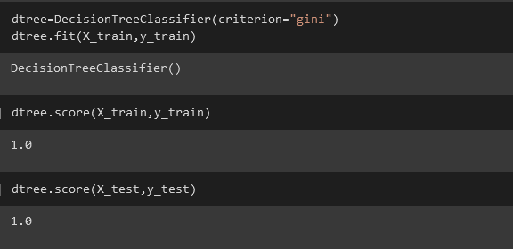
Conclusion
Hence I prefer DesicionTree for better results as it got 100 score in this scenario

