Slide 1
Threads

Slide 2
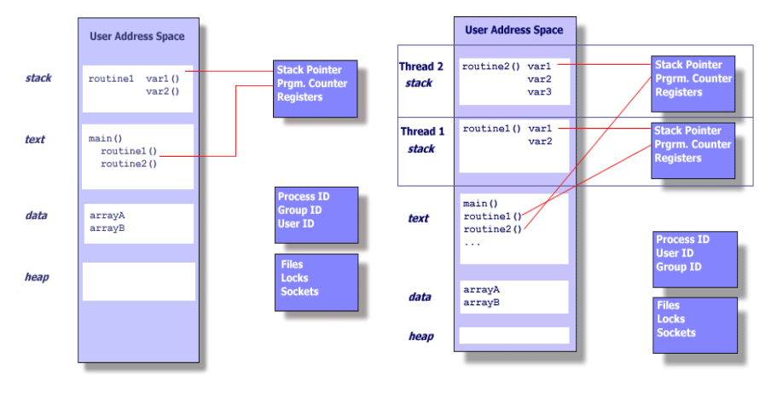
Single and Multithreaded Processes

Slide 3
User vs Kernel Level Threads
User-level threads – manage threads in user code
  advantages – efficient and flexible in space, speed, switching, and scheduling
  disadvantages – one thread blocked on I/O can block all threads, cannot take advantage of SMP
Kernel-level threads – kernel manages the threads
  Advantages – removes disadvantages of user-level threads
  Disadvantages – greater overhead due to kernel involvement
  Examples – provided by almost all general-purpose OS
    Windows, Solaris, Linux, Mac OS, etc.

Slide 4
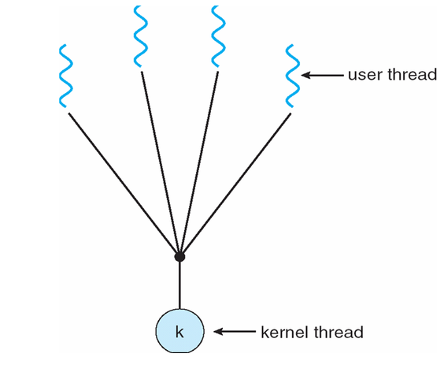
Multithreading Models
Many to One Model

Slide 5
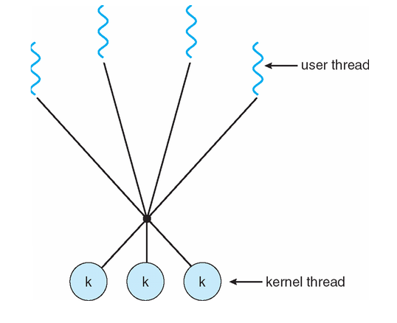
Multithreading Models
Many to Many Model

Slide 6
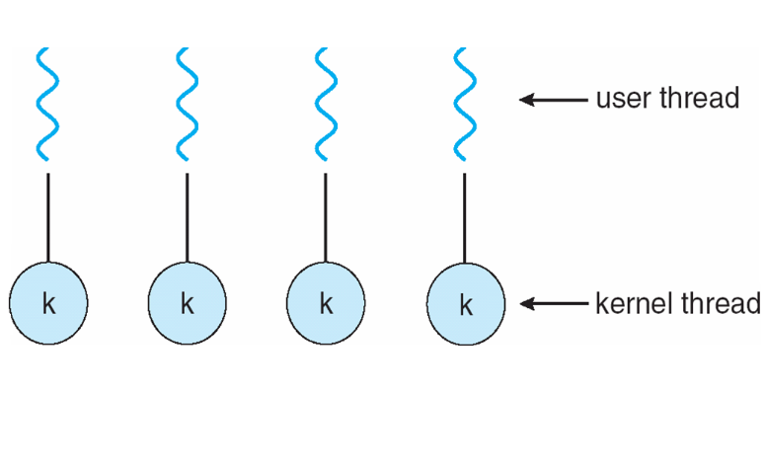
Multithreading Models
One to One Model

Slide 7
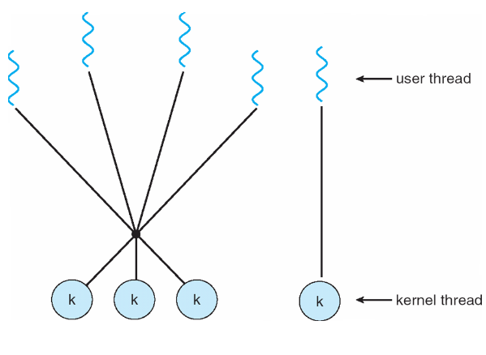
Multithreading Models
Two Level Multithreading Model

Slide 8
Code Examples

Slide 9
Schedulers

Slide 10
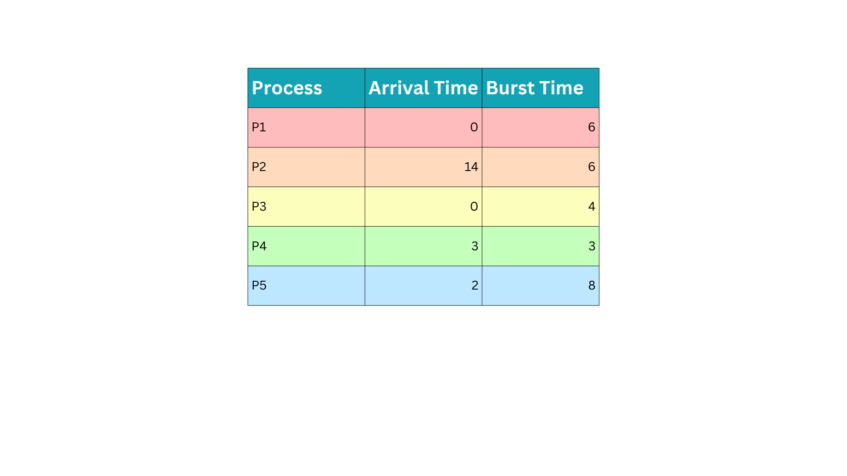
SJF
0

Slide 11
SJF
0
4
7
13
21
27

Slide 12
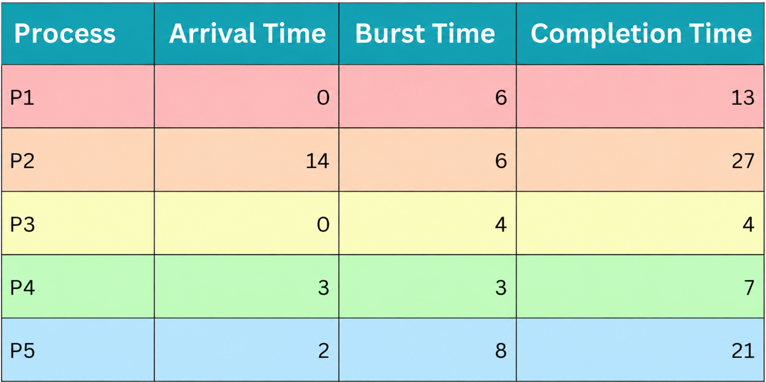
SJF
Completion Time – Arrival Time – Burst Time = Waiting Time
13 – 0 – 6 = 7
27 – 14 – 6 = 7
4 – 0 – 4 = 0
7 – 3 – 3 = 1
21 – 2 – 8 = 11
Average Wait Time = The sum of all wait times / number of processes
Average Wait Time = (7 + 7 + 0 + 1 + 11)/5 =
5.2

Slide 13
PSJF
0

Slide 14
PSJF
0
4
7
13
14
20
27

Slide 15
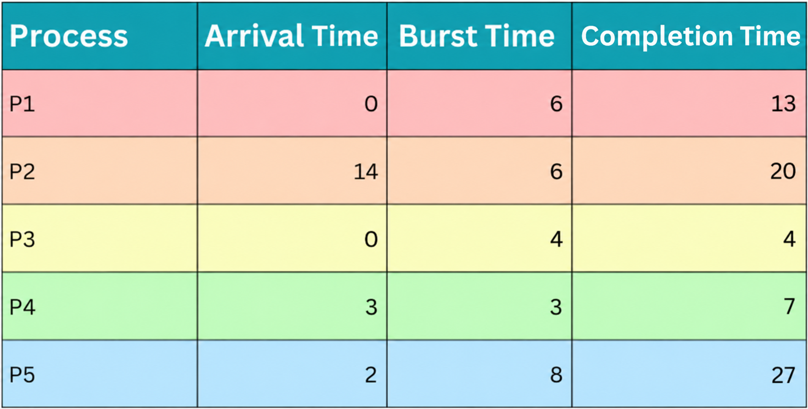
PSJF
Completion Time – Arrival Time – Burst Time = Waiting Time
13 – 0 – 6 = 7
20 – 14 – 6 = 0
4 – 0 – 4 = 0
7 – 3 – 3 = 1
27 – 2 – 8 = 17
Average Wait Time = The sum of all wait times / number of processes
Average Wait Time = (7 + 0 + 0 + 1 + 17)/5 =
5.0

Slide 16
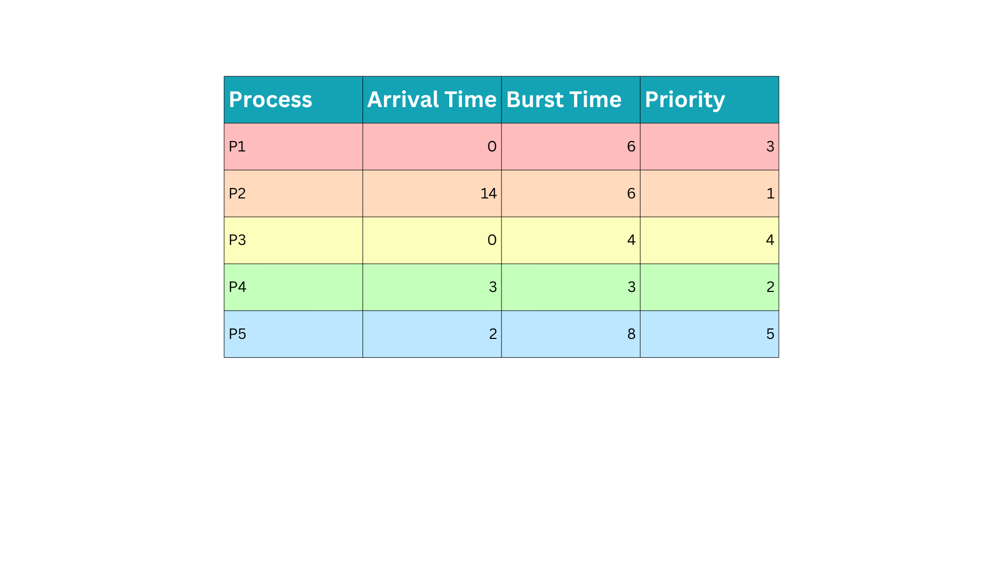
PRI
0

Slide 17
PRI
0
6
9
13
21
27

Slide 18
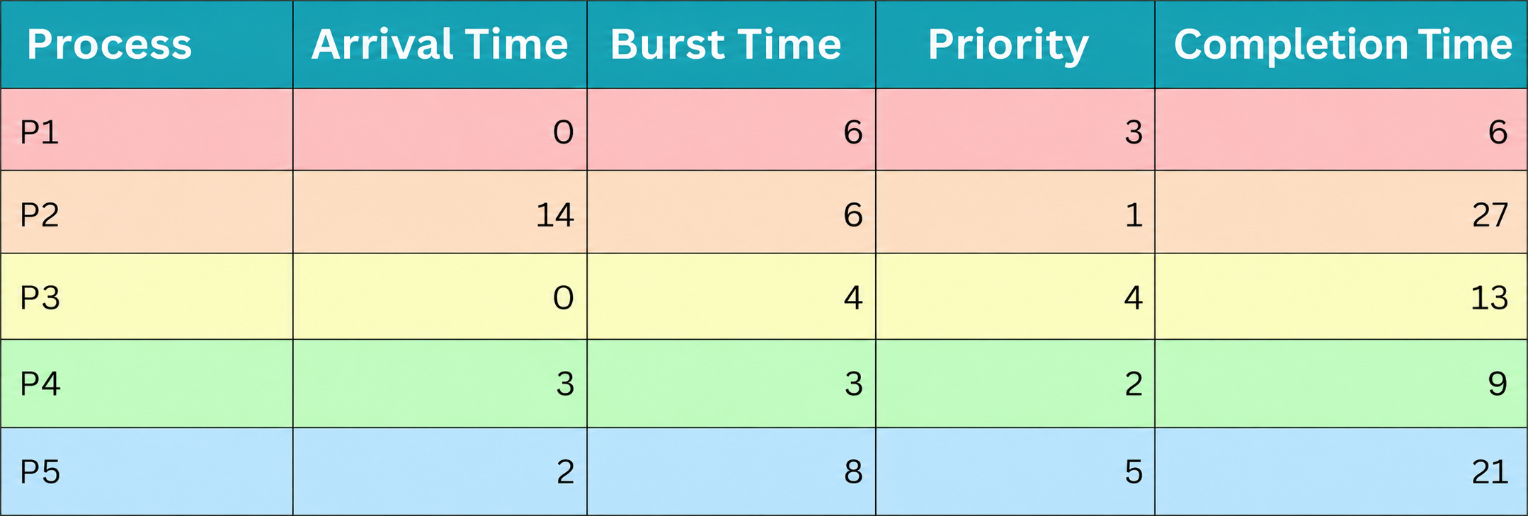
PRI
Completion Time – Arrival Time – Burst Time = Waiting Time
6 – 0 – 6 = 0
27 – 14 – 6 = 7
13 – 0 – 4 = 9
9 – 3 – 3 = 3
21 – 2 – 8 = 11
Average Wait Time = The sum of all wait times / number of processes
Average Wait Time = (0 + 7 + 9 + 3 + 11)/5 =
6.0

Slide 19
PPRI
0

Slide 20
PPRI
0
3
6
9
13
14
20
27

Slide 21
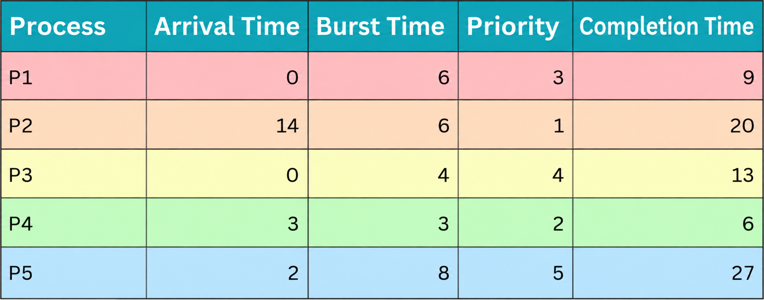
PPRI
Completion Time – Arrival Time – Burst Time = Waiting Time
9 – 0 – 6 = 3
20 – 14 – 6 = 0
13 – 0 – 4 = 9
6 – 3 – 3 = 0
27 – 2 – 8 = 17
Average Wait Time = The sum of all wait times / number of processes
Average Wait Time = (3 + 0 + 9 + 0 + 17)/5 =
5.8

Slide 22
RR (quantum = 3)
0

Slide 23
RR (quantum = 3)
0
3
6
9
12
15
16
19
22
24
27

Slide 24
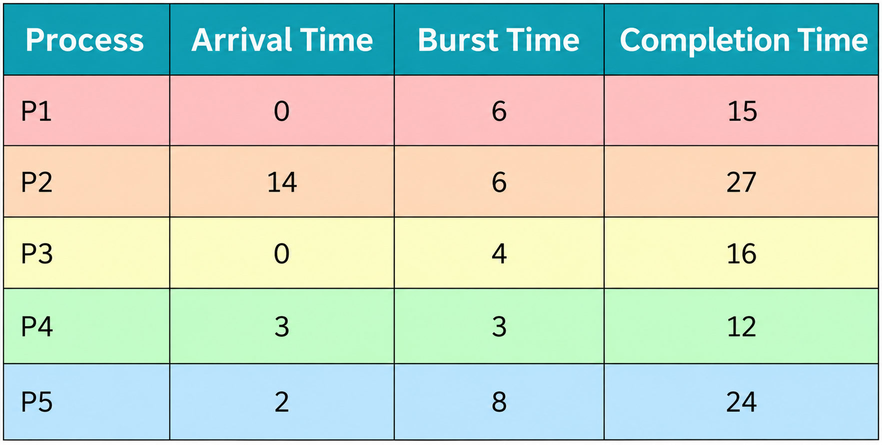
RR (quantum = 3)
Completion Time – Arrival Time – Burst Time = Waiting Time
15 – 0 – 6 = 9
27 – 14 – 6 = 7
16 – 0 – 4 = 12
12– 3 – 3 = 6
24 – 2 – 8 = 14
Average Wait Time = The sum of all wait times / number of processes
Average Wait Time = (9 + 7 + 12 + 6 + 14)/5 =
9.6

