Slide 1

DEEP LEARNING · PROJECT 2
House Price Prediction
with Neural Networks
A disciplined, reproducible workflow — not just the lowest error.
Ames housing dataset · 1,460 homes · 79 features · TensorFlow / Keras
Notes:
Hi everyone. This project is about predicting house prices - what a home actually sold for, based on things like its size, quality, location, and age. The dataset has about fourteen hundred and sixty homes, with seventy-nine pieces of information about each one, and I built the model using TensorFlow and Keras. But I want to be clear up front: the point of this project wasn't to get the smallest possible error. It was to do the work carefully and in the right order. And I'll finish with an honest answer to a question worth asking - whether a neural network was even the right tool for this job. Let's start with the data.

Slide 2

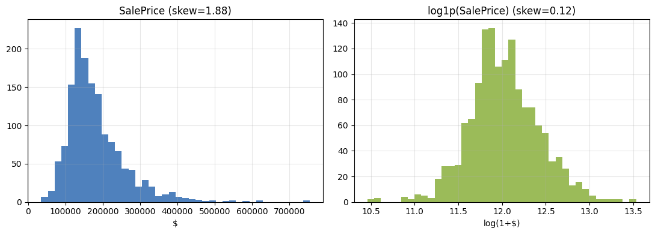
TASK 1 · BECOME ONE WITH THE DATA
Problem & dataset
1,460
Target is right-skewed → we model log(price)
training homes
79
input features
36 / 43
Why it matters Skew = 1.88 → 0.12 after log1p. Training in log-space optimises % error across a $35k–$755k range and matches the Kaggle metric.
Data quality 19 cols have NAs; for 15 of them NA means feature absent (no pool/garage) → kept as category "None". Two abnormal-sale outliers flagged.
numeric / categorical
Notes:
Before building anything, I looked closely at the data, and two things stood out. First, the prices are lopsided. Most homes are cheap-to-mid-priced, and a few are very expensive. If I predict prices directly, those few expensive homes dominate everything and distort the model. So instead, I predict price on a stretched-out, logarithmic scale. That evens things out, and it makes the model care about being off by a percentage rather than a flat dollar amount - which is what actually matters, whether a house is a hundred thousand or seven hundred thousand. Second, a lot of the 'missing' data isn't really missing. A blank in the 'pool quality' column just means the house has no pool. So I treat those blanks as a real answer - 'None' - instead of guessing a value. I also flagged two strange sales: very large houses that sold for very little. So with the data understood, the next step was to build something simple to compare against.

Slide 3

METHOD · KARPATHY'S TRAINING RECIPE
The workflow we followed
1
2
3
4
5
6
Data
Baselines
Sanity
Overfit
Regularize
Tune
understand it first
dumb references
trust the pipeline
prove capacity
close the gap
explore HPs
“Trust the pipeline before trusting the model.”
Every project task maps onto one stage of this recipe. Complexity is added only after the simpler version behaves exactly as expected — each experiment states what changed, why, what we expected, and what happened.
Notes:
I didn't jump straight to building a network. I followed a well-known checklist, in order. Understand the data first. Then build simple models to beat. Then run quick tests to make sure the code is actually correct. Then deliberately let the network memorize the data, to prove it's powerful enough. Then add techniques to stop it over-memorizing. And only then, fine-tune. The discipline throughout is simple: change one thing at a time, and predict what'll happen before you run it. The whole idea on this slide is right here - make sure the setup is trustworthy before you trust the model's results. So let's look at those simple models.

Slide 4

TASKS 2 & 3 · DUMB & CLASSICAL BASELINES
Baselines — how hard is the problem?
Predicting the mean is weak ≈ $88k RMSE. Any real model must crush this reference.
Linear regression is strong RMSE ≈ $23k, RMSE(log) 0.13 on well-prepared features.
The big question On small structured tabular data, classical models are tough to beat. Is Deep Learning even justified here?
Notes:
These are the yardsticks. Every fancy model has to beat them. The simplest thing you can do is guess the average price for every house. That's bad - it's off by about eighty-eight thousand dollars on average. So that's the floor; any real model has to clearly beat that. But here's the surprise. A basic linear regression - essentially a straight-line formula - already gets the typical error down to about twenty-three thousand dollars. That's strong. And it raises the question that runs through the rest of this talk: if a simple model is already this good, is a neural network even worth it? Hold that thought. Before I answer it, I had to make sure my setup was actually correct.

Slide 5

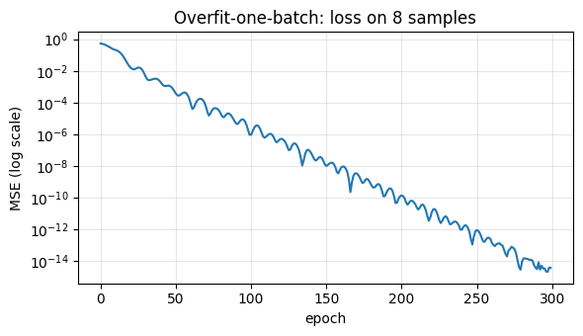
TASK 4 · TRAINING SUCCESS ≠ CORRECT LEARNING
Pipeline verification & sanity checks
Loss at initialization
Overfit one tiny batch
No data leakage
1.000
≈ 0
train-only
≈ 1.0 expected (standardized target, zero-init output) — OK
8 samples driven to ~0 loss → the model can learn
imputer / scaler / one-hot fit on training rows only
Overfit-8 loss collapses to zero
Why this matters. A running training loop does not imply a correct model. Passing these sanity checks means later results reflect the model, not a silent bug in labels, loss or preprocessing.
Notes:
These are quick sanity checks to catch bugs before wasting time tuning anything. First: when the network starts out untrained, its error should land on a specific, predictable number - and it does, exactly one-point-zero on our scale. That tells me the math is wired up correctly. Second: I give the network just eight houses and check whether it can memorize them perfectly. It drives its error all the way to zero - so it's genuinely capable of learning. And third: I make sure the model never peeks at the test data while I'm preparing things - no accidental cheating. The takeaway is that code which runs isn't the same as code that's correct. So I verify first, then build. Which brings us to the network itself.

Slide 6

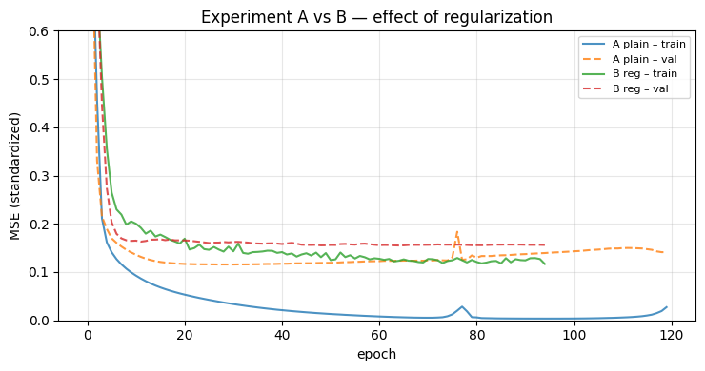
TASK 5 · OVERFIT → REGULARIZE → TUNE
Development — one change at a time
Exp | What changed | Why | Result
A · plain | MLP, He init, Adam 3e-4, no reg. | prove it can fit (overfit) | $29k
B · regularized | + BatchNorm, Dropout 0.3, L2, early stop | close the train/val gap | $29k
C · tuned | deeper net, Adam vs Nadam | explore hyperparameters | $28k
Regularization closes the gap
Selected final model: NN-B regularized — best validation loss with the restored best checkpoint. Architecture/optimizer tweaks moved the needle far less than regularization, exactly as the recipe predicts.
Notes:
I ran three experiments, and each one changed just a single thing. Experiment A is a bare-bones network with no safeguards. Its only job is to prove the network is powerful enough to memorize the training data. And you can see that in the chart - the training error drops way below the validation error, which is the classic sign of memorizing. Experiment B adds standard techniques to stop that over-memorizing, so it does better on new, unseen houses. Experiment C tries a deeper network and a different training method. And honestly? All three are very close. I picked B as the final model, because it did best on data it hadn't seen. The real lesson here is that the safeguards mattered far more than fiddling with the network's shape. So - how good is that final model, really?

Slide 7

TASK 6 · METRICS THAT MEAN SOMETHING
Evaluation & business interpretation
$16k
What it means. Predictions typically land within ~$16k of true price (11% of a $154k median). Usable for triage/portfolio estimates; too coarse for a binding individual offer.
MAE (avg error)
$29k
RMSE
Honest verdict. The neural network only matches linear regression — it does not clearly beat it. On small structured data that is the expected outcome, not a failure.
11%
of median home price
Notes:
Let me put the numbers in plain terms. On average, the model is off by about sixteen and a half thousand dollars, and its typical error is around twenty-nine thousand - which is roughly eleven percent of a typical home's price. So what's that good for? It's fine for a rough estimate, or for sorting through a big list of properties. But it's not precise enough to make a firm offer on a single house - eleven percent of a three-hundred-thousand-dollar home is thirty thousand dollars, and that's real risk. And here's the honest verdict, which is really the heart of this project: the neural network only tied the simple linear model. It didn't beat it. And for a small table of numbers like this, that's exactly what we'd expect - it's not a failure, it's the expected result. Now let me show you that the model is at least reasoning sensibly.

Slide 8

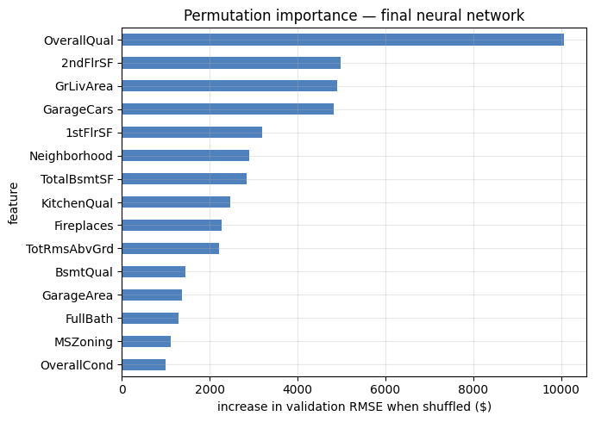
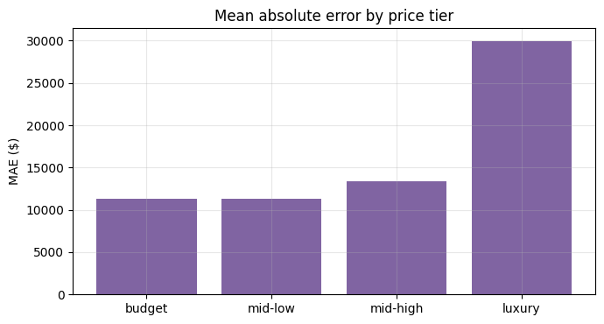
TASK 7 · DO THE MODEL'S REASONS MAKE SENSE?
Explainability & error analysis
Permutation importance — top features
Sensible drivers. The network leans on OverallQual, 2ndFlrSF, GrLivArea, GarageCars, 1stFlrSF, Neighborhood — the same factors that topped the EDA correlations. Model logic agrees with domain intuition.
Error grows with price (MAE by tier)
Notes:
Two questions here: is the model using sensible information, and where does it go wrong? On the left, I measured how important each feature is by scrambling it and seeing how much worse the predictions get. The most important ones are overall quality, living area, garage and basement size, and neighborhood. That's exactly what you'd expect - and exactly what looked important back when I explored the data. That agreement builds trust. On the right, you can see where it struggles. The errors grow with price. Expensive homes are predicted about three times worse than mid-priced ones - simply because there are very few of them to learn from. So in practice, I'd attach a 'lower confidence' warning whenever the model prices an expensive home. Now, what would it actually take to use this in the real world?

Slide 9

TASK 8 · FROM NOTEBOOK TO PRODUCTION
Deployment & monitoring
Offline training
Model artifact
API serving
Monitoring
monthly on new sales
weights + preprocessing + metadata
single prediction on demand
drift + performance decay
Drift type | Housing example | Signal to watch
Covariate | new neighbourhoods / home-type mix | input feature distributions shift
Label | general price inflation | predicted vs realised price diverges
Concept | interest-rate / demand changes | error rises though inputs look normal
Retraining & fallback
Scheduled + drift-triggered retraining; versioned checkpoints for rollback.
Fallback to the linear baseline (or a human appraiser) for luxury / out-of-distribution homes.
Notes:
Imagine a real-estate company actually using this. They'd retrain it every so often - say monthly - as new sales come in, and serve predictions through a simple online service. And importantly, you don't ship the training code - you ship a self-contained package: the trained model, plus the data-preparation steps, plus notes about it. Then you have to keep watching it, because the housing market constantly changes. New neighborhoods appear. Prices drift upward with inflation. And interest-rate changes can shift how features even relate to price. So we'd set up alerts for those shifts, retrain when needed, keep older versions so we can roll back, and fall back to the simple model - or a human appraiser - for unusual homes. So, to wrap up: what did we actually learn?

Slide 10

KEY LESSONS
What the project really taught
1
Was Deep Learning justified?
2
Highest-impact decisions
Not clearly. A linear regression matched the tuned network on 1,460 tabular rows — the textbook "DL may be overkill" case. The value was the process.
The log-target transform, leakage-free preprocessing, and regularization + early stopping. Architecture tweaks mattered far less.
3
Biggest challenge
4
Before deployment
Getting the network to even match the baseline, and large errors on rare luxury / abnormal-sale homes.
Drift monitoring, a retraining policy, calibrated uncertainty, a baseline/human fallback — and the humility to ship the simpler model.
Notes:
Let me close with the honest reflection. Was the neural network worth it? Not really - a simple model did just as well. And that's the expected outcome for a small table of numbers like this. The real payoff was the careful process, not the model. The decisions that mattered most were preparing the data well - the stretched price scale, and no cheating - and the safeguards against over-memorizing. Not the network's design. The hardest part was the expensive homes. And before trusting this in the real world, you'd want monitoring, confidence estimates, a backup plan, and frankly, the humility to ship the simpler model. So my final takeaway is this: a model you understand and trust beats a slightly better one that's a black box. Thank you - I'm happy to take any questions.

