Slide 1

Climate change analysis - Temperature & CO2
Group Project
Big Data Tools and Analytics
Presented by Rosanna Mueller, Rodrigo Conceição and João Silvestre

Slide 2
Index
Motivation
Datasets
Initial Questions
Data Cleansing
Answering Questions through Data Analysis
Initial Questions vs. Final Questions
Conclusions
References

Slide 3

Motivation
Climate change is one of biggest issues nowadays
Study seeks to explore topic in further detail
Analyze several time series of city temperature and CO2 emissions to find patterns and asses the gravity of the problem

Slide 4
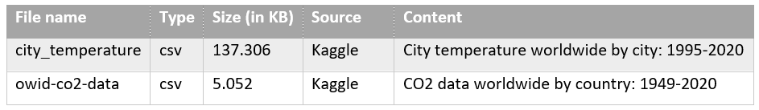
Datasets
Objectives:
Understand how the temperature has changed along the last years
Understand how the total CO2 emissions are distributed
among the countries,
over time,
by multiple perspectives
Identify if there is a relation between temperature and CO2 emissions

Slide 5
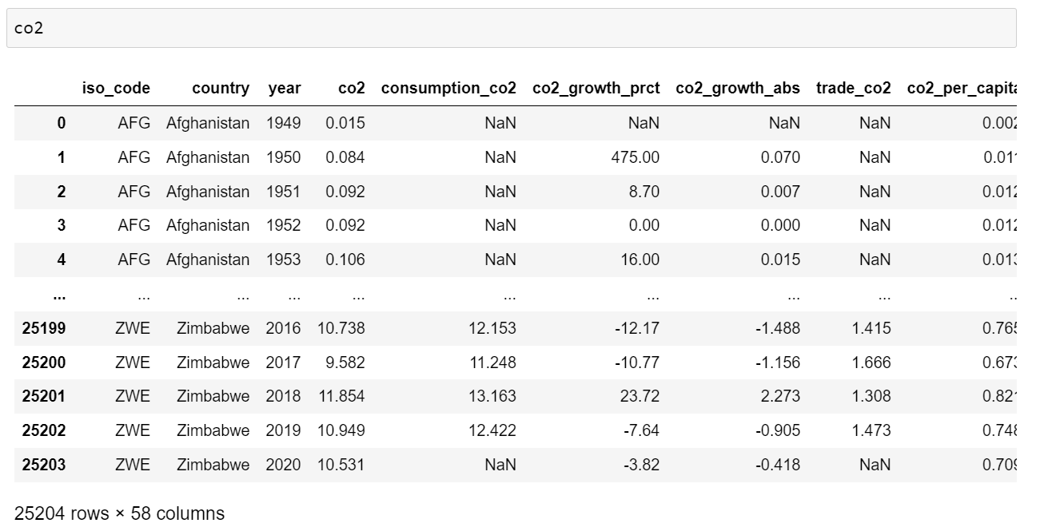
CO2 File

Slide 6
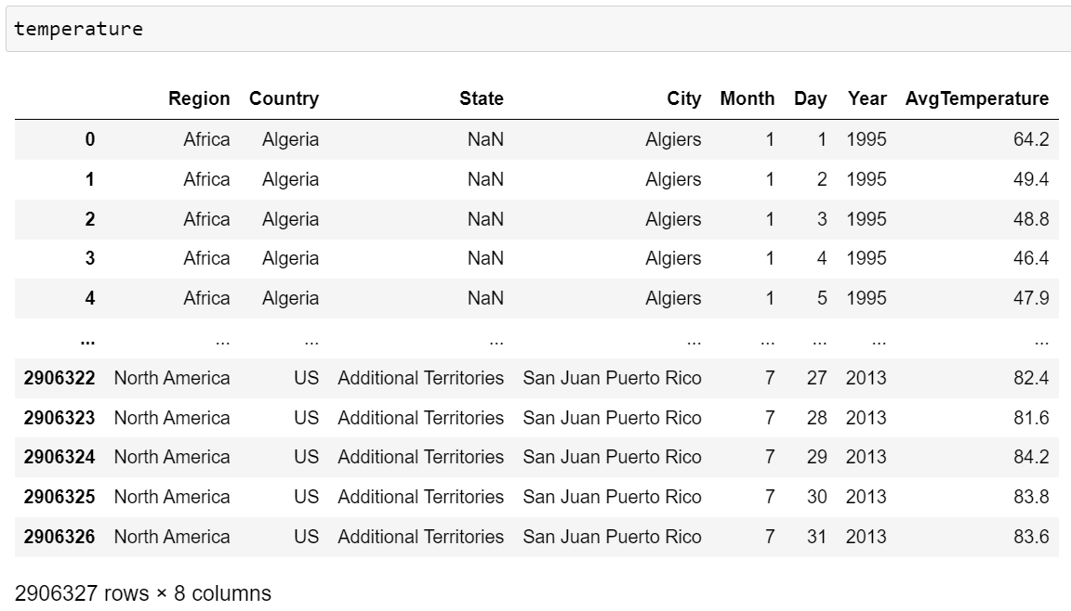
City Temperature File

Slide 7
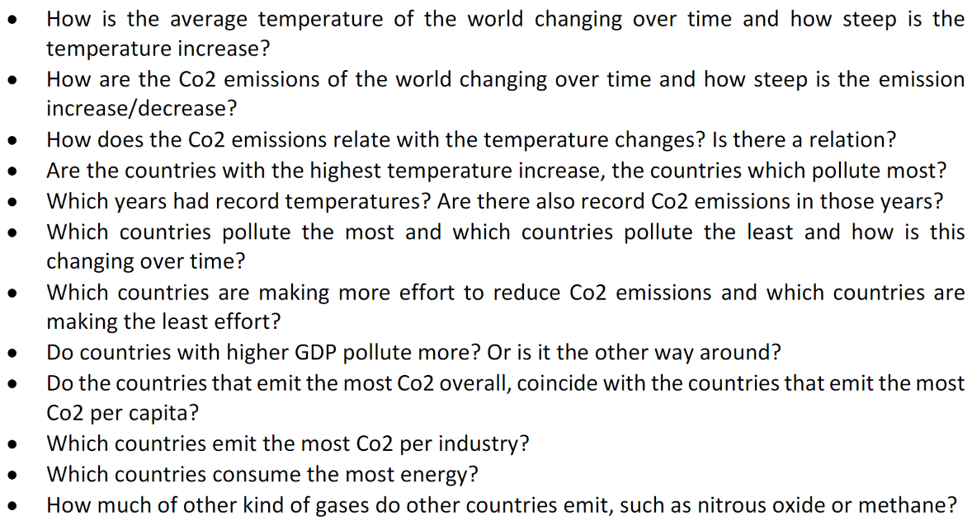
Initial Questions

Slide 8
Index
Motivation
Datasets
Initial Questions
Data Cleansing
Answering Questions through Data Analysis
Initial Questions vs. Final Questions
Conclusions
References

Slide 9
Index
Motivation
Datasets
Initial Questions
Data Cleansing
Answering Questions through Data Analysis
Initial Questions vs. Final Questions
Conclusions
References

Slide 10
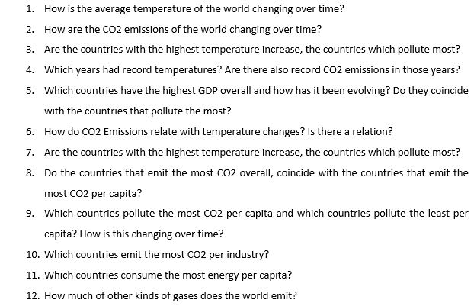
Initial Questions vs Final Questions

Slide 11

Conclusion
Temperature is changing at a fast pace, especially in the last few years.
CO2 production has a positive correlation with average temperature worldwide.
Need of worldwide consensus between all countries to reduce CO2 emissions and, therefore, restore temperature levels back to what they once were.

Slide 12
References
Kaggle, 2020, “Daily Temperature of Major Cities”, accessed 16 April 2022, https://www.kaggle.com/datasets/sudalairajkumar/daily-temperature-of-major-cities.
Kaggle, 2021, “GHG Emissions”, accessed 16 April 2022, https://www.kaggle.com/datasets/shabou/ghg-emissions?select=owid-co2-data.csv.

Slide 13

Questions?

