Slide 1
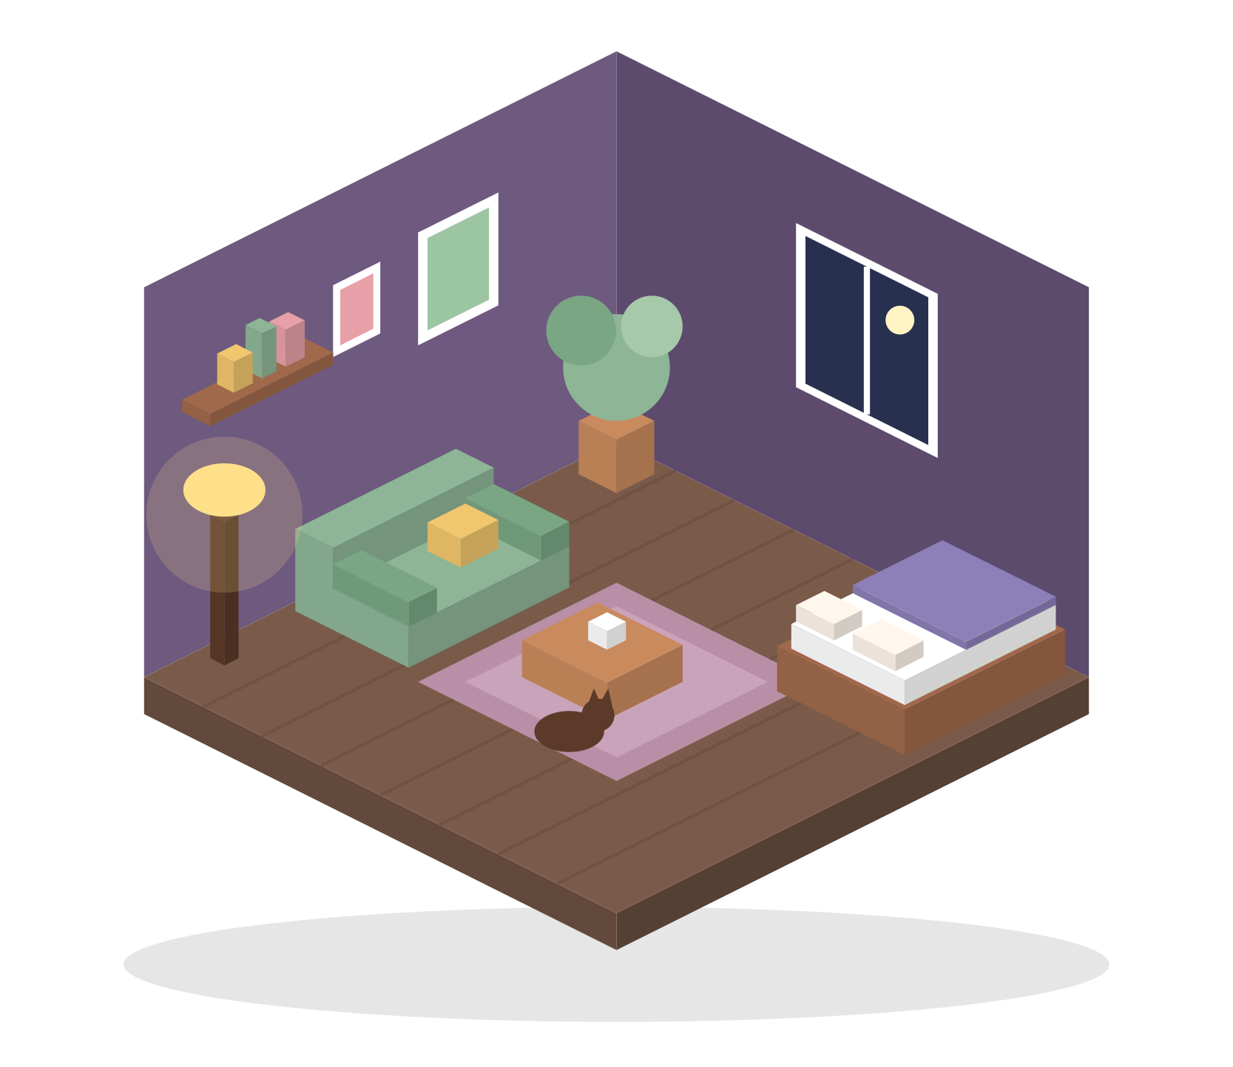
Another Home
No goals. Just home.
A comfy room, home or whatever designer — full Steam release of the itch.io hit by lane (emiwa)
Team 7 · Producer: Abdulazizov Abduazim · Director: Alexey · Budget $75,000
Notes:
Open with the tagline. Another Home is a free browser game on itch.io; we pitch its full Steam release with a $75k budget.

Slide 2
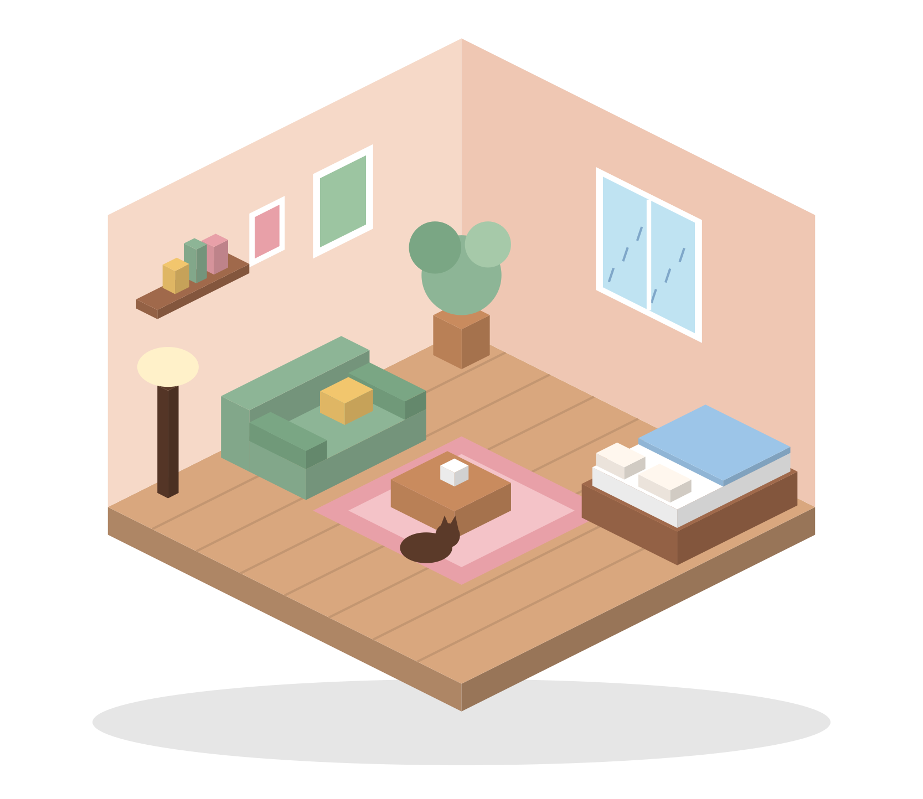
Game Overview
Cozy isometric home-decorating sandbox · Steam (PC, Steam Deck) · $9.99
GENRE
PLATFORM
Cozy sandbox / decorating
Steam + free browser version
PRICE
PLAYERS
$9.99 · DLC $2.99
16–30, cozy & design fans
SESSION
DEV TIME
20–60 min, endless replay
10 months · $75,000
Another Home · Team 7 · 2

Slide 3
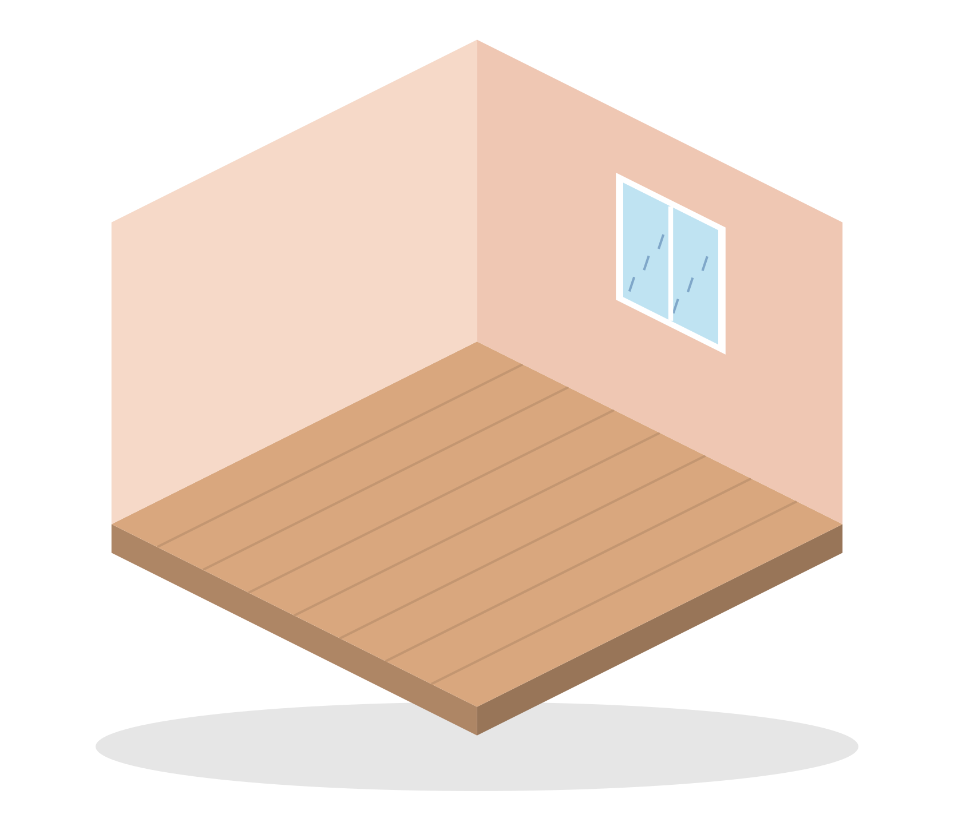
Video Trailer — 30-second storyboard
“Make Another Home” · shown on Steam page, TikTok and at Next Fest
Another Home
1
0–5 s
2
5–15 s
3
15–25 s
4
25–30 s
Empty grey room. Text: “My first apartment was empty…”
Fast satisfying placement: rug pops, sofa squishes, lamp clicks on
Rain starts, evening falls, cat curls up on the rug
“…so I made another home.” Logo + “Wishlist on Steam”
Another Home · Team 7 · 3

Slide 4
Core Loop
Every step is relaxing — nothing can go wrong
Choose a space
Satisfying touch
Unlock new pieces
Pick furniture
Every object pops, squishes and makes a soft sound.
≈ 2 min
per cycle
Optional Cozy Requests
Neighbours suggest themes and reward new furniture sets.
Admire & share
Place & adjust
Monthly furniture drops
Set the mood
Free updates bring players back every month.
Another Home · Team 7 · 4

Slide 5
Unique Selling Proposition
Pure, pressure-free creativity — the calmest decorating game on Steam
01
No goals, no stress
02
Tactile ASMR feel
No timer, no score, no fail state. Every choice is the right one.
Placement sounds are the #1 thing players praise in itch.io comments.
03
Huge living catalogue
04
Decorate together
≈ 1,000 pieces at launch + free furniture every month.
Online co-op for 2–4 friends, photo mode, postcards.
Another Home · Team 7 · 5

Slide 6
Demand
Goal-less cozy builders sell — and players already love this exact game
616k
0.6–1.1M
95%
≈180
copies of Tiny Glade sold in its first month
estimated copies of Townscaper (under $6)
positive reviews for “diorama”, the dev’s Steam version
player comments on the free itch.io page
GameDiscoverCo, 2024
Estimate — verify
83 reviews, Steam
emiwa.itch.io/home
Trends: Steam Deck growth · #cozygames and room-makeover content on TikTok · players ask for “more furniture” and “bigger houses”.
Another Home · Team 7 · 6

Slide 7
Position Map
Freedom vs. price — Another Home owns the free, affordable corner
Higher price
Our spot
House Flipper 2
More personal than Townscaper and Tiny Glade (interiors, your own room)
Freer than Unpacking and House Flipper
Impulse price of $9.99
Unpacking
Tiny Glade
Another Home
Townscaper
Lower price
diorama
Goal-driven
Total freedom
Another Home · Team 7 · 7

Slide 8
User Persona
Who buys Another Home
M
Mina, 22
J
Jake, 29
University student, Seoul
Office worker, Toronto
Plays Stardew Valley, Unpacking
Watches cozy room-makeover TikToks
Owns a Steam Deck, plays in bed
Spends ≈ $15 / month on games
Plays Townscaper, Minecraft creative
Likes LEGO and dioramas
Plays co-op with his partner
Buys games on Steam sales
“I want something calm before sleep — no pressure.”
“After work I just want to build something nice.”
Another Home · Team 7 · 8

Slide 9
Price & Gross Revenue
Base scenario · 3 years after launch · all figures USD
3-year gross revenue
$9.99
Steam game
Low
8k wishlists
$38k
$2.99
Furniture DLC pack
Base
25k wishlists
$4.99
Soundtrack
$207k
High
60k wishlists
Free
Browser version (tips)
$854k
Another Home · Team 7 · 9

Slide 10
Market Estimation
Top-down TAM → SAM → SOM (Steam)
TAM · 6.5M
TAM 6.5M
Steam players who buy cozy / sandbox games (≈ 5% of ~130M MAU)
SAM · 975k
SAM 975k
Of them, interested in home decorating under $15 (15%)
SOM · 15k
SOM
15k
Copies we can win in Year 1 (≈ 1.5% of SAM)
Approximate public figures — see Market Estimation sheet in the financial model.
Another Home · Team 7 · 10

Slide 11
Targets
Base scenario KPIs for the first year after launch
25,000
15,000
90%+
wishlists at launch
copies in Year 1
positive Steam reviews
$113k
20%
Year 2
gross revenue Year 1
players buy a DLC pack
break-even
Another Home · Team 7 · 11

Slide 12
Roadmap
10 months to launch, then monthly furniture drops and DLC
M1
M3
M5
M7
M9
M11
M13
M15
M17
Pre-production
Core rebuild
Steam page live
Content production
Co-op & Cozy Requests
Demo + Next Fest
Polish & localization
LAUNCH
Monthly furniture drops
DLC packs #1–2
Another Home · Team 7 · 12

Slide 13
Needs
What we need to make it happen
Team (freelance, remote)
$75,000
production budget (10 months)
Lead programmer
9 months
Partnership
with the original developer lane (emiwa)
Isometric 2D artist
8 months
Game designer
6 months
Creators
network of cozy streamers & TikTokers
Sound designer
2 months
QA tester
3 months
Steam Next Fest
demo slot before launch
Another Home · Team 7 · 13

Slide 14
Development Cost
$74,580 planned of $75,000 · $420 left
72% goes into the team — content is the product.
Another Home · Team 7 · 14

Slide 15
No goals. Just home.
$75k
budget, 10 months
15k
copies in Year 1 (Base)
Year 2
break-even
+17%
ROI after 3 years (Base)
Thank you! · Team 7 · Intro to Game Planning 2026-2

