Slide 1
Servlet
Servlet is a java based technology which features the base of web development using java
Using simple j2ee
Java
Using spring mvc
Using spring boot
There is no way to ignore servlet from web development where we are going to use Java

Slide 2

Servlet is a virtual concept
There is no real world existence of servlet
Tomcat
Jetty/Netty
Undertow
“Servlet is a concept & Tomcat/Jetty/Undertow… are implementations.”

Slide 3
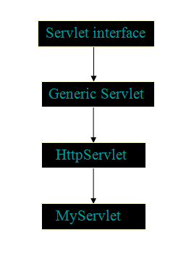
To achieve the abstraction.
class
inheritance
class
Get, post, put
inheritance
class

Slide 4
Tomcat
It a server which allows us to run servlet applications, this software was developed by Apache Software Foundation.
Servlet Application
deployment
Tomcat Server
Localhost:8080/project-servlet

Slide 5
Todo Application
Add todo, remove todo, mark as done
Todo 1
Todo 2
Web.xml (deployment descriptor)
url -> servlet
Todo 3
Todo 4
submit
Todo 4

Slide 6
Any request (GET/POST/DELETE)
Service method :
service(HttpServletRequest req, HttpServletResponse res){
}
Service method handles every request sent from client
doGet method: it handles only the get requests
doPost method: it handles only the post requests

Slide 7
Monolithic Approach
Service Based Approach
Approach 1
Approach 2
Servlet + JSP
Servlet API + HTML
Learn JSP
Servlet – JSP
What is REST API
Javascript
Task :
setup maven project and tomcat server to run servlet application
Try to make get & post request from html to servlet.

Slide 8
Client Side Redirect
Server Side Redirect
response.sendRedirect();
request.getRequestDispatcher(“home.jsp”).forward(request, response);
Fast
Slow
Data send with client side redirect is visible to user/client
Data send with server side redirect is not visible to user/client
url?variable=value
url query parameter
servlet
jsp
data

Slide 9
Session
Chrome
Localhost:8080
Cookies
User ID
Local Storage
Session Storage
Storage

Slide 10
User ID will be stored in session storage(servlet session storage)
success
LoginServlet
redirect
User
Dashboard.jsp
User id
User Data from Database

Slide 11
Logged in
Filter
DashboardServlet
LoginServlet
TodoServlet
Servlet

Slide 12
Condition 1
Condition 2
Filter
Filter
Servlet
User
If request fulfills the condition 1 & 2 properly then only the request will be forwarded to the servlet
Otherwise the user will receive proper error response or a default response
Condition 1 : is less than 30 ?
Condition 2 : is even ?

Slide 13
ToDo Application
(Track Day to Day activities)
List of ToDos
Write your todo
Todo 1
Write your todo here
Login/Register
Todo 2
save
Add todo
Wireframe Design

Slide 14
Sci - Calculator
History save

