Slide 1
Core Java :
Basics (loop, if else, switch case)
OOPs
Threading
Collection Framework
Java 8
I/O
String
Exception
Advance Java (Java EE) :
Java JDBC(Java Database Connectivity)
Servlet, JSP
Hibernate ( ORM – Object Relation Mapper )
Spring Framework
Spring Boot

Slide 2
Collection Framework
Collection
obj
obj
Collection is a object
And it holds multiple objects
Java version 2 – introduction of collection framework
Java version 1 – there were no collection framework

Slide 3
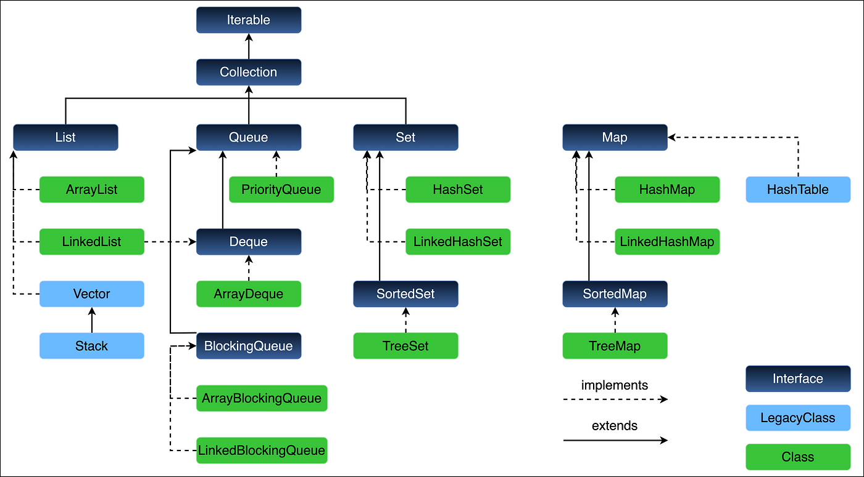

Slide 4
Legacy Class :
Ex: Vector, Stack, HashTable
ArrayList :
Dynamic Memory Allocation (10)
Supports only one datatype
Doesn’t support primitive datatypes (int, float)
Access time constant.
Delete, insert – excess time.
[1,2,3,4,5,6]
[1,2,3,4,5,6,7]
LinkedList :
1
1
1
Access time not constant.
1
Delete, insert – no excess time is needed.

Slide 5
Map
There are total 4 types of Map in Java
HashMap
HashTable
LinkedHashMap
TreeMap
HashMap
Stores Data in Key – Value Pair format
Type Safe – the datatype of key and value will remain same
Access time is constant
Insertion time constant
Keys will be unique – values can be repeated
HashTable – Legacy class
Stores Data in Key – Value Pair format
Type Safe – the datatype of key and value will remain same
Access time is constant
Insertion time constant
Keys will be unique – values can be repeated

Slide 6
SET
HashSet
LinkedHashSet
TreeSet
Unique set of elements
Insertion time log n
Access time constant
3,41,50,5
3,5,41,50

