Slide 1
Probability
Mr. Sunanda Das

Slide 2
Experiment: describes any process that generates a set of data. A simple example of a statistical experiment is the tossing of a coin.
Sample space: The set of all possible outcomes of a statistical experiment is called the sample space and is represented by the symbol S.
Each outcome in a sample space is called an element or a member of the sample space, or simply a sample point.
S = {H, T}, where H and T correspond to heads and tails, respectively.

Slide 3
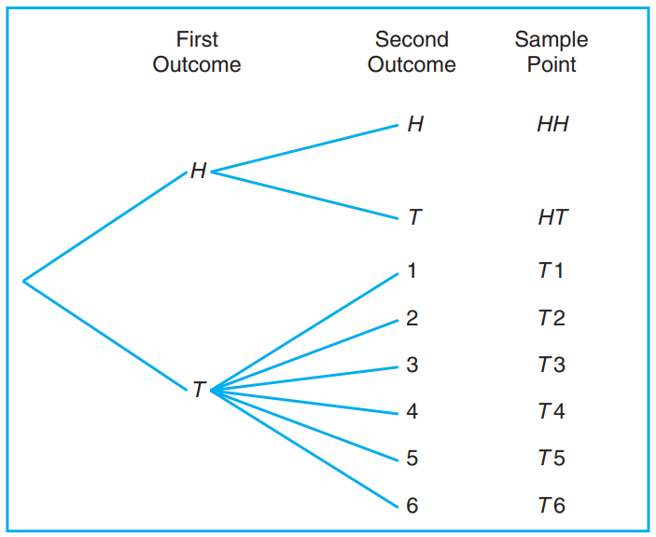
Sample space

Slide 4
If the possible outcomes of an experiment are the set of cities in the world with a population over 1 million,
our sample space is written
S = {x | x is a city with a population over 1 million}
which reads “S is the set of all x such that x is a city with a population over 1 million.”

Slide 5
Event
An event is a subset of a sample space.
Given the sample space
S = {t | t ≥ 0},
where t is the life in years of a certain electronic component, then the event A that the component fails before the end of the fifth year is the subset
A = {t | 0 ≤ t < 5}.

Slide 6
Suppose that A and B are two events associated with an experiment. In other words, A and B are subsets of the same sample space S.
let A be the event that an even number occurs and B the event that a number greater than 3 shows.
Then the subsets A = {2, 4, 6} and B = {4, 5, 6} are subsets of the same sample space S = {1, 2, 3, 4, 5, 6}
Both A and B will occur on a given toss if the outcome is an element of the subset {4, 6}, which is just the intersection of A and B
The intersection of two events A and B, denoted by the symbol A ∩ B, is the event containing all elements that are common to A and B

Slide 7
Let V = {a, e, i, o, u} and C = {l, r, s, t}; then it follows that V ∩ C = φ. That is, V and C have no elements in common and, therefore, cannot both simultaneously occur.
Two events A and B are mutually exclusive, or disjoint, if A ∩ B = φ, that is, if A and B have no elements in common.

Slide 8
A = {2, 4, 6} and B = {4, 5, 6}, we might be interested in either A or B occurring or both A and B occurring. Such an event, called the union of A and B, will occur if the outcome is an element of the subset {2, 4, 5, 6}.
The union of the two events A and B, denoted by the symbol A∪B, is the event containing all the elements that belong to A or B or both.

Slide 9
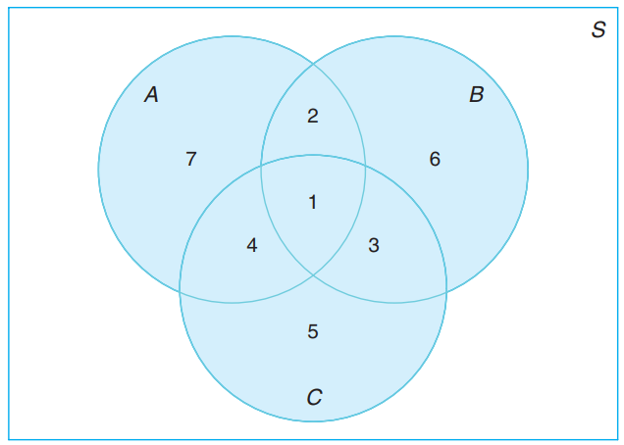
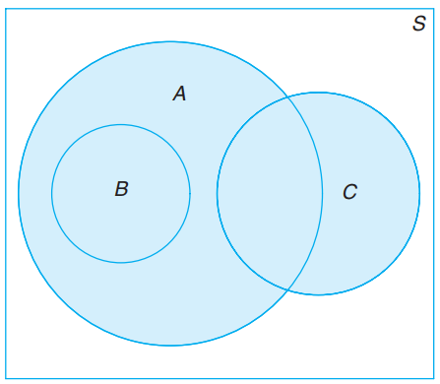
The relationship between events and the corresponding sample space can be illustrated graphically by means of Venn diagrams.

Slide 10
The fundamental principle of counting
Often referred to as the multiplication rule .
If an operation can be performed in n₁ ways, and if for each of these ways a second operation can be performed in n₂ ways, then the two operations can be performed together in n₁n₂ ways.

Slide 11
How many sample points are there in the sample space when a pair of dice is thrown once?
The first die can land face-up in any one of n1 = 6 ways. For each of these 6 ways, the second die can also land face-up in n2 = 6 ways. Therefore, the pair of dice an land in n1n2 = (6)(6) = 36 possible ways.

Slide 12
If a 22-member club needs to elect a chair and a treasurer, how many different ways can these two to be elected?
Solution: For the chair position, there are 22 total possibilities. For each of those 22 possibilities, there are 21 possibilities to elect the treasurer. Using the multiplication rule, we obtain n1 × n2 = 22 × 21 = 462 different ways.

Slide 13
How many even four-digit numbers can be formed from the digits 0, 1, 2, 5, 6, and 9 if each digit can be used only once?

Slide 14
A permutation is an arrangement of all or part of a set of objects.
The number of permutations of n objects is n!.
Consider the three letters a, b, and c. The possible permutations are abc, acb, bac, bca, cab, and cba. Thus, we see that there are 6 distinct arrangements.

Slide 15


The number of permutations of n distinct objects taken r at a time is
In one year, three awards (research, teaching, and service) will be given to a class of 25 graduate students in a statistics department. If each student can receive at most one award, how many possible selections are there?

Slide 16

Permutations that occur by arranging objects in a circle are called circular permutations
The number of permutations of n objects arranged in a circle is (n − 1)!.
The number of distinct permutations of n things of which n1 are of one kind, n2 of a second kind, . . . , nk of a kth kind is

Slide 17

In a college football training session, the defensive coordinator needs to have 10 players standing in a row. Among these 10 players, there are 1 freshman, 2 sophomores, 4 juniors, and 3 seniors. How many different ways can they be arranged in a row if only their class level will be distinguished?

Slide 18
we are concerned with the number of ways of partitioning a set of n objects into r subsets called cells.
A partition has been achieved if the intersection of every possible pair of the r subsets is the empty set φ and
if the union of all subsets gives the original set.

Slide 19
Consider the set {a, e, i, o, u}. The possible partitions into two cells in which the first cell contains 4 elements and the second cell 1 element are
{(a, e, i, o), (u)}, {(a, i, o, u), (e)}, {(e, i, o, u), (a)}, {(a, e, o, u), (i)}, {(a, e, i, u), (o)}.

Slide 20
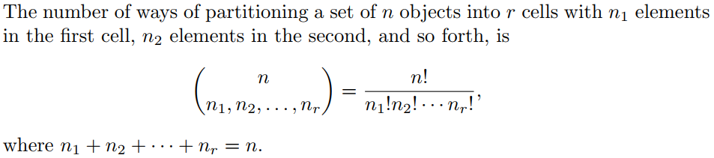

Slide 21
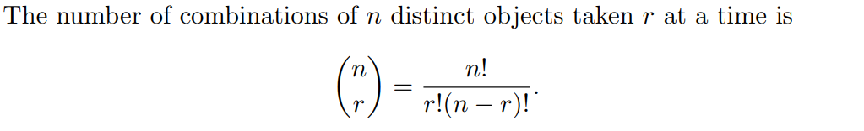
Combination
We are interested in the number of ways of selecting r objects from n without regard to order
These selections are called combinations.

Slide 22
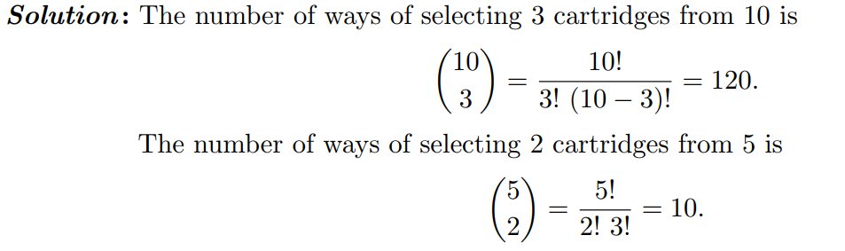
A young boy asks his mother to get 5 Game-BoyTM cartridges from his collection of 10 arcade and 5 sports games. How many ways are there that his mother can get 3 arcade and 2 sports games?
Using the multiplication rule with n1 = 120 and n2 = 10, we have (120)(10) = 1200 ways.

Slide 23
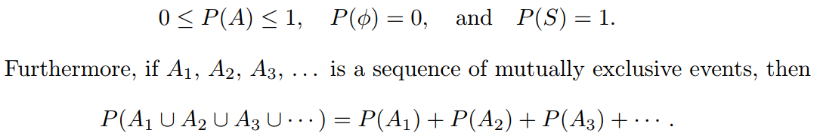
Probability
To find the probability of an event A, we sum all the probabilities assigned to the sample points in A. This sum is called the probability of A and is denoted by P(A)

Slide 24
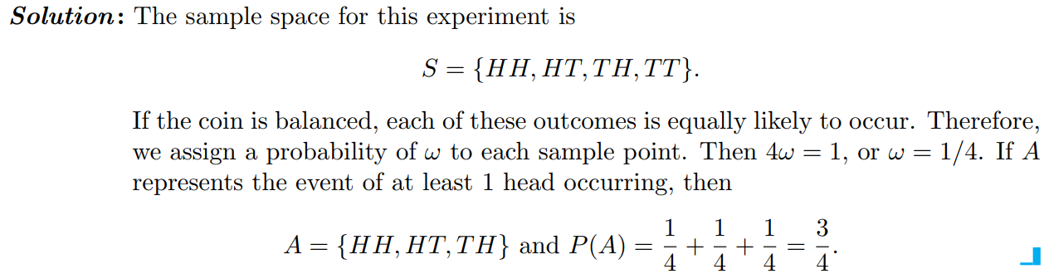
A coin is tossed twice. What is the probability that at least 1 head occurs?

Slide 25
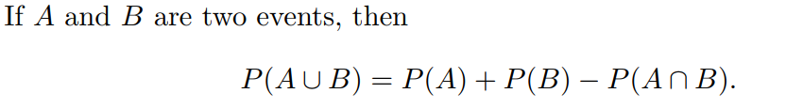
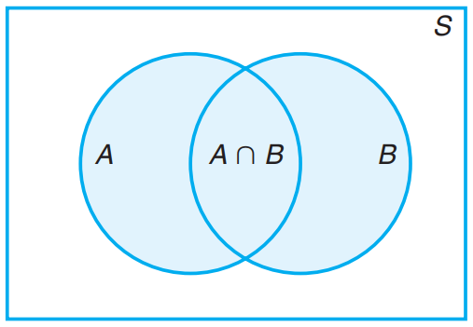
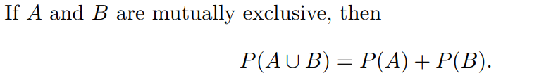
Additive Rules

Slide 26
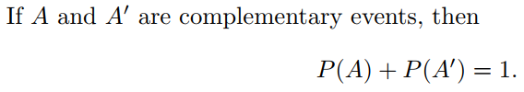
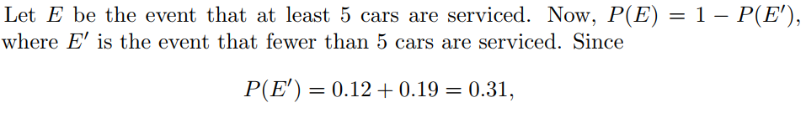

If the probabilities that an automobile mechanic will service 3, 4, 5, 6, 7, or 8 or more cars on any given workday are, respectively, 0.12, 0.19, 0.28, 0.24, 0.10, and 0.07, what is the probability that he will service at least 5 cars on his next day at work?

Slide 27
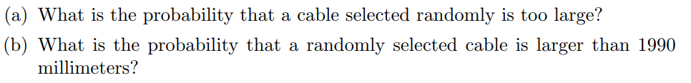
Suppose the manufacturer’s specifications for the length of a certain type of computer cable are 2000 ± 10 millimeters. In this industry, it is known that small cable is just as likely to be defective (not meeting specifications) as large cable. That is, the probability of randomly producing a cable with length exceeding 2010 millimeters is equal to the probability of producing a cable with length smaller than 1990 millimeters. The probability that the production procedure meets specifications is known to be 0.99.

Slide 28
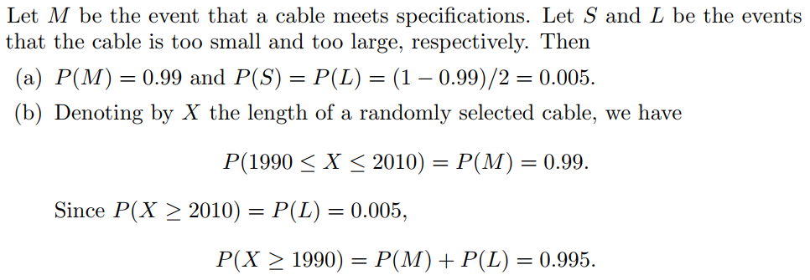

Slide 29
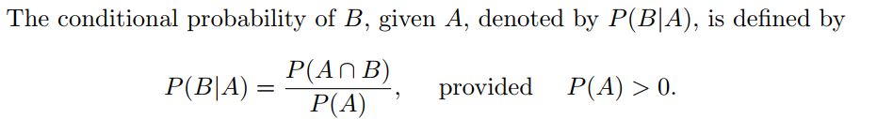
Conditional Probability
The probability of an event B occurring when it is known that some event A has occurred is called a conditional probability and is denoted by P(B|A).
“the probability of B, given A.”

Slide 30
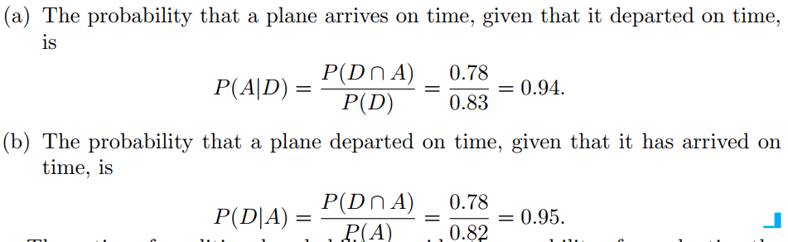
The probability that a regularly scheduled flight departs on time is P(D) = 0.83; the probability that it arrives on time is P(A) = 0.82; and the probability that it departs and arrives on time is P(D ∩ A) = 0.78. Find the probability that a plane (a) arrives on time, given that it departed on time, and
(b) departed on time, given that it has arrived on time.

Slide 31
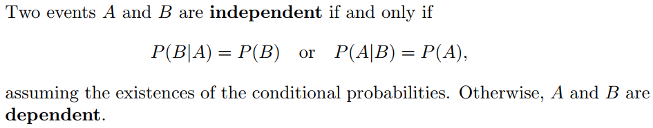
Independent Events

Slide 32
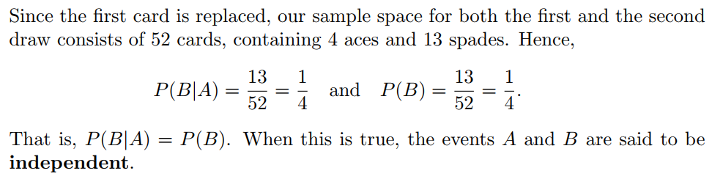
consider an experiment in which 2 cards are drawn in succession from an ordinary deck, with replacement. The events are defined as A: the first card is an ace, B: the second card is a spade

Slide 33
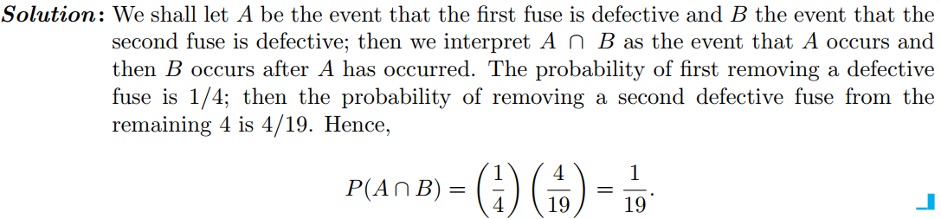
The Product Rule, or the Multiplicative Rule
Suppose that we have a fuse box containing 20 fuses, of which 5 are defective. If 2 fuses are selected at random and removed from the box in succession without replacing the first, what is the probability that both fuses are defective?

Slide 34
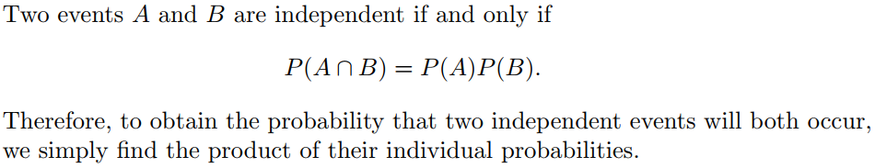
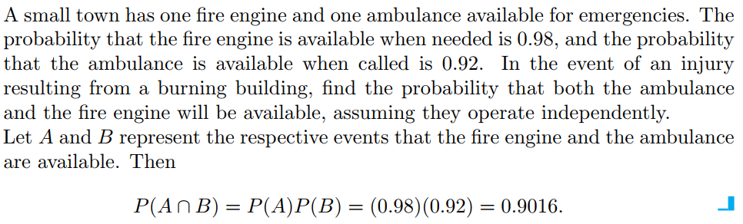

Slide 35
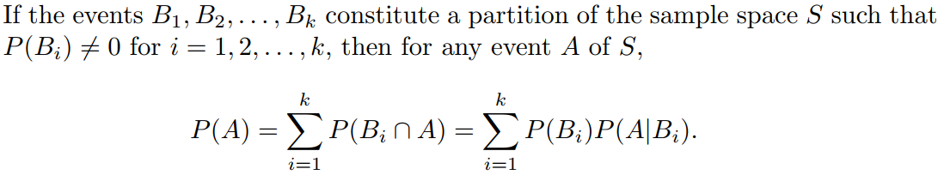
Theorem of total probability

Slide 36
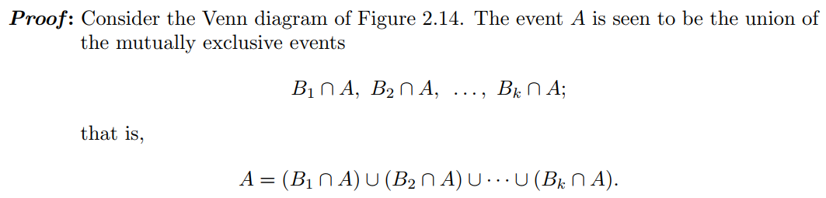
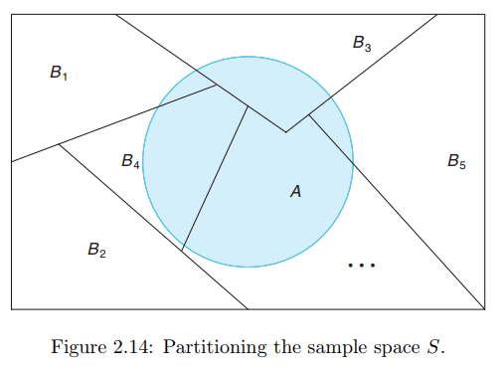
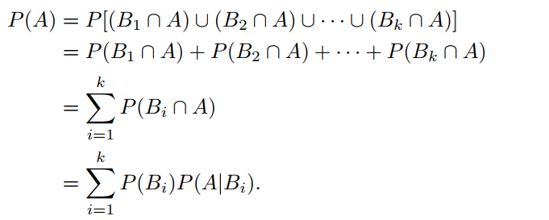

Slide 37
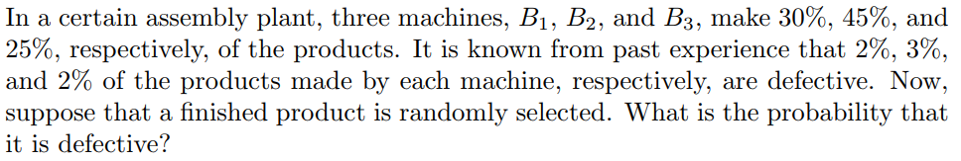

Slide 38
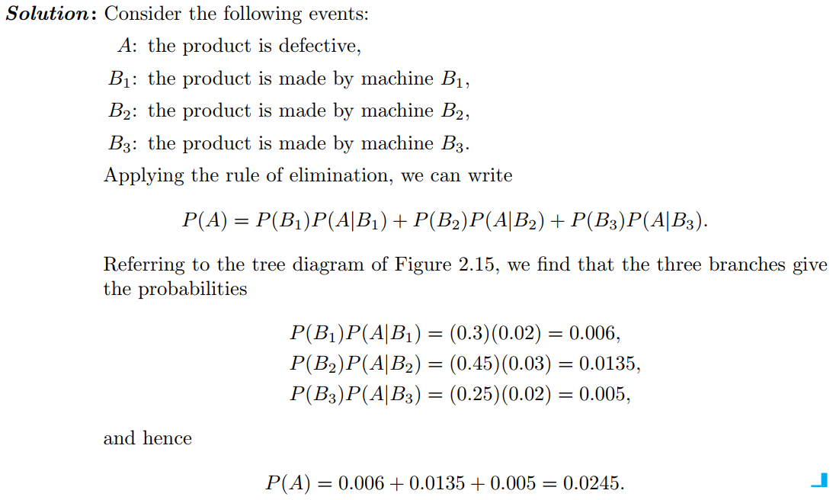

Slide 39
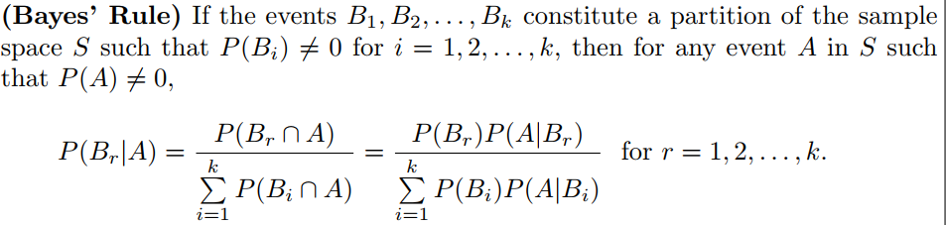
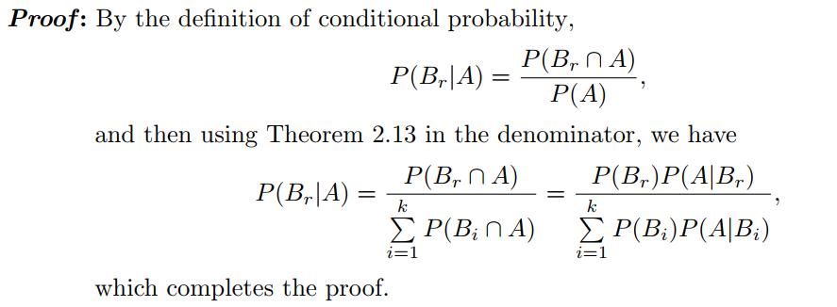
Bayes’ Rule

Slide 40
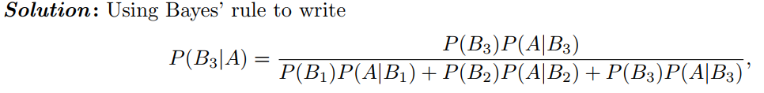

if a product was chosen randomly and found to be defective, what is the probability that it was made by machine B3?

Slide 41
References
Probability & Statistics for Engineers & Scientists by Ronald E. Walpole, Raymond H. Myers, Sharon L. Myers, Keying Ye
PROBABILITY AND STATISTICAL INFERENCE by Robert V. Hogg, Elliot A. Tanis, Dale L. Zimmerman

