Slide 1
COMPUTER NETWORKS
An Introduction
Dola Das
Lecturer, CSE, KUET

Slide 2
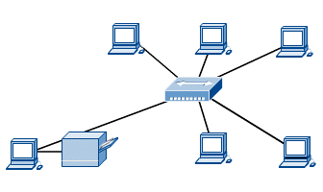
Computer Networks
A computer network, often simply referred to as a network, is a collection of computers and devices connected in various ways in order to communicate and share resources
Usually, the connections between computers in a network are made using physical wires or cables
some connections are wireless, using radio waves or infrared signals

Slide 3
Computer Networks
The purpose of a network is to share resources. A resource may be:
A file, folder, printer, disk drive
Or just about anything else that exists on a computer.
The computers can be geographically located anywhere.
Networking is the term that describes the processes involved in designing, implementing, upgrading, managing and otherwise working with
networks and network technologies.

Slide 4
Applications of Networks
Resource Sharing
Hardware (computing resources, disks, printers)
Software (application software)
Information Sharing
Easy accessibility from anywhere (files, databases)
Search Capability (WWW)
Communication
Email
Message broadcast
Remote computing
Distributed processing (GRID Computing)

Slide 5
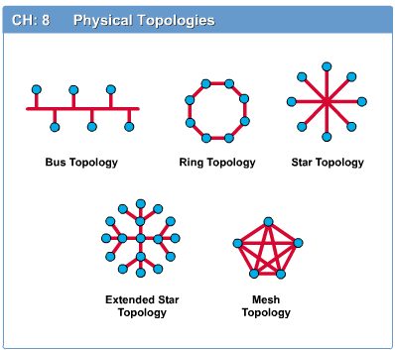
Network Topology
The network topology defines the way in which computers, printers, and other devices are connected.
A network topology describes the layout of the wire and devices as well as the paths used by data transmissions.

Slide 6
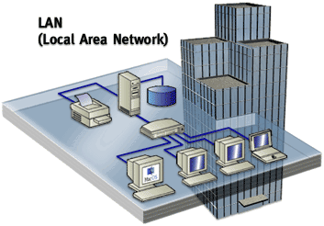
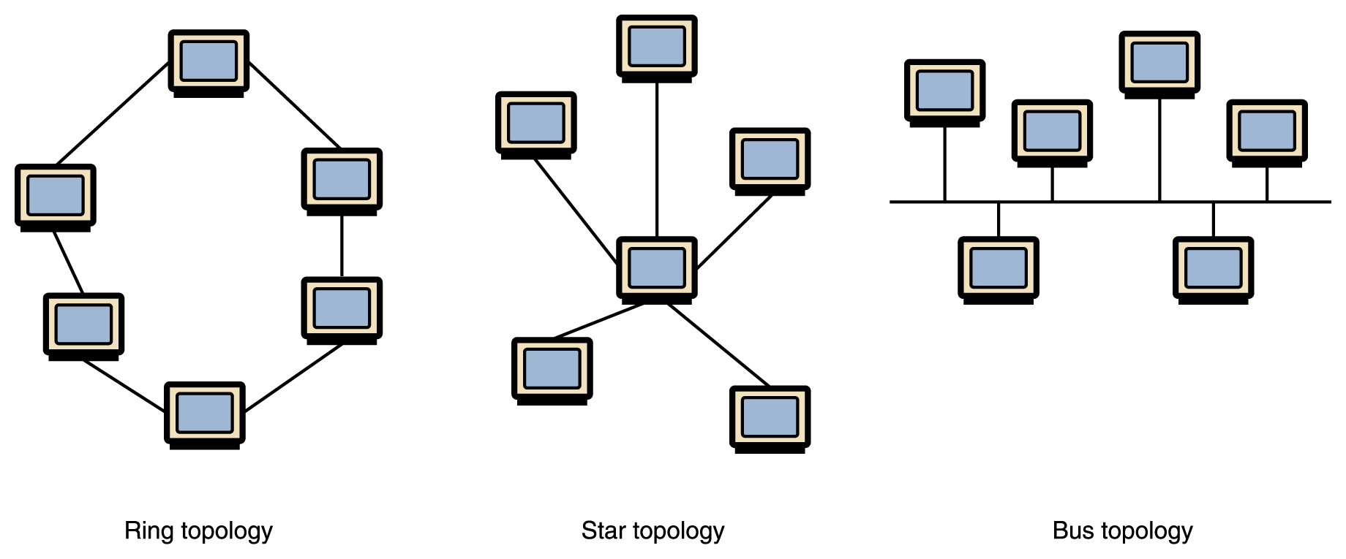
Types of Networks
Local-area network (LAN) A network that connects a relatively small number of machines in a relatively close geographical area (Room, Building or a Campus)
Ring topology connects all nodes in a closed loop on which messages travel in one direction
Star topology centers around one node to which all others are connected and through which all messages are sent
Bus topology nodes are connected
to a single communication
line that carries messages
in both directions

Slide 7
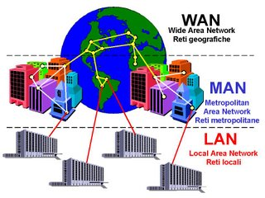
Types of Networks
Wide-area network (WAN) A network that connects LANs and other types of networks over a potentially large geographic distance (Country or across Globe)
The Internet, as we know it today, is essentially the ultimate wide-area network, spanning the entire globe
Communication between networks is called internetworking
Metropolitan-area network (MAN) The communication infrastructures that have been developed in and around large cities

Slide 8
Internetwork
Connection of two or more distinct computer networks or network segments via a common routing technology
three variants, depending on who administers and who participates in them:
Internet
Intranet
Extranet

Slide 9
Internet
It is a worldwide system of computer networks - a network of networks in which users at any one computer can, if they have permission, get information from any other computer (and sometimes talk directly to users at other computers).
Global system of interconnected computer networks that use the standard Internet Protocol Suite (TCP/IP) to serve billions of users worldwide.
It consists of millions of private and public, academic, business, and government networks of local to global scope that are linked by a broad array of electronic and optical networking technologies.

Slide 10

Internet
Internet carries vast information resources and services,
most notably the inter-linked hypertext documents of the World Wide Web (WWW)
and the infrastructure to support electronic mail
Inter net services, you can get,
VoIP and IPTV,
Newspaper publishing Web sites,
blogging, Internet forums, and SNS,
file sharing, e-commerce,
research, download books or software,
E-mail, Video Conferencing,
Chat Groups, Instant Messengers
Internet Radio
and many more

Slide 11
Intranet & Extranet
Intranet: An intranet is a private network that is contained within an enterprise.
It may consist of many interlinked local area networks and also use leased lines in the wide area network.
An intranet uses TCP/IP, HTTP, and other Internet protocols and in general looks like a private version of the Internet.
With tunneling, companies can send private messages through the public network, using the public network with special encryption/decryption and other security safeguards to connect one part of their intranet to another.
Extranet - internetwork that is limited in scope to a single organization and also has limited connections to the networks of one or more other trusted organizations

Slide 12
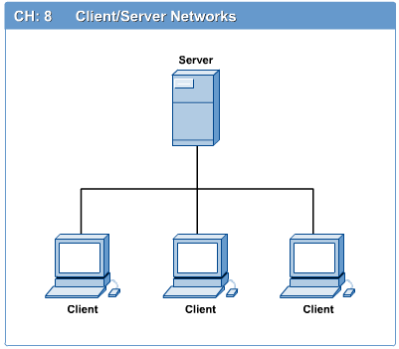
Computers Role: Clients and Servers
In a client/server network arrangement, network services are located in a dedicated computer whose only function is to respond to the requests of clients.
Server computer is a core component of the network, providing a link to the resources necessary to perform any task.
The server contains the file, print, application, security, and other services in a central computer that is continuously available to respond to client requests.
Client computers normally request and receive information over the network

Slide 13
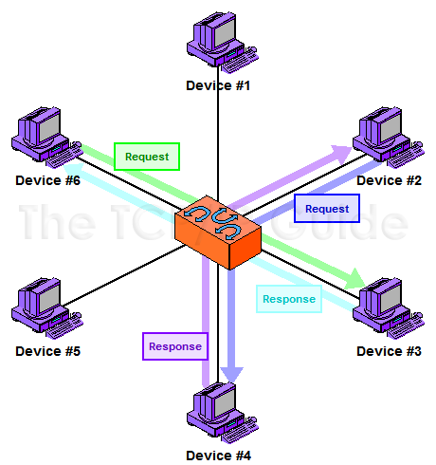
Computers Role: Peer to Peer
A peer-to-peer network is a network where the computers act as both workstations and servers.
great for small, simple, and inexpensive networks.
In a strict peer-to-peer networking setup, every computer is an equal, a peer in the network.
Each machine can have resources that are shared with any other machine.
There is no assigned role for any particular device, and each of the devices usually runs similar software. Any device can and will send requests to any other.

Slide 14
Protocol
In computing, a protocol is a set of rules which is used by computers to communicate with each other across a network.
Protocol achieves:
What is communicated between computers?
How it is communicated?
When it is communicated?
What conformance (bit sequence) between computers?
Key elements of a protocol are:
SYNTAC: Data format and signal levels
SEMANTICS: Control information for coordination and error handling
TIMING: Synchronization, speed matching, and sequencing
Examples of protocols: TCP/IP
Protocols may be implemented by hardware, software, or a combination of the two.

Slide 15
Open Systems
Proprietary system: A system that uses technologies kept private by a particular commercial vendor
One system couldn’t communicate with another, leading to the need for
Interoperability: The ability of software and hardware on multiple machines and from multiple commercial vendors to communicate
Open systems: Systems based on a common model of network architecture and a suite of protocols used in its implementation

Slide 16
Open Systems Interconnection (OSI) Model
International standard organization (ISO) established a committee in 1977 to develop an architecture for computer communication.
Open Systems Interconnection (OSI) reference model is the result of this effort.
In 1984, the Open Systems Interconnection (OSI) reference model was approved as an international standard for communications architecture.
Term “open” denotes the ability to connect any two systems which conform to the reference model and associated standards.

Slide 17
OSI Reference Model
The OSI model is now considered the primary Architectural model for inter-computer communications.
It describes how information or data makes its way from application programmes (such as spreadsheets) through a network medium (such as wire) to another application programme located on another network.
The OSI reference model divides the problem of moving information between computers over a network medium into SEVEN smaller and more manageable problems .
This separation into smaller more manageable functions is known as layering.

Slide 18
OSI Reference Model
The process of breaking up the functions or tasks of networking into layers reduces complexity.
Each layer provides a service to the layer above it in the protocol specification.
Each layer communicates with the same layer’s software or hardware on other computers.
The lower 4 layers (transport, network, data link and physical —Layers 4, 3, 2, and 1) are concerned with the flow of data from end to end through the network.
The upper 3 layers of the OSI model (application, presentation and session—Layers 7, 6 and 5) are orientated more toward services to the applications.
Data is Encapsulated with the necessary protocol information as it moves down the layers before network transit.

Slide 19
OSI Model
Open System Interconnection Model is description for layered communications and computer network protocol design
7 Layers
Physical Layer - defines the relationship between a device and a physical medium. This includes layout of pins, voltages, cable specifications, and more
Data Link Layer - provides the functional and procedural means to transfer data between network entities and to detect and possibly correct errors
Network Layer – determine logical path for transferring data sequences from a source to a destination via one or more networks

Slide 20
OSI Model
Transport Layer - The Transport Layer controls the reliability of a given link through flow control, segmentation/desegmentation, and error control
Session Layer - controls the connections between computers. It establishes, manages and terminates the connections between the local and remote application
Presentation Layer - provides independence from differences in data representation (e.g., encryption) by translating from application to network format, and vice versa
Application Layer - interacts with software applications that implement a communicating component

Slide 21
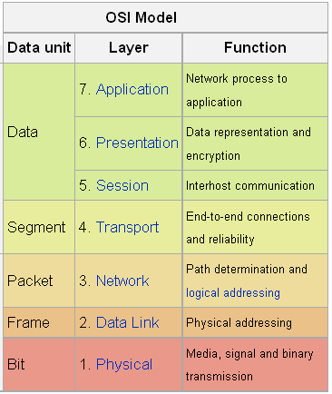
OSI Reference Model: 7 Layers

Slide 22
TCP/IP
TCP stands for Transmission Control Protocol
TCP software breaks messages into packets, hands them off to the IP software for delivery, and then orders and reassembles the packets at their destination
IP stands for Internet Protocol
IP software deals with the routing of packets through the maze of interconnected networks to their final destination

Slide 23
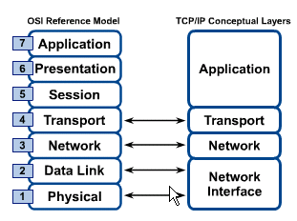
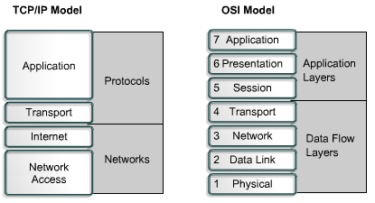
OSI & TCP/IP Models

Slide 24
Reference Books
Computer Networking A Top-Down Approach Featuring the Internet
J F Kurose, K W Ross
Data Communications and Networking
B A Forouzan
Computer Networks
A S Tanenbaum
Computer Networks A Systems Approach
L L Peterson, B S Davie

