Slide 1
PROG-30493
Assignment 2
Jordan Way, Omar Kanawati

Slide 2
Assets Used
Zero Rare
Retro Sounds

Slide 3
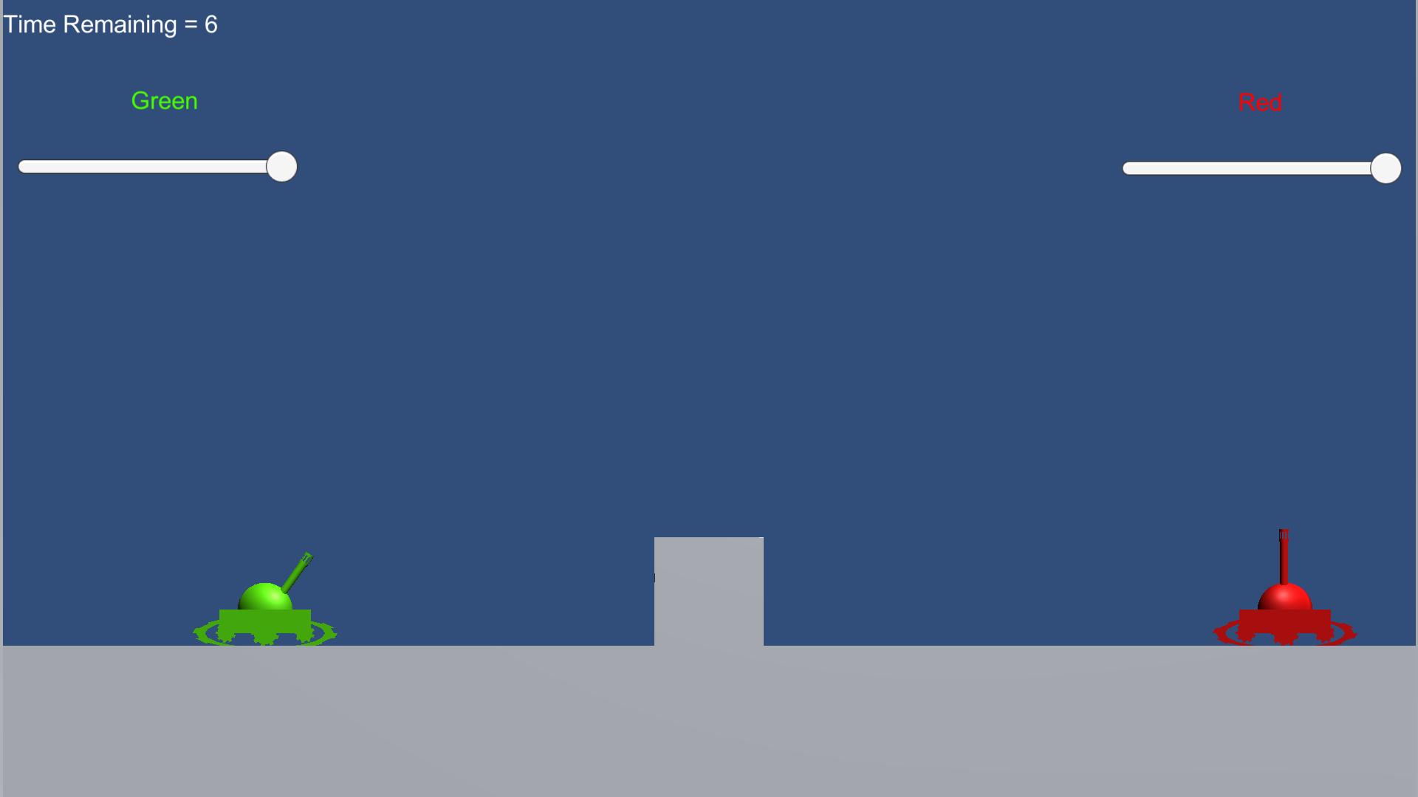
Level Visual

Slide 4
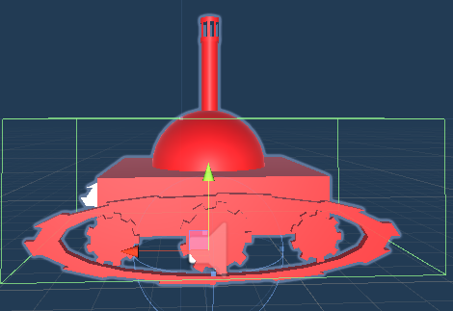
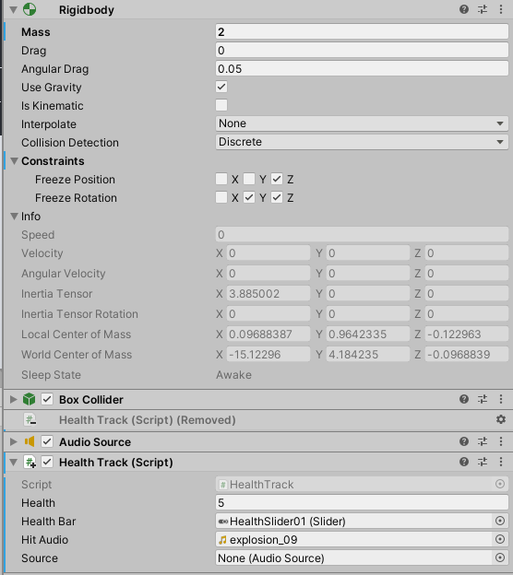
Prefab - Tank
Each tank contains
Rigidbody with constraint freezes
Box collider
Audio Source
Makes use of a “Health Track Script

Slide 5
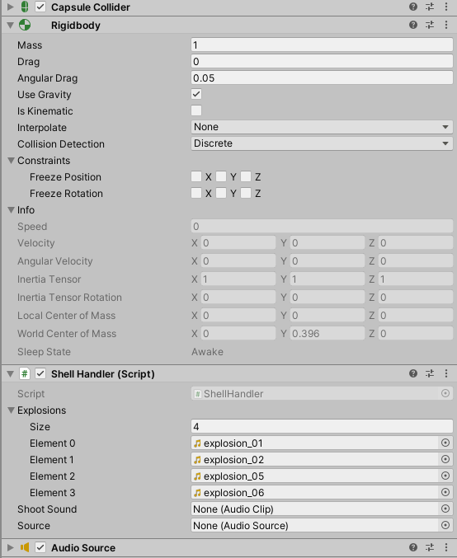
Prefab - Shell
Each shell uses
Rigidbody
Capsule collider
Audio source
A shell handler script with sounds pre-attached

Slide 6
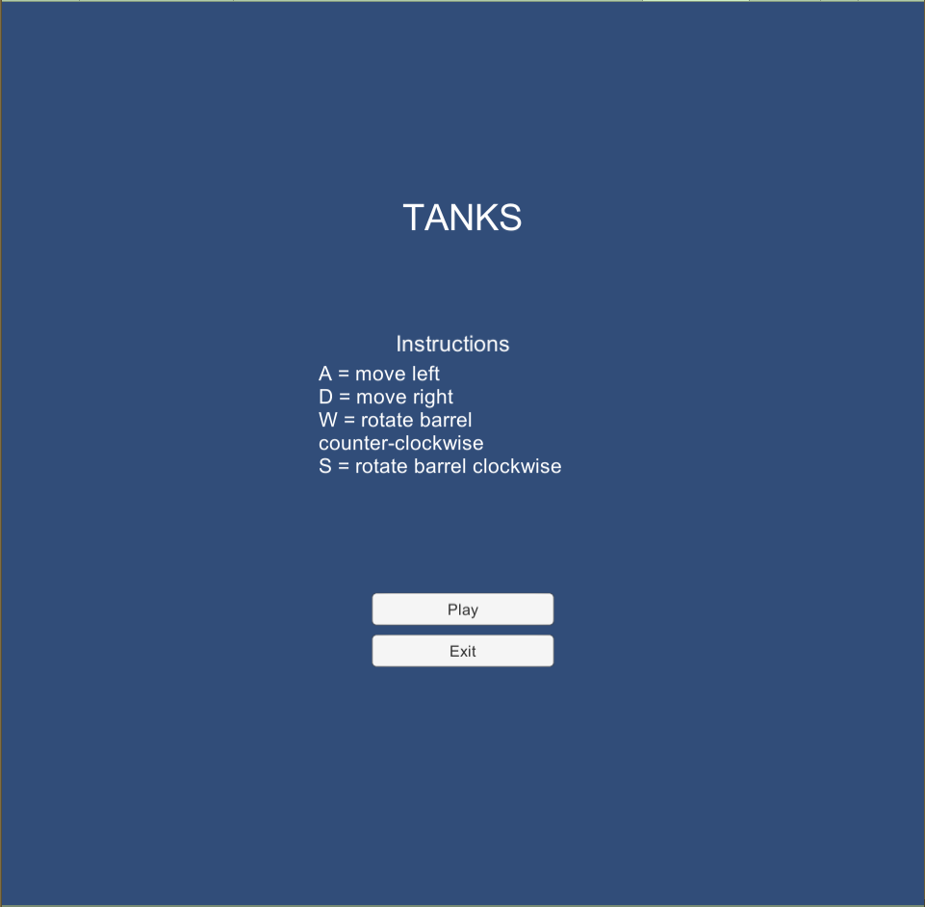
Main Menu
Gives instructions to the player
Play button loads the game scene
Exit closes the application
Only in build versions

Slide 7
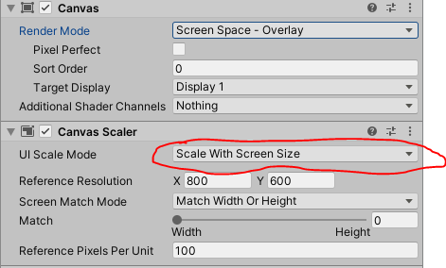
Canvas Scaling
We changed the UI scale mode to better handle different screen sizes
Set to “Scale with screen size”

Slide 8

UI - Timer
Appears in the top left of the screen
Displayed as a value rounded to 1 decimal place
Updated by the Timer script

Slide 9
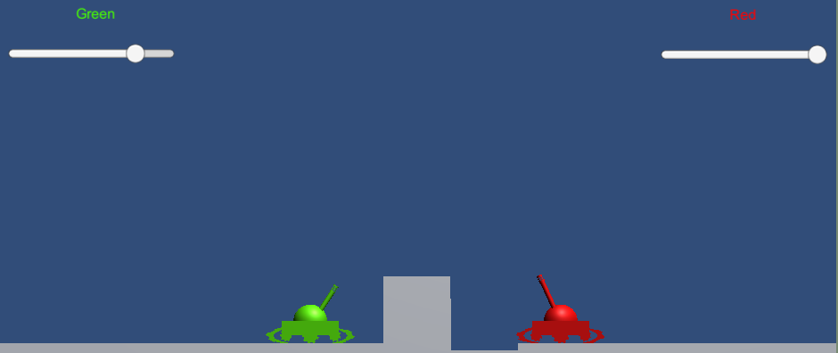
UI - Healthbars
2 bars appear on both screen sides above the players
Uses a slider to represent remaining health

Slide 10

Terrain - Destructible
4 Layers of the ground are destructible
Destroyed by Shell Handler Script
There is an undestroyable bottom to prevent the player from falling through the ground
Tagged as wall

Slide 11

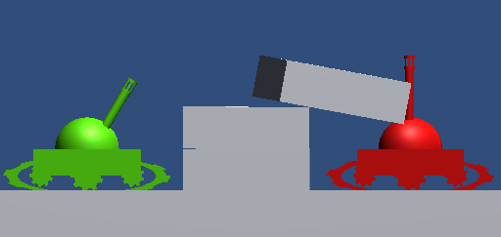
Terrain Center Wall
The wall in the level center is also destructible
Players are also able to ram and move them
Both wall and player use rigidbodies to allow this

Slide 12
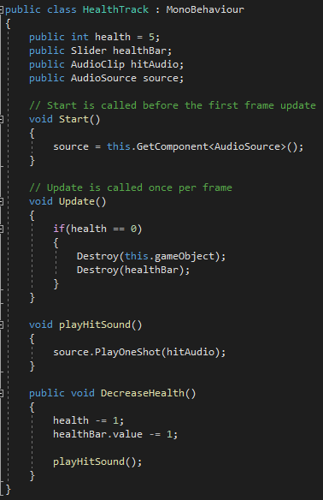
Health Tracking - Script
Each tank starts with 5 health
When hit decrement health by 1
Updates healthbars with each decrement
Destroy the tank if health reaches 0

Slide 13

Health Tracking - Damage Sounds
When either player loses health play a particular sound
Uses the audio source of the tank prefab

Slide 14
Player Handler - Script
Attached to a “Player Handler” Gameobject
Finds components of the tank on initialization
The tank body
Tank barrels
Tank shell points (where the shell will appear)

Slide 15
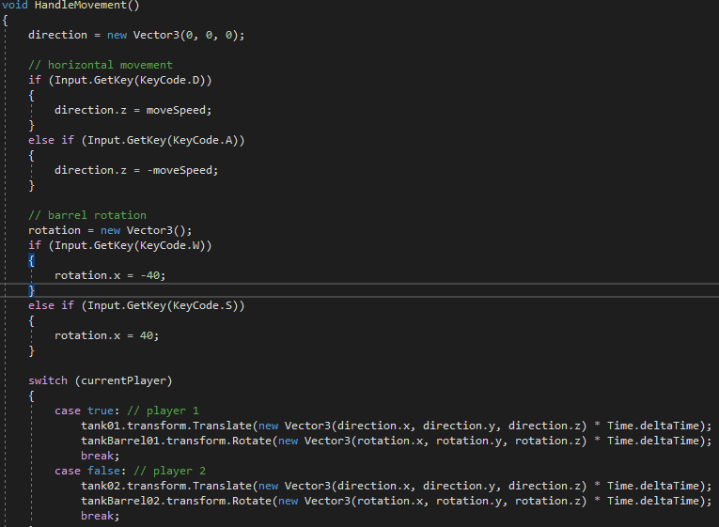
Player Handler - Movement
Takes player input and applies all needed transforms
Movement
A = move left
D = move right
Barrel Angling
W = rotate counter-clockwise
S = rotate clockwise

Slide 16
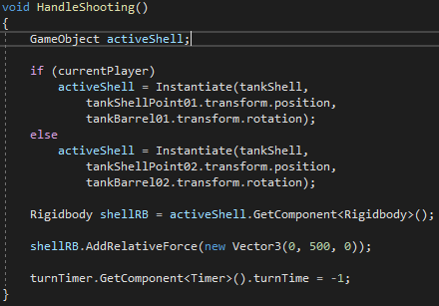
Player Handler - Shooting
If the player presses spacebar, HandleShooting will be called from update
Creates and “fires” a new shell from the current player tank
Ends the players turn by setting time to -1

Slide 17
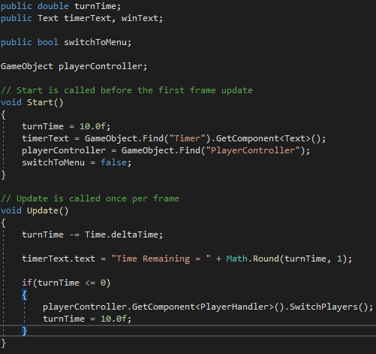
Timer - Script
Starts eachs players turn with 10 seconds
The initial 10 is decremented by every frame time
Updates the UI timer with the current remaining time

Slide 18

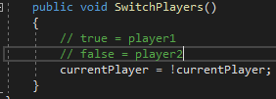
Turn Switching
When the player fires or time reaches 0, the next turn is started
This process starts in the Timer script which calls a function from the Player Handler Script

Slide 19
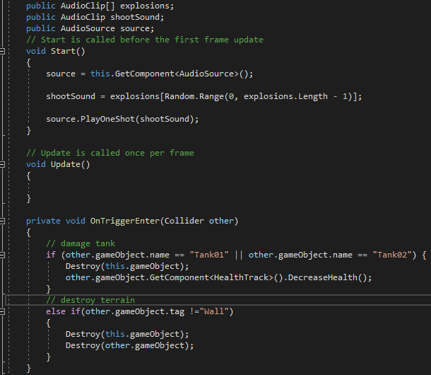
Shell Handler
Attached to each shell fired
Plays a random sound on shell creation
Damages tanks and destroys terrain on trigger

