Slide 1



Border Trimmer
imgix interview – image processing engineer
take home project
Yan Jiao
Mar. 25th, 2020

Slide 2
Border
Property
Known RGB, single color
(Suppose the top-left pixel is in border area)
(in this project)
Unknown widths
Perfectly row/column aligned
(might not consider the variance in alpha channel)

Slide 3
Overall Idea
Get real file type image, PNG, JPEG or WebP
Read image to OpenCV Mat
Set channels
Get Mat type
Write trimmed image to a new Mat and save image file
Detect 4 borders position.
(If border has noise -> need denoise process. For this project, the border is pure color.)

Slide 4
Get Real File Type Image
Use “libmagic” to get the MIME type of the image file
True image file type may not be consistent with the file extension
This project covers:
image/png
image/jpeg
image/webp

Slide 5
Read Image
Use OpenCV cv::imread() to read image BGR data to cv::Mat
Use cv::Mat::type()
get color depth and channels

Slide 6
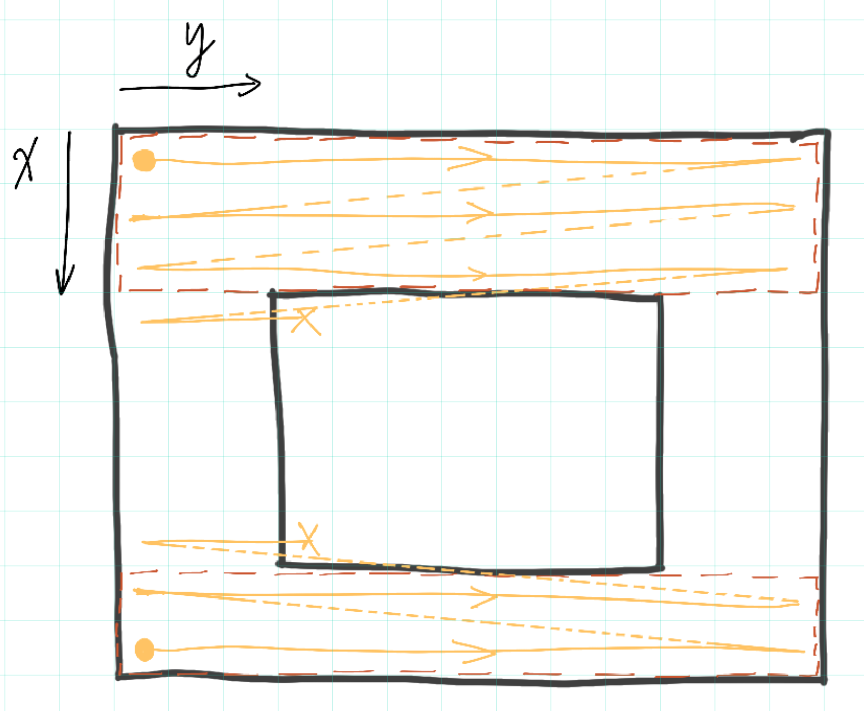
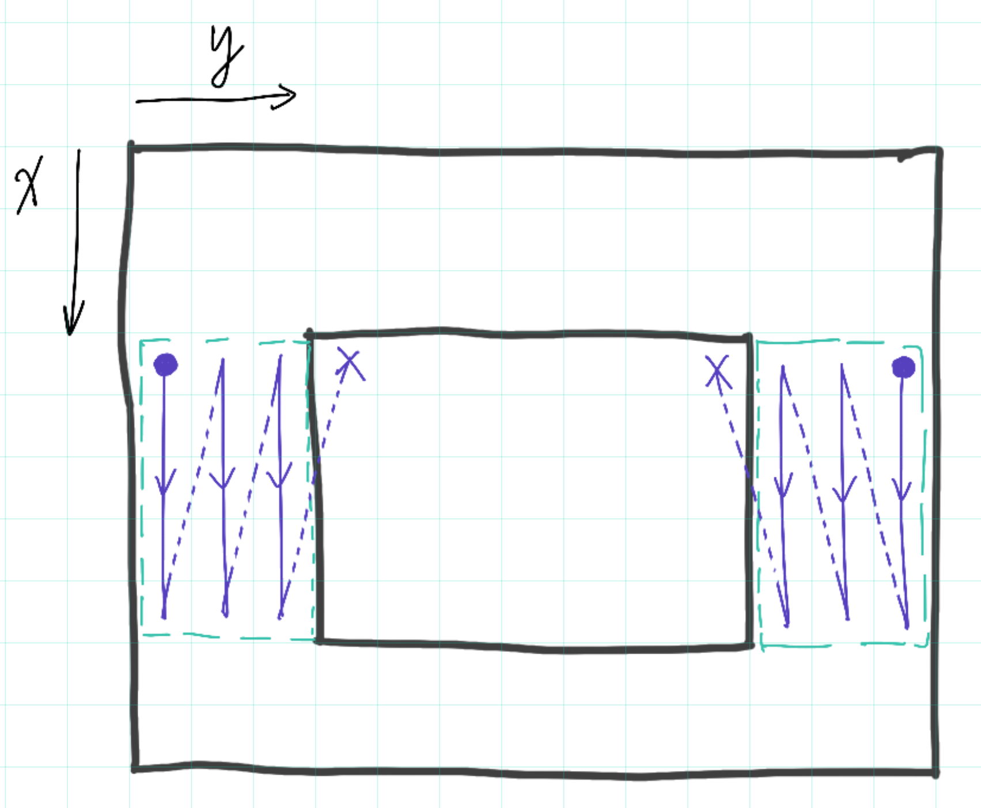
Detect Border Position

Slide 7
Write Trimmed Image
Copy data in ROI to new cv::Mat
Write output image
cv::imwrite()

Slide 8




Thank You!

