Slide 1
Functions
Functions, Parameters and Return Values

Slide 2
Function's function?
Functions allow us to chunk repeated code into smaller segments of clear purpose.
Allows for reusability for repeated statements
Improves ability to extend application and update bugs by minimising the places we need to update.
Creates a layer of Abstraction from the inner complexities of the code.
We don’t need to know how the GetArea() function works we just expect it to return the area.

Slide 3
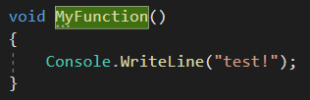
Defining a function
To define a function, we use two parts:
Void + identifier.
In this example I've called it "MyFunction", we'll look at what void means shortly.
In all functions we open and close the brackets after the identifier to let the compiler know it’s a function.
After which we open and close our curly brackets to wrap around the block of code for that function.
Everything inside the curly brackets gets executed when we call our function.

Slide 4
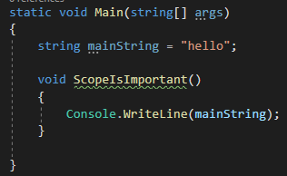
Scope
When defining blocks of code, particularly with functions, scope becomes very important.
Variable definitions for example are declared within their surrounding scope.
This means that they can be accessed anywhere within that scope (block or curly brackets).
This also includes nested or internal functions.

Slide 5
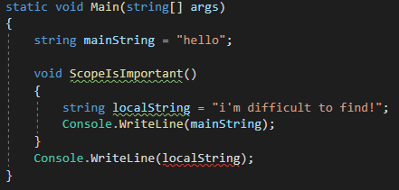
Scope
This accessibility is one way.
For example, if we create a variable within a function, it is not accessible outside that functions scope. Including the outer method, class etc.
Its declaration is only for the scope with which its defined.
Note the example here where the compiler cannot find the variable localString as its defined within the function.
This is true for any block statement:
If, else, while, for etc

Slide 6
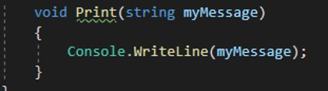
Function Parameters
Functions on their own are useful but become more powerful when we can influence the execution of the code by defining and varying the inputs.
In functions these are called parameters.
They are function defined variables that have their value set when the function is called.
Before we can pass them in however, we need to declare them in the function itself.
This is done inside the brackets. You might recognise the syntax:

Slide 7
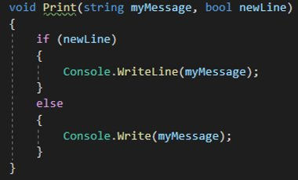

Function Parameters
We use the same structure of type - identifier like normal variables.
The important part to note here is that the variable when defining the function does not have value yet.
In fact, we don’t have any indication of what it is other than its type.
We can provide multiple input parameters by separating them with commas in the brackets.
To call it:

Slide 8
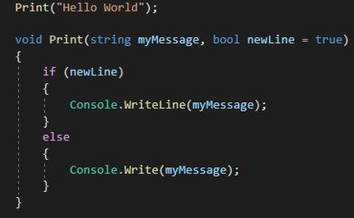
Optional and Defaults
Parameters can be customised to have a default value should one not be provided.
What this means is that the parameter does not need to be provided when the function is called.
It is now an optional parameter.
These must go after all required parameters.
Note newLine has no value.

Slide 9

Return Value
You might have noticed this keyword we haven't seen before when defining a function:
"Void"
This is for the value type that the function will return.
In this case void stands for nothing. I.e. there is no return value for this function.
In its place we can put any data type or object we want to return.

Slide 10
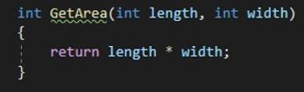
Return Value
Now that we have told the compiler it returns a value, we need to make sure it does.
To return a value we use the keyword "return" and after it pass the value we wish to return.
Here is the function for GetArea() we looked at before in full:

Slide 11
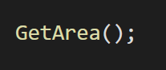


Using Functions
In order to use a function, you can call the function Name/Identifier:
If a function has parameters remember to only pass the value not the types:
If the function returns a value you can store the result of the function into a variable:

