Slide 1
WPF & Data Binding
Week / Session 14
Namrata Aneja
ICT40518 Certificate IV in Programming
Data Driven Applications
ICTPRG431 | Apply Query Language
ICTPRG432 | Develop Data Driven Applications

Slide 2
Session Contents
Adding class in the program
Data binding in ListBox and Textbox
Data Binding in two Wpfs

Slide 3
Requirements
WPF & Database 3

Slide 4
Requirements
You will require:
Windows 10 PC or Virtual Machine
Laragon with MySQL or MariaDB (preferred) running
Visual Studio Community 2019 (preferred)
Sample Database
This is in the presentation from Session 12

Slide 5
Setting up the Data binding on Session 13 program by Making changes in the Previous session program
Session14/ Wpf & Data binding

Slide 6
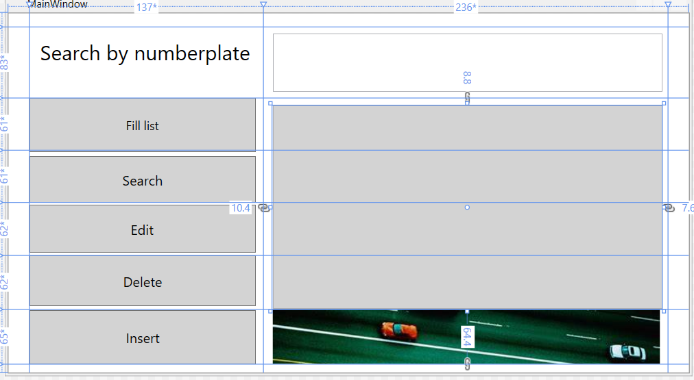
Created the GUI Layout in Session 13
We shall be
changing Edit
operation because
all the records were updated
with the speed =90
And speed limit =60
What do you say, is it
the correct way to do??
Surely you will say No

Slide 7

Faulty Edit operation in the program
In the given code we are updating every record with the speed of 90 and speed limit 60. It is not correct way of updating any record. Let’s fix it
private void Editrecord_Click(object sender, RoutedEventArgs e)
string sqlQuery = "Update traffic set speed=90, speed_limit=60 where number_plate like '%" + SearchTextbox.Text + "%';";
try
{
VehicleListbox.Items.Clear();
conn.Open();
MySqlCommand cmd = new MySqlCommand(sqlQuery, conn);
cmd.ExecuteNonQuery();
}
catch (Exception ex)
{
MessageBox.Show(ex.ToString());
}
conn.Close();
}
Notes:
We know adding WPF windows in the project as we have done it in Insert button and it is working efficiently. If we try to add another class Does it work in a similar way.

Slide 8

Replace the code Edit operation in the program
private void Editrecord_Click(object sender, RoutedEventArgs e)
{
if (string.IsNullOrEmpty(SearchTextbox.Text))
{
MessageBox.Show("Enter numberplate data in Search box ");
}
else
{
Updaterecord ob = new Updaterecord(SearchTextbox.Text);
ob.ShowDialog();
}
}
.
Notes:
We know adding WPF windows in the project as we have done it in Insert button and it is working efficiently. In a similar way,we are adding another Wpf window Updaterecord

Slide 9
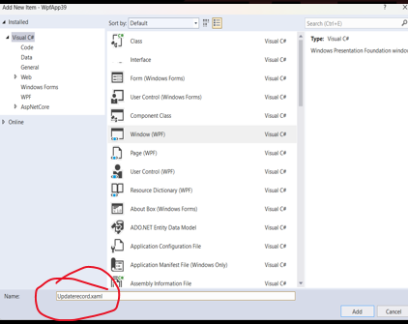
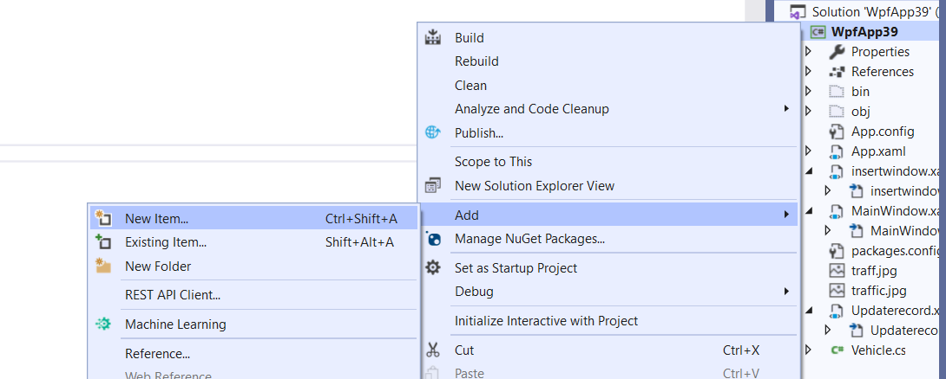

Add a new Wpf with the the name Updaterecord.xaml

Slide 10
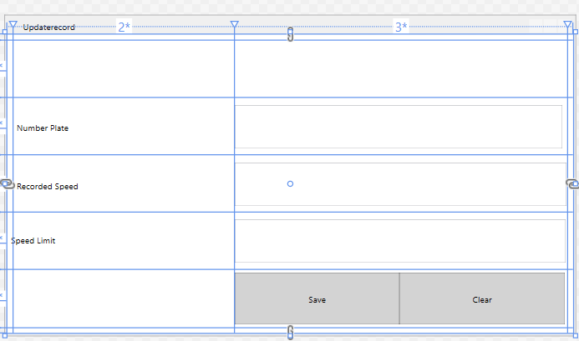
To create a Updaterecord window like below ,Code in the Updaterecord.xaml is
Code required is written between the grid tags
<Grid.ColumnDefinitions>
<ColumnDefinition Width="8"/>
<ColumnDefinition Width=“1*"/>
<ColumnDefinition Width="2"/>
<ColumnDefinition Width="8"/>
</Grid.ColumnDefinitions>
<Grid.RowDefinitions>
<RowDefinition Height="8"/>
<RowDefinition Height="1*"/>
<RowDefinition Height="1*"/>
<RowDefinition Height="1*"/>
<RowDefinition Height="1*"/>
<RowDefinition Height="1*"/>
<RowDefinition Height="8"/>
</Grid.RowDefinitions>

Slide 11
Add the following code in the Updaterecord. xaml file Code required is written between the grid tags
<StackPanel x:Name="ButtonStackPanel"
Grid.Column="2"
Grid.Row="5"
Orientation="Horizontal">
<Button x:Name="Save"
Background="LightGray"
Foreground="Black"
Content="Save"
MinWidth="80"
Margin="0,4,0,3.8"
Padding="16,4"
Click="Save_Click" Width="231"/>
<Button x:Name="Clear"
Background="LightGray"
Foreground="Black"
Content="Clear"
MinWidth="80"
Margin="0,4,0,3.8"
Padding="16,4"
Width="232" Click="Clear_Click"/>
</StackPanel>

Slide 12
Add the following code in the Updaterecord. xaml file Code required is written between the grid tags
<Label x:Name="VehicleNumberPlateLabel"
Content="Number Plate"
Grid.Column="1"
Grid.Row="2"
VerticalAlignment="Center"
HorizontalContentAlignment="Left"
Margin="0,29.2,0.2,25.6"/>
<Label x:Name="VehicleSpeedLabel"
Content="Recorded Speed"
Grid.Column="1"
Grid.Row="3"
VerticalAlignment="Center"
HorizontalContentAlignment="Left" Margin="0,30.4,0.2,25.4" />
<Label x:Name="SpeedLimitLabel"
Content="Speed Limit"
Grid.Row="4"
VerticalAlignment="Center"
HorizontalContentAlignment="Left" Margin="0,25.6,8.2,29.2" Grid.ColumnSpan="2" />

Slide 13
The Updaterecord.xaml will look like this
Code required is written between the grid tags
<TextBox x:Name="numberplatetb" TextWrapping="Wrap" Text="" Grid.Column="1" Margin="311,10.2,6.6,9.6" Grid.Row="2" Grid.ColumnSpan="2" IsReadOnly="False"/>
<TextBox x:Name="speedtb" TextWrapping="Wrap" Text="" Grid.Column="1" Margin="311,10.4,1.6,9.4" Grid.Row="3" Grid.ColumnSpan="2"/>
<TextBox x:Name="speedlimittb" TextWrapping="Wrap" Text="" Grid.Column="1" Margin="311,9.6,2.6,10.2" Grid.Row="4" Grid.ColumnSpan="2"/>

Slide 14
Adding codes in Updaterecord.xaml.cs by double clicking save and Clear button
private void Save_Click(object sender, RoutedEventArgs e)
{
vehicle.Updaterec();
MessageBox.Show("Saved");
}
private void Clear_Click(object sender, RoutedEventArgs e)
{
speedtb.Clear();
speedlimittb.Clear();
}

Slide 15
Adding another class Vehicle in the program
We are working in a Partial class Mainwindow, Insertwindow of C sharp & Wpf.
Normally in a Csharp program we work in one class.
All the functions belong to one class and called by the objects created under that class.
However, C# and wpf permits to add another class.
Here, we are adding a new class in the given project

Slide 16
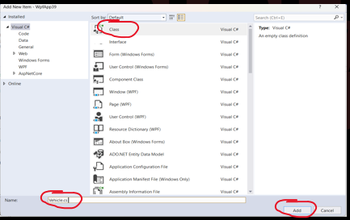
Adding another class Vehicle in the Program
Right Click the at the name of the project in the Solution Explorer
Click at Add
Click at New Item
After clicking at New Item You will get similar screen as shown below
Click on Class and give it a name. I have given it Vehicle.cs.
& Add it.

Slide 17
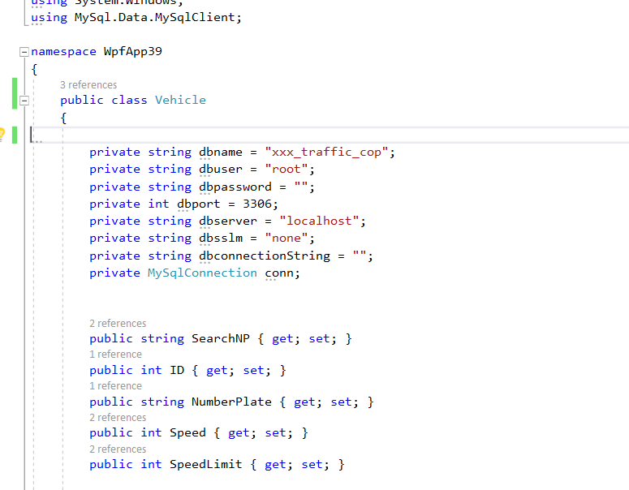
Adding another class Vehicle in the program
Writing the given code in the class Vehicle
Notes:
The given code is
private string dbname = "xxx_traffic_cop";
private string dbuser = "root";
private string dbpassword = "";
private int dbport = 3306;
private string dbserver = "localhost";
private string dbsslm = "none";
private string dbconnectionString = "";
private MySqlConnection conn;
public string SearchNP { get; set; }
public int ID { get; set; }
public string NumberPlate { get; set; }
public int Speed { get; set; }
public int SpeedLimit { get; set; }

Slide 18
Adding a constructor Vehicle
public Vehicle()
{
dbconnectionString = String.Format("server={0};port={1};user={2};password={3};database={4};sslMode={5}", dbserver, dbport, dbuser, dbpassword, dbname, dbsslm);
conn = new MySqlConnection(dbconnectionString);
try
{
conn.Open();
}
catch (MySqlException ex)
{
MessageBox.Show("No DB Connection");
}
finally
{
conn.Close();
}
}

Slide 19
Adding a function Searchrec()
public void Searchrec( string searchdata)
{
try
{
string sqlToRun = "Select id,number_plate,speed,speed_limit from traffic where number_plate = '" + searchdata + "'; ";
SearchNP = searchdata;
conn.Open();
MySqlCommand cmd = new MySqlCommand(sqlToRun, conn);
MySqlDataReader rdr = cmd.ExecuteReader();
while (rdr.Read())
{
ID = Convert.ToInt32(rdr["id"].ToString());
NumberPlate = rdr["number_plate"].ToString();
Speed = int.Parse(rdr[2].ToString());
SpeedLimit = int.Parse(rdr[3].ToString());
}
conn.Close();
}
catch
{
MessageBox.Show("No record found");
}
}

Slide 20
Adding a function Updaterec()
public void Updaterec()
{
try
{
string sqlToRun = "Update traffic set speed= " + Speed + ",speed_limit= " + SpeedLimit + " where number_plate = '" + SearchNP + "';";
conn.Open();
MySqlCommand cmd = new MySqlCommand(sqlToRun, conn);
cmd.ExecuteNonQuery();
}
catch (Exception ex)
{
MessageBox.Show("No record found");
}
finally
{
conn.Close();
}
}

Slide 21
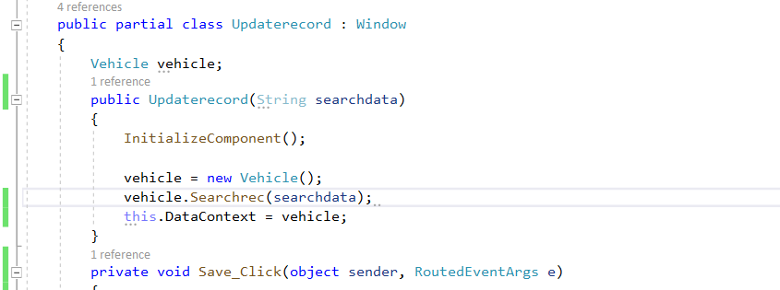
Making Changes in Updaterecord.xaml.cs adding class Vehicle
DataContext is the public object that can be used or called using this object and here we are equating/passing the vehicle object into Datacontext. It will create the bridge between Updaterecord.xaml.cs and Vehicle.cs. Hence with the help of DataContext a different class Vehicle is added into the Program. The complete code of Updaterecord.xaml.cs is given in the notes below
Notes:
public partial class Updaterecord : Window
{
Vehicle vehicle;
public Updaterecord(String searchdata)
{
InitializeComponent();
vehicle = new Vehicle();
vehicle.Searchrec(searchdata);
this.DataContext = vehicle;
}
private void Save_Click(object sender, RoutedEventArgs e)
{
vehicle.Updaterec();
MessageBox.Show("Saved");
}
private void Clear_Click(object sender, RoutedEventArgs e)
{
speedtb.Clear();
speedlimittb.Clear();
}
}
}

Slide 22
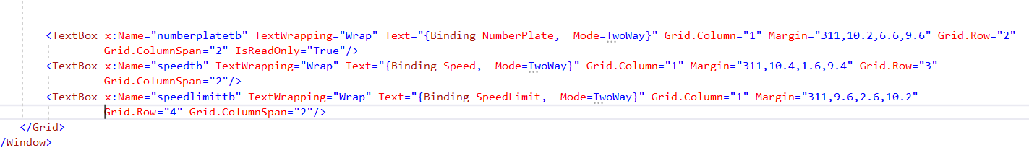
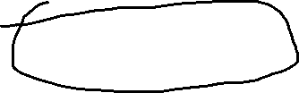
Making Changes in Updaterecord.xaml adding Binding in the Xaml file
DataContext is the public object that can be used or called using this object and here we are equating/passing the vehicle object into Datacontext. It will create the bridge between Updaterecord.xaml.cs and Vehicle.cs. Hence with the help of DataContext a different class Vehicle is added into the Program. The complete code of Updaterecord.xaml.cs is given in the notes below
Notes:
As you can see that here the variables declared at Vehicle class should be displayed at Updaterecord.xaml file. Thus, we are binding the textbox text with the variables of Vehicle class.
Therefore, using Class Vehicle variable NumberPlate in Textbox Text=“{Binding NumberPlate}” with the Textbox named numberplatetb.
using Class Vehicle variable Speed in Textbox Text {Binding Speed} with the Textbox named speedtb.
using Class Vehicle variable SpeedLimit in {Binding SpeedLimit} with the Textbox named speedlimittb.

Slide 23
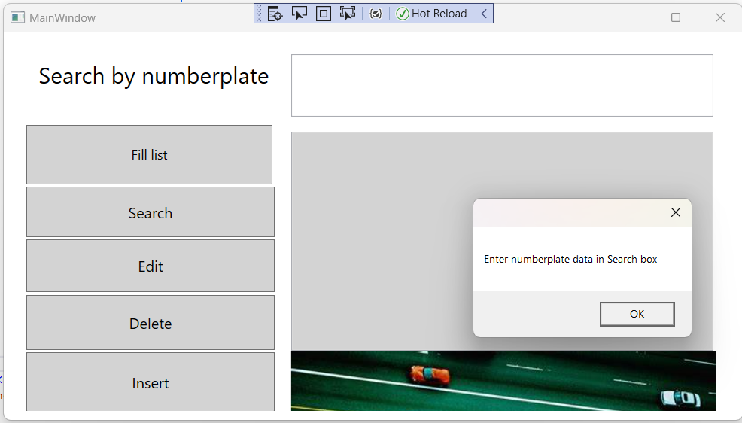
Now the class Vehicle is part of Updaterecord.xaml file after executing the Project we get the following windows . Clicking Edit button will give the screen below.

Slide 24
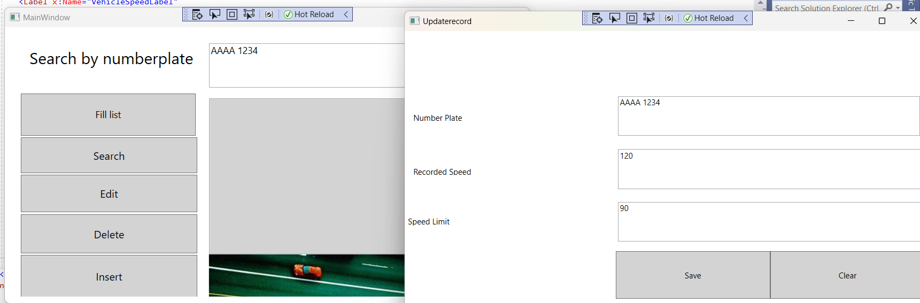
After adding numberplate in Search text box Click edit button and you will be connected to Updaterecord window. Click Clear button to clear data in textboxes, Update Speed &Speed Limit then click Save button.

Slide 25
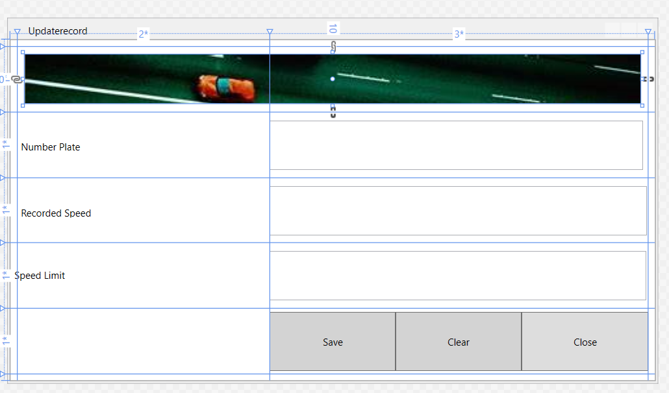
Finally adding an Image and Close button. Double Click the close button and write the given code under close button.
private void Close_Click(object sender, RoutedEventArgs e)
{
this.Close();
}

Slide 26
adding Checkboxes
WPF & Data Binding

Slide 27
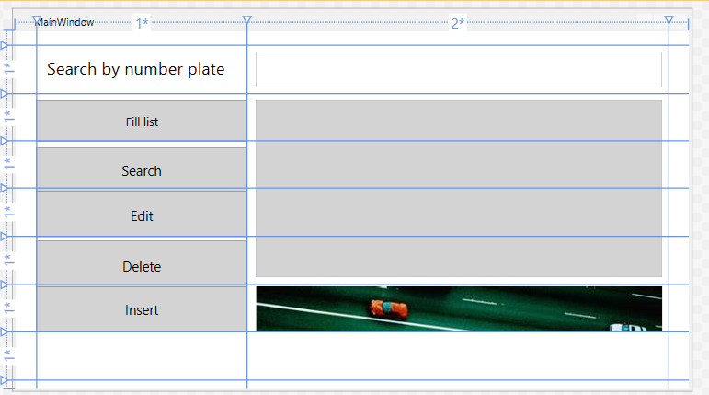
Add an additional row in the Mainwindow.xaml.cs
<Grid.RowDefinitions>
<RowDefinition Height="16"/>
<RowDefinition Height="1*"/>
<RowDefinition Height="1*"/>
<RowDefinition Height="1*"/>
<RowDefinition Height="1*"/>
<RowDefinition Height="1*"/>
<RowDefinition Height="1*"/>
<RowDefinition Height="1*"/>
<RowDefinition Height="16"/>
</Grid.RowDefinitions>

Slide 28
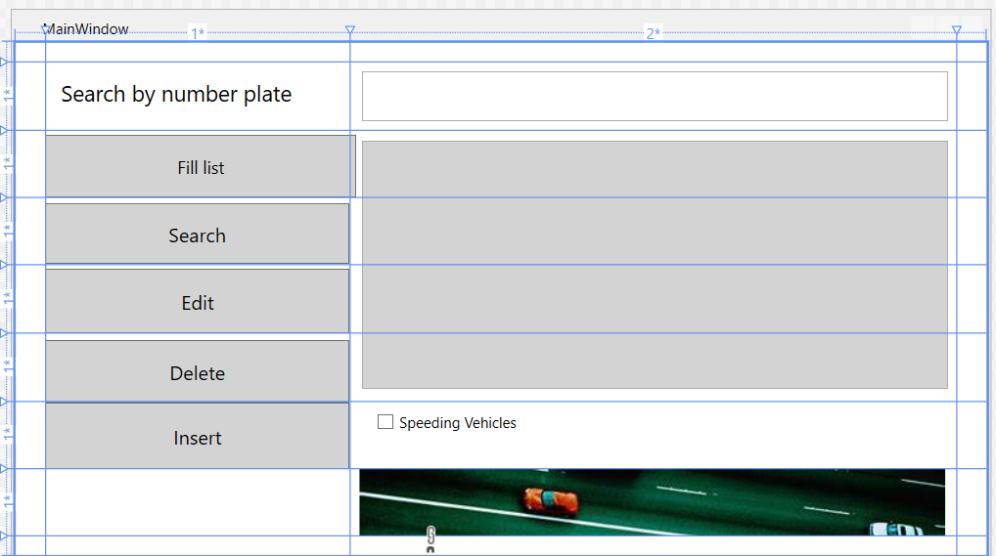
Make some adjustments by dragging image in the 7th row and add a checkbox in Mainwindow.xaml for finding Speeding Vehicles
<CheckBox Content="Speeding Vehicles" Grid.Column="2" HorizontalAlignment="Left" Margin="22.2,10.4,0,0" Grid.Row="6" VerticalAlignment="Top" Checked="SpeedingCheckbox_Checked"
Unchecked="SpeedingCheckbox_Unchecked"/>
Add highlighted text in the Check Box tags

Slide 29
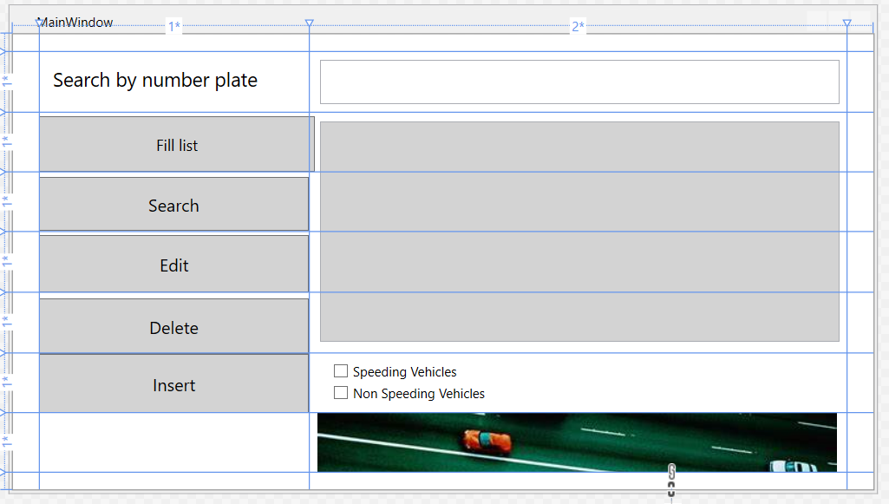
Add another checkbox in Mainwindow.xaml
<CheckBox Content="Non Speeding Vehicles" Grid.Column="2" HorizontalAlignment="Left" Margin="22.2,30.4,0,0" Grid.Row="6" VerticalAlignment="Top" Checked="Checkbox_Checked"
Unchecked="Checkbox_Unchecked"/>
Add highlighted text in the Check Box tags

Slide 30
Double click the Speeding Checkbox. Add codes under the checkbox in the Mainwindow.xaml.cs.
private void SpeedingCheckbox_Checked(object sender, RoutedEventArgs e)
{
string sqlQuery1 = "SELECT * FROM traffic WHERE speed > speed_limit;";
try
{
VehicleListbox.Items.Clear();
conn.Open();
MySqlCommand cmd = new MySqlCommand(sqlQuery1, conn);
MySqlDataReader rdr = cmd.ExecuteReader();
while (rdr.Read())
{
VehicleListbox.Items.Add($"{rdr[1],5}: {rdr[2],5}kph: {rdr[3],5}:");
}
}
catch (Exception ex)
{
MessageBox.Show(ex.ToString());
}
conn.Close();
}
SPEEDING CHECK BOX WHEN CHECKED
private void SpeedingCheckbox_Unchecked(object sender, RoutedEventArgs e)
{
string sqlQuery1 = "SELECT * FROM traffic;";
try
{
VehicleListbox.Items.Clear();
conn.Open();
MySqlCommand cmd = new MySqlCommand(sqlQuery1, conn);
MySqlDataReader rdr = cmd.ExecuteReader();
while (rdr.Read())
{
VehicleListbox.Items.Add($"{rdr[1],5}: {rdr[2],5}kph: {rdr[3],5}:");
}
}
catch (Exception ex)
{
MessageBox.Show(ex.ToString());
}
conn.Close();
}
SPEEDING CHECK BOX WHEN UNCHECKED

Slide 31
Double click the Non Speeding Vehicles Checkbox. Add codes under the checkbox in the Mainwindow.xaml.cs.
private void Checkbox_Checked(object sender, RoutedEventArgs e)
{
string sqlQuery1 = "SELECT * FROM traffic WHERE speed =< speed_limit;";
try
{
VehicleListbox.Items.Clear();
conn.Open();
MySqlCommand cmd = new MySqlCommand(sqlQuery1, conn);
MySqlDataReader rdr = cmd.ExecuteReader();
while (rdr.Read())
{
VehicleListbox.Items.Add($"{rdr[1],5}: {rdr[2],5}kph: {rdr[3],5}:");
}
}
catch (Exception ex)
{
MessageBox.Show(ex.ToString());
}
conn.Close();
}
NON-SPEEDING CHECK BOX WHEN CHECKED
private void Checkbox_Unchecked(object sender, RoutedEventArgs e)
{
string sqlQuery1 = "SELECT * FROM traffic;";
try
{
VehicleListbox.Items.Clear();
conn.Open();
MySqlCommand cmd = new MySqlCommand(sqlQuery1, conn);
MySqlDataReader rdr = cmd.ExecuteReader();
while (rdr.Read())
{
VehicleListbox.Items.Add($"{rdr[1],5}: {rdr[2],5}kph: {rdr[3],5}:");
}
}
catch (Exception ex)
{
MessageBox.Show(ex.ToString());
}
conn.Close();
}
}
NON-SPEEDING CHECK BOX WHEN UNCHECKED

Slide 32
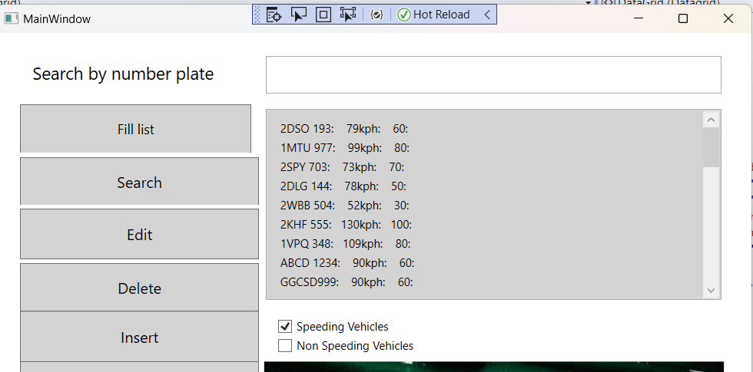
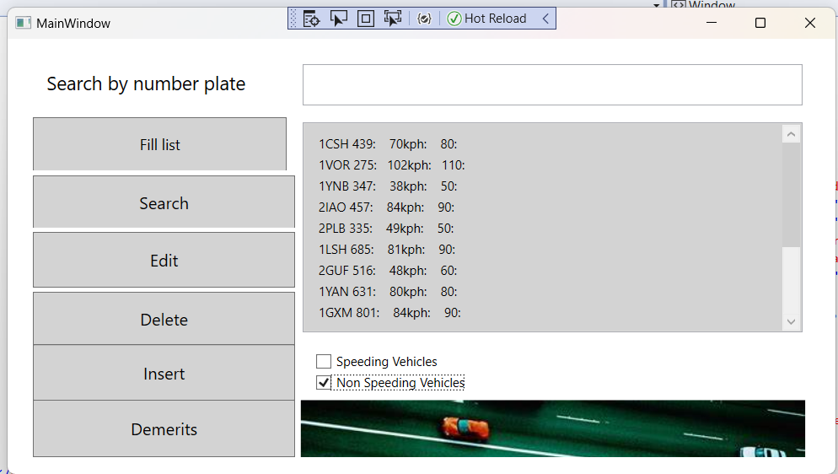
After Checking the checkbox you will get similar output
SPEEDING CHECK BOX WHEN CHECKED NON-SPEEDING CHECK BOX WHEN CHECKED

Slide 33
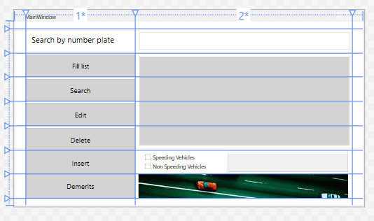
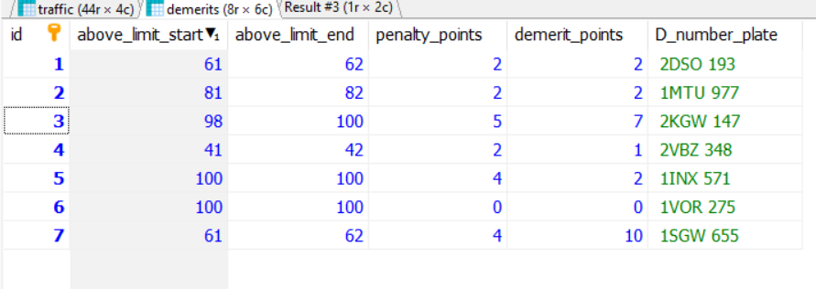
Adding a DataGrid and a Demerits button to know demerits points related to speeding cars
Demerits related to speeding cars are taken care of by DEMERITS table.
Altered DEMERITS table to make it relatable to traffic table added a number plate column and changed the data.
Commands like Alter table, Update and set to make the changes. My Demerits table look like this
Notes:
Leave it on you to create a new table with the same name and delete the old one, Or modify the current one .

Slide 34
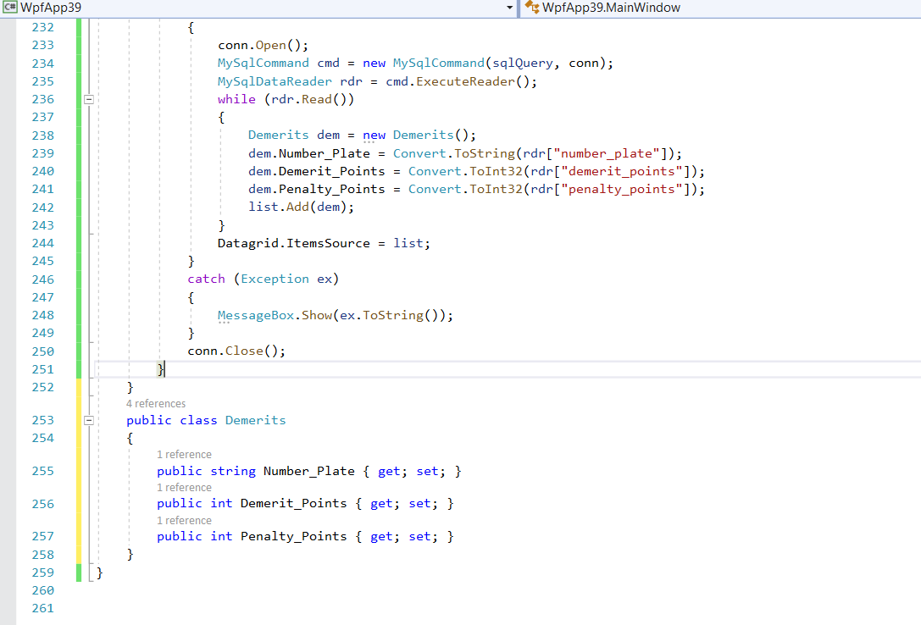
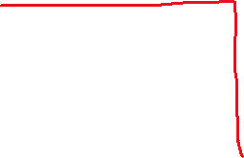
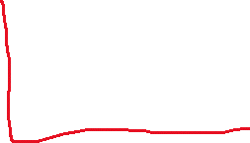
Adding a Class Demerits in the MainWindow.cs at the end of the MainWindow.cs.after the closing braces }.
public class Demerits
{
public string Number_Plate { get; set; }
public int Demerit_Points { get; set; }
public int Penalty_Points { get; set; }
}
Notes:
Leave it on you to create a new table with the same name and delete the old one, Or modify the current one .

Slide 35
Under the demerits button click write the given code
private void Demerits_Click(object sender, RoutedEventArgs e)
{
List<Demerits> list = new List<Demerits>();
string sqlQuery = "Select traffic.number_plate,demerits.demerit_points,demerits.penalty_points from" +
" traffic inner join demerits where number_plate like '%" + SearchTextbox.Text + "%';";
try
{
conn.Open();
MySqlCommand cmd = new MySqlCommand(sqlQuery, conn);
MySqlDataReader rdr = cmd.ExecuteReader();
while (rdr.Read())
{
Demerits dem = new Demerits();
dem.Number_Plate =Convert.ToString(rdr["number_plate"]);
dem.Demerit_Points = Convert.ToInt32(rdr["demerit_points"]);
dem.Penalty_Points = Convert.ToInt32(rdr["penalty_points"]);
list.Add(dem);
}
Datagrid.ItemsSource = list;
}
catch (Exception ex)
{
MessageBox.Show(ex.ToString());
}
conn.Close();
}
Creating a Class outside the Class Mainwindows. The way we created above in databinding Under the same namespace and using that class in the List <> which is a generic class.
Placing Demerits class within the angled braces and creating a list object adding dem in it.
Finally transfering list in the Datagrid.Itemsource.
Datagrid.ItemSource=list;
Notes:
string sqlQuery = "Select traffic.number_plate,demerits.demerit_points,demerits.penalty_points from traffic inner join demerits where number_plate like '%" + SearchTextbox.Text + "%';";

Slide 36
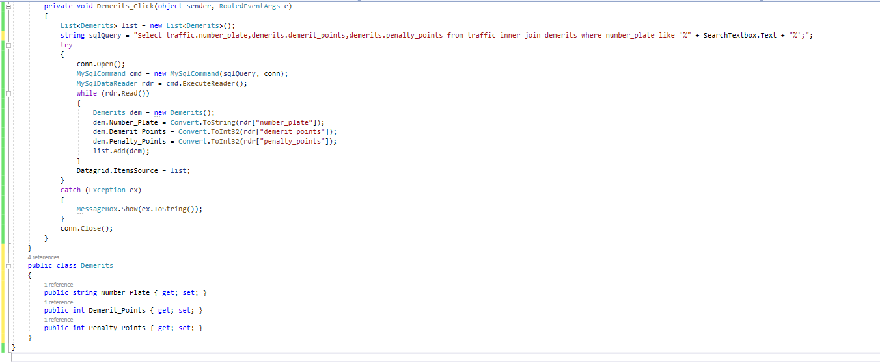
To make Datagrid effective write the following code.
Notes:
private void Demerits_Click(object sender, RoutedEventArgs e)
{
List<Demerits> list = new List<Demerits>();
string sqlQuery = "Select traffic.number_plate,demerits.demerit_points,demerits.penalty_points from" +
" traffic inner join demerits where number_plate like '%" + SearchTextbox.Text + "%';";
try
{
conn.Open();
MySqlCommand cmd = new MySqlCommand(sqlQuery, conn);
MySqlDataReader rdr = cmd.ExecuteReader();
while (rdr.Read())
{
Demerits dem = new Demerits();
dem.Number_Plate = Convert.ToString(rdr["number_plate"]);
dem.Demerit_Points = Convert.ToInt32(rdr["demerit_points"]);
dem.Penalty_Points = Convert.ToInt32(rdr["penalty_points"]);
list.Add(dem);
}
Datagrid.ItemsSource = list;
}
catch (Exception ex)
{
MessageBox.Show(ex.ToString());
}
conn.Close();
}
}
public class Demerits
{
public string Number_Plate { get; set; }
public int Demerit_Points { get; set; }
public int Penalty_Points { get; set; }
}
}

Slide 37
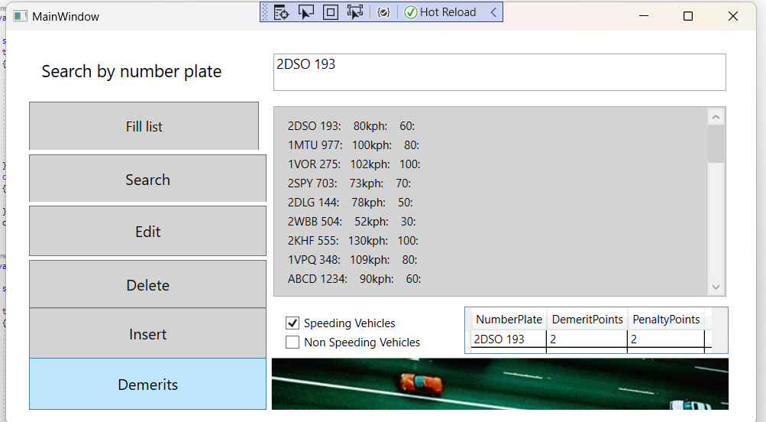
Place a speeding car number plate in Search Text box and click Demerits button. You will get a output like this

Slide 38
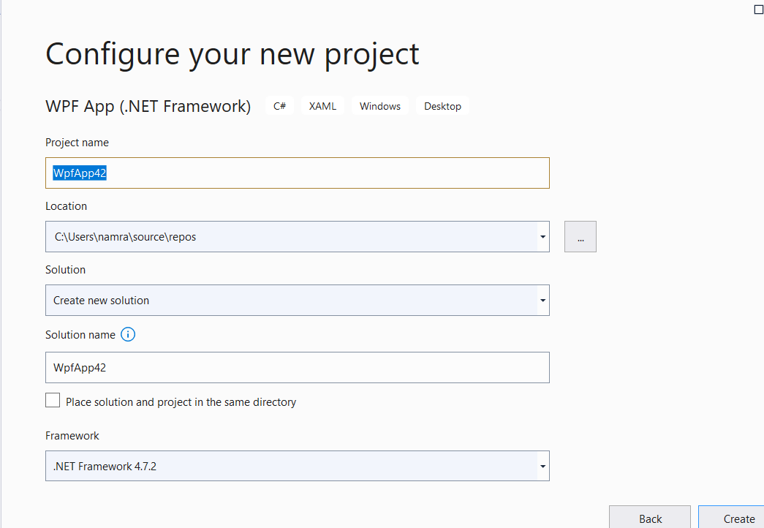

To save and upload the Project
Go to File explorer
Follow the path used while creating the Project
C:\Users\namra\source\repos
Select the name of the project
Right Click and Create a Zip file and Upload

Slide 39
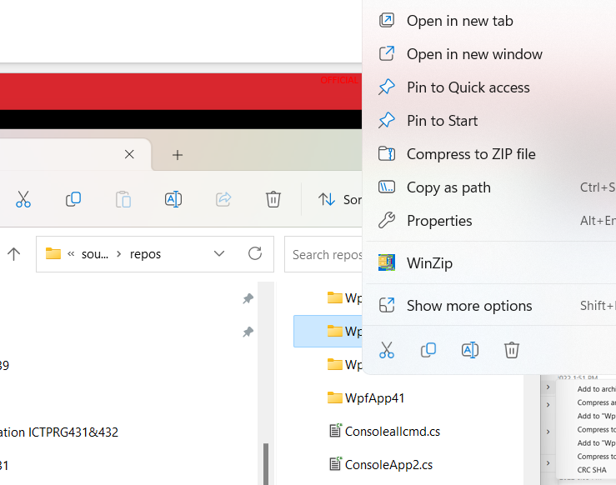
To save and upload the Project
Follow the path used while creating the Project
C:\Users\namra\source\repos
Select the name of the project
Right Click and Create a Zip file and Upload
The above discussed project WpfApp39.zip is attached
here.

Slide 40
Exercise
Replace VehicleListbox with a DataGrid and do the same operations

