Slide 1
WPF & Database
Week / Session 12
Namrata Aneja
Chris Arnold
ICT40518 Certificate IV in Programming
Data Driven Applications
ICTPRG431 | Apply Query Language
ICTPRG432 | Develop Data Driven Applications

Slide 2
Session Contents
Connecting to a MySQL/MariaDB
Using SQL in C#
Reading Tables in C#
Listing Record Summaries in WPF
Showing Record Details in WPF

Slide 3
Setting Up
Refer to the main slides for session 12; pp3-20.

Slide 4
Using SQL in C#
WPF & Database 1

Slide 5
UX vs UI
Talk to your neighbour about your experience with WPF so far. What kinds of UI elements do you know? How might you apply them to your portfolio database?

Slide 6
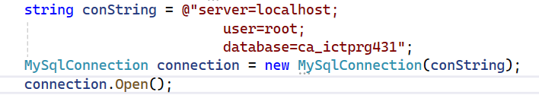
Creating a connection to MySQL
To connect, create an SqlConnection instance.
Configure it with a connection string:
The connection string is a semicolon-delimited list of options. For details of the options, see: https://dev.mysql.com/doc/connector-net/en/connector-net-connections-string.html

Slide 7
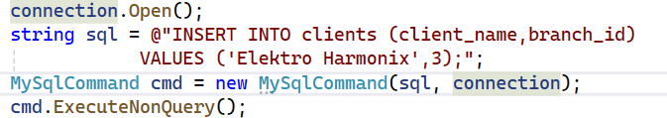
Issue a simple command
Use an SqlCommand
It needs an open SqlConnection
ExecuteNonQuery() will not return a value, even if your SQL query has a result set

Slide 8
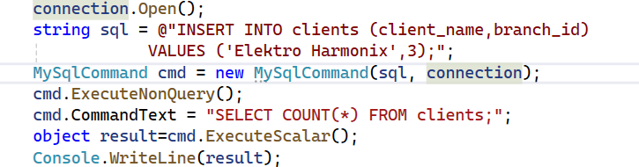
Retrieve a simple value
We can also (unsurprisingly!) fetch data from the database.
Single values can be fetched with ExecuteScalar():

Slide 9
Recap
The connection string: what do these elements mean? Some might need a guess!
server
database
uid
pwd
IntegratedSecurity / sspi
encrypt
sslmode
protocol

Slide 10
Reading Tables In C#
WPF & Database 1

Slide 11
UX vs UI
Talk to your neighbour about your experience with WPF so far. What process do you (as the user of your WPF app) go through to add/edit/delete data? Can you think of other processes from websites or apps you’ve seen?

Slide 12
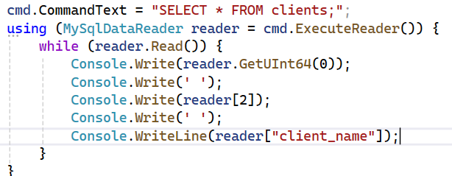
Retrieve a table
Tables can be fetched with ExecuteReader(). This returns an object with an iterator pattern:
Look at the code suggestions in Visual Studio: there are lots of methods for accessing the elements of a row.

Slide 13
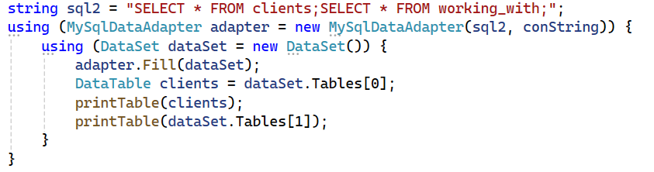
Retrieve one or more tables
An SqlDataAdapter object can read from many tables in a single command:

Slide 14
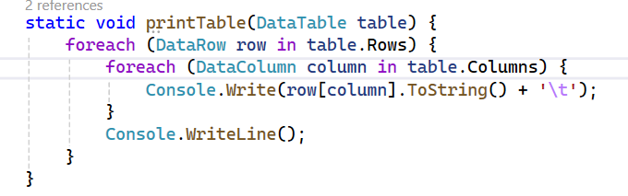
Retrieve one or more tables
SqlDataAdapter fills a DataTable, which has a more intuitive API for reading data:

Slide 15
Recap
Think about WPF and your project data structure. What form controls do you think will be useful?

Slide 16
Adding Data to the GUI Layout
WPF & Database 1

Slide 17
UX vs UI
UX is quite a different way of thinking about how we put together interfaces; here’s a quick primer:
https://www.youtube.com/watch?v=TgqeRTwZvIo
This UX designer talks about his work day, and what he focuses on:
https://www.youtube.com/watch?v=ljFRp4N9aok

Slide 18
Creating the GUI Layout
We’re going to add our client data to a grid:

Slide 19
List view
Together, we’ll develop a list/detail view of our data.
Add a ListBox to your WPF form
Add text boxes for all the columns
Fill the list with row summaries
Add an event handler to initialise the edit controls.

Slide 20
Detail View
I’ll show how to add a separate add/edit form for the clients table.
Add a new WPF Window item to your project
Add the controls and extend the constructor to take a client as a parameter
A new window is displayed with Show() or ShowDialog()

Slide 21
Recap
Discuss some ideas with your neighbour for the add / edit record functions we need for the project. Can you come up with any different workflows? If not, what are the merits/downsides of each (that is, the 1-screen interface vs the 2-screen interface)?

Slide 22
Creating the GUI Layout –XAML file
Week_12…_01 will match the name of your project… Do not change this
Updating the title
Edit the Window definition to read:
<Window x:Class="Week_12_WPF_Database_01.MainWindow"
xmlns="http://schemas.microsoft.com/winfx/2006/xaml/presentation"
xmlns:x="http://schemas.microsoft.com/winfx/2006/xaml"
xmlns:d="http://schemas.microsoft.com/expression/blend/2008"
xmlns:mc="http://schemas.openxmlformats.org/markup-compatibility/2006"
xmlns:local="clr-namespace:Week_12_WPF_Database_01"
mc:Ignorable="d"
Title="Week 12: WPF Database Integration" Height="450" Width="800">
Width and Height – default window size
MinWidth, MaxWidth, MinHeight, MaxHeight to limit size

Slide 23
Creating the GUI Layout
Add the Grid column definitions inside the <Grid> … </Grid> tags:
<Grid.ColumnDefinitions>
<ColumnDefinition Width="24"/>
<ColumnDefinition Width="1*"/>
<ColumnDefinition Width="2*"/>
<ColumnDefinition Width="24"/>
</Grid.ColumnDefinitions>
24 is a fixed width
1* and 2* provide for the remaining area to be divided into parts of size 1/3 and 2/3

Slide 24
Creating the GUI Layout
Add the row definitions, after the Column definitions:
<Grid.RowDefinitions>
<RowDefinition Height="16"/>
<RowDefinition Height="1*"/>
<RowDefinition Height="1*"/>
<RowDefinition Height="1*"/>
<RowDefinition Height="1*"/>
<RowDefinition Height="1*"/>
<RowDefinition Height="16"/>
</Grid.RowDefinitions>
16 is a fixed height
Having five 1* gives each row 1/5 of the height of the remaining space

