Slide 1
Graphic User Interface with C# & WPF
Week / Session 11
Maryam Shahabi Lotfabadi
Adrian Gould
Namrata Aneja
ICT40518 Certificate IV in Programming
Data Driven Applications
ICTPRG402 | Apply Query Language
ICTPRG403 | Develop Data Driven Applications

Slide 2
Session Contents
WPF Introduction
Features
Installation
…

Slide 3
Requirements
WPF and C#

Slide 4
Requirements
You will require:
Windows 10 PC
Laragon with MySQL / MariaDB running
Visual Studio 2019/2022 (preferred)

Slide 5
Requirements
Downlaod Visual Studio from:
https://visualstudio.microsoft.com/downloads/
In Visual Studio 2019 workloads:
Desktop and mobile: '.NET Desktop development’
Other tool-sets required:
'data storage and processing‘
'.NET Core cross-platform development’
Video to help:
https://www.youtube.com/watch?v=DpEUV6IAPwI

Slide 6
About Visual Studio
Visual Studio:
Integrated Development Environment
A creative launching pad
Use to edit, debug, and build code
Also used to build & publish applications into production

Slide 7
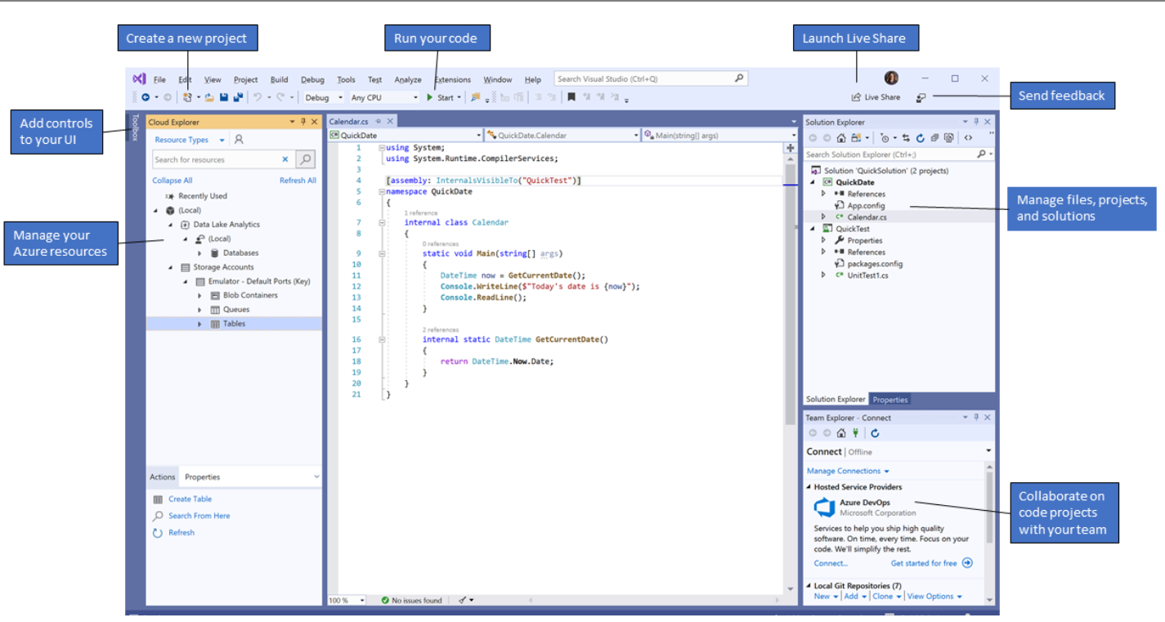
Visual Studio: Interface

Slide 8
About Visual Studio
Solution Explorer:
Located top right
Lets you view, navigate, and manage your code files.
Help organize your code by grouping the files into solutions and projects.

Slide 9
About Visual Studio
The editor window
Located in the centre
Most time spent in this area
Displays file content
Provides space for adding and editing code
Provides space to design a user interface such as a window with buttons and text boxes.

Slide 10
About Visual Studio
Team Explorer
Located bottom right
Allows you to track work items and share code with others
Uses version control technologies such as Git and Team Foundation Version Control (TFVC).

Slide 11
WPF
WPF and C#

Slide 12
WPF
WPF-Windows Presentation Foundation It is a powerful framework for building Windows applications.
In WPF, UI elements are designed in XAML while behaviors can be implemented in procedural languages such C# and VB.Net. So it very easy to separate behavior from the designer code.
With XAML, the programmers can work in parallel with the designers. The separation between a GUI and its behavior can allow us to easily change the look of a control by using styles and templates.

Slide 13
WPFWPF – Features WPF is a powerful framework to create Windows application. It supports many great features, some of which have been listed below −
WPF is a powerful framework to create Windows application. It supports many great features, some of which have been listed below −
Feature | Description
Control inside a Control | Allows to define a control inside another control as a content.
Data binding | Mechanism to display and interact with data between UI elements and data object on user interface.
Media services | Provides an integrated system for building user interfaces with common media elements like images, audio, and video.
Templates | In WPF you can define the look of an element directly with a Template
Animations | Building interactivity and movement on user Interface
Alternative input | Supports multi-touch input on Windows 7 and above.
Direct3D | Allows to display more complex graphics and custom themes

Slide 14
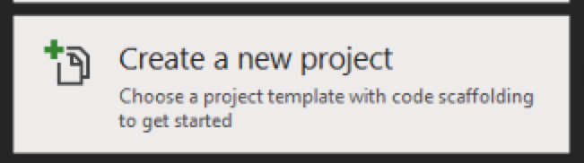
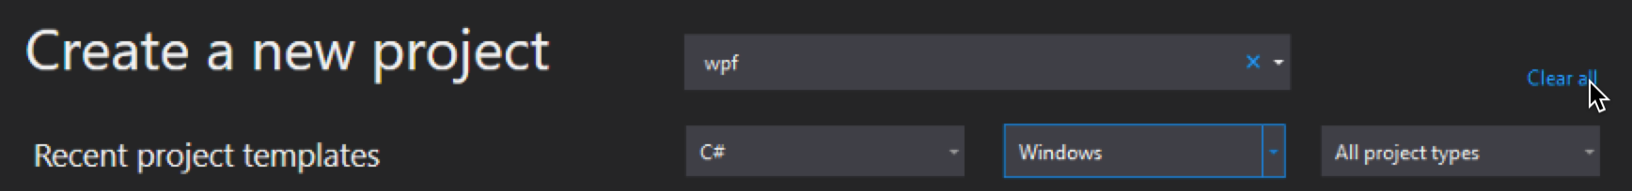
WPF
Creating a WPF Project
Open Visual Studio 2019
Click on “Create a New Project”
Use the filters to select C#, Windows and All project types
Type WPF in the top ‘search’ box

Slide 15
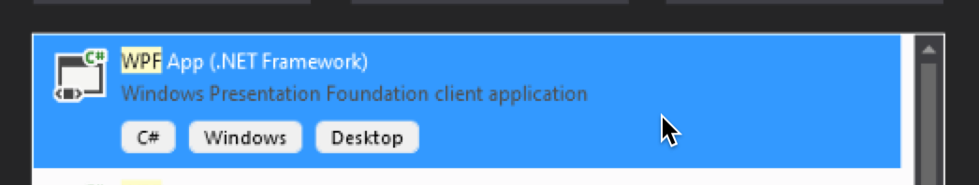
WPF
Creating a WPF Project (cont)
Select the C# WPF App (.NET Framework) option
Click Next

Slide 16
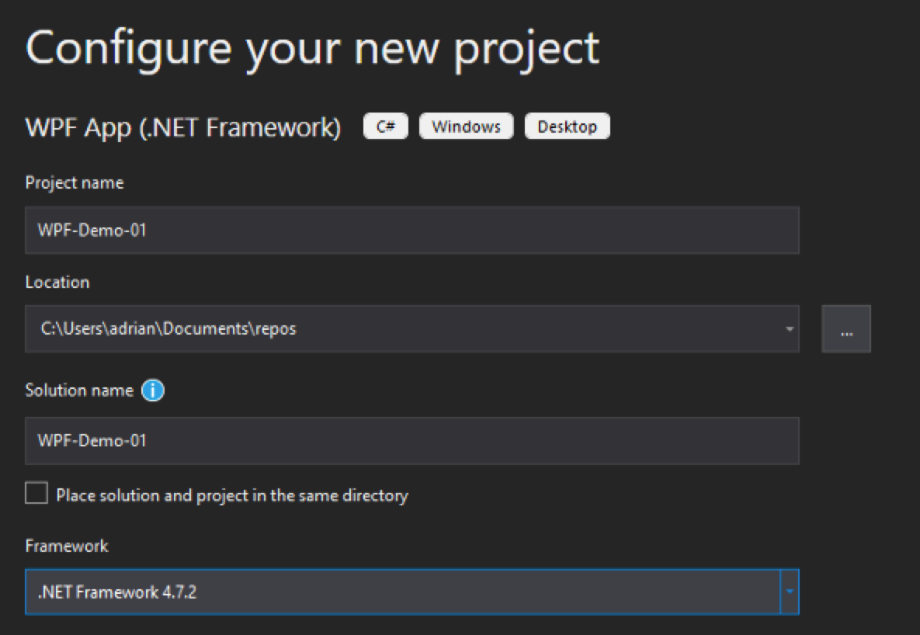
WPF
Creating a WPF Project (cont)
Complete the dialog box by giving the project a name and location
The Framework should be the latest
Click Create

Slide 17
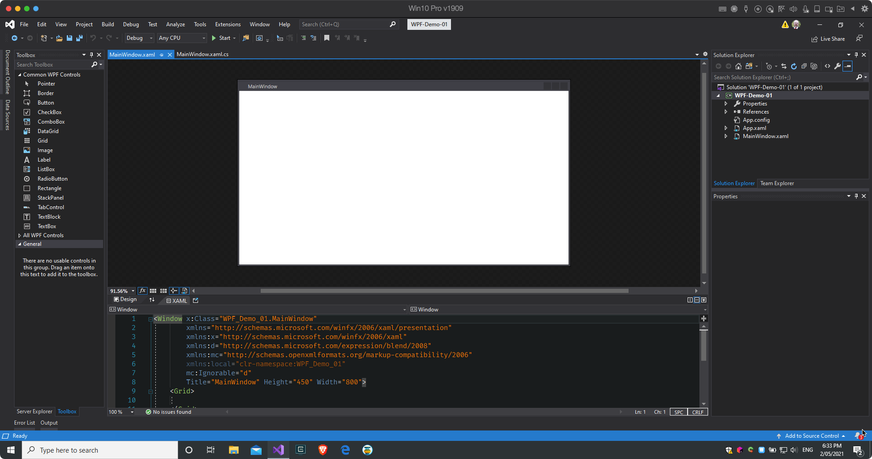
WPF
Solution Explorer
Toolbox
Layout Preview
XAML Code for the Layout

Slide 18
WPF and XAML
XAML is just another simple and easy way to design UI elements.
With XAML, it doesn’t mean that what you can do to design UI elements is the only way. You can either declare the objects in XAML or define them using code.
XAML is optional, but despite this, it is at the heart of WPF design.
The goal of XAML is to enable visual designers to create user interface elements directly.
WPF aims to make it possible to control all visual aspects of the user interface from mark-up

Slide 19
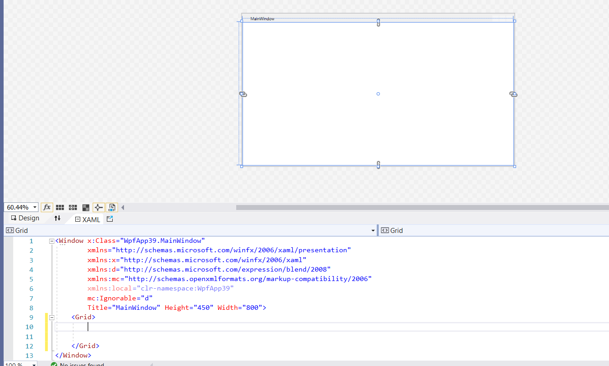
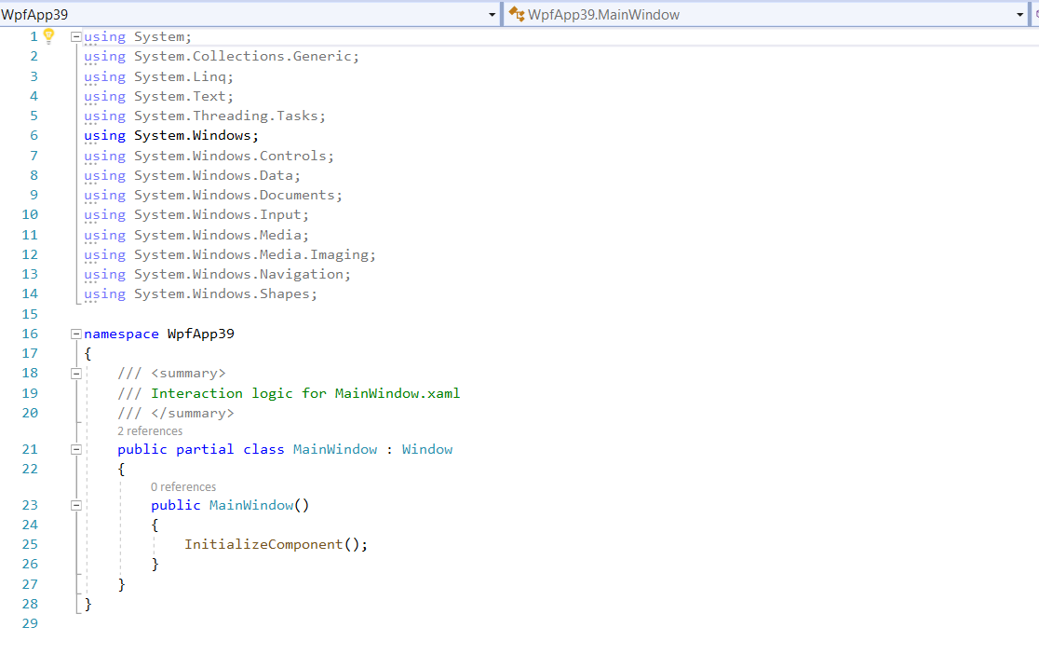
WPF and XAML
XAML screen
C# Screen

Slide 20
WPF and XAML
The XAML code is FRONT END User Interface, and is created by using different kinds of tools.
The XAML code is written in the XAML screen and Most of the times it is written in between the GRID Tags.
It is represented by file name XAML.app
The other screen is for C# that will connect Xaml or UI interface with BACK END SQL.
The file is called as Main. Window.xaml.cs

Slide 21
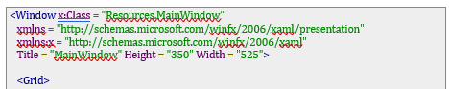
WPF Basic Syntax-When you create your new WPF project, you will encounter some of the XAML code by default in MainWindow.xaml as shown below.
The above XAML file contains different kinds of information. The following table briefly explains the role of each information.

Slide 22
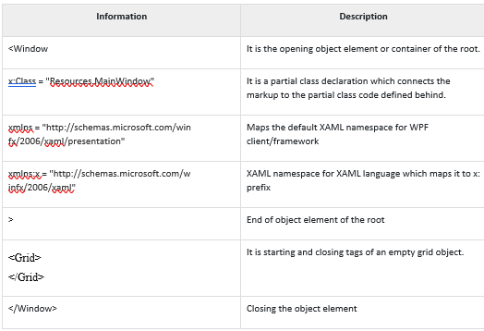
WPF

Slide 23
WPF
Now you know XAML area and C# AreaClick in the XAML Code area
We will edit this code for this demo
XAML code tools are written in Grid area
Starts with
<GRID>
and ends with
</GRID>
within < Windows> tags

Slide 24
WPF and XAML-Write the given code in XAML
<Window x:Class = "WpfApplication3.MainWindow"
xmlns = "http://schemas.microsoft.com/winfx/2006/xaml/presentation"
xmlns:x = "http://schemas.microsoft.com/winfx/2006/xaml"
xmlns:views = "clr-namespace:WpfApplication3"
Title = "MainWindow" Height = "350" Width = "604">
<Grid>
<Label Width=“340" Height="240" Background="Aqua" Content="Hello World"/>
</Grid>
</Window>

Slide 25
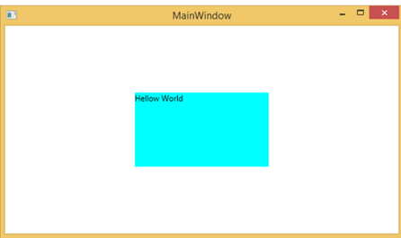
You will get this output

Slide 26
understanding-StackPanel & WrapPanel using codes
In a Xaml file, you will get this code in a XAML file
Type the given code within Grid tags placing a stack of buttons
<Window x:Class = "WPFElementsTree.MainWindow"
xmlns = "http://schemas.microsoft.com/winfx/2006/xaml/presentation"
xmlns:x = "http://schemas.microsoft.com/winfx/2006/xaml"
Title = "MainWindow" Height = "350" Width = "604">
<StackPanel>
<Button >Button1</Button>
<Button >Button1</Button>
<Button >Button1</Button>
<Button >Button1</Button>
<Button >Button1</Button>
<Button >Button1</Button>
<Button Width="200" Height="100" VerticalAlignment="Center">Button1</Button>
<Button Width="200" Height="100" VerticalAlignment="Center">Button1</Button>
<Button Width="200" Height="100" VerticalAlignment="Center">Button1</Button>
<Button Width="200" Height="100" VerticalAlignment="Center">Button1</Button>
</StackPanel>
</Window>
Notes:
Stack panel is where we can stack any of the tools it could be buttons or text box items or any.

Slide 27
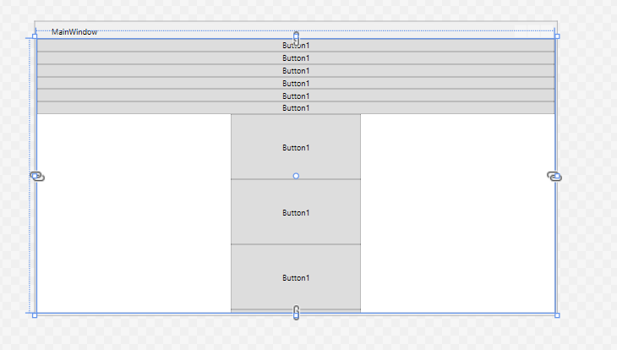
You will get the given output

Slide 28
WPF AND XAML
You will get this code in XAML file
Replace the stack panel with wrap panel
<Window x:Class = "WPFElementsTree.MainWindow"
xmlns = "http://schemas.microsoft.com/winfx/2006/xaml/presentation"
xmlns:x = "http://schemas.microsoft.com/winfx/2006/xaml"
Title = "MainWindow" Height = "350" Width = "604">
<WrapPanel>
<Button >Button1</Button>
<Button >Button1</Button>
<Button >Button1</Button>
<Button >Button1</Button>
<Button >Button1</Button>
<Button >Button1</Button>
<Button Width="200" Height="100" VerticalAlignment="Center">Button1</Button>
<Button Width="200" Height="100" VerticalAlignment="Center">Button1</Button>
<Button Width="200" Height="100" VerticalAlignment="Center">Button1</Button>
<Button Width="200" Height="100" VerticalAlignment="Center">Button1</Button>
</WrapPanel>
</Window>
Notes:
Replacing Wrap panel instead of Stack panel you will notice the difference in the output where buttons are wrapped up.

Slide 29
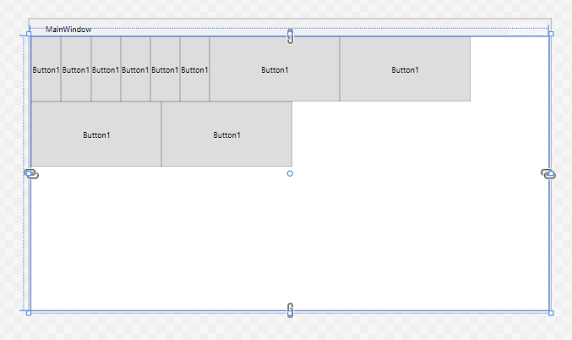
The output for WrapPanel is

Slide 30
WPF Try to use different tools between the Grid tags
Edit the XAML
<Grid>
<TextBlock HorizontalAlignment="Left” Margin="252,47,0,0" TextWrapping="Wrap” Text="Select a message option and then choose the Display button.” VerticalAlignment="Top"/>

Slide 31
WPF Try to use different tools between the Grid tags
Edit the XAML
<Grid>
<TextBlock HorizontalAlignment="Left" Margin="252,47,0,0"
TextWrapping="Wrap" Text="Select a message option and then choose the Display button."
VerticalAlignment="Top"/>

Slide 32
WPF Try to use different tools between the Grid tags
<RadioButton x:Name="HelloButton" Content="Hello" IsChecked="True" HorizontalAlignment="Left" Margin="297,161,0,0"
VerticalAlignment="Top"/>

Slide 33
WPF Try to use different tools between the Grid tags
<RadioButton x:Name="GoodbyeButton" Content="Goodbye" HorizontalAlignment="Left" Margin="488,161,0,0" VerticalAlignment="Top"/>

Slide 34
WPF- Try to use different tools between the Grid tags
<Button Content="Display" HorizontalAlignment="Left" Margin="377,270,0,0" VerticalAlignment="Top" Width="75"/>
</Grid>

Slide 35
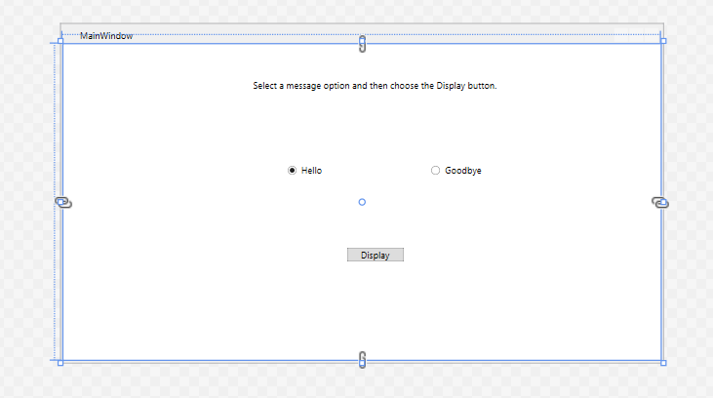
You will see output like this

Slide 36
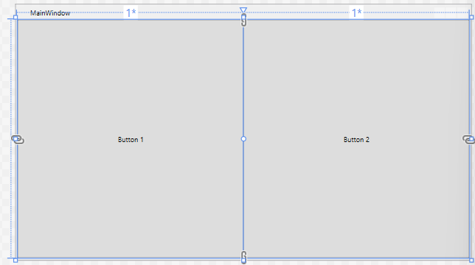
To divide Grid in equal parts Column wise
<Grid.ColumnDefinitions> <ColumnDefinition Width="*" />
<ColumnDefinition Width="*" />
</Grid.ColumnDefinitions> <Button>Button 1</Button>
<Button Grid.Column="1">Button2</Button>
(Here Column count starts from 0 )
Notes:
When asterisk (*) is considered as width of Grid column then Screen is divided by the WPF software on its own.
However, when numbers like 1 or 2 are considered it means that user is responsible for the division of screen.

Slide 37
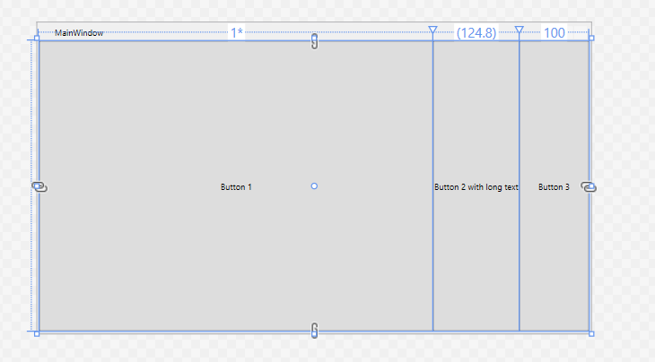
Another example for Grid
<Grid>
<Grid.ColumnDefinitions>
<ColumnDefinition Width="1*" />
<ColumnDefinition Width="Auto"/>
<ColumnDefinition Width="100" /> </Grid.ColumnDefinitions>
<Button>Button 1</Button>
<Button Grid.Column="1">
Button 2 with long text
</Button>
<Button Grid.Column="2">
Button 3
</Button>
</Grid>
Notes:
Here, column width for first column is 1* or we can say the first button has a star width it will accommodate the rest of the space, the second column has its width set to Auto and the last one has a static width of 100 pixels, as can be seen in the screenshot the second button only takes exactly the amount of space it needs to render its longer text as a result of auto width, the third button takes exactly the 100 pixels it was promised and the first button, with the variable width, takes the rest of the space.

Slide 38
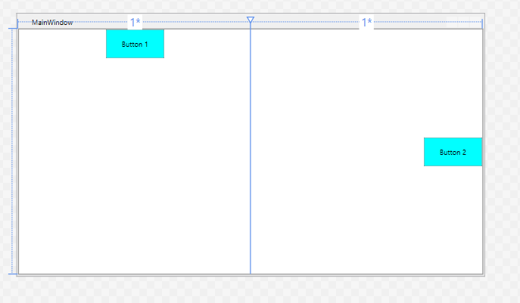
To divide Grid in equal parts
<Grid.ColumnDefinitions>
<ColumnDefinition Width="*" />
<ColumnDefinition Width="*" />
</Grid.ColumnDefinitions>
<Button VerticalAlignment="Top“ HorizontalAlignment="Center“ Background="Aqua“ Height="50" Width="100">
Button 1
</Button>
<Button Grid.Column="1" VerticalAlignment="Center" HorizontalAlignment="Right“ Background="Aqua“ Height="50" Width="100">
Button 2
</Button>
Notes:
To be more precise when we are using Asterisk /star it says that whatever the width size is it will be divided into half as two columns of equal size are to be accommodated by the screen. To know about it more do replace Asterisk (*)with Auto or 1* or 1. You will come to know the difference.

Slide 39
WPF &C#
The program is too large to be accommodated on one screen
Contd..
<Grid.ColumnDefinitions>
<ColumnDefinition Width="2*" />
<ColumnDefinition Width="1*" />
<ColumnDefinition Width="1*" />
</Grid.ColumnDefinitions>
<Grid.RowDefinitions>
<RowDefinition Height="2*" />
<RowDefinition Height="1*" />
<RowDefinition Height="1*" />
</Grid.RowDefinitions>
<Button>Button 1</Button>
<Button Grid.Column="1">Button 2</Button>
<Button Grid.Column="2">Button 3</Button>
<Button Grid.Row="1">Button 4</Button>
<Button Grid.Column="1" Grid.Row="1">
Button 5</Button>
<Button Grid.Column="2" Grid.Row="1">
Button 6</Button>
<Button Grid.Row="2">Button 7</Button>
<Button Grid.Column="1" Grid.Row="2">
Button 8</Button>
<Button Grid.Column="2" Grid.Row="2">Button9
</Button>
Notes:
<ColumnDefinition Width="2*" /> Two parts of total width area of screen
<ColumnDefinition Width="1*" /> One part of total width area of screen
<ColumnDefinition Width="1*" /> One part of total width area of screen
Similarly
<RowDefinition Height="2*" />Two parts of total width area of screen
<RowDefinition Height="1*" />One part of total width area of screen
<RowDefinition Height="1*" />One part of total width area of screen

Slide 40
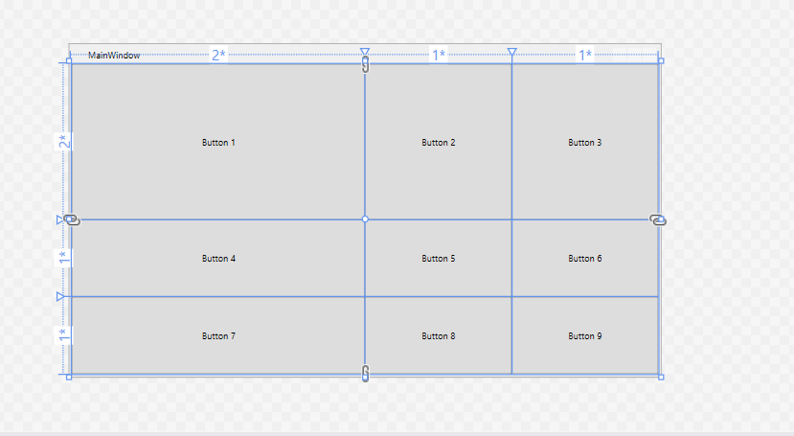
Grid Area in XAML code dividing it with WPF commands. Here is the XAML screen below

Slide 41
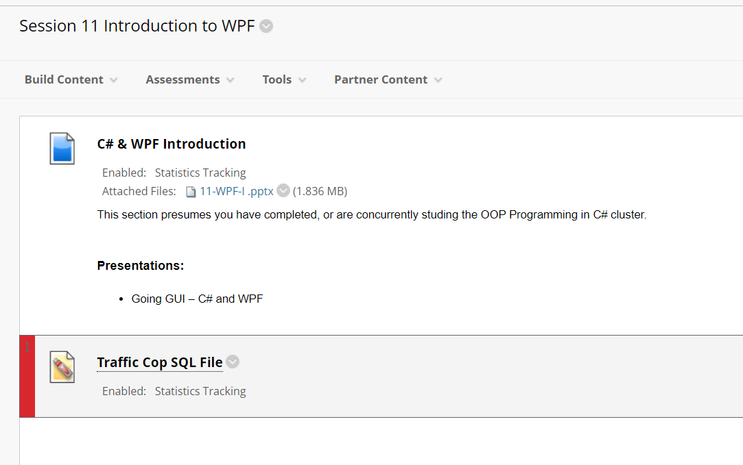

Create a data base Traffic Cop using Laragon. (The Sql file with the data is given in the Session 11.)

Slide 42
Preparation
Sample data is presented as a number of SQL files
These are in a compressed file in the Session Folder
Download the file
Uncompress the ZIP file
Open your Database Management Application
Log in as the admin (root) user
Open your SQL tab
Open each file in turn using a text editor
COPY the file content, PASTE into the SQL entry area and RUN the code
Any errors? There should not be if all working correctly.

Slide 43
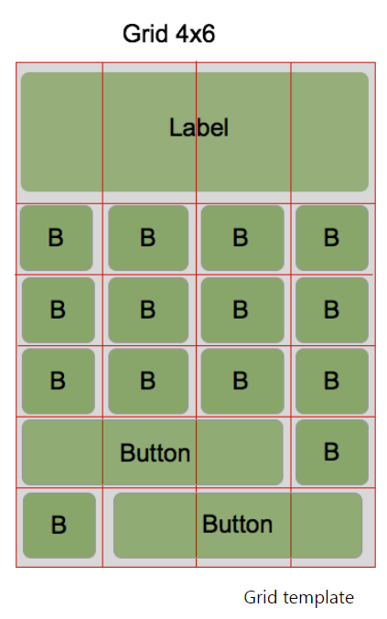
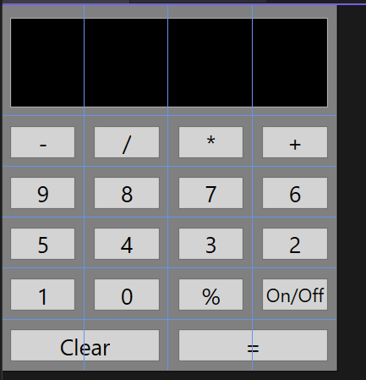
Exercise
Create a calculator using xaml
and place label on each button
Notes:
To create a calculator in XAML, the codes are written in Windows tag and in Grid tag. Look into the bold lines that has been coded to create calculator. This code will create first 3 rows. Rest of the rows should be created by you.
To make it a complete Calculator.
You can use toolbox for button tool or Copy /paste the button given above.
<Window x:Class="WpfApp1.MainWindow"
xmlns="http://schemas.microsoft.com/winfx/2006/xaml/presentation"
xmlns:x="http://schemas.microsoft.com/winfx/2006/xaml"
xmlns:d="http://schemas.microsoft.com/expression/blend/2008"
xmlns:mc="http://schemas.openxmlformats.org/markup-compatibility/2006"
xmlns:local="clr-namespace:WpfApp1"
mc:Ignorable="d"
Title="MainWindow" Height="451" Width="360" Background="Gray">
<Grid>
<Grid.ColumnDefinitions>
<ColumnDefinition Width="1*"/>
<ColumnDefinition Width="1*"/>
<ColumnDefinition Width="1*"/>
<ColumnDefinition Width="1*"/>
</Grid.ColumnDefinitions>
<Grid.RowDefinitions>
<RowDefinition Height="3*" />
<RowDefinition Height="1*"/>
<RowDefinition Height="1*"/>
<RowDefinition Height="1*"/>
<RowDefinition Height="1*"/>
<RowDefinition Height="1*"/>
</Grid.RowDefinitions>
<TextBox HorizontalAlignment="Left" Margin="10,57,0,0" TextWrapping="Wrap" Text="" Background="Black" VerticalAlignment="Top" Width="340" Grid.ColumnSpan="4" Height="96"/>
<Button Content="-" HorizontalAlignment="Center" Background="LightGray" Foreground="Black" FontSize="24" Grid.Row="1" VerticalAlignment="Center" Width="70" Height="35"/>
<Button Content="/" HorizontalAlignment="Center" Grid.Row="1" Background="LightGray" Foreground="Black" FontSize="24" VerticalAlignment="Center" Width="70" Height="35" Grid.Column="1"/>
<Button Content="*" HorizontalAlignment="Center" Background="LightGray" Foreground="Black" FontSize="24" Grid.Row="1" VerticalAlignment="Center" Width="70" Height="35" Grid.Column="2"/>
<Button Content="+" HorizontalAlignment="Center" Background="LightGray" Foreground="Black" FontSize="24" Grid.Row="1" VerticalAlignment="Center" Width="70" Height="35" Grid.Column="3"/>
<Button Content="9" HorizontalAlignment="Center" Background="LightGray" Foreground="Black" FontSize="24" Grid.Row="2" VerticalAlignment="Center" Width="70" Height="35"/>
<Button Content="8" HorizontalAlignment="Center" Grid.Row="2" Background="LightGray" Foreground="Black" FontSize="24" VerticalAlignment="Center" Width="70" Height="35" Grid.Column="1"/>
<Button Content="7" HorizontalAlignment="Center" Background="LightGray" Foreground="Black" FontSize="24" Grid.Row="2" VerticalAlignment="Center" Width="70" Height="35" Grid.Column="2"/>
<Button Content="6" HorizontalAlignment="Center" Background="LightGray" Foreground="Black" FontSize="24" Grid.Row="2" VerticalAlignment="Center" Width="70" Height="35" Grid.Column="3"/>
</Grid>
</Window>

