Slide 1
Database & Data Basics
Week / Session 01
Maryam Shahabi Lotfabadi
Adrian Gould
Namrata Aneja
ICT40518 Certificate IV in Programming
Data Driven Applications
ICTPRG431 | Apply Query Language
ICTPRG432 | Develop Data Driven Applications

Slide 2
Session Contents
Database Basics
Introduction to MariaDB / MySQL Server

Slide 3
Data Driven Applications
Database & Data Basics

Slide 4
Programming
Series of steps
Instruct computer how to
Solve a problem
Notes:
Typically programming involves laying out a series of steps in order that you want the computer to do.

Slide 5
Data Driven Programming
Code describes the
Data
Relationships
Flow of the program
Recipe on how to make something
Notes:
With data driven programming, the code you write describes the types of data and their relationships and the data, in turn, controls the program flow.
Think of it as writing a recipes compared to writing a report.
A recipe is a list of instructions - one thing after another.
This is roughly in line with normal programming.
The report however, is defined by the data.
How it is structured, what the conclusions and recommendations are and so on are largely determined by the data used to inform the report.
A report into road deaths that finds they are well below average will be very different to one that uses data that shows they are far too high.
Note that this is by no means a perfect analogy - We will not be creating reports - but it demonstrates how the content of the data can direct the flow of the software.
The short version is that data driven programming is all about databases.

Slide 6
Data Driven Programming
Reports are ‘summaries’ of facts
Like a film review
Report is defined by the data
Report on road deaths:
May show below average
Or show far too high
Notes:
The report however, is defined by the data.
How it is structured, what the conclusions and recommendations are and so on are largely determined by the data used to inform the report.
A report into road deaths that finds they are well below average will be very different to one that uses data that shows they are far too high.
Note that this is by no means a perfect analogy - We will not be creating reports - but it demonstrates how the content of the data can direct the flow of the software.

Slide 7
Data Driven Programming
The short version:
data driven programming is all about databases
Notes:
The short version is that data driven programming is all about databases.

Slide 8
Data vs Information
Data
Information
Raw facts
Frank
45
78
180
Data has:
No context
Just values
No insight to meaning
Context is provided
Name: Frank
Age: 45 years
Weight: 78kg
Height: 180cm
Information has:
Unit of measurement
The context / meaning
Notes:
Data is raw facts and numbers about something.
So, for example, two pieces of data about Frank might be 45 and 180.
By themselves, they don’t provide any particular insight - they’re just numbers.
Information is data given context so that it becomes meaningful and useful.
So, if I was to say Frank weighs 45kg and is 180cm tall, that is information.
The units of measurement give it context.

Slide 9
Data vs Information
Adding More Context
Average weight of human male in Australia:
85.9kg
Many items of data (ie weights) combined to give average
From this:
Also determine Frank is below average weight
Notes:
We can add more context and create more information. The average weight of a human male in Australia is 85.9kg, which is a piece of information gained from combining many weights. From this, we can also tell that Frank is below average weight.

Slide 10
Terminology
Database & Data Basics

Slide 11
Terminology
DBMS
Database Management System
Application that provides:
Database management
Data access and security
User access and security
Querying of data
Reliable data storage
Notes:
A database management system (DBMS) is software that works with databases - creating them, maintaining relationships, searching, sorting and such like.
A good DBMS needs to be incredibly fast since, outside the classroom, data sets can get incredibly big.
Imagine the database that runs Amazon, for example - millions upon millions of products that it can search so fast that transmitting the webpage showing the results to you takes longer.
A DBMS also needs to be exceptionally reliable.
Any bug that affects the results from your search or, worse, corrupts the database can absolutely not be tolerated.
Millions of companies run their day to day operations from DBMSs and need something well tested with huge datasets over a long period of time.
One critical aspect of a DBMS is its ability to query the database. More later.

Slide 12
Terminology
Example DBMS
Microsoft SQL Server
Oracle
Altibase
SQLite
PostgreSQL
MariaDB
MySQL
Redis
CouchDB
Notes:
MariaDB (or MySQL) very commonly used with Web Applications.
SQLite is the one you’re most likely to encounter outside of huge databases maintained by big businesses and is currently the most used in the world.
SQLite is small, lightweight, fast, reliable, free and, importantly, comes included with every mobile phone, tablet and most computers.
It is therefore the DBMS of choice for the vast majority of app developers.
Anything on your phone that stores more than a few token pieces of data likely uses SQLite.

Slide 13
Terminology
Database
Storehouse of data
Data is ‘organised’
Contains zero of more tables
May be:
Relational
Object
Document

Slide 14
Terminology
Table
Collection of data about one type of thing
Eg: Cars, clients, patients, pets, movies
Never stores data about different types of things
Eg: cannot store a car and a pet in same table
Databases:
Usually have related tables
Notes:
A table is a collection of data about a single type of thing.
So, a database could contain a table with data about cars, or clients, or patients, pets, academic writings, movies…
Whatever needs to have data stored about it.
A table should never store information about two things.
So, for example, if you have a table containing details about people and you want to store next of kin, that’s fine.
However, if you find yourself wanting to store things about the next of kin, then that should probably be a separate linked table.

Slide 15
Terminology
Field
Tables contain one or more fields
‘identifies’ the data ‘context’
For example:
Name
Age
Weight
Title
Publisher
Notes:
Tables contain multiple fields. Each field is a piece of information that the table is storing.
So, to take the earlier example with Frank, a table of basic medical data of people may contain fields for name, surname, weight and height.
A table of books would contain fields like title, author, publisher, publication year and so on.

Slide 16
Terminology
Data Type
What sort of data is stored in field
For example:
String
Integer
Floating point
Date
Time
…

Slide 17
Terminology
Record
One or more fields containing data
Combined to represent a single ‘entity’
Eg: a person, book, product, student, pet
Medical Record example:
Frank’s record
Contains all the information about Frank
Notes:
A record is made of the information stored in fields and represents a single entity - a person, book, product, student,
pet… whatever. So, in our mythical health table, Frank’s record would contain all the information about Frank.

Slide 18
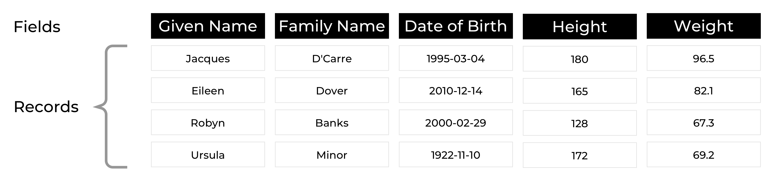
Records example
Four Records
Each record contains:
1 person’s details
Notes:
Above is a table.
It contains four records.
Each record is about ONE person.
Each record has five fields, each of which stores a piece of information about the person.
Now that you can see that a table is, well, just a table, it’s worth pointing out that you can create and maintain a database in a spreadsheet program like Excel.
For small jobs, this is fine.
So, if you wanted to maintain a master inventory of everything in your house for any possible insurance claim later, something like Excel would be perfectly doable.
However, spreadsheets are not really made for it and lack some key functionality, most importantly queries.
We’ll talk about queries in a bit.

Slide 19
Terminology
Primary Key
Unique identifier for a record
May join fields
Usually best to use an ‘ID’
Reason for:
Numbers identifying everything
Examples:
Student ID
Tax File Number
Medicare Number
ISBN
Notes:
For a table to be useful for a computer, each record must be
This requirement of databases is why we have so many identifying numbers for everything - student IDs, tax file numbers, phone numbers, number plates, Medicare numbers, Australian Business Numbers, International Standard Book Numbers (ISBN) and so on.
These numbers are called primary keys. uniquely identifiable.

Slide 20
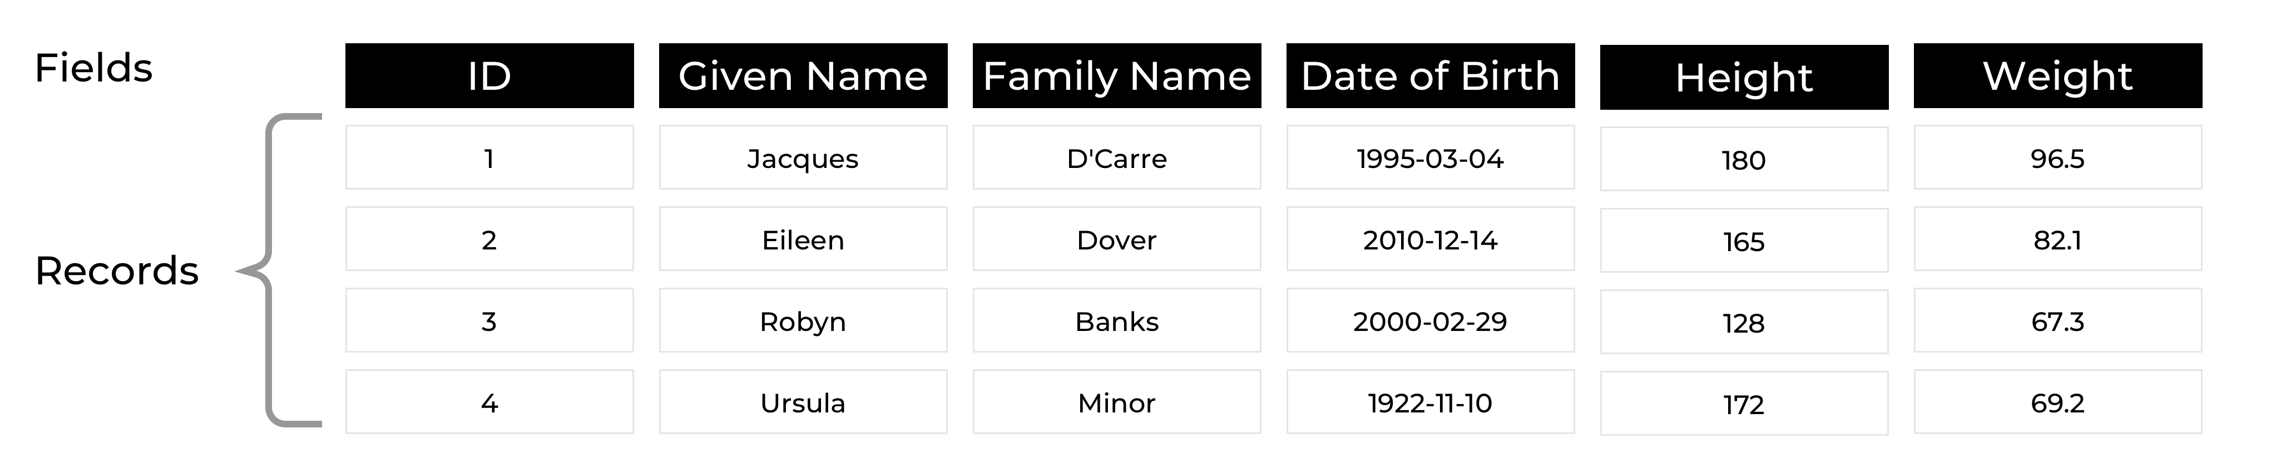
Terminology
Primary Key
Notes:
In the above example, each record can be identified by the combination of first and last name - but the table is also very small.
With anything larger, it would be foolish to assume you will never have two people with the same name.
So, to identify records, an ID of some kind is added, as shown.

Slide 21
Terminology
Index
Don’t usually work with these
Like a book’s index
Provide quicker lookup of data
Take up a little more space
Primary Key has an index
Notes:
Tables also have indexes.
You don’t normally deal with these but it’s useful to know that they’re there and what they do.
They operate mostly like indexes in books - so, they use some extra space to list information that is already elsewhere in the book with the idea of making it faster to get to the details about that information.
In effect, indexes trade space for time.
In books, they add pages to the book so it’s faster to find information.
In databases, they increase the storage size of the tables, again to make look ups faster.
Indexes are a big part of how databases can run so fast even though they can contain millions of records.
The primary key of a database will have an index built around it and so will any other keys you specify.
In practical terms, a key is basically “something I want to search for really fast”.

Slide 22
Terminology
Query
Asking a question
Simple
Give me all images of avocados sorted from most to least popular
To Complex
Give me images of avocados sorted from most popular to least but only if they’re high quality, are free to use for non-commercial use and are less than a month old
Notes:
A query is simply asking a question of a database.
So, if you search on Google for pictures of avocados, then behind the scenes a query will be sent saying, basically, “Give me all images of avocados sorted from most popular to least”.
Queries can get very complex.
Again using a Google example, you could have something like “Give me images of avocados sorted from most popular to least but only if they’re high quality, are free to use for non-commercial use and are less than a month old”.
To make a query is not quite so easy, of course.
Computers are really bad at understanding natural, conversational English.
Instead, we use a query language which arranges the parts of the request, mandates we use certain phrasing and so on to make it easier for a computer to understand.

Slide 23
Terminology
SQL
Pronounced Es-Queue-El
Most popular database query language
Reads quite naturally
Fairly easy to ‘scan’ a query and work out what it does
It is not a DBMS
Also sometimes called:
Sequel
Notes:
SQL (Structured Query Language) is by far the most popular database query language in use, and has been for decades. It reads quite naturally and it’s pretty easy to work out what’s happening by scanning an SQL query.
SQL is a language only, not a DBMS.
There are a number of DBMSs that use the SQL language (see later), like Microsoft SQL Server, Oracle, Altibase and so on.

Slide 24
Terminology
Examaple SQL
SELECT CustomerName FROM Customers WHERE city = “Perth”;
Notes:
Even without knowing anything about SQL, that’s pretty close to normal English and mostly makes sense.
We’re asking for the names of all customers in the “Customers” table who live in Perth.

Slide 25
DBMS Types
Relational
Object-oriented
Document
NoSQL
Graph
Refer to:
Panwar, A (2020) Types of database management systems. https://www.c-sharpcorner.com/UploadFile/65fc13/types-of-database-management-systems/
Fatima, N (2020) A quick overview of different types of databases. https://www.astera.com/type/blog/a-quick-overview-of-different-types-of-databases/
Notes:
https://www.c-sharpcorner.com/UploadFile/65fc13/types-of-database-management-systems/
https://www.astera.com/type/blog/a-quick-overview-of-different-types-of-databases/

Slide 26
Database Uses
Local data storage [Desktop and Mobile]
Web data storage
Examples:
iTunes
Spotify
Facebook
Calendar app
Notes:
A DBMS can be used for storing local data, as is done for many smaller apps.
So, in a music playing app, there may be a SQLite database that keeps track of all the tracks and playlists.
Depending in the app, however, they can be overkill.
Generally speaking, you should use a database when there is a lot of data and/or if you need to make arbitrary queries on that data (eg. “Give me all the five star music from George Michael.”)
Databases are also used on the internet.
Say the music app was a streaming app which delivers music over the internet from a server somewhere.
In this case, the device you’re playing the music on (called the client or front end) does not have a database but rather talks to a server (or back end) to access the tracks.
The server will have software written in a language such as PHP that accepts the requests, queries the database on the server and transmits back whatever is required (be it some music or an error message).
Since most apps now have a back end (server) component, if only for syncing data, SQL is most commonly used on servers.

Slide 27
Introducing Laragon
Session 1

Slide 28
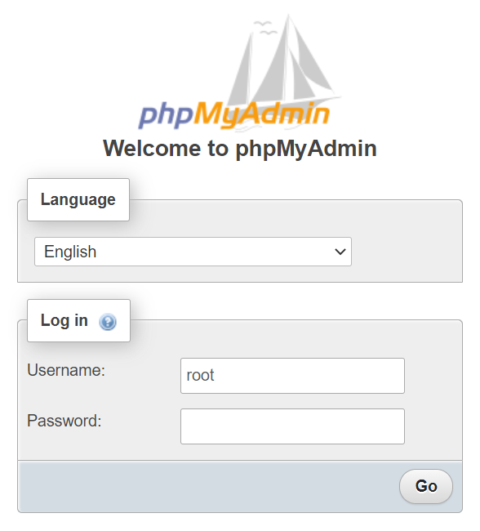
Create Database & User
Run Laragon on the PC
Open PhpMyAdmin using:
http://localhost/phpmyadmin
Username: root
Password: leave this blank

Slide 29


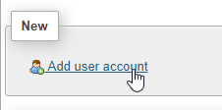
Create Database & User
Click the Home button
On right side, click the “Users Accounts” tab
Click “Add User Account” link

Slide 30
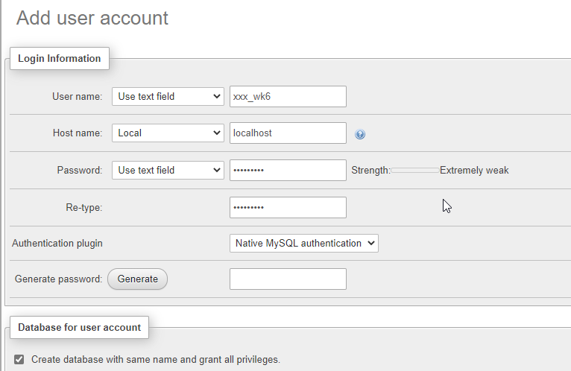
Create Database & User
Create a user by filling in the form
User name: initials_wk6
Initials are YOUR initials
Host name: localhost
Password: password1
Tick the “Create database…” checkbox
Click Go

Slide 31
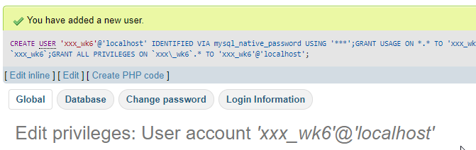

Create Database & User
User is created
Database shown on left
All databases under your initials are grouped together

Slide 32

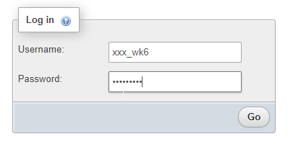
Log Out of Root and Login as New User
Click on the logout button
Fill the login screen with the new username and password

Slide 33
Laragon & PHPmyadmin/HeidiSQL
Is laragon working on your PC??

