Slide 1
Session-06
Week / Session 06
Maryam Shahabi Lotfabadi
Adrian Gould
Namrata Aneja
ICT40518 Certificate IV in Programming
Data Driven Applications
ICTPRG431 | Apply Query Language
ICTPRG432 | Develop Data Driven Applications

Slide 2
Session Contents
Like in Queries
JOIN
UNION
UNION all
DISTINCT
Nested query/Subquery

Slide 3
Using Like operator
Like operator is used for the fieldnames that has VARCHAR / CHAR/ DATE data type.
Using Database ArtGallery We all have worked with Computermart database in session 4,
Database Design powerpoint presentation slide 15-18
use following commands for like operator

Slide 4
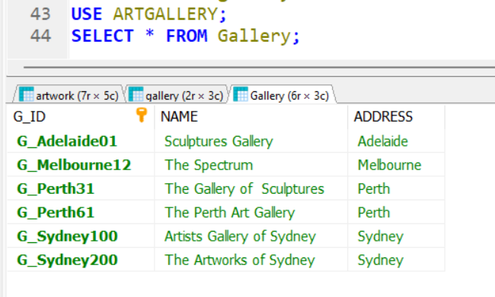
We have a table Gallery in database ArtGallery.

Slide 5
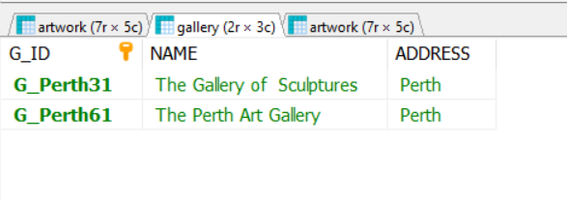
Try the given commands with like operator
Use ArtGallery;
SELECT * FROM gallery WHERE address LIKE 'P%';
Notes:
The above command with like displays records that where initial letter is P in the address.

Slide 6
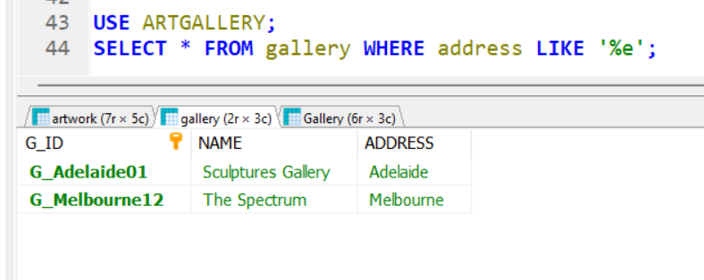
Try the given commands with like operator
Notes:
The above command finds the addresses that end with letter ‘e’.

Slide 7
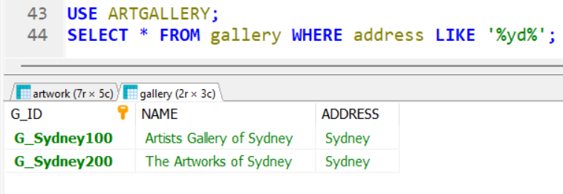
Try this
-SELECT * FROM gallery WHERE address LIKE '%yd%’;
-SELECT * FROM gallery WHERE address LIKE 'P%h';
Notes:
The above command finds those records where address carry ‘yd’ in its middle.
The other command finds addresses that start with ‘P’ and ends with ‘h’.

Slide 8
Try the given commands
Use artgallery;
SELECT * FROM gallery WHERE address LIKE ‘__l%’;
Use Drivers;
-SELECT * FROM Driverslicences WHERE LastDemeritsDate LIKE ‘2021%’;
Notes:
The above command from art gallery database finds records in Gallery table where the address has got third letter ‘l’.
The record with address as Melbourne should be shown.
The next command using Drivers database results into the record where LastDemeritsDate starts with year 2021.

Slide 9
Session 6-Joining tables

Slide 10
Why Joinining table
The relational data base is collection of related tables.
Join command gives us information from two joined tables. SQL Join statement is used to combine data or rows & columns from two or more tables based on a common field between them.
Notes:
Join Command- The SQL JOIN joins two tables based on a common column and selects records that have matching values in these columns.

Slide 11
Creating Tables for JOIN
REMINDER: Example Table Creation
USE database_name;
CREATE TABLE table_name ( id BIGINT UNSIGNED AUTO_INC, name VARCHAR(64) NOT NULL, PRIMARY KEY (id) );
Notes:
Join command is used to Join two tables and we can get combined information by joining two different tables So lets create two tables first and later we will join them

Slide 12
Creating tables for using JOIN Command First Table is employee_salary
Create database IF NOT EXISTS abc_store;
USE abc_Store;
DROP TABLE IF EXISTS Employee_salary;
DROP TABLE IF EXISTS PRODUCT;
CREATE TABLE if NOT exists employee_salary (id BIGINT UNSIGNED ,name VARCHAR(64) NOT NULL,
salary float(10,2) NOT NULL,
PRIMARY KEY (id));
Notes:
First table-Employee_salary is created by using above command

Slide 13
Creating tables for using JOIN Command First Table is employee_salary
- Insert into employee_salary values(101,'Steven Ross',6000), (102,'Greg Hardy',7000),
(103,'Tina Berry',5500), (104,'Eric Stan',6500), (105,'Vanessa Tass',4000),
(106,'Nick Clair',4500);
Select * from employee_salary;
Notes:
First Table is populated

Slide 14
Creating tables for using JOIN Command Second Table is employee_address
-USE abc_Store;
-CREATE TABLE employee_address(id BIGINT UNSIGNED,name VARCHAR(64) NOT NULL,
address VARCHAR(64) NOT NULL,
PRIMARY KEY (id));
Notes:
Second Table employee_address is created

Slide 15
Creating tables for using JOIN Command Second Table is employee_address
Insert into employee_address values(101,'Steven Ross','23,new street, Sydney'),
(102,'Greg Hardy',' 67,old street, Sydney'), (107,'Nancy Gold','55 green st, Sydney'),
(108,'Carmal Arnold','43 yellow street, Sydney'), (109,'Gale Steve','78 high street, Sydney');
Select * from employee_address;
Notes:
Second table Populated

Slide 16
Joining 2 tables with the Join command
The SQL JOIN joins two tables based on a common column, and selects records that have matching values in these columns
The SQL joins 2 tables based on a common column and selects records that have matching values in these columns
Select employee_salary.name,salary,address from employee_salary join employee_address on employee_salary.name = employee_address.nam ;
Notes:
Selecting name and salary from employee_salary table and address from employee address table and creating a table with the join command.

Slide 17
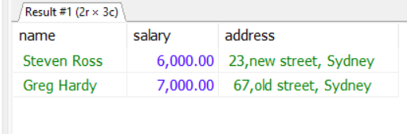
Using JOIN Command- join/inner join
Result
Join/Inner join
Select employee_salary.name,salary,address from employee_salary join employee_address where employee_salary.id=employee_address.id;
Select employee_salary.name,salary,address from employee_salary inner join employee_address on employee_salary.id=employee_address.id;
Notes:
Join / Inner join produce similar results
If the column name is similar in both the tables then one must use table name with the column name by using a (.)dot as connector.
As shown above field names id and name are similar in both the
tables and it cant be used as id or name because it will confuse the software which id or name is being referred. Therefore, to consider column id and name from table employee salary it is written like this
- employee_salary.id and employee_salary.name.
Similarly for employee_address table it will be employee_address.id and employee_address.name.

Slide 18
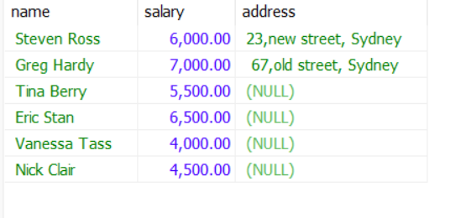
Using JOIN Command- left/right join
Select employee_salary.name,salary,address from employee_salary left join employee_address
on employee_salary.name=employee_address.name;
Notes:
Left join will bring those records that satisfy the condition and all the records from the left table & the Left table is employee_salary.

Slide 19
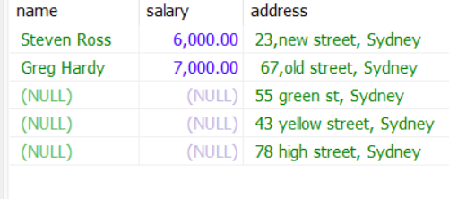
Using JOIN Command- left/right join
Select employee_salary.name,salary,address from employee_salary right join employee_address
on employee_salary.name=employee_address.name;
Notes:
Right join will bring those records that satisfy the condition and all the records from the Right table. Right table here is employee_address.

Slide 20


UNION of Tables
Session 6

Slide 21
Using Union Command
TO USE UNION command IN SQL WE MUST ALWAYS REMEMBER FOLLOWING POINTS
1. COLUMN COUNT of ALL THE TABLES MUST BE SAME
2.THE DATA TYPE MUST BE SAME.
3.THE COLUMS IN THE TABLES MUST BE IN THE SAME ORDER.
Explaining further with the help of an example

Slide 22
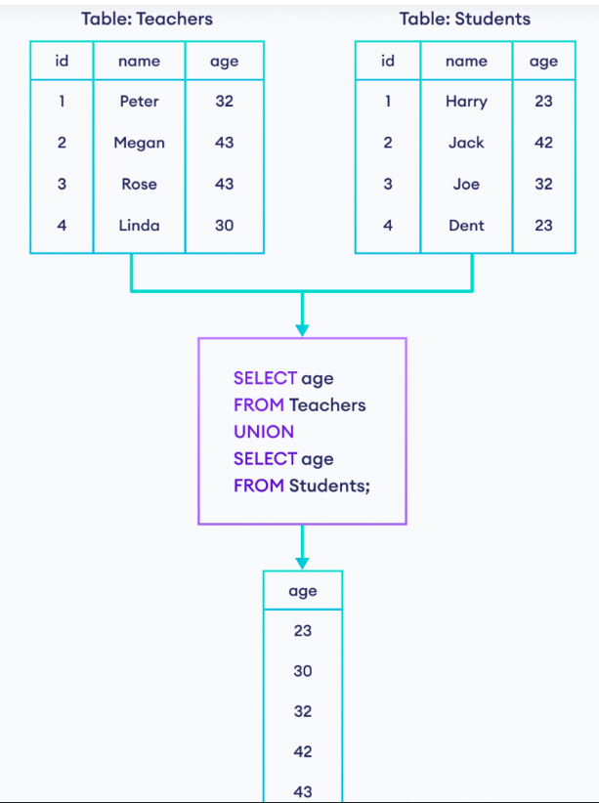
Using UNION
Notes:
Create above tables and try Union command

Slide 23
SQL UNION ALL Operator
The UNION ALL operator selects rows from two or more tables similar to UNION. However, unlike UNION, UNION ALL doesn't ignore duplicate rows.
Let's try the previous SQL command again using UNION ALL instead of UNION.

Slide 24
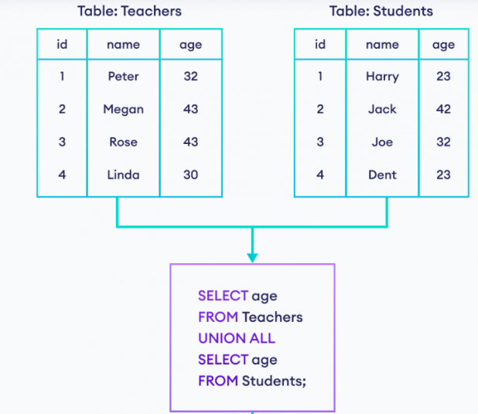
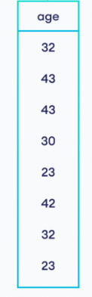
Using UNION all
Notes:
Create above tables and try Union All command

Slide 25
DISTINCT COMMAND
Session 6

Slide 26
SQL Distinct
DISTINCT keyword in SQL is used to fetch only unique records from a database table. It is usually used in conjunction with the SELECT statement. For the uninitiated, the SELECT statement is used to fetch desired records from the data table. Distinct keyword removes all duplicate records and fetches only unique ones.
Considering Art Gallery example created
in session 4 Database Design
power point presentation slide 15-18

Slide 27
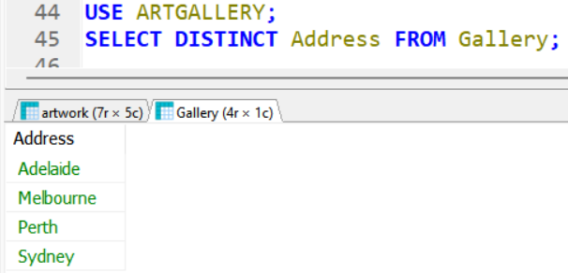
SQL Distinct
By giving command
- SELECT Distinct Address From Gallery;
We get the following result.
Notes:
The distinct command has removed the repeated addresses from the column and displayed only the unique addresses. The table Gallery had 2 Perth and 2 Sydney records. However, the use of distinct command shows it once.

Slide 28
Nested Queries
Session 6

Slide 29
SQL Nested query or Subquery
In SQL, it's possible to place a SQL query inside another query known as subquery.
Here is an example to support it
WE all have worked with Computermart database in session 4 Database Design powerpoint presentation slide 19-25
Notes:
In a nested query 2 queries are working one after another. One is called Inner query and the other is called outer query. The Inner query here is SELECT avg(price) FROM Product.
and Outer query is SELECT * FROM Product WHERE Price…….
Here the rule is that inner query is executed first then its result is used in the outer query. In the above query average price is result of inner query and it is compared with every price in the records. Only those records are selected who have higher price than average price as the result of outer query.

Slide 30
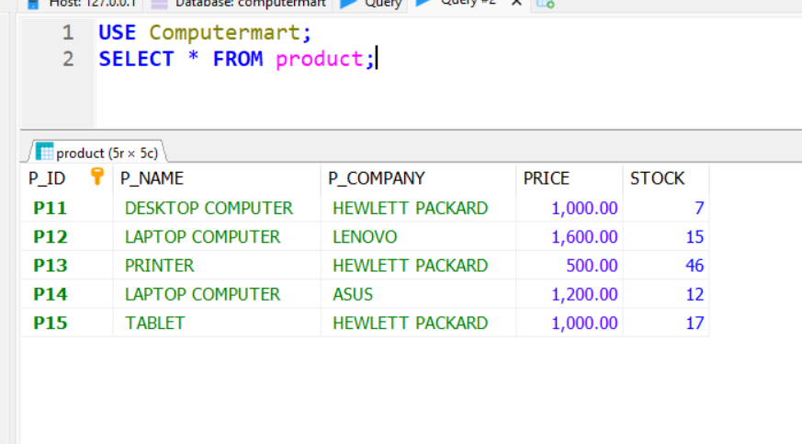
SQL Nested query or Subquery
In SQL, it's possible to place a SQL query inside another query known as subquery.
Here is an example to support it
WE all have worked with
Computermart database in
session 4 Database Design
powerpoint presentation slide 19-25

Slide 31
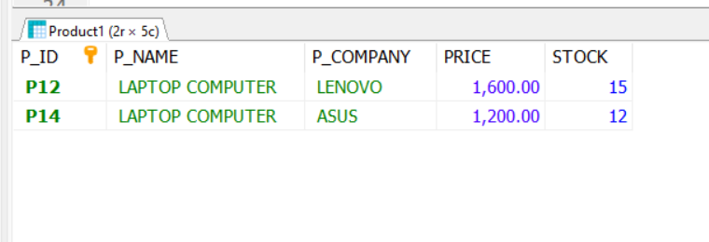
SQL Nested query or Subquery
In SQL, it's possible to place a SQL query inside another query known as subquery.
Here is an example to support it
WE all have worked with Computermart database in session 4 Database Design powerpoint presentation slide 19-25
SELECT *
FROM Product
WHERE Price >=
( SELECT avg(price)
FROM Product
);
Notes:
In a nested query 2 queries are working one after another. One is called Inner query and the other is called outer query. The Inner query here is SELECT avg(price) FROM Product.
and Outer query is SELECT * FROM Product WHERE Price…….
Here the rule is that inner query is executed first then its result is used in the outer query. In the above query average price is result of inner query and it is compared with every price in the records. Only those records are selected who have higher price than average price as the result of outer query.

Slide 32
Using operators in a Nested query
In nested queries, query execution starts from innermost query to outermost queries. The execution of inner query is independent of outer query, but the result of inner query is used in execution of outer query. Various operators like IN, NOT IN, EXISTS, ANY, ALL etc. are used in writing independent nested queries.
WE all have worked with Computermart database in session 4 power point presentation slides19-25
Notes:
In a nested query The inner query is executed first It is
SELECT avg(price)
FROM Product
and later outer query is executed i.e.
SELECT *
FROM Product
WHERE Price >=( inner query);
Also, The EXISTS condition in SQL is used to check whether the result of a correlated nested query is empty (contains no tuples) or not. The result of EXISTS is a boolean value True or False. It can be used in a SELECT, UPDATE, INSERT or DELETE statement.

Slide 33
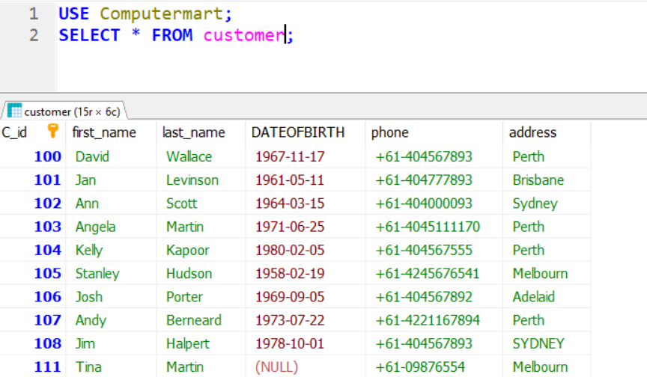
Using operator IN - in Nested query
Example using IN -
using two different tables
we all have worked with Computermart database,
Thus, using ComputerMart
in session 4 powerpoint presentation slide 19-25
Use Computermart;
SELECT
C_id, first_name, last_name
FROM customer
WHERE C_id IN
(SELECT C_id FROM ORDER);
Notes:
This nested query is using 2 tables
One is customer and another is order.

Slide 34
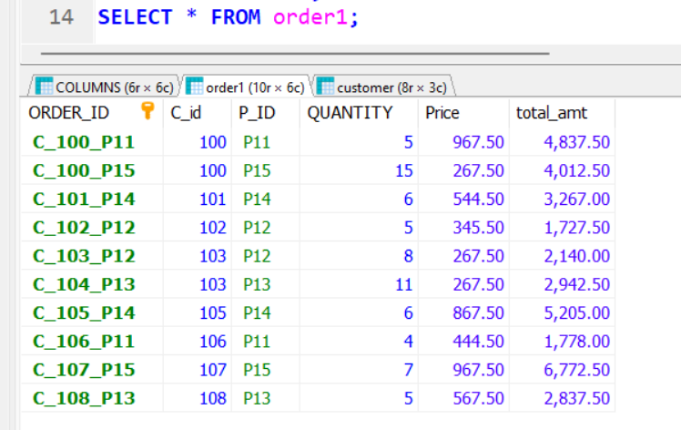
Using operator IN - in Nested query
Example using IN -
using two different tables
we all have worked with Computermart database,
Thus, using ComputerMart
in session 4 powerpoint presentation slide 19-25
Use Computermart;
SELECT
C_id, first_name, last_name
FROM customer
WHERE C_id IN
(SELECT C_id FROM ORDER);
Notes:
This nested query is using 2 tables
One is customer and another is order and with this query we are extracting information from both the tables.
The information is of getting records from customer table with the columns like Customer id, first name, last name where customer id of Table customer matches with the customer id of Table order.

Slide 35
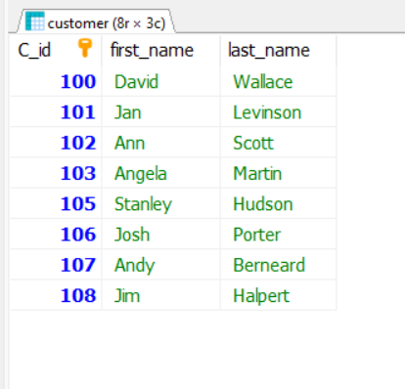
Using operator IN - in Nested query
Example using IN -
using two different tables
we all have worked with Computermart database,
Thus, using ComputerMart
in session 4 powerpoint presentation slide 19-25
Use Computermart;
SELECT
C_id, first_name, last_name
FROM customer
WHERE C_id IN
(SELECT C_id FROM ORDER);
Notes:
In a nested query The inner query is executed first It is written in the () brackets and outer query is in written in italics and underlined
C_id, first_name, last_name <-- Outer query in the Italics & underlined
FROM customer
WHERE C_id
IN
(SELECT C_id FROM ORDER); <-- Inner query in the () brackets

Slide 36
Practice: Exercise
Relational Databases & Database Design

Slide 37
Query Exercises:
Practice join command in database Computermart using tables created Customers,Orders,Order-products,Categories &Items in session 5.
Find the order details of customer name =‘Vincent’.
Find the Qty, Price sold at & descrition of Item-code 678-943.

Slide 38
Query Exercises:
Practice join command in database Computermart using tables created Customers,Orders,Order-products,Categories &Items in session 5.
Find the name and address of customer who gave the order A100.
Find the description and category of Items used in
orderA100.
Find the quantity,description, and category of Items used in
table categories and items.

Slide 39
Revising a few Important commands
Session 6

Slide 40
Renaming Tables
We will rename our newly created tables
To rename a table use the following:
USE database_name;
ALTER TABLE old_table_name RENAME TO new_table_name;
For example:
USE xxx_wk6;
ALTER TABLE xyz RENAME TO abc;

Slide 41
Adding a field to a table
Relational Databases & Database Design

Slide 42
Alter table, update and set command
Before joining tables Let us learn How these Alter table, update and set command work together.
We have got the data base Computermart and the tables Customer, product and order1 from session 4

Slide 43
Alter table with update and set command
Try this
Use computermart;
ALTER TABLE ORDER1 ADD COLUMN total_amt FLOAT(10,2);
UPDATE order1
SET total_amt=quantity*price
Select * from Order1;

Slide 44
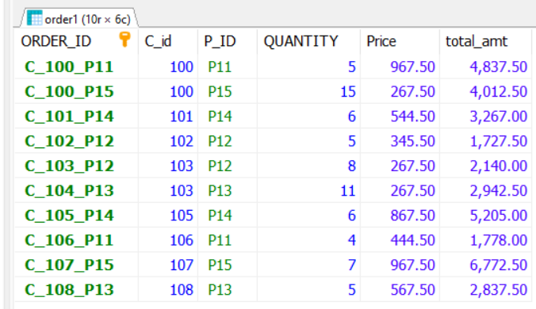
Or the same command can be written like this
UPDATE order1
SET total_amt = quantity * price
WHERE order_id<>NULL;
SELECT * FROM order1;

Slide 45
Another example Adding a Field to a Table
Run the following SQL to create the “states” table:
USE xxx_wk6;
CREATE TABLE states( code VARCHAR(3) NOT NULL, state VARCHAR(32) NOT NULL);
What’s missing?
Notes:
In the above table we have forgotten to name a fiel name as Primary key

Slide 46
Adding a Field to a Table
To add a field we use an SQL command similar to this:
USE database_name;
ALTER TABLE table_name ADD COLUMN new_column_name field_type_and_size other_options AFTER existing_column_name;

Slide 47
Adding a Field to a Table
So for our states table:
USE xxx_wk6;
ALTER TABLE states ADD COLUMN id BIGINT UNSIGNED AUTO_INCREMENT PRIMARY KEY First ;

Slide 48
Adding a Field to a Table
We forgot the ID
To add a primary key use:
ALTER TABLE table_name ADD COLUMN id BIGINT UNSIGNED AUTO_INCREMENT PRIMARY KEY first;

Slide 49
Practices with practice exercises given in BB

