Slide 1
Intermediate programming Unit Tests
Session 04
John Robertson
ICT40220 Certificate IV in Information Technology (Programming)
Cluster: Intermediate programming and open source (IPOS)
ICTPRG439 | Use pre-existing components
ICTPRG429 | Maintain open-source code programs
ICTPRG443 | Apply intermediate programming skills in different languages

Slide 2
In this session, you will learn about unit testing
Background about unit testing
Short video about unit testing in Python
Socratica: https://www.youtube.com/watch?v=1Lfv5tUGsn8
Components of the Python unittest framework
Exercise:
Write your first unit test
Wrap up
Session duration: about 40 minutes

Slide 3
Testing as a Discipline
Requirements
Test Planning
Test Case Creation
Environment setup
Execute
Close & Clean Up
The cycle for building your tests should be consistent across the project/team
This process is independent of the language you are using
The key to long term maintenance & development

Slide 4
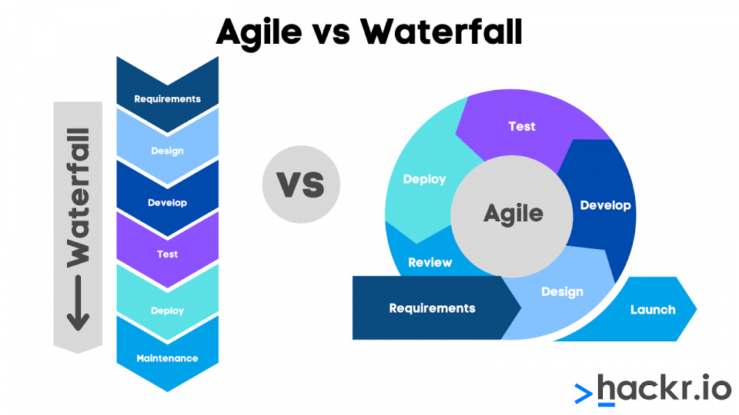
Testing in Project Methodology
https://hackr.io/blog/project-manager-interview-questions

Slide 5
Types of Testing
These can be Manual or Automated (CI/CD & the world of DevOps)
Unit – todays focus…
Integration – do modules/services work well together?
Functional – does the output match the requirements?
End-to-End – does the system cover all user behaviour?
Acceptance – does the entire system satisfy the requirements?
Performance – how does the system behave under load?
Smoke – do the critical features still work?

Slide 6
What is unit testing?
It’s in the name… It tests units of code
For example: a single function
In an OO context, those units are usually classes or functions
Preferably, unit testing is part of an automated process
Sometimes integrated into CI/CD workflow:
Commit a change ⇒ run tests ⇒ accept (or decline) change
Notes:
CI/CD ⇒ Continuous Integration / Continuous Deployment

Slide 7
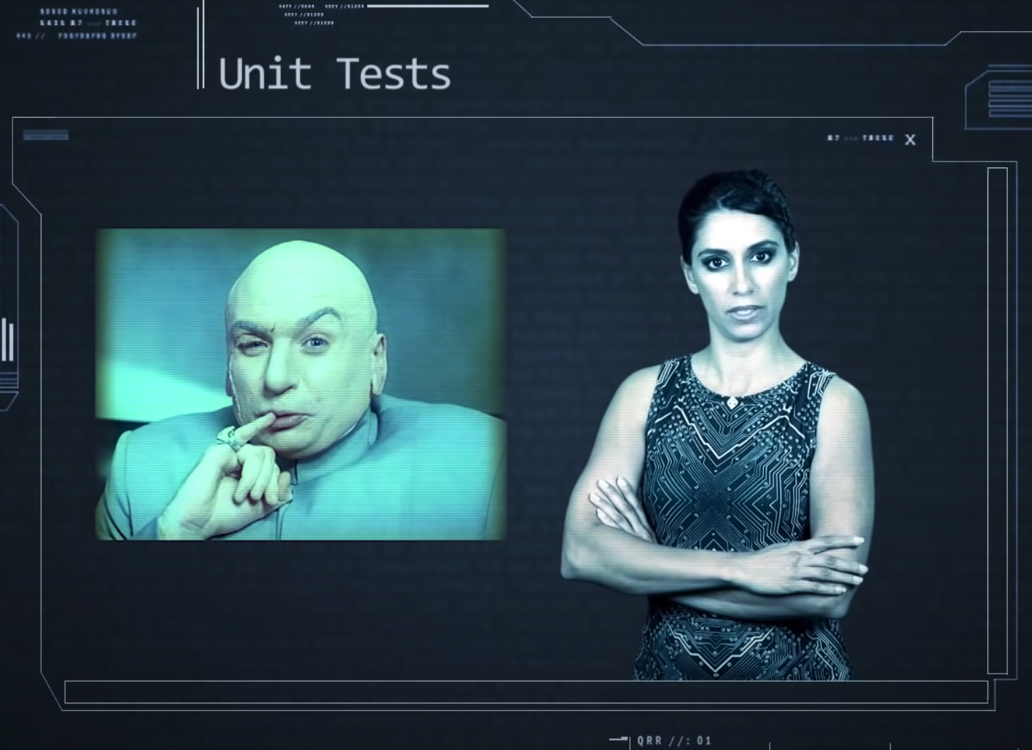
Video: Socratica on Python unit testing
Link: https://www.youtube.com/watch?v=1Lfv5tUGsn8
Notes:
https://www.youtube.com/watch?v=1Lfv5tUGsn8

Slide 8
Python unit testing
Python provides the unittest framework
Concepts used in unit testing:
Test fixture
Test case
Test suite
Test runner

Slide 9
Test fixture
The preparation needed to run (a) test(s)
Cleanup too
For example:
Creating temporary class instance or proxy database
Creating or setting up directories
Starting a server process

Slide 10
Test case
This is the individual unit of testing
Test cases are derived from the base class TestCase
It checks for a specific response to a stimulus (input)
Based on “assertions” (statements that should be True)

Slide 11
Test suite
This is a collection of test cases or test suites
Use this to group tests that belong together

Slide 12
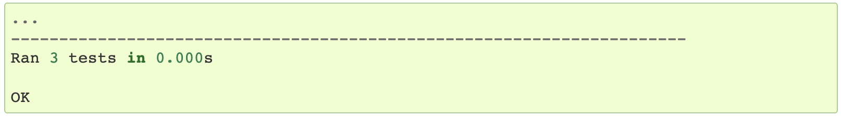
Test runner
Runs the tests and conveys the results (pass/fail) to the user
Example output of a successful run:

Slide 13
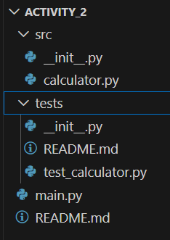
Project structure
The project has a separate
src directory
tests directory
The test directory is a “package”
hence the __init__.py (which can be empty)
without it, no tests will be found!
Notes:
This is just an example of how you can set up your project. For very simple project, like the one in Exercise 1, you don't need to do this. Just put the unit tests in the same folder as the source code.

Slide 14
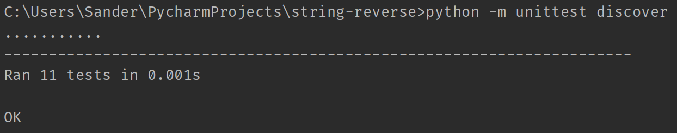
Running unit tests
This will automatically discover unit tests
If the terminal in PyCharm doesn’t work, use a regular terminal

Slide 15
Structure of unit tests
Example: test_stack.py
import unittest
from app.stack import Stack # The object we’re testing
class TestStack(unittest.TestCase):
def setUp(self):
# Prepare the test fixture:
# create a stack to be used by each test
# that has a depth of 3 objects.
self.stack = Stack(max_size=3)
Notes:
The method setUp is called before each and every test in the class.
That way, each test can run from a pre-defined state, in this case using an empty stack with a capacity of three elements.
It also prevents code duplication, as you don’t have to instantiate a Stack object for each test.

Slide 16
Set Up and Tear Down
As part of the arrange >>> act >>> assert testing flow.
the setUp method in a TestCase runs before each test method.
useful for arranging any objects needed by tests.
After we make our assertions, tearDown runs after each test method
cleanup activities incl. disconnecting from database or api
this ensures each test runs with in isolation
Consider what object or states would a Tic Tac Toh test need?
Notes:
See mocking examples

Slide 17
Structure of unit tests
A single test in the test class:
class TestStack(unittest.TestCase):
# setup etc…
# continued…
def test_is_empty_is_true_for_empty_stack(self):
self.assertTrue(self.stack.is_empty())
Notes:
This assert method tests that the return value from the method is_empty() is indeed True for an empty Stack. If the methods returns False, an exception is raised, and the test fails.
If you’re expecting a False result, you can also use the self.assertFalse() method of the test class.

Slide 18
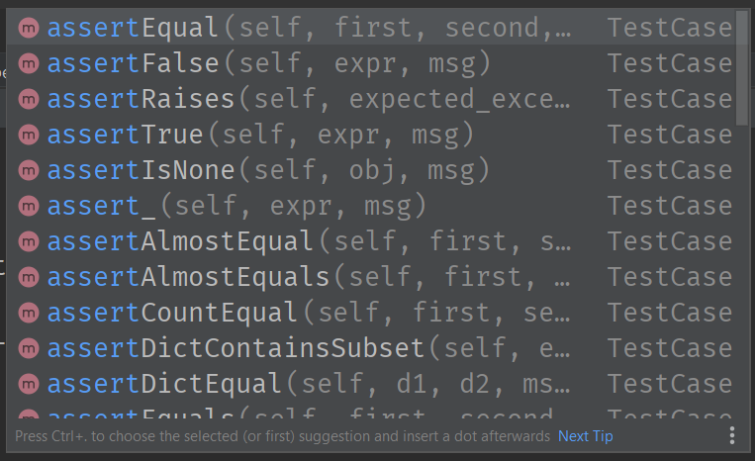
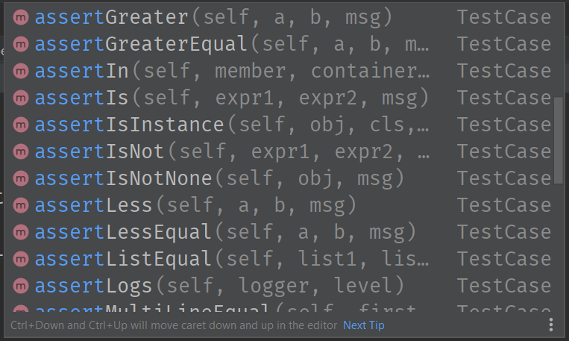
Assertions
There are numerous assertions available

Slide 19
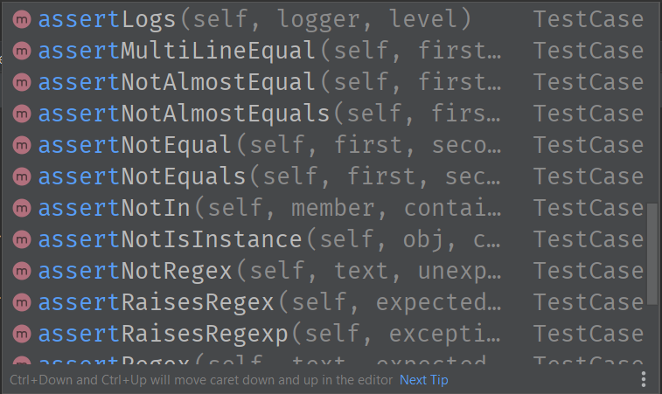
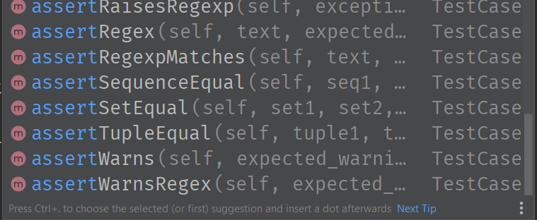
Assertions
There are numerous assertions available

Slide 20
Common assertions
We’ve seen assertTrue (assertFalse tests opposite)
self.assertEquals(a, b) compares two values a and b
If a != b, an exception is raised, and the test fails.
A third parameter can be used as a “message” field, which will be shown if the test fails.

Slide 21
Common assertions
If you want to test whether an exception is raised:
def test_exception_is_raised(self):
# You can tell which exception is expected
with self.assertRaises(IndexError):
self.stack.push(3)
Note: that the Socratica video shows another method of checking for exceptions.
Notes:
This technique uses a context manager (the “with” statement).

Slide 22
Break
Notes:
This technique uses a context manager (the “with” statement).

Slide 23
Activity 1 – In class
watch the Socratica video on unit testing
download the zip file
complete the Socratica task, so all of the three tests run successfully.

Slide 24
Activity 2 – In class
Write a function that calculates the sum of two numbers
Call it add or add2, not sum (that is a built-in function)
Include a docstring!
Write the unit tests that check:
that correct values are calculated for integer, floating point, and complex numbers (e.g., 2 - 1j is complex)
that a TypeError is raised if any of the arguments is not a valid type
Question:
do you need to test for a ValueError like in the Socratica video?

Slide 25
Activity 3 – Test Driven Development
In applications of scale it is can be productive to build your tests first.
when a defect is found, write a test exposing the defect
decompose a program feature into a sequence of unit tests
situation specific tests – e.g. performance testing under load
code coverage is evidence of TDD – 80% is a benchmark
version control show that test code is added to any Pull Request

Slide 26
Activity 3 – TDD in practice

Slide 27
Arranging our Test with unittest.mock
some test require unique objects in place of our system
Mocks return predefined values to calls
can be checked to see if the Mock objects were accessed as expected.
useful when the real objects are difficult to include in our unit tests,
Such as accessing a database or an API…

Slide 28
Extending our Mock objects with patch
part the unittest.mock module.
let's us replace real objects with mock objects during tests.
isolating the unit of code, we are testing
can simulates interactions with external systems
avoids side effects on database or Api's
https://docs.python.org/3/library/unittest.mock.html

Slide 29
Patch objects
## Patching a Class
class TestStartGame(TestCase):
@patch('game.TicTacToe')
def test_start_game(self, MockTicTacToe):
# Create a mock instance of TicTacToe
mock_game_instance = MockTicTacToe.return_value
mock_game_instance.player1 = 'Alice'
mock_game_instance.player2 = 'Bob'
mock_game_instance.board =
[["" for _ in range(3)] for _ in range(3)]
mock_game_instance.current_turn = 'Alice'
## Patching an input
@patch('builtins.input', return_value='Alice')
def test_greet_user(self, mock_input):
# Call the function using the input
result = greet_user()
# Assert that the function returns the expected result
self.assertEqual(result, "Hello,Alice!")
https://docs.python.org/3/library/functions.html
Notes:
There are many builtins you can replicate

Slide 30
unittest vs pytest
 | unittest | pytest
Usage | Structured and uses classes | Simple and Python-friendly.
Setup | Needs extra setup e.g. writing classes. | Less setup we write our tests as simple functions.
Assertions | Uses special methods to check conditions. | Only uses assert statements in Python.

Slide 31
pytest
# test_fixtures.py
import pytest
# @pytest.fixture defines a setup function (sample_data) that returns a value.
@pytest.fixture
def sample_data():
return "data"
# test_with_fixture uses this fixture to get the setup data.
def test_with_fixture(sample_data):
assert sample_data == "data"

