Slide 1
Intermediate programming
Session 02
Rafael Avigad
John Robertson
ICT40220 Certificate IV in Information Technology (Programming)
Cluster: Intermediate programming and open source (IPOS)
ICTPRG439 | Use pre-existing components
ICTPRG429 | Maintain open-source code programs
ICTPRG443 | Apply intermediate programming skills in different languages

Slide 2
Defining Modular programming
Part 1

Slide 3

What is modular programming?
Notes:
"Modular programming is a software design technique that emphasises the separation of functionality into independent, interchangeable modules. A module in this context is a self-contained component of a system that encapsulates specific functionality and interfaces with the rest of the system in a well-defined, minimal manner. It's like building with Lego blocks, each block (or module) does one thing well and can be connected to other blocks to create a larger structure (or program)."

Slide 4
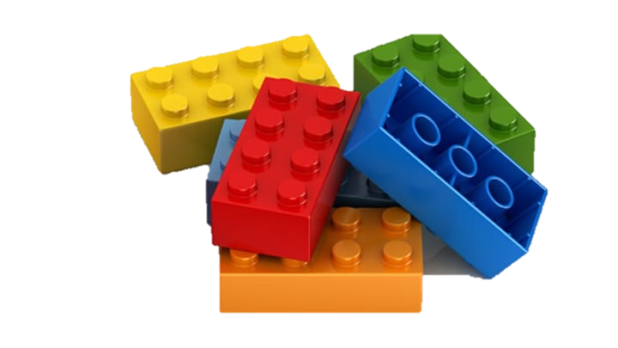
Benefits
Reusability
Maintainability
Testing and debugging
Collaboration
Notes:
Reusability: Once a module is written, it can be reused across the program, or even in other programs. This saves time and effort and promotes code consistency.
Maintainability: When functionality is separated into modules, it becomes easier to maintain and update the software. If a change needs to be made to a specific feature, you only have to modify the related module, minimising the risk of unintentionally affecting other parts of the program.
Testing and Debugging: It's easier to test and debug modules as standalone units, and any bugs that are found and fixed in a module will be fixed everywhere the module is used.
Collaboration: In large projects, different teams can work on different modules simultaneously with less risk of interfering with each other's work."

Slide 5
Downsides
Complexity
Testing and debugging
(weren’t you on the other slide???)
Integration/version control
Notes:
Increased Complexity: While modular programming can simplify individual components of a program, it can also increase the overall complexity of a system. Managing how modules interact and ensuring they function correctly together can become a challenging task, especially in large software projects.
Design Overhead: To design a program in a modular way, careful planning is required upfront to define clear, sensible boundaries for modules. This can increase the amount of time spent in the design phase, which might not be ideal for small projects or prototypes.
Dependencies Between Modules: If not managed well, modules can become tightly coupled, meaning a module depends heavily on the internal workings of another module. This can create issues when trying to modify, update, or reuse a module. The aim should always be to create loosely coupled modules where possible.
Version Control: When reusing modules across different projects, it's vital to ensure that all projects are using the correct version of the module. If a module is updated for one project, it could potentially break functionality in another project that relies on the old version.
Integration Issues: Individual modules might work perfectly in isolation but fail when integrated due to unforeseen conflicts or discrepancies between module interfaces.
NOTE: this is where AI begins to break down as it lack the “Context” of the other modules.

Slide 6
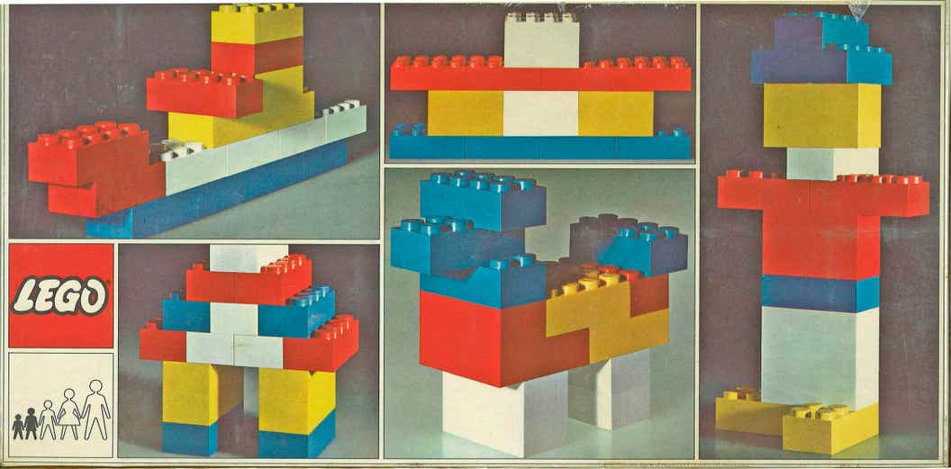
Making a start
Notes:
Ask students to create a simple function in a file (say “hello world”) and then create a new file and import that module:
e.g.
import my_module: This imports the whole module, and we can use its functions like so: my_module.hello_world().
from my_module import hello_world: This imports only the hello_world function from the module, and we can use it directly like so: hello_world().
import my_module as mm: This imports the module but gives it a shorter alias, useful for modules with longer names. We can use its functions like so: mm.hello_world().
See the GitHub repo for additional exercises

Slide 7
Pass-by-reference
Part 2

Slide 8
What.
Recall: variables created in a function stay in the function (true of most languages)
But, in low level languages, when we call a function with arguments, the parameters can:
  Provide the address in memory of something (a reference)
  Provide the something (a value)
Discuss: consider how the above relates to whether functions can change (mutate) things outside their scope
Notes:
Local scope – the scope of the function (function frame)
Global score – the scope of the entire program (main frame)
Run the scope example

Slide 9
Call Stack
Heap
main
Notes:
Optional – explanation of the call stack <generated by ChatGPT 4, and reviewed by Rafael>
The call stack is a region of memory that Python uses to keep track of function calls.
When a function is called, Python creates a stack frame at the top of the call stack.
This stack frame contains all of the variables that are created within that function, as well as some additional information that Python uses to keep track of the function call.
When the function returns, its stack frame is removed from the call stack.

Slide 10
Call Stack
Heap
main
Notes:
In Python, all data is stored as objects in the heap, a region of your computer's memory.
The heap is not structured; it's more like a big pool of memory that Python can request space from whenever it needs to create a new object.
When you create a variable, Python creates an object in the heap and then stores a reference to that object in the variable. The variable itself is stored in the call stack.
The call stack is a region of memory that Python uses to keep track of function calls.
When a function is called, Python creates a stack frame at the top of the call stack.
This stack frame contains all of the variables that are created within that function, as well as some additional information that Python uses to keep track of the function call.
When the function returns, its stack frame is removed from the call stack.

Slide 11
Call Stack
Heap
main
Notes:
When you pass a variable to a function in Python, what you're actually passing is the reference to the object in the heap.
Python stores this reference in the function's stack frame on the call stack.
If the object is mutable, the function can use this reference to modify the object in the heap.
However, the function can't change the object that the original variable refers to, because the function only has a copy of the reference, not the original reference itself.
This is why changes to mutable objects (like lists or dictionaries) within a function are visible outside the function, but reassignments of a variable within a function don't affect the original variable outside the function.

Slide 12
Stack and Heap: summary
Python's heap is where all data (in the form of objects) is stored.
Python's call stack is where function calls are stacked storing the variables local to that function in each stack frame.
In turn, the local variables are references to objects in the heap.
Python's pass-by-object-reference mechanism means that functions receive a copy of the reference to an object in the heap, not the original reference.
Functions can modify the object (if it's mutable), but they can't change out-of-scope variables that refer to a different object.

Slide 13
Visualize the call stack
https://pythontutor.com/visualize.html#mode=edit

Slide 14
Python is a bit different
In Python everything is an object
Yes, E.V.E.R.Y.THING
Variables are just names for the addresses of objects!
Remember: “the map is not the territory; the name is never the thing named!” –Gregory Bateson.
Tip: look behind the curtain with id(my_var)
Notes:
Python's parameter passing model is a bit different from some other programming languages.
It's often characterised as "pass-by-object-reference" or "pass-by-assignment".
Essentially, when you pass a variable to a function in Python, you're passing a reference to the object that the variable refers to, not the actual object itself.
To understand this, it's essential to understand that in Python, everything is an object.
Whether it's a number, a string, a list, or a custom class - they're all objects. And variables in Python are references to these objects.

Slide 15
Python parameters in depth
When you pass a variable to a function you are passing a reference (always pass-by-reference)
You are assigning the (named) addresses in the arguments to the names defined by the parameters
When the parameter addresses reference an immutable object, any changes you make only stay in the function
When they reference a mutable, you can change the object and those changes persist out of scope
Discuss: Why?
Notes:
When you pass a variable to a function, Python passes the reference to the function.
Therefore, if the object is mutable (like lists or dictionaries), the function can modify the object, and the changes are visible outside the function.
This is because the function and the calling code are both referencing the same object.
However, if the object is immutable (like integers or strings), the function cannot modify the object.
Any changes made inside the function will create a new object, and the variable in the calling code will continue to reference the original object.

Slide 16
Try this code:
def modify(n, list_):
n = 2
list_.append(3)
n = 1
list_ = [1, 2]
modify(n, list_)
print(n) # Outputs: 1
print(list_) # Outputs: [1, 2, 3]
Notes:
In this example, n is an integer (an immutable object), so the change inside the modify function doesn't affect the original variable. However, list_ is a list (a mutable object), so the change inside the function is visible outside the function.
Now, comparing Python with a lower-level language like C, in C, we explicitly have two distinct modes of passing parameters: pass-by-value and pass-by-reference.
In pass-by-value (the default in C), a copy of the value is made and passed to the function. Changes to the copy inside the function do not affect the original variable.
In pass-by-reference, a pointer to the original variable is passed to the function. Changes to the variable inside the function do affect the original variable. This is somewhat analogous to passing mutable objects in Python.
However, Python's model isn't exactly like C's pass-by-reference, because you can't directly change the value of a passed variable (like you could with a dereferenced pointer in C). It's more accurate to say Python has a single way of passing variables that behaves somewhat like pass-by-value for immutable objects, and somewhat like pass-by-reference for mutable objects.

Slide 17
Revision
How would you explain Python's parameter passing mechanism? Is it more like pass-by-value or pass-by-reference?
Given the following Python code, what will be the output and why?

Slide 18
def modify_list(list_):
  list_.append("new")
  list_ = ["completely", "new"]
items = ["original"]
modify_list(items)
print(items)
Notes:
First line in the function modifies the list object
next line assigns a new memory address to the local variable list_ so the changes on the first line will be reflected in the original items list,
the second line will only have a reference in the function and will soon be garbage-collected.

Slide 19
Benefits of Pass by Reference
Memory efficient: a we are not creating copies of objects.
Changes made to mutable objects inside a function are reflected outside the function.
The same mechanism is used for both mutable and immutable objects.
Developers don't need to worry about pointers explicitly
OOP is well-supported by the pass-by-object-reference mechanism.
We pass references not values, overhead is reduced when dealing with large objects.
When multiple parts of a program need to work with the same data, using references makes it easier to synchronise changes.
Notes:
When you pass a variable to a function, Python passes the reference to the function.
Therefore, if the object is mutable (like lists or dictionaries), the function can modify the object, and the changes are visible outside the function.
This is because the function and the calling code are both referencing the same object.
However, if the object is immutable (like integers or strings), the function cannot modify the object.
Any changes made inside the function will create a new object, and the variable in the calling code will continue to reference the original object.

Slide 20
Revision
If Python uses pass-by-reference, why doesn't reassigning a variable inside a function change the original variable outside the function? How is this related to the mutability of Python objects?
Notes:
Python uses a mechanism called "pass-by-object-reference."
When you pass a variable to a function in Python, you are passing a reference to the object the variable refers to, not the variable itself.
This can lead to confusion because it might seem like pass-by-reference, but there's a subtle difference.
When you reassign the variable inside a function, it only modifies the local reference, not the original reference outside the function.
However, if you modify the mutable object itself (like a list or dictionary), the changes will be visible outside the function.

Slide 21
Introduction to 2d data structures
Part 3 (optional)

Slide 22
Consider
Discuss how can you make a Python list 2-dimensional? (or 3, 4, 5 dimensional for that matter?)
What are some possible applications?
How would you code and parse a 2D data structure?
To be continued next week…

Slide 23
Revision
What is a module in Python? How do you create one?
What is the purpose of the import statement in Python? Can you provide a code example of its usage?
How can you import only a specific function or class from a module in Python? What is the syntax for this?

