Slide 1
Intermediate programming
Session 03
John Robertson
ICT40220 Certificate IV in Information Technology (Programming)
Cluster: Intermediate programming and open source (IPOS)
ICTPRG439 | Use pre-existing components
ICTPRG429 | Maintain open-source code programs
ICTPRG443 | Apply intermediate programming skills in different languages

Slide 2
2D Data Structures – how, why, when?
Part 1

Slide 3

Consider
Discuss how can you make a Python list 2-dimensional? (or 3 for that matter?)
What are some possible applications?
How would you code and parse a 2D data structure?
Notes:
Creating multidimensional lists (which can function as 2D, 3D, etc., data structures) in Python can be achieved through the concept of nested lists. A list is a versatile data structure in Python which can contain elements of different data types, including other lists.
Applications of Multidimensional Lists:
Representing data: In fields like data science and machine learning, multidimensional lists are often used to represent and manipulate data. For instance, a 2D list can represent a matrix or a data table.
Spatial problems: In game development or graphics programming, 2D and 3D lists can be used to represent grids or spatial coordinates.
Graphs and trees: In more advanced data structures, multidimensional lists can represent graphs or trees.

Slide 4
Create 2D STRUCTURES- Workshop Part 1
Start thinking about the KBA 1 and Portfolio Part 1

Slide 5
Accessing a 2D list (List of Lists)
two_dim_list = [[1, 2, 3], [4, 5, 6], [7, 8, 9]]
two_dim_list[1][2]
Warm-ups were worth it!
Notes:
Ensure students can understand which subscript corresponds to rows (first one) and which to columns and why.
Ensure students write list and are able to access elements by number
Show that python allows us to write it on multiple lines…

Slide 6

More readable presentation
two_dim_list = [[1, 2, 3],
[4, 5, 6],
[7, 8, 9]]
two_dim_list[1][2]
That’s better!
Notes:
Both lists are the same, but python allows us to use whitespaces without semantic meaning within brackets square, curly, or round and this can enhance readability.

Slide 7
Sequential iteration (nested loop pattern)
two_dim_list = [[1, 2, 3], [4, 5, 6], [7, 8, 9]]
for row in two_dim_list:
for elem in row:
print(elem, end=' ‘)
print() # Delete me to see what I do!
Notes:
demonstrates a common pattern in programming known as "nested looping",
specifically, with 2D data structures like lists of lists (which can be thought of as a matrix or a grid).
The for loops iterate over each row of the two_dim_list, and then for each row,
they iterate over each element within that row.
This pattern is often used to traverse 2D data structures where you need to access every element.
The outer for loop goes through each sub-list (row), while the inner for loop goes through each element within the current sub-list.

Slide 8
Iteratively created a rows x cols list
rows, cols = 3, 3 # define the size of your 2D list
two_dim_list = []
for i in range(rows):
row = []
for j in range(cols):
row.append((i+1)*(j+1))
two_dim_list.append(row)
print(two_dim_list) # prints: [[1, 2, 3], [2, 4, 6], [3, 6, 9]]
Notes:
You can also do a list comprehension (1 level)
for i in range(rows):
row = [(i+1)*(j+1) for j in range(cols)]
two_dim_list.append(row)
Or 2 levels:
two_dim_list = [[(i+1)*(j+1) for j in range(cols)] for i in range(rows)]
Or an empty list (do as exercise and ask students to think about why they might want to create something like that…
tic-tac-toe comes to mind…
w, h = 3, 3
# using list comprehension
two_dim_list = [[None for _ in range(w)] for _ in range(h)]
print(two_dim_list)

Slide 9
Caveats
Iteration is slow in Python (and most interpreted languages)
Think of some of the examples we gave:
  High-res images
  Complex data analysis
  Remember in python E.V.R.Y.THING is an object
  Not good, right?!
Notes:
In python this is slow due to the fact that Python is an interpreted language. In contrast, compiled languages like C and C++ often perform iterations faster because they execute directly on the machine's hardware.
This discrepancy can become particularly noticeable when working with large data structures, complex computations, or both.
Recall some of the examples we discussed earlier, such as high-resolution images and complex data analysis tasks.
These scenarios often involve multi-dimensional arrays and require a high degree of computational performance. When dealing with such data, the slower iteration speed in Python can become a significant bottleneck.
Everything in Python is an object. While this design simplifies many aspects of programming, it also introduces overhead.
While Python offers numerous advantages in terms of ease of use, readability, and versatility, it's crucial to be aware of these potential limitations when designing and implementing your code.

Slide 10
How the pros do it…
Numpy: actual arrays with vectorized operations on each element (efficient, fast, very)
Pandas: builds on numpy to create a full-featured tabular* data structure. Fast, efficient, and with lots of programmatic spreadsheet goodness!
Lets run our Numpy and Panda code in the Pycharm debuggerso we can view the data structure
*DataFrame: a labeled 2D structure
Notes:
While Python's native lists are great for a variety of tasks, there are some limitations when it comes to mathematical processing, sorting and dealing with column labels
That's where NumPy and Pandas come in.
**NumPy**:
NumPy, which stands for Numerical Python, is a library that provides support for large, multi-dimensional arrays and matrices, along with a collection of mathematical functions to operate on these arrays.
Compared to native Python lists, NumPy arrays are more efficient in terms of memory and performance. They also provide more functionality for numerical operations, like element-wise operations, matrix multiplication, and more.
Here's how you can create a 2D array (which is similar to a list of lists) in NumPy:
Pandas is very powerful for handling and analysing data. For instance, it provides functionality for handling missing data, merging/joining datasets, reshaping data, filtering data, and more. It's also great for reading and writing data in a variety of formats, like CSV, Excel, SQL databases, Machine & Deep learning.

Slide 11
Consider
In a 2D data structure, we could iterate over each element in sequence: this is called sequential access
We can also go to a specific element directly, this is called random access
What are the adv/disadvantages of these approaches?
What properties would a data structure need to have to allow for random access? Sequential access?

Slide 12
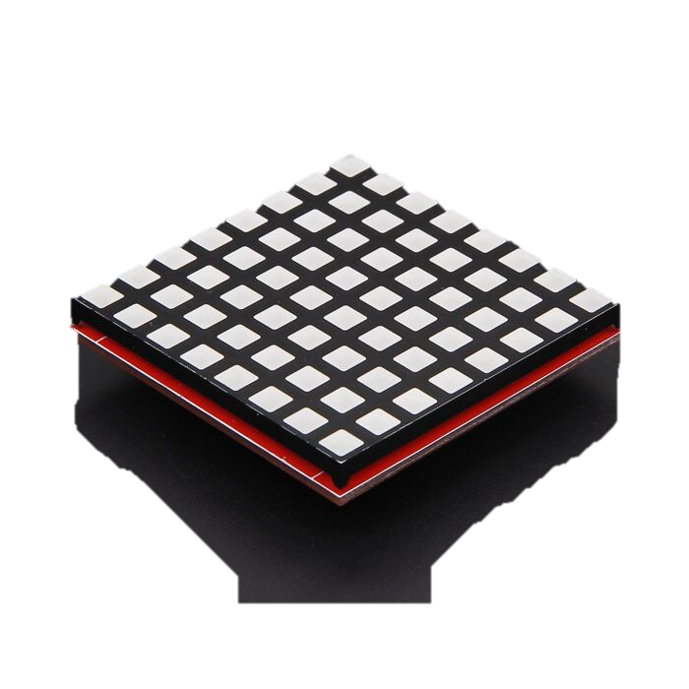
Challenge
Images can be represented as a grid
The grid contains R, G, B values
How many dimensions does each point in the grid have?
Notes:
Ensure students understand that dimensionality is the properties required to represent a given point, thus since a given point has h, w, (r, g, b) it is 3D (not 2d or 5D)

Slide 13
2D plus 1 more…
each point in the grid is defined by its position and its colour.
the position of any point in the grid is given by its coordinates - h, w
where `h` is the height (row) and `w` is the width (column).
However, the colour of a point is represented by RGB values (r, g, b) describing the red, green, and blue components.
Notes:
Ensure students understand that dimensionality is the properties required to represent a given point, thus since a given point has h, w, (r, g, b) it is 3D (not 2d or 5D)

Slide 14
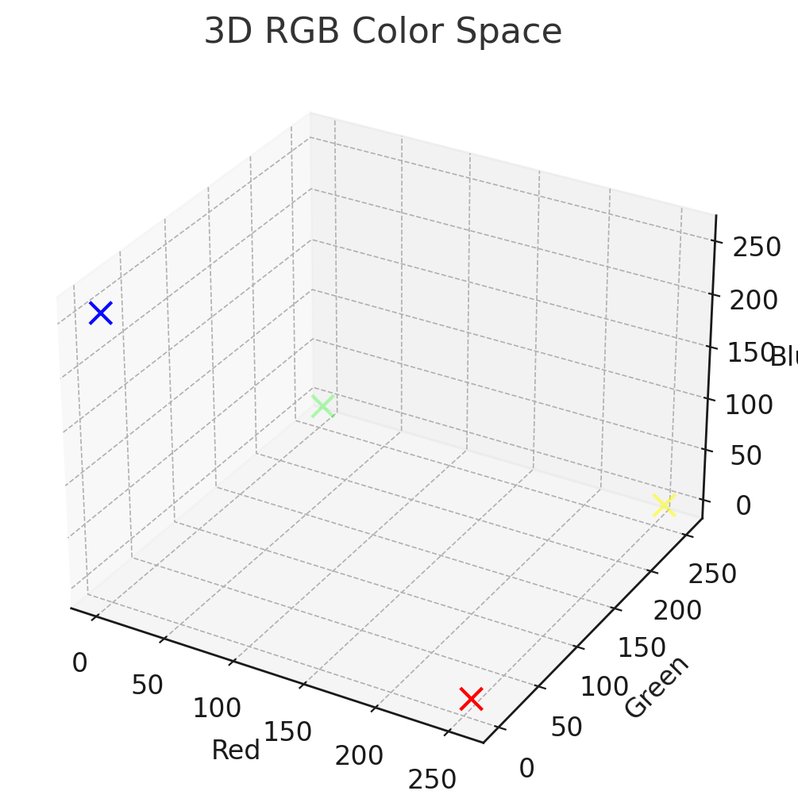
3rd Dimension
These additional properties for each grid point can be considered a 3rd dimension
Notes:
not 2d – this considers only h & w
not 5d – this treats the rgb as being on the same plane as the position, we know the colour properties are separate form the grid properties

Slide 15
A 2x2 example
# Grid Size
- Width: 2 (0x02)
- Height: 2 (0x02)
# RGB Values for Each Point
- Point (0, 0): (255, 0, 0) -> 0xFF 0x00 0x00
- Point (0, 1): (0, 255, 0) -> 0x00 0xFF 0x00
- Point (1, 0): (0, 0, 255) -> 0x00 0x00 0xFF
- Point (1, 1): (255, 255, 0) -> 0xFF 0xFF 0x00
# Converted Binary Content
02 02 FF 00 00 00 FF 00 00 00 FF FF FF 00
2x2 grid with 4 points
each with a h & w position
RGB values for each point
Notes:
More on binary files to coming in later sessions.

Slide 16
Accessing the structure using our nested pattern
# Sequentially accessing the RGB values from the binary file
index = 2
height = 2
width = 2
rgb_values = []
for _ in range(height):
for _ in range(width):
r = binary_content[index]
g = binary_content[index + 1]
b = binary_content[index + 2]
rgb_values.append((r, g, b))
index += 3
Grid size: 2x2 with 4 points
RGB values for each point
Consider , why would we then increment the index by 3?
Notes:
More on binary files to coming in later sessions.

Slide 17
Activities - Workshop Part 2
Building & using 2D structures.

Slide 18
Finally:
  Consider the tic-tac-toe game:
  what data structure does it use?
  What should it use?
  How could you use it?
  Let's review the tic_tac_toe.py file from last sessions workshop

Slide 19
PREVIEW: UNIT TESTING - Workshop Part 3
Start thinking about next week…

Slide 20
Revision
How can you create a 2D list in Python both with and without list comprehension? Provide an example for each.
How would you access the element at row i and column j of a 2D list? Is this sequential or random access?
Explain the difference between sequential and random access when working with 2D lists. When would you use one over the other?

Slide 21
Revision
What are some practical uses of 2D lists in Python? Provide at least two examples where 2D lists could be useful.
What are some potential pitfalls or limitations when working with 2D lists in Python? How might you work around these?
Why might you use libraries like NumPy or Pandas for working with 2D data structures instead of native Python lists? Discuss the benefits they offer and how they build upon Python's native lists and NumPy's arrays.

