Slide 1
Intermediate Git: diff, oops, and maybe
Various
ICT40120 Certificate IV in Information Technology
Applied Programming in Python
ICTICT449 | Use version control systems in development environments
ICTPRG430 | Introductory object-oriented techniques

Slide 2
Session Contents
Creating and interpreting diffs
Reverting and resetting
Stashing

Slide 3
Diff
A diff is a standard representation of the difference between text files or sets of text files
Diffs are designed to be human readable but IDEs can make them easier to work with
They provide enough fidelity to be used as a patch

Slide 4
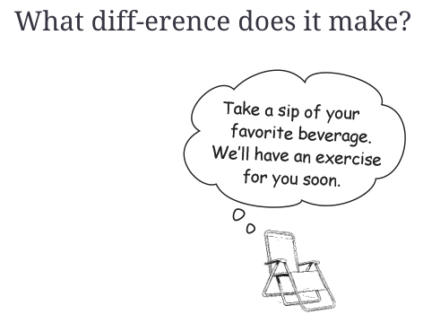
Differences are all around us
When you run git status the question is “what is the diff”
When you run merge – ditto
Pull or push – yep…
Head First Git: great write up!
Notes:
https://learning.oreilly.com/library/view/head-first-git/9781492092506/ch03.html#what_diffhyphenerence_does_it_makequesti

Slide 5
But what is the difference?
Many times, we don’t just want to know that there is a difference but we want to know what is the difference
You saw an example of differences when you ran a pull request
Discuss on what levels were differences highlighted (folder/file/line/word/character)?

Slide 6
Diffs can be performed at many levels
Between files
Between commits
Between staging (index) and the object database (repo)
Between the working copy and any of the above

Slide 7
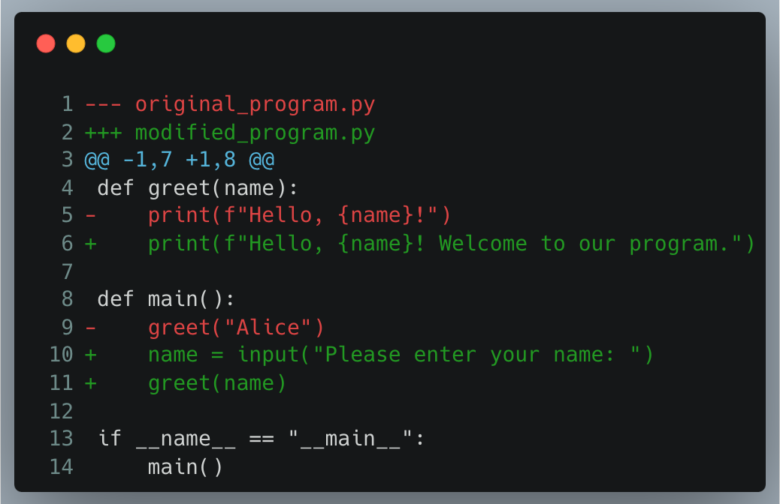
Interpreting a diff
Header
The files being compared
The symbol (+/-) associated with each insertion
For temporally related changes, an insertion in the past is a deletion in the present ☺

Slide 8
Interpreting a diff
Hunk headers
The line numbers in the ‘-’ file and the ‘+’ file

Slide 9
Interpreting a diff
A difference!
- prefixed: --- file
+ prefixed: +++ file
Not prefixed: common (context)
Challenge: what line numbers in each file do these changes relate to?

Slide 10
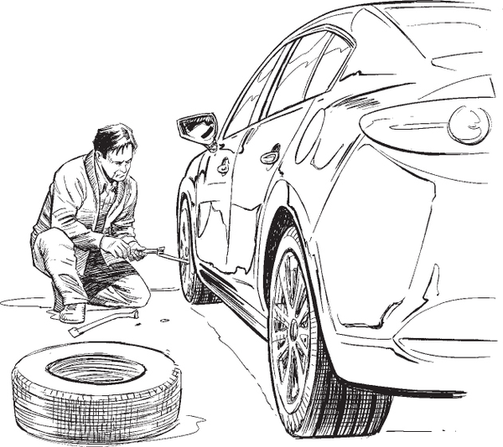
OOPSY: Undoing changes
Notes:
https://learning.oreilly.com/library/view/head-first-git/9781492092506/ch04.html

Slide 11
Oops! You made a mistake
Git stores E.V.E.R.Y.T.H.I.N.G
That’s not always a good thing.
You will:
Accidently add a file you did not want to add
Make a commit you didn’t intend to commit (too soon, wrong branch, etc)
Make a commit and decide you want to change it or its commit message
Push a change you didn’t mean to push
Make updates to your working copy you want to remove!

Slide 12
Everything can be fixed, but…
Anything can be fixed but the difficulty level does rise pretty quickly
In general, there are two strategies:
Revert changes by creating a new commit
Reset changes by removing them from history
Each has their respective advantages

Slide 13
 | git revert | git reset
Operation | Creates a new commit that undoes changes | Moves the branch pointer to a previous commit
Commit History | Preserves the original commit history | Modifies the commit history
Branch State | Updates the branch with a new commit | Moves the branch pointer to a different commit
Working Directory | Does not modify the working directory | Can optionally modify the working directory
Collaboration | Safe for shared repositories, as it creates a new commit | Potentially dangerous for shared repositories, as it rewrites the commit history
Use Cases | Undoing commits, fixing mistakes, reverting changes | Discarding local commits, cleaning up history, resetting to a previous state
Remote Repositories | Suitable for reverting changes pushed to remote repositories | Not suitable for resetting changes pushed to remote repositories

Slide 14
WARNING: resets are hazardous!
Losing work
Misaligned commit history (after push)

Slide 15
Exercise: Upcoming exercises will help you practice these commands so stay tuned.

Slide 16
Stashing: putting changes aside for a bit

Slide 17
Stashing
Uncommitted changes can get in the way of branching
If one branch is ahead of your working copy and switching to it will clobber your changes git won’t let you
So what do you do?
No really, have a think how you would solve it…

Slide 18
What you’d have to do
Copy the changes – you are not sure what files changed, so you probably grab everything (yuck!)
Copy to another folder (yuck yuck)
Use git reset --hard to DESTROY the working copy changes (yuck yuck yuck)
Switch to the branch
Do work
Switch back, copy all the files back and really really hope you didn’t stuff everything up

Slide 19
OR
git stash
switch
switch back
git stash pop
Done!
HOW GOOD IS THAT!

Slide 20
Public service announcement
Git stash is sometimes not taught in intro git
But it is just about the most useful command you can find to make working with git seamless
Particularly if you are branch/working with a remote
i.e. using git as intended ☺

