Slide 1
Web Technologies: Introduction
ICT40120 Certificate IV in Information Technology (Programming)
Code | Title
ICTWEB441 | Produce basic client-side script
ICTWEB452 | Create a markup language document

Slide 2
Overview
This session includes:
Media Queries
Pseudo Selectors & Elements
Fonts & Typography
Challenge Exercises
Transitions & Animations
Work on Phase 1 & 2

Slide 3
Pseudo Selectors & Elements
ICT40120 Certificate IV in Information Technology (Programming)

Slide 4
CSS Selectors
/* Descendant Selector */
article p {
font-style: italic;
}
/* Child Selector */
ul > li {
list-style-type: square;
}
/* Adjacent Sibling Selector */
.item + p {
margin-top: 10px;
}
/* General Sibling Selector */
h3 ~ p {
color: gray;
}
We have previously looked at at how we can select semantic HTML elements using CSS selectors…

Slide 5
CSS Pseudo Classes & Elements
Pseudo-Classes: keywords added to selectors to define a special state of an element.
Pseudo-Elements: are used create virtual elements in the DOM that can be styled like regular elements.
/* Pseudo Class */
a:active {
color: red;
}
/* Pseudo Element */
li:nth-child(odd) {
background-color: lightblue;
}

Slide 6
Pseudo Classes - Examples
/* Pseudo-classes */
button:hover {
background-color: lightgray;
}
a:active {
color: red;
}
li:nth-child(odd) {
background-color: lightblue;
}
li:first-child {
font-weight: bold;
}
:hover: Styles an element when the mouse pointer hovers over it.
:active: Styles an element when it's being clicked or activated.
:nth-child(): Selects elements based on their position within a parent element.
:first-child: Selects the first child element of its parent.

Slide 7
Pseudo Elements - Examples
/* Pseudo-elements */
button::before {
content: "🚀";
margin-right: 5px;
}
button::after {
content: "Click Me!";
font-weight: bold;
}
::before: Adds content before the selected element.
::after: Adds content after the selected element.
How might these be used for a hamburger menu?

Slide 8
Attribute Selectors
Attribute Selectors: Attribute selectors target HTML elements based on their attributes or attribute values.
Syntax: The basic syntax of an attribute selector can be shown as [attribute=value]
[type="submit"] {
background-color: green;
}
[href*="example.com"] {
color: purple;
}

Slide 9
Attribute Selectors
/* Attribute Presence Selector */
[target] {
border: 1px solid blue;
}
/* Exact Match Selector */
[type="submit"] {
background-color: green;
}
/* Substring Match Selector */
[href*="example.com"] {
color: purple;
}
Attribute Presence Selector: Targets elements with a specific attribute
Exact Match Selector: Targets elements with a specific attribute and exact attribute value
Substring Match Selector: Targets elements with an attribute value containing a specific substring.

Slide 10
Attribute Selectors
Starts With Selector: Targets elements with an attribute value that starts with a specific string.
Ends With Selector: Targets elements with an attribute value that ends with a specific string.
/* Starts With Selector */
[src^="images/"] {
border: 2px solid gray;
}
/* Ends With Selector */
[class$="-btn"] {
background-color: yellow;
}

Slide 11
Challenge 1
Download the starter code – in session 7
Make the first Navigation link a different colour to the rest using first-child
Make the header before the events list standout using only a pseudo element
Style the button using an attribute selector so that it changes colour on hover
Use the nth-child selector to make the two “read more” links different colours from each other

Slide 12
@Media Queries

Slide 13
Recap…
Defining Breakpoints: specific screen widths
Responsive Design: crucial role in mobile first design
Adaptive Layouts: used as conditions to apply different styles
Design Considerations: anticipate how the content will look at different breakpoints.
Multiple Breakpoints: A website can have multiple breakpoints
@media screen and (min-width: 1200px) {
body {
font-size: 20px;
}
.container {
max-width: 1140px;
}
}

Slide 14
Breakpoint Usage
@media screen and (min-width: 768px) {
body {
font-size: 18px;
}
.container {
max-width: 768px;
margin: 0 auto;
}
}
@media screen and (min-width: 1200px) {
body {
font-size: 20px;
}
.container {
max-width: 1140px;
}
}
Mobile-first (default): font size is set to 16px & the container has some padding.
Tablet breakpoint (min-width: 768px): font size is increased to 18px & the container's maximum width is set to 768px with centered alignment.
Laptop breakpoint (min-width: 1200px): font size is increased to 20px & the container's maximum width is set to 1140px.

Slide 15
Media Query Structure
Basic Structure: syntax starts with @media followed by one or more conditions enclosed in parentheses.
Conditions: can include media features like screen width, orientation, resolution
Applying Styles: styles are only applied when the conditions are met.
@media screen and (min-width: 1200px) {
body {
font-size: 20px;
}
.container {
max-width: 1140px;
}
}
Notes:
@media: This at-rule is used in CSS to apply styles only when certain conditions are met, such as the size of the viewport or the device's characteristics.
not screen: This part of the media query specifies a condition under which the styles should apply. In this case, it specifies that the styles should not apply when the device is a screen, meaning they would apply to devices that are not screens, such as printers or speech synthesisers.
and (color): This is a feature query within the media query. It checks if the device supports colour rendering. If the device supports colour, the styles within this media query will be applied.

Slide 16
Media Types
/* Example 1: Styles for screens */
@media screen {
body {
background-color: lightgray;
}
}
/* Example 2: Styles for printing */
@media print {
.print-header {
display: none;
}
}
screen: used for typical screens print: styles when printing a webpage
all: default value for all media types.

Slide 17
Logical Operators
and: combines conditions, ensuring all conditions are met
not: negates a condition, applying styles when the specified condition is not met.
only: only ensures that the styles are applied only when the specified conditions are met.
@media not screen and (color) {
body {
background-color: white;
color: black;
}
}
@media only screen and (max-width: 1200px) {
.menu {
display: none;
}
}

Slide 18
@Media features
width and height: width and height of the viewport
orientation: whether the device is in landscape or portrait mode.
device-width & device-height: target the physical width and height of the device screen.
min-width & max-width: minimum and maximum viewport width at which the styles should apply.
@media not screen and (color) {
body {
background-color: white;
color: black;
}
}
@media only screen and (max-width: 1200px) {
.menu {
display: none;
}
}

Slide 19
@Media Features - Examples
/* Using Width for Breakpoints: */
@media (max-width: 768px)
/* Orientation change */
@media (orientation: landscape)
/* Device-Dependent Styles: */
@media (device-width: 320px)
/* Combining Features */
@media (min-width: 768px) and (orientation: landscape)

Slide 20
Challenge 2
using the same code as challenge 1 & chrome inspector & choosing grid or flexbox
use mobile first design to create two break points for tablet and desktop
apply different styling to the main container class, navigation menu and events list for mobile, tablet & desktop

Slide 21
Fonts

Slide 22
Web-safe Fonts
These are fonts that are commonly available on most devices and operating systems.
They don't require external loading as they're already present on the user's system.
Examples include: Arial, Helvetica, Times New Roman, and Courier New.

Slide 23
External Font API’s
Font API’s provide a wide variety of free web fonts that you can include in your HTML and CSS.
Simply link to the desired fonts in your HTML's <head> section using the <link> tag. For example:
<link rel="stylesheet" href="https://fonts.googleapis.com/css?family=Open+Sans:400,700">
<link href='http://fonts.googleapis.com/css?family=Audiowide|Exo+2|Rambla|Scada' rel='stylesheet' type='text/css'>

Slide 24
Custom Fonts
You can also use custom fonts by uploading font files (.woff, .woff2, .ttf, .otf)
@font-face in your CSS to specifies non-standard font sources.
@font-face {
/* This is the name you'll use to reference the font */
font-family: ‘MyFont’;
/* Provide the path to the font files */
src: url('fonts/my-font.woff2’) format('woff2'), url('fonts/my-font.woff') format('woff');
}

Slide 25
Font Properties – Common Examples
font-family: specifies the font to be used for text, in order of preference
font-style: values include normal & italic
text-transform: values include uppercase & none.
text-align: alignment of the text
letter-spacing: spacing between characters.
line-height: space between lines of text.
h1 {
font-family: "MyFont", sans-serif;
font-weight: bold;
letter-spacing: 2px;
text-align: center;
text-transform: uppercase;
}

Slide 26
Challenge 3
Download a font in Google Fonts – load this file into your fonts folder (try 2 fonts for an extra challenge)
Apply this font to your code using @font-face
Select another font from Google Fonts but use the <link> method in your html <head> to load it
Apply this font to your code using font-family

Slide 27
The DOM
Programming interface in the form of a tree, each node in the tree corresponds to an element, attribute, or text in the document.
Provides a dynamic representation of the document, which can be modified in real-time through scripting languages.
Many languages like Python, Ruby, or JavaScript can also interact with the DOM.

Slide 28
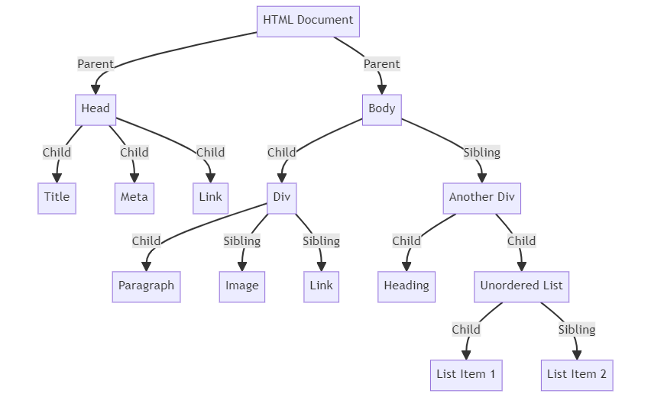
The DOM Tree

Slide 29
The DOM – Modern CSS
Both CSS and JavaScript interact with the DOM. CSS selects elements in the DOM to apply styles
CSS can utilise pseudo-classes like hover or :focus to apply styles based on user interaction(events)
Features like animations, transitions, and flexbox/grid layouts add dynamic behaviour to web elements using the DOM.

Slide 30
CSS Variables

Slide 31
CSS Variables
we may want to implement a theme or a common style/animation
CSS variable reduces the need for repeated code
they also improve maintainability as we can change our theme in one place
/* Define CSS variables in the :root selector */
:root {
--main-color: #3498db;
--secondary-color: #2ecc71;
--font-size-large: 18px;
}
/* Use CSS variables in styles */
body {
font-size: var(--font-size-large);
color: var(--main-color);
}

Slide 32
CSS Animations

Slide 33
CSS Animations
/* Define the animation keyframes */
@keyframes fadeIn {
0% {
opacity: 0;
}
100% {
opacity: 1;
}
from {
opacity: 0;
}
to {
opacity: 1; /
}
}
as modern CSS works with the DOM we can use CSS to animate our UI
use the @keyframes rule to control and change
define your animation name and also use keywords such as from

Slide 34
Challenge 4
implement global variables
apply an animation to your code
apply a theme

Slide 35
Transitions, Variables & Animations
Out of Class Activity – Excellent session on how to apply these core skills to a mobile menu:
https://www.youtube.com/watch?v=PN5OC1mZlfY&list=PL0Zuz27SZ-6Mx9fd9elt80G1bPcySmWit&t=4s

Slide 36
🦆

