Slide 1
Web Technologies: Introduction
ICT40120 Certificate IV in Information Technology (Programming)
Code | Title
ICTWEB441 | Produce basic client-side script
ICTWEB452 | Create a markup language document

Slide 2
Overview
This session may include:
CSS Grids
CSS Flexbox
Challenges
Assessment Portfolio (Pt 1) Overview

Slide 3
CSS3 Grids
ICT40120 Certificate IV in Information Technology (Programming)

Slide 4
CSS Grid Layout
creates two-dimensional grid, defining rows & columns within a grid container.
control both rows and columns(number & size)
position items anywhere within the grid using line numbers or named grid areas.
ideal for creating complex layouts, like multi-column form

Slide 5
Grid, tracks & lines
both rows and columns are treated as equals.
Grid Lines: define the boundaries of rows and columns.
Grid Tracks: spaces between adjacent grid lines
Grid Cells: intersections of grid lines form grid cells
NOTE: place grid items into cells using line numbers or naming grid areas

Slide 6
Grid cell placement
The intersections of grid lines form grid cells.
You can place grid items directly into these cells using line numbers or by naming grid areas.

Slide 7
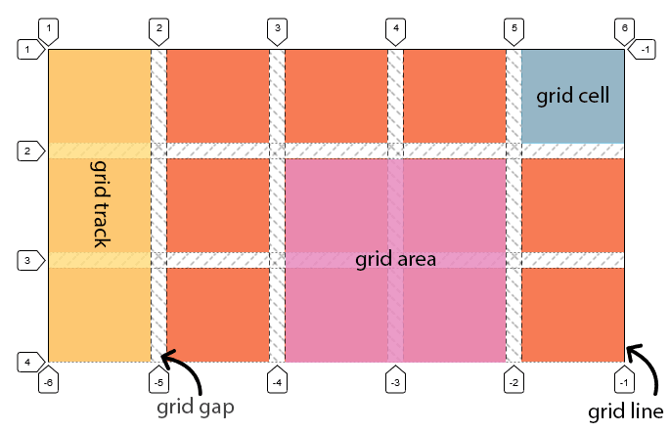
Grids, tracks & lines contd…
https://dev.to/busramemis/css-grid-layout-3kc1

Slide 8
Grid Container & Items
the container establishes a grid format
defined using the display: grid;
container contains both rows and columns,
forming the grid structure for its child elements (grid items)
.container {
display: grid;
grid-template-columns: 50px 50px 50px 50px;
grid-template-rows: auto;
grid-template-areas:"header”;
}

Slide 9
Grid Item Placement
"grid items" - child elements of the grid container.
items are positioned by specifying the row and column
items are placed using properties like grid-row and grid-column
specify the start and end lines in both row & column dimensions.
/* Placing Grid Items */
.item-1 {
/* Place in row 1 */
grid-row: 1;
/* Place in column 1 */
grid-column: 1;
}

Slide 10
Grid Rows & Columns
define rows and columns using the grid-template-rows and grid-template-columns properties
template values define the size and behaviour of grid tracks
you can use various units like pixels, percentages, and the fr unit (fractional unit)
.container {
display: grid;
grid-template-columns: 1fr 2fr 1fr;
grid-template-rows: auto;
grid-template-areas:
"header";
}

Slide 11
Grid Rows & Columns
you can specify a specific length for each track using units like px or em.
the fr unit distributes available space (on the right you see a 1:2:1 ratio).
auto keyword allows a track to automatically size based on its content.
the minmax(min, max) function sets a minimum and maximum size for a track.
.container {
display: grid;
grid-template-columns: 1fr 2fr 1fr;
grid-template-rows: auto;
grid-template-areas:
"header";
}

Slide 12
Grid Naming - Example
/* Grid Container */
.grid-container {
display: grid;
grid-template-columns: 1fr;
grid-template-rows: repeat(3,100px);
grid-gap: 10px;
width: 300px;
grid-template-areas:
"header"
"main"
"footer";
}
/* Naming Grid Areas & place items*/
.header {
grid-area: header;
}
.main {
grid-area: main;
}
.footer {
grid-area: footer;
}
grid-template-columns: 1fr to create one column
grid-template-rows: repeat(3, 100px): defines 3 rows, each with a fixed height of 100px.
grid-template-areas: defines named areas for the single column and 3 rows: "header," "main," and "footer.”
.header, .main, and .footer classes are used to name the grid areas.
grid-area: property is used to place each item

Slide 13
Grid Gap - spacing or gutter
grid-gap property sets the gap between rows and columns
shorthand property that combines grid-row-gap and grid-column-gap.
use units like px or % to define the gap size.
use flexible units like em for relative sizing
grid-row-gap property sets the gap between rows
grid-column-gap property sets the gap between columns

Slide 14
Grid Gap - Example
.grid-container class creates a grid container with three columns and two rows.
grid-column-gap property adds a 20px gap between columns
grid-row-gap property adds a 10px gap between rows.
/* Grid Container */
.grid-container {
display: grid;
grid-template-columns: repeat(3, 1fr);
grid-template-rows: repeat(2, 100px);
/* Gap between columns */
grid-column-gap: 20px; /* Gap between rows */
grid-row-gap: 10px;
width: 400px;
}

Slide 15
Challenges – CSS Grid
Complete these challenges as part of your learning and practice

Slide 16
Challenge 1 – Image Gallery Grid
Create a responsive image gallery using CSS Grid.
Display a grid of images that adjusts its layout based on screen size.

Slide 17
Challenge 2 – Grid Flexible Card Layout
Create a flexible card layout using CSS Grid
Design cards that stack horizontally on desktop screens and switch to a vertical stack on smaller screens.

Slide 18
CSS3 Flexbox
ICT40120 Certificate IV in Information Technology (Programming)

Slide 19
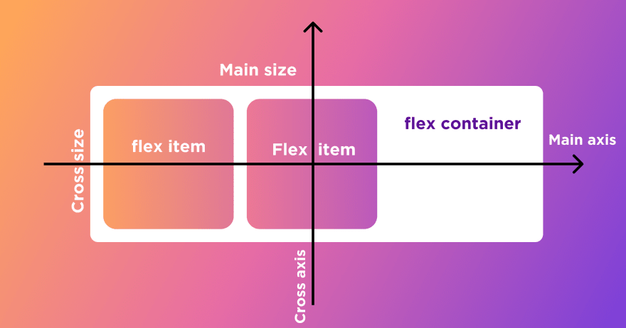
CSS Flexbox
works along a single axis known as the "main axis,"
orthogonal axis known as the "cross axis."
https://dev.to/virensuthar/get-started-with-flexbox-3in5

Slide 20
Flexbox - Advantages
adapts to different screen sizes and devices.
containers expand and contract as needed.
provides precise control over item alignment
complex layouts, like navigation bars are more manageable.
requires less CSS code
widely supported in modern browsers

Slide 21
Flex Container and Flex Items
Container - holds a group of child elements and establishes a flex formatting context.
Items - child elements of the flex container & can be configured individually or collectively
<div class="flex-container">
<div class="flex-item">Item 1</div>
<div class="flex-item">Item 2</div>
<div class="flex-item">Item 3</div>
</div>
Notes:
Flex Container and Flex Items:
Flex Container: The "flex container" is an element that holds a group of child elements and establishes a flex formatting context. It's the parent element in which flex items are positioned.
Flex Items: "Flex items" are the child elements of the flex container. They can be any HTML element within the container. Each flex item can be configured individually or collectively using flex properties.
Child Relationship:
Parent-Child Relationship: The flex container defines a parent-child relationship with its flex items. The container dictates the layout behavior of its items.
Directionality: Flex items are arranged in a row or column, depending on the value of the flex-direction property set on the container.
Flex Properties:
Individual Control: Each flex item can have its own flex-related properties, such as flex-grow, flex-shrink, and flex-basis, which control how the item grows, shrinks, and its initial size.
Collective Control: Flex properties on the container, such as justify-content and align-items, control the overall alignment and spacing of flex items.

Slide 22
Flex Properties
/* This item grows twice as much as others */
.flex-item:nth-child(2) {
flex-grow: 2;
}
/* This item shrinks twice as much as others */ .flex-item:nth-child(3) {
flex-shrink: 2;
}
Individual: Each flex item can have its own flex-related properties
Collective: Flex properties on the container alignment and spacing of flex items.
Notes:
Individual Control: Each flex item can have its own flex-related properties, such as flex-grow, flex-shrink, and flex-basis, which control how the item grows, shrinks, and its initial size.
Collective Control: Flex properties on the container, such as justify-content and align-items, control the overall alignment and spacing of flex items.

Slide 23
Distribution & Auto Sizing
Main Axis: is the direction of flex items.
Cross Axis: used for alignment and positioning of items.
Flexible Sizing: Flex items can grow or shrink based on available space.
.flex-container {
display: flex;
/* Horizontally center items */
justify-content: center;
/* Vertically center items */
align-items: center;
/* Set a fixed container height*/
height: 300px;
}
Notes:
Space Distribution:
Main Axis: The main axis is the direction of flex items. The flex container distributes space along this axis based on defined flex properties.
Cross Axis: The orthogonal axis to the main axis is the cross axis. It's used for alignment and positioning of items.
Auto Sizing:
Flexible Sizing: Flex items can grow or shrink based on available space, enabling them to adapt to different screen sizes or content lengths.
Responsive Layouts: This flexibility makes it easier to create responsive layouts that adjust to various viewports while maintaining a coherent design.

Slide 24
Distribution & Auto Sizing
flex-direction: row : the main axis runs horizontally from left to right
flex-direction: column : the main axis runs top to bottom
justify-content: align along the main axis
align-items: align along the cross axis
.flex-container {
display: flex;
flex-direction: column;
/* Horizontally center items */
justify-content: center;
/* Vertically center items */
align-items: center;
}
Notes:
Direction Determination:
Row Layout: If flex-direction: row; is set on the container, the main axis runs horizontally from left to right, and the cross axis runs vertically from top to bottom.
Column Layout: If flex-direction: column; is set on the container, the main axis runs vertically from top to bottom, and the cross axis runs horizontally from left to right.
Main Axis Alignment:
Justify Content: The justify-content property controls how items are aligned along the main axis. Common values include flex-start, flex-end, center, space-between, and space-around.
Cross Axis Alignment:
Align Items: The align-items property controls how items are aligned along the cross axis. It affects all items as a group and has values like flex-start, flex-end, center, baseline, and stretch.
Align Self: The align-self property can be applied to individual items, allowing them to override the alignment set by the container's align-items.
Use Cases:
Main Axis (Row): Ideal for horizontally aligning items, like in navigation menus.
Main Axis (Column): Useful for vertically stacking items, such as in a list.

Slide 25
Defining the context – 4 steps
.flex-container {
display: flex;
flex-direction: column;
/* Horizontally center items */
justify-content: center;
/* Vertically center items */
align-items: center;
}
enable the flex formatting
define the main axis direction
align along the main axis
justify along the cross axis
Notes:
Direction Determination:
Row Layout: If flex-direction: row; is set on the container, the main axis runs horizontally from left to right, and the cross axis runs vertically from top to bottom.
Column Layout: If flex-direction: column; is set on the container, the main axis runs vertically from top to bottom, and the cross axis runs horizontally from left to right.
Main Axis Alignment:
Justify Content: The justify-content property controls how items are aligned along the main axis. Common values include flex-start, flex-end, center, space-between, and space-around.
Cross Axis Alignment:
Align Items: The align-items property controls how items are aligned along the cross axis. It affects all items as a group and has values like flex-start, flex-end, center, baseline, and stretch.
Align Self: The align-self property can be applied to individual items, allowing them to override the alignment set by the container's align-items.
Use Cases:
Main Axis (Row): Ideal for horizontally aligning items, like in navigation menus.
Main Axis (Column): Useful for vertically stacking items, such as in a list.

Slide 26
Step 2: Main Axis Direction (flex-direction)
row: items are arranged horizontally in a row (default).
row-reverse: items are arranged horizontally in reverse
column: items are stacked vertically.
column-reverse: items are stacked vertically in reverse order.
Notes:
Direction Determination:
Row Layout: If flex-direction: row; is set on the container, the main axis runs horizontally from left to right, and the cross axis runs vertically from top to bottom.
Column Layout: If flex-direction: column; is set on the container, the main axis runs vertically from top to bottom, and the cross axis runs horizontally from left to right.
Main Axis Alignment:
Justify Content: The justify-content property controls how items are aligned along the main axis. Common values include flex-start, flex-end, center, space-between, and space-around.
Cross Axis Alignment:
Align Items: The align-items property controls how items are aligned along the cross axis. It affects all items as a group and has values like flex-start, flex-end, center, baseline, and stretch.
Align Self: The align-self property can be applied to individual items, allowing them to override the alignment set by the container's align-items.
Use Cases:
Main Axis (Row): Ideal for horizontally aligning items, like in navigation menus.
Main Axis (Column): Useful for vertically stacking items, such as in a list.

Slide 27
Step 3: Align on the Main Axis (justify-content)
flex-start: items align at the start of the main axis.
flex-end: items align at the end of the main axis.
centre: items align at the centre along the main axis.
space-between: items are spaced evenly
(first and last item at the edges)
space-around: items are spaced evenly with equal space around them.
Notes:
Direction Determination:
Row Layout: If flex-direction: row; is set on the container, the main axis runs horizontally from left to right, and the cross axis runs vertically from top to bottom.
Column Layout: If flex-direction: column; is set on the container, the main axis runs vertically from top to bottom, and the cross axis runs horizontally from left to right.
Main Axis Alignment:
Justify Content: The justify-content property controls how items are aligned along the main axis. Common values include flex-start, flex-end, center, space-between, and space-around.
Cross Axis Alignment:
Align Items: The align-items property controls how items are aligned along the cross axis. It affects all items as a group and has values like flex-start, flex-end, center, baseline, and stretch.
Align Self: The align-self property can be applied to individual items, allowing them to override the alignment set by the container's align-items.
Use Cases:
Main Axis (Row): Ideal for horizontally aligning items, like in navigation menus.
Main Axis (Column): Useful for vertically stacking items, such as in a list.

Slide 28
Step 4: Align on the Cross Axis(align-items)
flex-start: items align at the start of the main axis.
flex-end: items align at the end of the main axis.
baseline: items align along their baselines.
stretch: items stretch to fill the container's cross axis.
Notes:
Direction Determination:
Row Layout: If flex-direction: row; is set on the container, the main axis runs horizontally from left to right, and the cross axis runs vertically from top to bottom.
Column Layout: If flex-direction: column; is set on the container, the main axis runs vertically from top to bottom, and the cross axis runs horizontally from left to right.
Main Axis Alignment:
Justify Content: The justify-content property controls how items are aligned along the main axis. Common values include flex-start, flex-end, center, space-between, and space-around.
Cross Axis Alignment:
Align Items: The align-items property controls how items are aligned along the cross axis. It affects all items as a group and has values like flex-start, flex-end, center, baseline, and stretch.
Align Self: The align-self property can be applied to individual items, allowing them to override the alignment set by the container's align-items.
Use Cases:
Main Axis (Row): Ideal for horizontally aligning items, like in navigation menus.
Main Axis (Column): Useful for vertically stacking items, such as in a list.

Slide 29
Media Queries
.container {
width: 100%;
}
@media (min-width: 768px) {
.container {
width: 75%;
margin: 0 auto;
}
}
designing for mobile devices before scaling up
allows for graceful enhancement on larger devices.
focuses on essential content for mobile users
Notes:
Direction Determination:
Row Layout: If flex-direction: row; is set on the container, the main axis runs horizontally from left to right, and the cross axis runs vertically from top to bottom.
Column Layout: If flex-direction: column; is set on the container, the main axis runs vertically from top to bottom, and the cross axis runs horizontally from left to right.
Main Axis Alignment:
Justify Content: The justify-content property controls how items are aligned along the main axis. Common values include flex-start, flex-end, center, space-between, and space-around.
Cross Axis Alignment:
Align Items: The align-items property controls how items are aligned along the cross axis. It affects all items as a group and has values like flex-start, flex-end, center, baseline, and stretch.
Align Self: The align-self property can be applied to individual items, allowing them to override the alignment set by the container's align-items.
Use Cases:
Main Axis (Row): Ideal for horizontally aligning items, like in navigation menus.
Main Axis (Column): Useful for vertically stacking items, such as in a list.

Slide 30
Media Queries – mobile 1st
.container {
width: 100%;
}
.container {
display: flex;
flex-direction: column;
}
.item {
flex: 1;
}
start with a single-column layout
use relative units like ems for layout and font
use flexbox or grid without relying heavily on media queries.
test designs on actual mobile devices
Notes:
Direction Determination:
Row Layout: If flex-direction: row; is set on the container, the main axis runs horizontally from left to right, and the cross axis runs vertically from top to bottom.
Column Layout: If flex-direction: column; is set on the container, the main axis runs vertically from top to bottom, and the cross axis runs horizontally from left to right.
Main Axis Alignment:
Justify Content: The justify-content property controls how items are aligned along the main axis. Common values include flex-start, flex-end, center, space-between, and space-around.
Cross Axis Alignment:
Align Items: The align-items property controls how items are aligned along the cross axis. It affects all items as a group and has values like flex-start, flex-end, center, baseline, and stretch.
Align Self: The align-self property can be applied to individual items, allowing them to override the alignment set by the container's align-items.
Use Cases:
Main Axis (Row): Ideal for horizontally aligning items, like in navigation menus.
Main Axis (Column): Useful for vertically stacking items, such as in a list.

Slide 31
Challenges - Flexbox
Complete these challenges as part of your learning and practice

Slide 32
Challenge 3 – Flexbox Responsive Navigation
Create a responsive navigation bar using Flexbox.
Design a horizontal navigation menu that adjusts to a vertical layout on smaller screens.

Slide 33
Challenge 4 – CSS Grid Flexible Card Layout
Convert your Flexbox flexible card layout to a CSS Grid layout
Design cards that stack horizontally on desktop screens and switch to a vertical stack on smaller screens.

Slide 34
Challenge 5 – Mobile First Design
Using using media queries change your CSS challenge(s) code to a mobile first design

Slide 35
🦆

