Slide 1
Web Technologies: Introduction
ICT40120 Certificate IV in Information Technology (Programming)
Code | Title
ICTWEB441 | Produce basic client-side script
ICTWEB452 | Create a markup language document

Slide 2
Web Tech: Sessions
ICT40120 Certificate IV in Information Technology (Programming)
Code | Title
ICTWEB441 | Produce basic client-side script
ICTWEB452 | Create a markup language document

Slide 3
Sessions
A session is a component of study
Sessions may include:
    Notes
    Demonstrations
    Challenges
    Out of class activities

Slide 4
1: Background to the Web
ICT40120 Certificate IV in Information Technology (Programming)

Slide 5
The internet
  Network
  PAN, LAN, WAN
  Intranet, extranet, internet
  Tim Berners-Lee
  CERN

Slide 6
Client/Server Side
  Protocols (TCP/IP) - Transmission Control & Internet
  WWW
  URI – Uniform Resource Identifier
  HTTP - Hypertext Transfer Protocol
  Client – content is manipulated at presentation stage
  Server – content is manipulated by the server

Slide 7
Open source
  Early ideas now across other areas
  Decentralised
  Non-Discrimination
  Bottom Up Design
  Universality
  Consensus

Slide 8
Trinity of Standards
  Behaviour - JavaScript
  Presentation - CSS
  Content & Structure - HTML

Slide 9
  Hyper Text Mark Up Language (HTML)
  XHTML, HTML 2- 5
Cascading Style Sheets (CSS)
  CSS 1- 3
JavaScript (JS)
  ES1- 6 – aka ECMA Script Versions

Slide 10
2: HTML 5 – Basic Page Structure
<!doctype html>
<html lang=“en-au”>
<head>
<title>Untitled Document</title>
</head>
<body>
<!-- content -->
<h1>This is a web page</h1>
<p>An example of a basic page with no extra structure</p>
<p>The &lt;!-- content --&gt; is a comment.
</body>
</html>

Slide 11
Session 1 Group Challenge 1
ICT40120 Certificate IV in Information Technology (Programming)

Slide 12
Introduction
  What is my name?
  What is my experience?
  What am I looking to achieve?

Slide 13
Challenge 1
  What do the following 5 terms stand for?
  PAN
  LAN
  WAN
  Intranet
  Extranet

Slide 14
What is HTTP
HTTP (Hypertext Transfer Protocol) is the foundation of data communication on the web.
HTTP is a stateless protocol, meaning each request is independent.

Slide 15
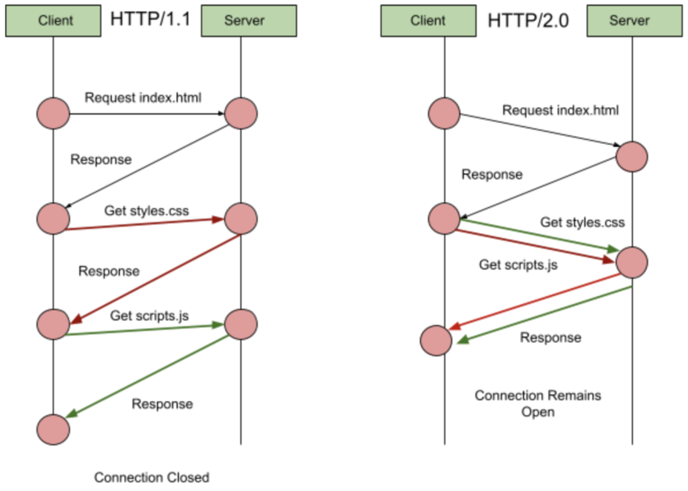
HTTP 1 vs 2
https://code.tutsplus.com/http-the-protocol-every-web-developer-must-know-part-1--net-31177t

Slide 16
Session 1 Challenge 2
ICT40120 Certificate IV in Information Technology (Programming)

Slide 17
Challenge 2
  Can you name the nine HTTP request methods?
  Pick three and describe what these request types do?
  Which request only retrieves data from a server

Slide 18
URI/URL
Uniform Resource Identifier: A generic term for all types of names and addresses.
Uniform Resource Locator: A specific type of URI that includes location information.
Components of a URL: scheme, host, path, query & fragment.

Slide 19
What is DNS?
The Domain Name System translates human-readable domain names:
Example:
  dev.screencraft.net.au
  IP addresses is 192.168.1.1

Slide 20
How DNS Works
User enters a domain name in a browser
The request is sent to a DNS resolver
If cached the IP is returned; otherwise, the DNS checks:
  - Root DNS servers
  - Top-Level Domain servers
  - Authoritative name servers
The resolved IP address is used to load the code

Slide 21
Session 1 Challenge 3
ICT40120 Certificate IV in Information Technology (Programming)

Slide 22
Session 1 Challenge 3
In your groups identify how a cloud platform uses
  IP Addresses
  URI & URL
  DNS
Are they different to traditional servers

Slide 23
Making a GET HTTP Request to API
Open/Download Postman (or in the browser inspector)
  Go to https://reqres.in/
Add the following URL pathe & parameter
  https://reqres.in/api/users?page=2
Paste the URL into a GET request in Postman/Refresh the browser page

Slide 24
Constructing the URL
Notice the following parameters, these build an address for us to make our request to.
api
users
page=2
Consider the key/value pair nature of the data you are receiving in the response.

Slide 25
Headers
Headers provide metadata about the request or response.
This can include:
  server settings
  information on usage
  cached/stored data to make content delivery faster
  custom headers to transmit application specific information

Slide 26
Common HTTP Headers
Content-Type : type of the resource or the data being sent to the
  Content-Type: application
Authorization: contains the credentials to authenticate a user (e.g. API Key)
  Authorization: Bearer <token>
Accept: Lets the server know what types of data the client can process.
  Accept: application/json
Cache-Control: caching information in requests and response for prompt delivery
  Cache-Control: no-cache
Referer: Contains the address of the previous web page
  Referer: https://example.com

Slide 27
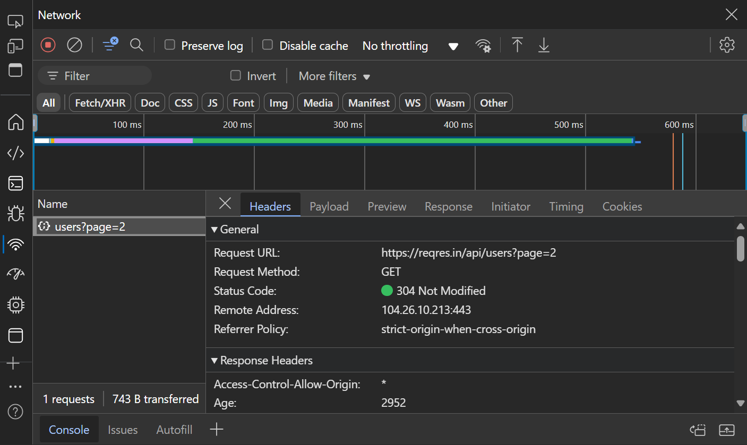
Request & Responses
Let's look at our request in Postman: https://reqres.in/api/users?page=2
Review the headers using Postman i icon or in the Browser Inspector Network tab

Slide 28
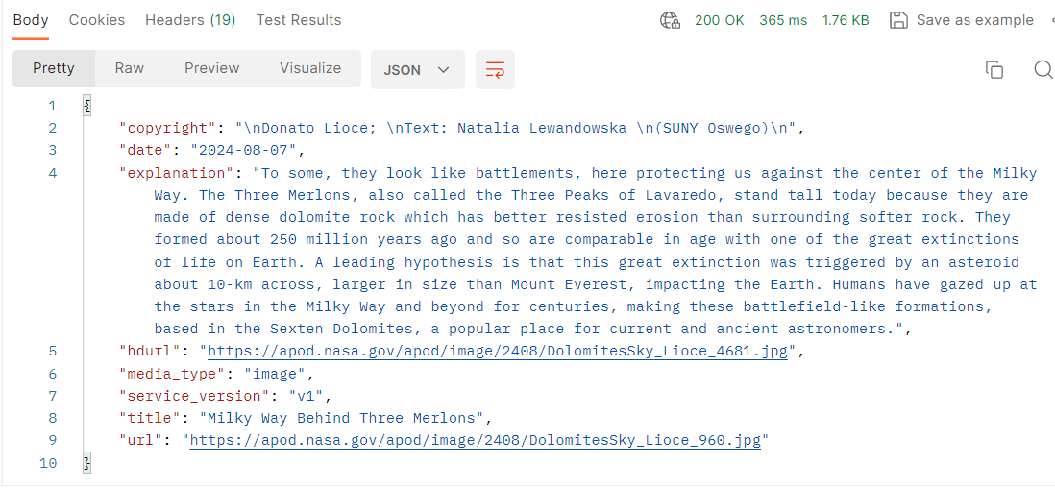
Status Codes
Responses provide a:
  status line with the code
  headers as we discussed
  body containing your data/message

Slide 29
Status Codes Ranges
Status codes indicate the result of the request.
  1xx - Informational only
  2xx - Successful response
  3xx - Redirection to another URI/URL
  4xx - Client Errors - front end errors
  5xx - Server Errors - backend errors
https://developer.mozilla.org/en-US/docs/Web/HTTP/Status

Slide 30
Request & Methods
There are several different methods however the most common relate to CRUD activities
GET: Retrieve data.
POST: Send data to the server.
PUT: Update existing data.
DELETE: Remove data.
This how we manipulate data in databases.
CREATE
READ
UPDATE
DELETE

Slide 31
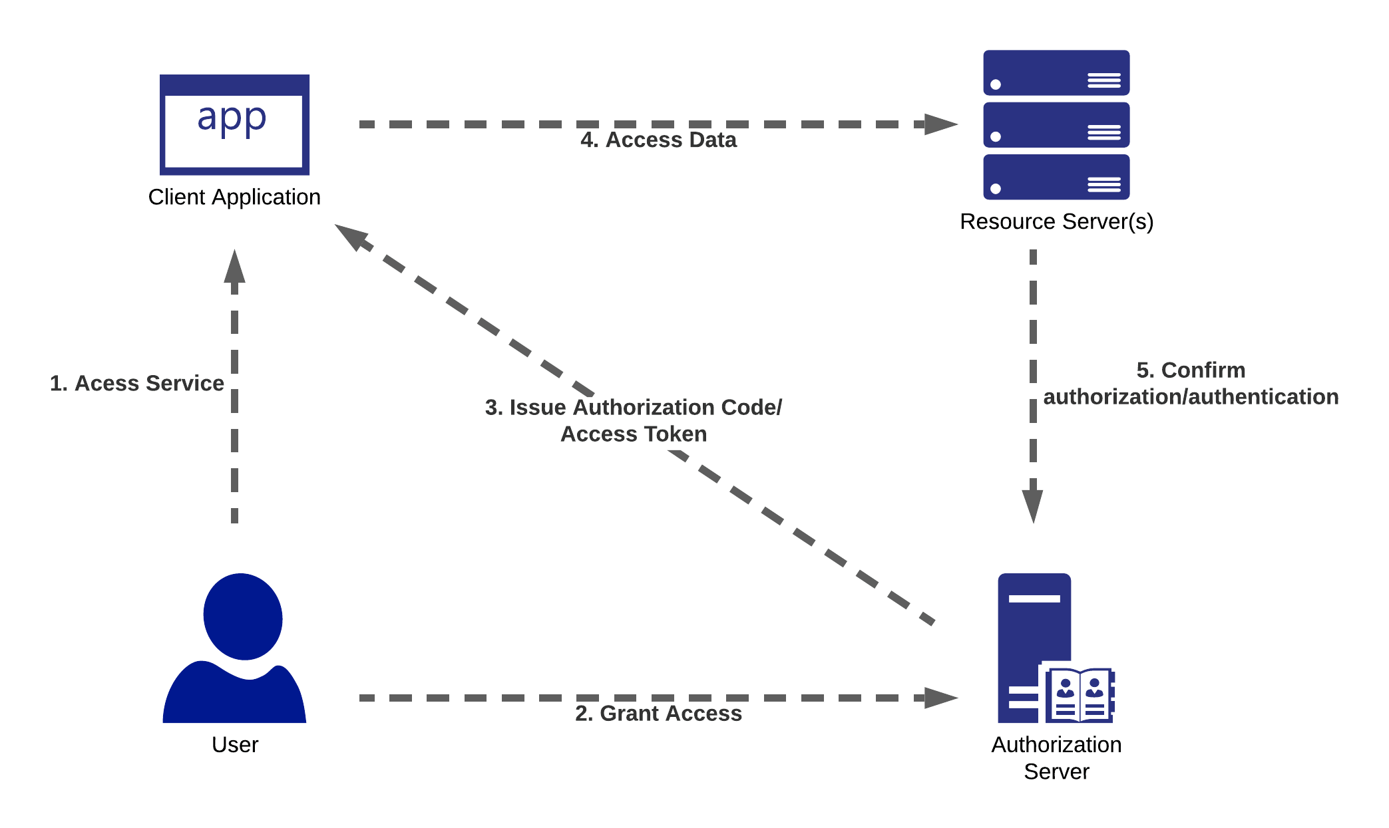
Client vs Server-Side Actions
O-Auth 2.0
Status codes indicate the result of the request.
  Client – user completes the form
  Client – user submits the form
  1st Server- request headers & content are checked
  1st Server - if successful access is granted
  Client – sends new token to the 2nd server
  2nd Server - if successful access is granted
https://securityboulevard.com/2021/04/common-rest-api-authentication-methods-explained/

Slide 32
Session 1 Challenge 4
ICT40120 Certificate IV in Information Technology (Programming)

Slide 33
Session 1 Challenge 3 - Testing HTTP Status Codes
Using our API & the documentation go to:
https://reqres.in/api/users/
Change the parameter when searching users with the API
Add an incorrect parameter
Make a call to a route that doesn’t exist
Add an incorrectly formed JSON to POST or PUT requests
Remove some/all headers from a request

Slide 34
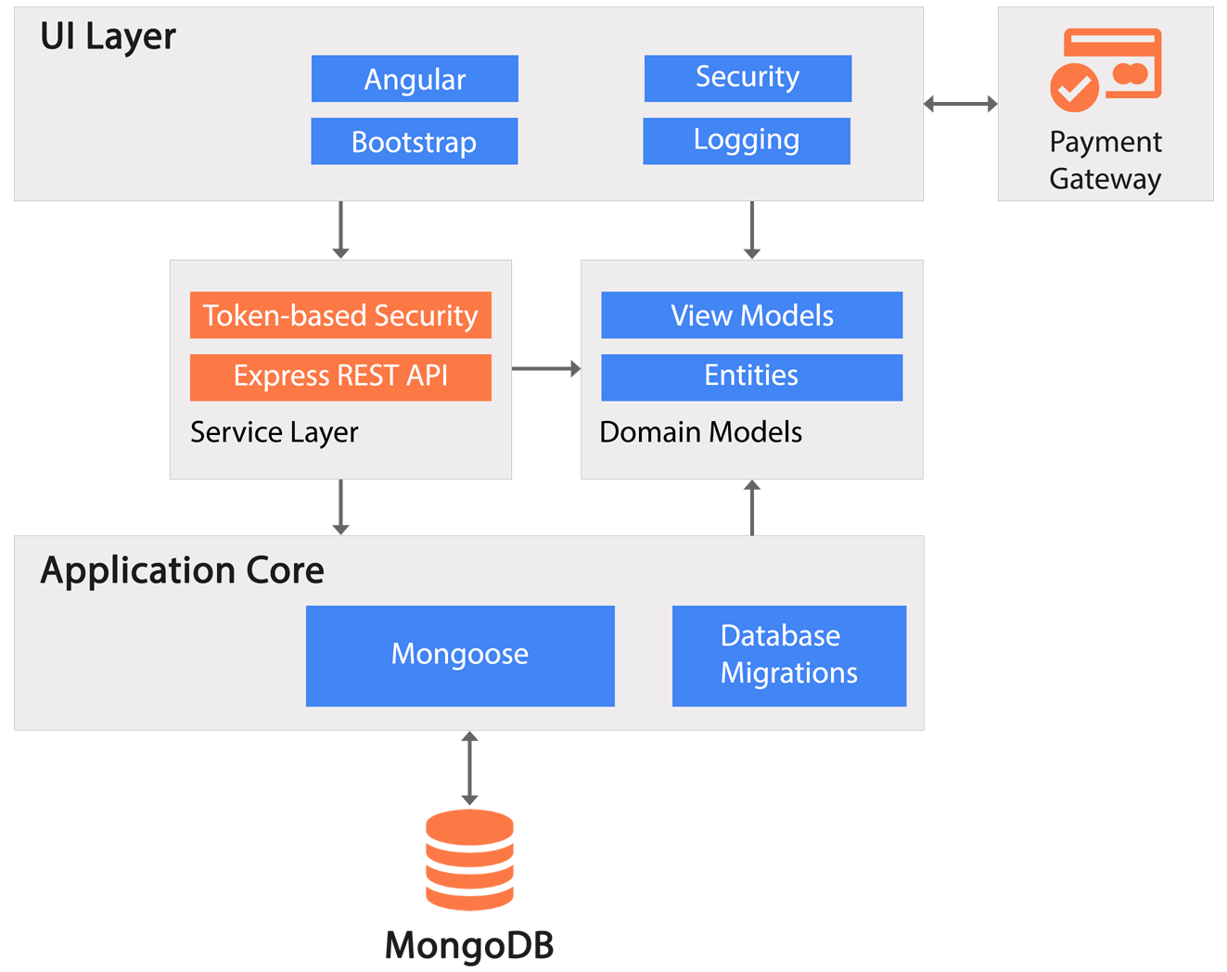
HTTP in Web Applications
Our font end code will need to:
authenticate using HTTP
handle errors using HTTP codes/response bodies
handle all status codes gracefully
be able to deal with changing complex objects
effectively cache(save) information to provide better user experience
https://www.dotnettricks.com/images/course/mean-stack-project-architecture.png

Slide 35
🦆

