Slide 1
Web Technologies: Introduction
ICT40120 Certificate IV in Information Technology (Programming)
Code | Title
ICTWEB441 | Produce basic client-side script
ICTWEB452 | Create a markup language document

Slide 2
Web Tech: Sessions
ICT40120 Certificate IV in Information Technology (Programming)
Code | Title
ICTWEB441 | Produce basic client-side script
ICTWEB452 | Create a markup language document

Slide 3
Sessions
A session is a component of study
Sessions may include:
    Notes
    Demonstrations
    Challenges
    Out of class activities

Slide 4
2: HTML5 Basics & IDEs
ICT40120 Certificate IV in Information Technology (Programming)

Slide 5
2: HTML 5 Basics – Web Pages
Behaviour
Presentation
Content
Structure
Document(s) containing
    Content
    Structure
    Presentation
    Behaviour

Slide 6
2: HTML 5 Basics – Web Pages
JS
CSS
HTML
Content
Written using
    Content
    HTML
    CSS
    JavaScript

Slide 7
2: HTML 5 Basics – 2 HTML
HTML
    Hypertext Markup Language
    Standard markup language for Web pages
    Describes page structure
    Structure described using elements

Slide 8
2: HTML 5 Basics – 2 HTML
HTML Elements & Tags
    Elements contain tags
    Elements instruct browser how to display content
    Elements may add meaning (semantics) to content

Slide 9
2: HTML 5 Basics – Elements & Tags
Element v Tag
    Tag is the HTML instruction to the browser
    Element may be “complete tag”
    <tag attributes> content </tag>
    Or an “empty” tag
    <tag attributes />
    All tags LOWER CASE
    Attributes may vary

Slide 10
2: HTML 5 Basics – Page Structure
5 Components for Well Structured HTML Page:
    doctype
    html
    head
    title
    body

Slide 11
2: HTML 5 Basics – doctype
Declare the version of HTML being used
Ensures proper rendering by web browsers
First line in a valid HTML web document
May include language for the page content
Examples:
  This is the doctype declaration for HTML 5
    <!DOCTYPE html>
  This is the doctype declaration for HTML 5 and French content
    <!DOCTYPE html lang=“fr”>
Notes:
Internationalization & Localisation

Slide 12
2: HTML 5 Basics – html
Encapsulates the entire HTML document
Contains head and body sections
Example:
    <!doctype html lang=“en-au”>
    <html>
    <head>…</head>
    <body>…</body>
    </html>

Slide 13
2: HTML 5 Basics – head
First section within an HTML document
Contains metadata such as character encoding
Contains the web page title
May also contain linked stylesheets, and scripts.
Example:
    <head>
    <meta charset="UTF-8">
    <title>My Webpage</title>
    </head>

Slide 14
2: HTML 5 Basics – title
Element specifies the title of a web page
Title is displayed in browser's title bar or tab
Example:
    Define the title as “My First Web Page”
      <title>My First Web Page</title>

Slide 15
2: HTML 5 Basics – body
Main content area of an HTML document
Contains the visible elements of a web page
Visible elements include:
    text,
    images,
    links
    interactive elements

Slide 16
2: HTML 5 Basics – Basic Page Example 1
<!doctype html>
<html lang=“en-au”>
<head>
<title>Untitled Document</title>
</head>
<body>
<!-- content -->
</body>
</html>
WARNING:
HTML does not like “smart quotes.”
Make sure “smart quotes” and ‘apostrophes’ are converted to their 'straight' versions ('…' and "…").

Slide 17
2: HTML 5 Basics – Basic Page Example 2
<!doctype html>
<html lang=“en-au”>
<head>
<title>Untitled Document</title>
</head>
<body>
<!-- content -->
<h1>This is a web page</h1>
<p>An example of a basic page with no extra structure</p>
<p>The &lt;!-- content --&gt; is a comment.
</body>
</html>

Slide 18
2: HTML 5 Basics – Site Structure
Common issue is badly organised sites
It is important to use meaningful:
  Folder names
  Filenames
We should define a site structure to adhere to

Slide 19
2: HTML 5 Basics – Site Structure Terms
Before we show the required folder structure…
Let’s define some terms:
    Site Root
    Absolute Reference
    Relative Reference
    Assets
    Default Page

Slide 20
2: HTML 5 Basics – Site Structure Terms
Term | Definition
Site root | The folder the website starts in. Common names for the remote hosting folder include public_html and www. Default locations for these folders vary based on operating system and web server. For example: /var/www (Linux, Apache/NginX), c:\inetpub\wwwroot (Windows IIS), c:\Laragon\www (Windows Laragon Apache/NginX).
Assets folder | This folder contains “assets” that are not HTML pages. It is usually divided into folders such as css, images, js, downloads, media and so on.

Slide 21
2: HTML 5 Basics – Site Structure Terms
Term | Definition
Default page | Web servers have default pages that are looked for in each folder. If they cannot find the file, then they should report a 404 Not Found error. These files include: index.php, index.html, default.html & others. These defaults are configured by the server management team.

Slide 22
2: HTML 5 Basics – Site Structure Terms
Term | Definition
Relative reference | A relative reference refers to how we navigate to folders in the site. This method uses the parent folder identifier, dot-dot (..), slashes (/) and folder names. You may concatenate multiple parent folders by putting a slash between each one. For example, if we were in the folder /demos/calculator and needed to access the calculator.js file in the assets/js folder then a possible relative reference could be: ../../assets/js/calculator.js

Slide 23
2: HTML 5 Basics – Site Structure Terms
Term | Definition
Absolute reference | Absolute references refer to using the root folder as the start of the reference to the location. We use the slash (/) to start and identify the site root, then add folder names and slashes as needed. For example, if we were in any folder in the website and needed to access the reset.css file in the assets/css folder then a possible absolute reference could be: /assets/css/reset.css

Slide 24
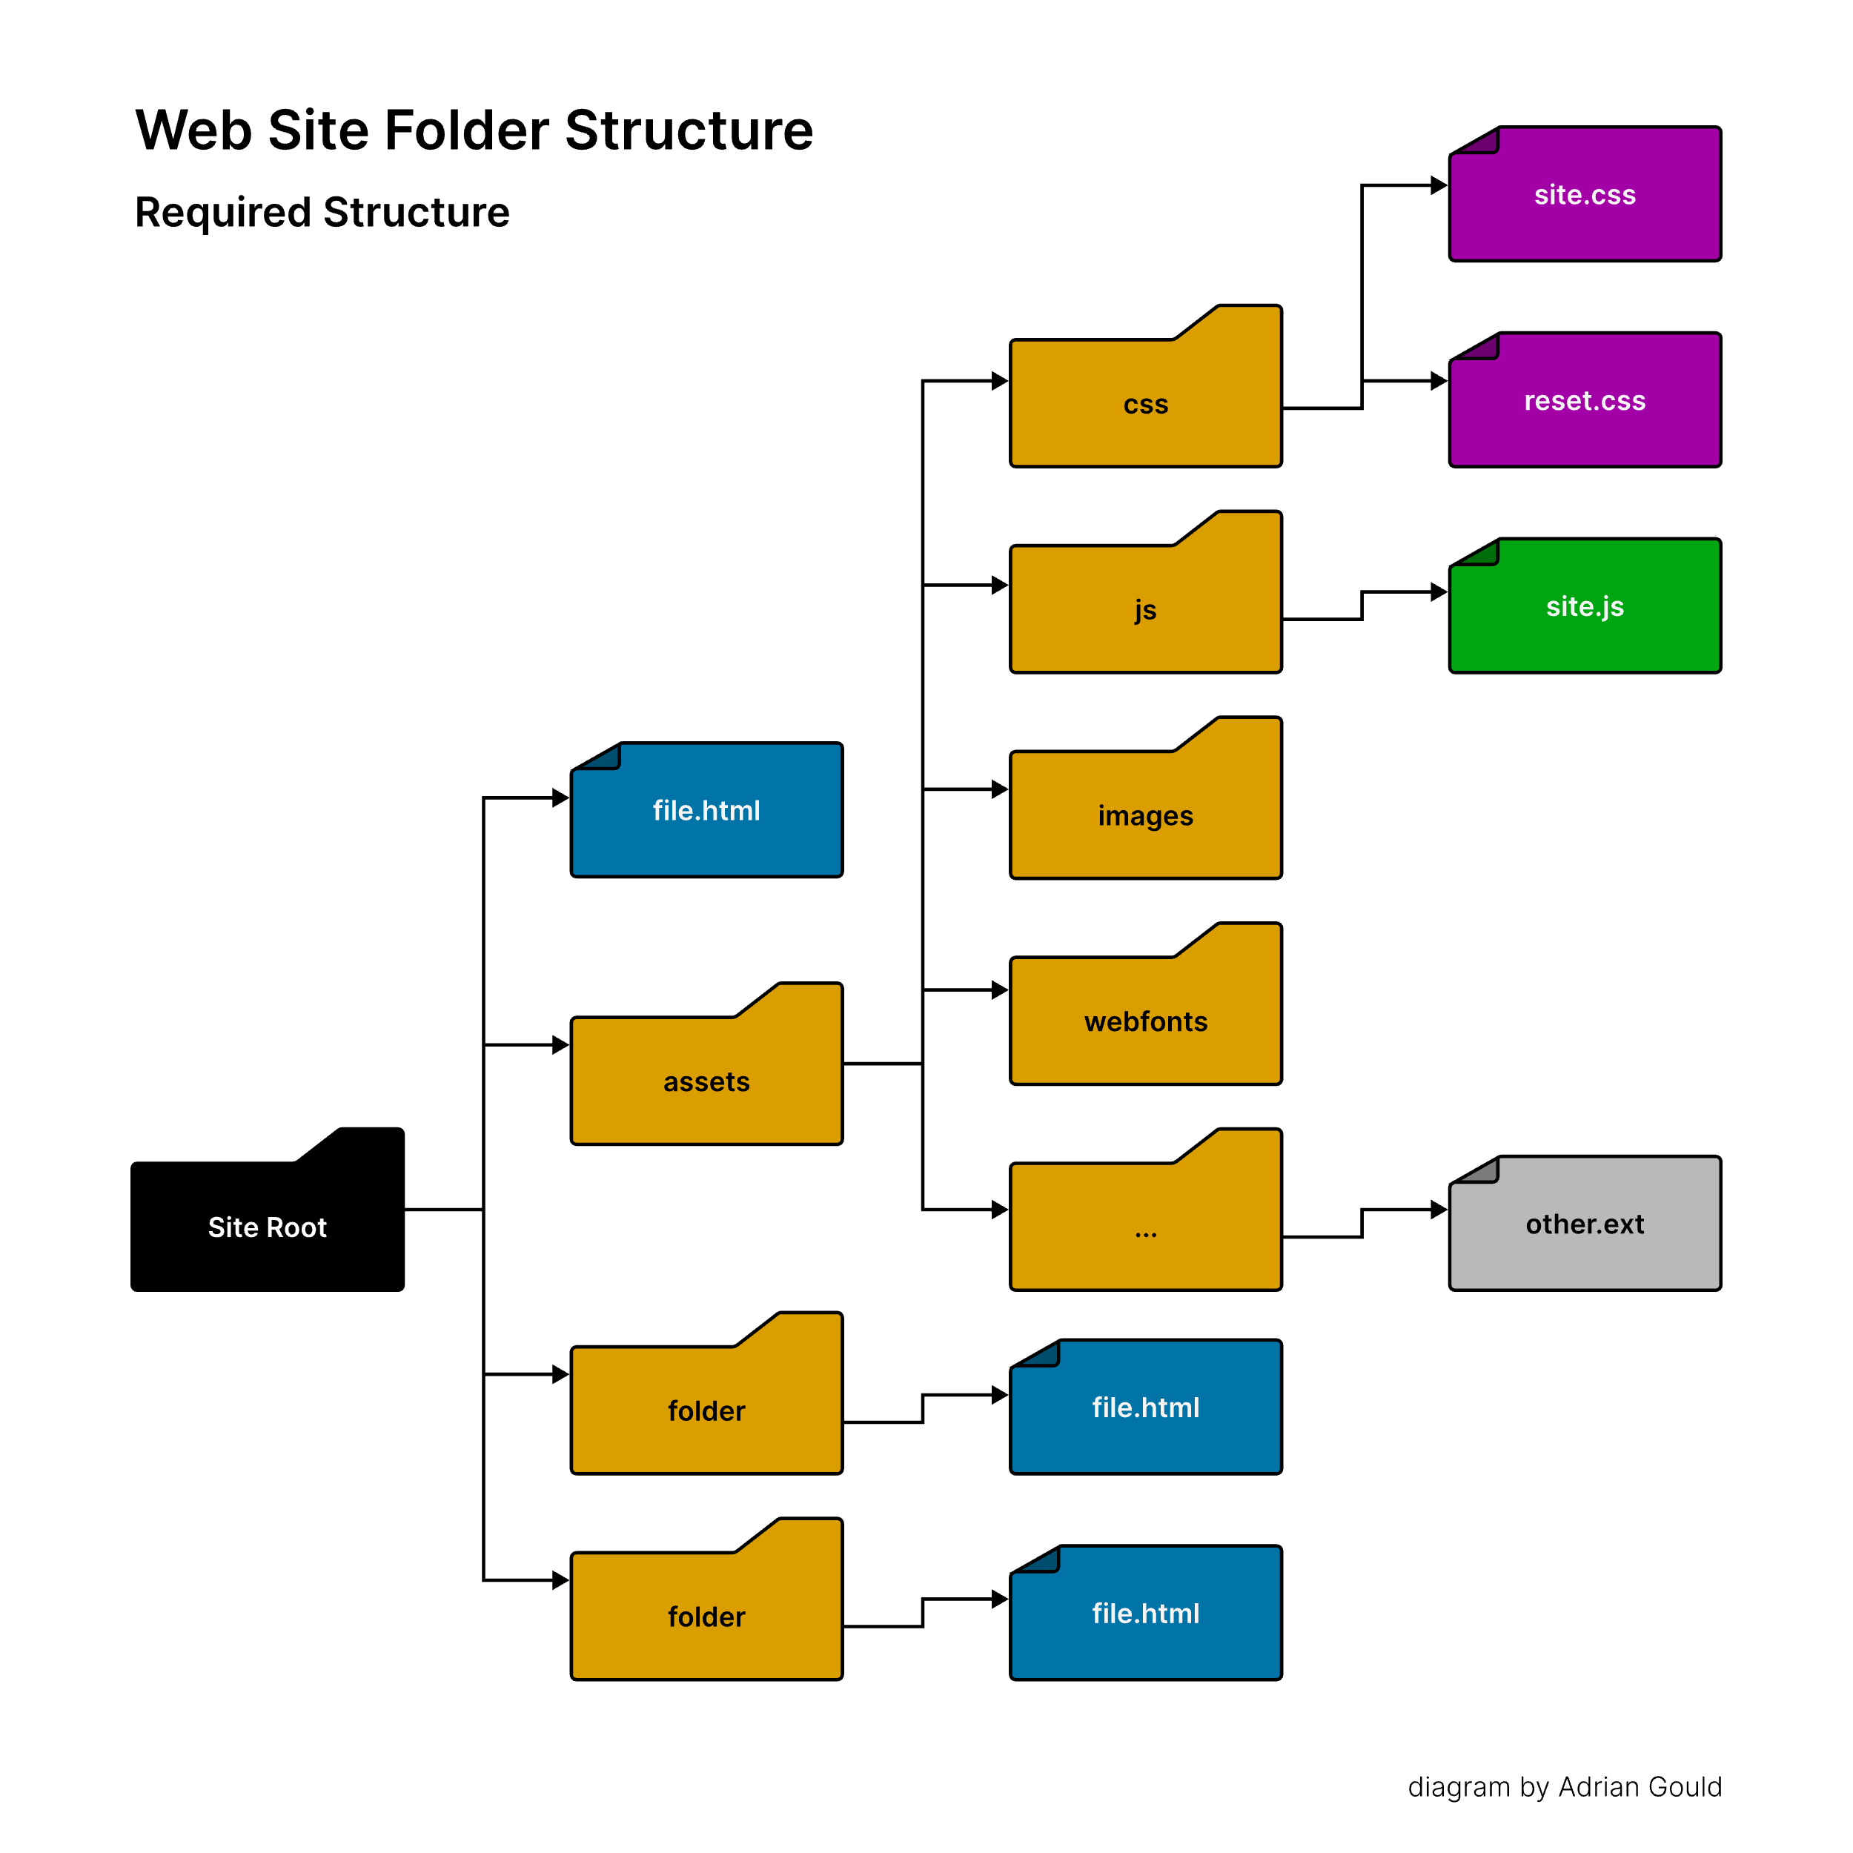
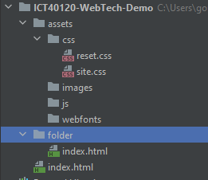
2: HTML 5 Basics – Site Structure
Site Root
  This is usually a WebStorm project folder
Notes:
Quiz the class

Slide 25

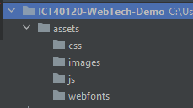
2: HTML 5 Basics – Site Structure
Open WebStorm
Create your Project
Open the WebStorm Terminal
Create an MS-DOS terminal
(click v and select Command Prompt)
Enter following command:
  mkdir assets\css then repeat for the following folders:
  assets\js assets\images assets\webfonts

Slide 26
Basic HTML Page
A well structured basic HTML 5 page…

Slide 27
2: HTML 5 Basics
Standard Structural (Semantic) Elements
    header
    nav
    main
    footer
    article
    aside
    section

Slide 28
2: HTML 5 Basics – Basic Page v1
<!doctype html>
<html lang=“en-au”>
<head>
<title>Untitled Document</title>
</head>
<body>
<header>…</header>
<nav>…</nav>
<main>…</main>
<footer>…</footer>
</body>
</html>

Slide 29
2: HTML 5 Basics – Basic Page v2
<!doctype html>
<html lang=“en-au”>
<head>
<title>Untitled Document</title>
</head>
<body>
<header>…
<nav>…</nav>
</header>
<main>…</main>
<footer>…</footer>
</body>
</html>
Note:
More on these two basic pages as we continue… including a demonstration.

Slide 30
2: North Metropolitan TAFE site
Let’s have a look at the college website structure in the browser inspector…
https://www.northmetrotafe.wa.edu.au
Notes:
Review elements & tags
Begin to insert text in the HTML
Quickly review styles – padding, margin, colour, width etc…

Slide 31
Session 2 Challenge 1
ICT40120 Certificate IV in Information Technology (Programming)

Slide 32
HTML 5 Challenge 1
a
article
aside
b
dd
dl
dt
em
footer
h
meta
title
Find out what each of the elements on the left are and how they are used.
Identify if they are structural, semantic or general purpose.

Slide 33
HTML 5 Challenge 1
header
i
li
main
ol
p
section
strong
ul
thead
tbody
tfoot
Find out what each of the elements on the left are and how they are used.
Identify if they are structural, semantic or general purpose.

Slide 34
HTML 5 Challenge 1
img
br
hr
area
embed
input
source
div
table
td
tr
th
Find out what each of the elements on the left are and how they are used.
Identify if they are structural, semantic or general purpose.

Slide 35
Session 2 Challenge 2
ICT40120 Certificate IV in Information Technology (Programming)

Slide 36
Session 2 – Challenge 2
Create a new HTML5 Boilerplate project in WebStorm.
https://www.youtube.com/watch?v=_NRodG8VcMs&t=2s

Slide 37
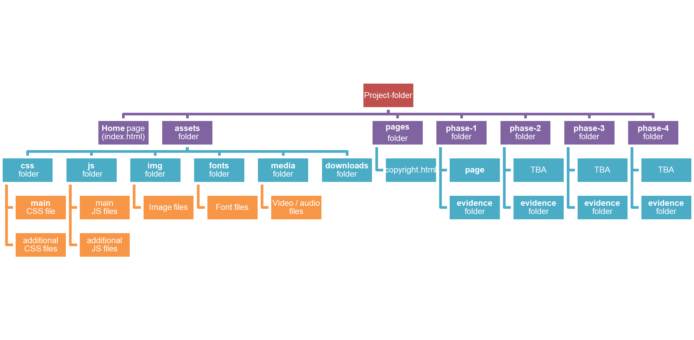
HTML 5 Challenge 2
Reorganise the folder structure to match the structure below.

Slide 38
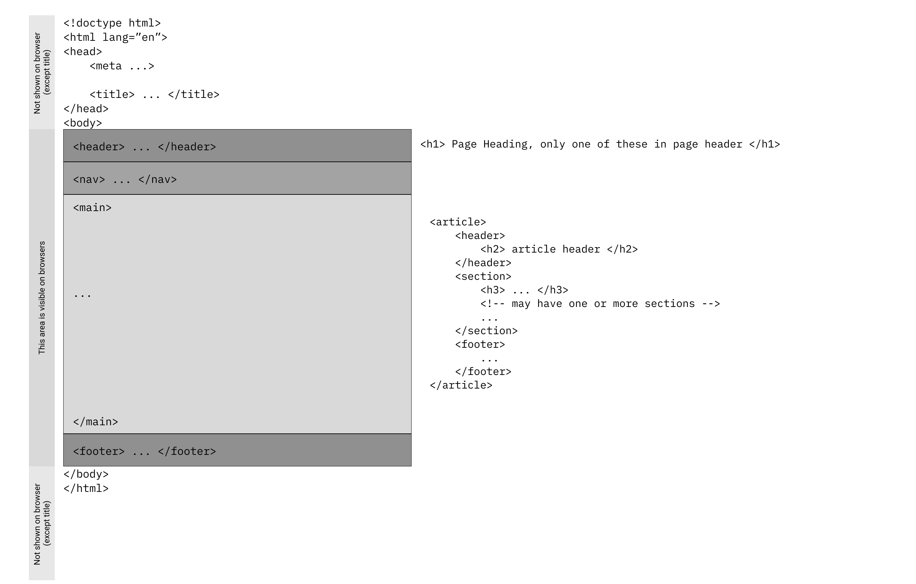
HTML 5 Challenge 2
Change the index.html page to look like this.

Slide 39
🦆

