Slide 1
Web Technologies: Introduction
ICT40120 Certificate IV in Information Technology (Programming)
Code | Title
ICTWEB441 | Produce basic client-side script
ICTWEB452 | Create a markup language document

Slide 2
Web Tech: Sessions
ICT40120 Certificate IV in Information Technology (Programming)
Code | Title
ICTWEB441 | Produce basic client-side script
ICTWEB452 | Create a markup language document

Slide 3
Sessions
A session is a component of study
Sessions may include:
Notes
Demonstrations
Challenges
Out of class activities

Slide 4

Loops

Slide 5
Loop-de-loop
Repeating something requires the use of a loop
These are some of the main loop types:
for ( …; …; … ) { … }
while ( … ) { … }
do { … } while ( … )
for … of … { … }

Slide 6
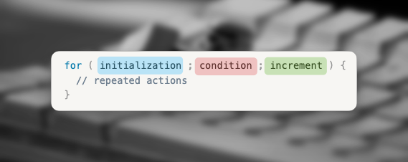
Loops: For
This loop contains four parts:
Initialisation
Condition
Increment
Repeated Actions

Slide 7
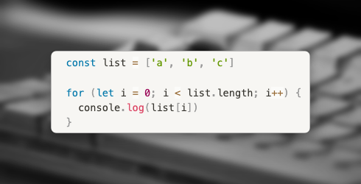
Loops: For

Slide 8
Loops: Do … While
The Do … While loop:
Contains the same four parts
These are in slightly different order:
Initialisation
Repeated operations
Increment / update
Condition

Slide 9
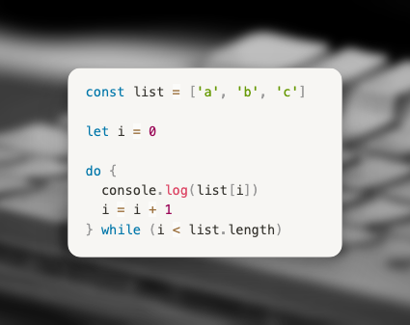
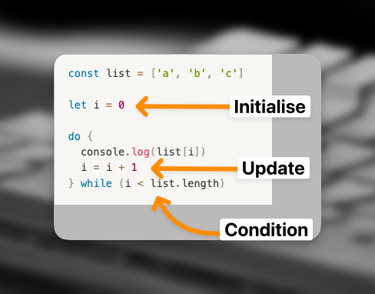
Loops: do … while

Slide 10
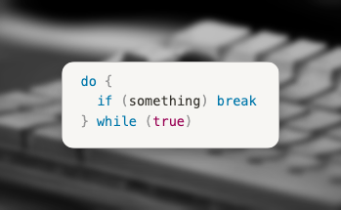
Loops: Do … While
Exit early out of a loop
Use break
Notes:
Early return pattern

Slide 11
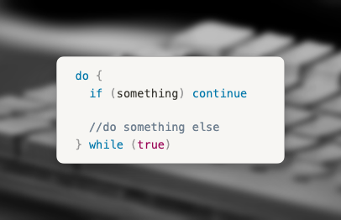
Loops: Do … While
Jump to next iteration:
Use continue

Slide 12
Challenge 1

Slide 13
Challenge 1
Create a simple do-while loop that counts down from 10
At each increment console.log() the count-down number

Slide 14
Loops: While …
The While … loop:
Contains the same four parts
These are in slightly different order:
Initialisation
Condition
Repeated operations
Increment / update

Slide 15
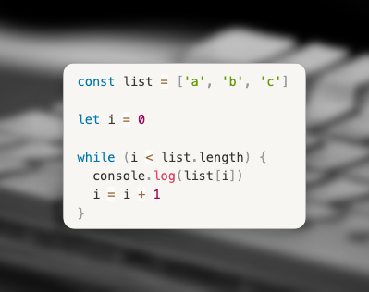
Loops: While …

Slide 16
Loops: While …
As with the do … while
While … loops may:
Be exited early
Using break
Or jump to next iteration
Using continue

Slide 17
Loops: For … of
Simpler loop
Does not have index value
Extracts values from array automatically
Has the form:
for ( element of array ) { … }

Slide 18
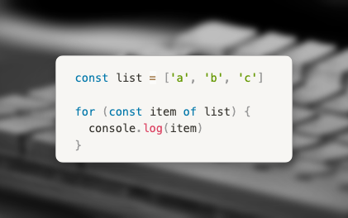
Loops: For … of

Slide 19
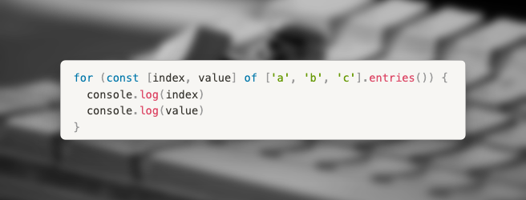
Loops: For … of
If you need an index, then:
Destructure the array
Use .entries() to get the elements
This loop creates a new “scope” for each iteration.
Thus the use of const is allowed.

Slide 20
Challenge 2

Slide 21
Challenge 2
Using the array in the challenge 2 starter code
Create a for … of loop which
De-structures the array using the entries() method to create index & number constants
Inside the loop uses modulo to check if the number has a remainder of 0 or 1
Checks else the remainder is 0, console.log() a message saying the number is even
If the remainder is 1, console.log() a message saying the number is odd

Slide 22
Video Reference
For of… For in…
https://youtu.be/ezPEbn2e2CE

Slide 23
Loops: For … in
The for … in loop:
Loop over enumerable properties of an object
Very different from for … of
This loop requires us to use a
let

Slide 24
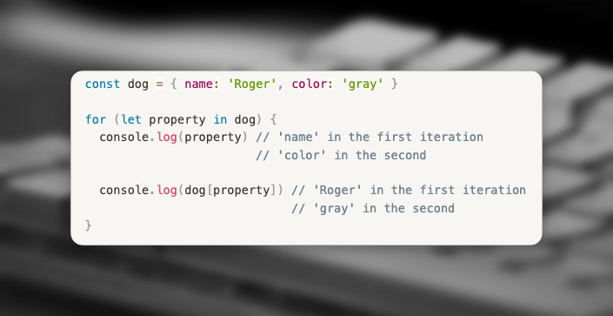
Loops: For … in

Slide 25
Loops: For … in
When used with an array
We get the index
Use the index to retrieve the value

Slide 26
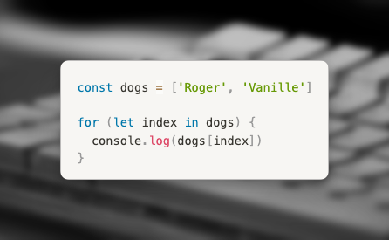
Loops: For … in

Slide 27
Challenge 3

Slide 28
Challenge 3
Using the array in the challenge 3 starter code
Create a for … in loop which
Loops through the product constant using let
console.log() a message with index & the value of the index

Slide 29
Video Reference
For of… For in…
https://youtu.be/ezPEbn2e2CE

Slide 30
Other Loops
Two special loops
Part of the Array object methods
Array.forEach()
Array.map()
More on these later

Slide 31
Interacting with the Browser

Slide 32
DOM Manipulation
DOM
Document
Object
Model
It “models” the HTML page

Slide 33
DOM “Hierarchy”
This is the code for a VERY simple HTML page.
We have purposely put the HTML elements in capital letters.
The indenting assists us to see the hierarchy.
<HTML>
<HEAD>
<TITLE> Page Title </TITLE>
</HEAD>
<BODY>
<H1> Header 1 Text </H1>
</BODY>
</HTML>

Slide 34
DOM “Hierarchy”
The DOM sees the page as a tree
Each element is an “element node”
Each piece of text is a “text node”
HTML Element node
HEAD
Element node
Page Title
Text Node
BODY Element node
H1 Element node
TITLE Element Node
Header Text
Text Node

Slide 35
DOM “Heirarchy”
HTML Node
The “Root” node, or “trunk” of the DOM is the HTML node

Slide 36
DOM “Heirarchy”
HTML Node
Has two child nodes
HEAD
BODY

Slide 37
DOM “Heirarchy”
The HEAD node:
One of the child nodes:
TITLE
which has a text node containing the text for the page title

Slide 38
DOM “Heirarchy”
Also, the HTML node has…
The BODY node:
which may have none, one or many child nodes
Each element becomes a node

Slide 39
DOM “Heirarchy”
This carries on for the whole HTML document

Slide 40
Example of a DOM
html
head
title
body
header
h1
nav
ul
li
a
li
a
li
a
main
h2
article
header
h3
div
p
p
...
footer
p
...
footer
div
...
div
...
...
...
...
title text
header text
Root Node
Element Node
Text Node

Slide 41
Searching the DOM

Slide 42
The DOM
The DOM is contained in a JavaScript object:
document
You may create an “alias” to this:
let dom = document

Slide 43
Finding the Elements
We can search the DOM
This lets us find elements
We can search by:
id
class
tag name

Slide 44
Finding the Elements: by id
document.getElementById(“id”)
An ID appears only ONCE on a page
Thus, getElementById retrieves ONE element

Slide 45
Finding the Elements: by class
document.getElementsByClassName(“class_name”)
A class may appear zero or more times on a page
Thus, getElementByClassName retrieves zero or more elements
The elements are returned as an array

Slide 46
Finding the Elements: by tag name
document.getElementByTagName(“tag”)
This will find all the elements with the name “tag”
The elements are returned as an array

Slide 47
Query Selectors
Selectors are
Elements,
IDs and
Classes

Slide 48
Query Selectors
There are two query selector functions
querySelector()
Retrieves one item with the given selector
querySelectorAll()
Retrieves all items with the given selector

Slide 49
Challenge 4

Slide 50
Challenge 4
Using the challenge 4 starter code
Use querySelectorAll() to find all of the “upcoming events” links
Use a for loop to loop through the event links array created using entries()
console.log() a message text inside the element in uppercase using innerHTML() & toUpperCase()

Slide 51
Parents, Children & Siblings
You are able to
obtain the parent and
the children of a selected node

Slide 52
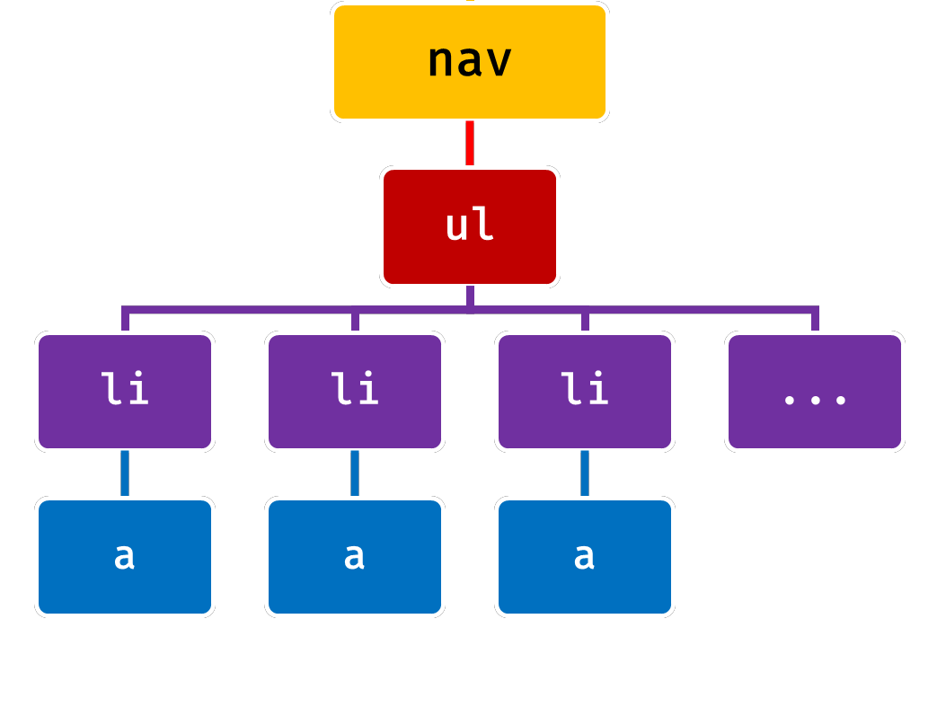
Getting hold of the Parents
parentNode the direct parent node of an element.
parentElement the direct parent element (ignoring non-elements text nodes or comments).
closest(selector) searches for the nearest ancestor that matches the specified CSS selector.

Slide 53
Trying to Understand Siblings
nextSibling next sibling node (element, text node, or comment).
previousSibling previous sibling node.
nextElementSibling the next sibling element (ignores non-element nodes).
previousElementSibling previous sibling element.

Slide 54
Getting control of your Children
childNodes collection of all child nodes an element.
children collection of child elements (ignores non-element nodes).
querySelector(selector) the first child element that matches the specified CSS selector.
querySelectorAll(selector) all child elements that match the specified CSS selector.

Slide 55
Using logic to navigate the DOM
Parent obtained by:
node.parentNode
Children obtained by…
first checking if there are children:
if (node.hasChildren()) {…} or
if (children.length > 0) {…}
Then getting the nodes
node.childNodes

Slide 56
Editing the DOM

Slide 57
Editing the DOM
We are able to alter the DOM tree
There are many ways to do this

Slide 58
Editing the DOM
Method | Action
document.createElement(“p”) | Creates a new Element Node
document.createTextNode(“…”) | Creates a new Text Element
element.appendChild(newChild) | alters the tree under "element", adding a new child Node "newChild" to it, after all the other children.
first.removeChild(second) | removes the child node "second" from the node "first"
existingNode.insertBefore(newNode) | inserts "newNode" as a sibling of "existingNode", placing it before that in the DOM tree structure.
element.prepend(newChild) | alters the tree under "element", adding a new child Node "newChild" to it, before other child elements. You can pass one or more child Nodes, or even a string that will be interpreted as a Text node.

Slide 59
Editing the DOM
Method | Action
element.replaceChild(newChild, existingChild) | alters the tree under "element", replacing "existingChild" with a new Node "newChild".
element.insertAdjacentElement(position, newElement) | inserts "newElement" in the DOM, positioned relatively to "element" depending on the "position" parameter value.
element.textContent = 'something' | changes the content of a Text node to "something".

Slide 60
Challenge 5

Slide 61
Challenge 5
Using the challenge 5 starter code
Complete the toggleSidebarContent() to do the following
Check if the sidebar <ul> list has Children using hasChildNodes()
use removeChild() to remove the first child (use .firstChild)
create and add a <p> element to the sidebar using createElement() and appendChild()

Slide 62
🦆

