Slide 1
Unlock the Possibilities of a Personal Shopping Assistant AI
PRSENTED BY
MOHAMED AJUMAL M
MOHAMED ATHIF HUSSAIN S
ABDUL HASEEF S
MENTOR
NANDHNI.C.S B.E.,M.E.,B.Ed.

Slide 2
Introduction to Personal Shopping Assistant AI
Benefits of Personal Shopping Assistant AI
Applications of Personal Shopping Assistant AI
Future of Personal Shopping Assistant AI
Conclusion
References

Slide 3

Introduction to Personal Shopping Assistant AI
Personal shopping assistant AI is a technology that uses artificial intelligence to help shoppers with their shopping needs. It can provide personalized recommendations, help with product search, and even provide product reviews. It can also help shoppers save time and money by providing them with the best deals.
This technology is becoming increasingly popular as it can provide shoppers with convenience and assistance. It is also becoming more accessible, as it can be used on mobile devices, websites, and even in-store kiosks.

Slide 4

Benefits of Personal Shopping Assistant AI
Personal shopping assistant AI can provide shoppers with a wide range of benefits. It can help save time by providing more accurate and faster product searches. It can also help shoppers save money by providing them with the best deals and discounts. Additionally, it can provide personalized recommendations based on the shopper’s preferences and past purchases.
The technology can also provide shoppers with detailed product reviews, helping them make more informed decisions. Finally, it can provide a more convenient shopping experience as it can be used on mobile devices, websites, and even in-store stocks

Slide 5
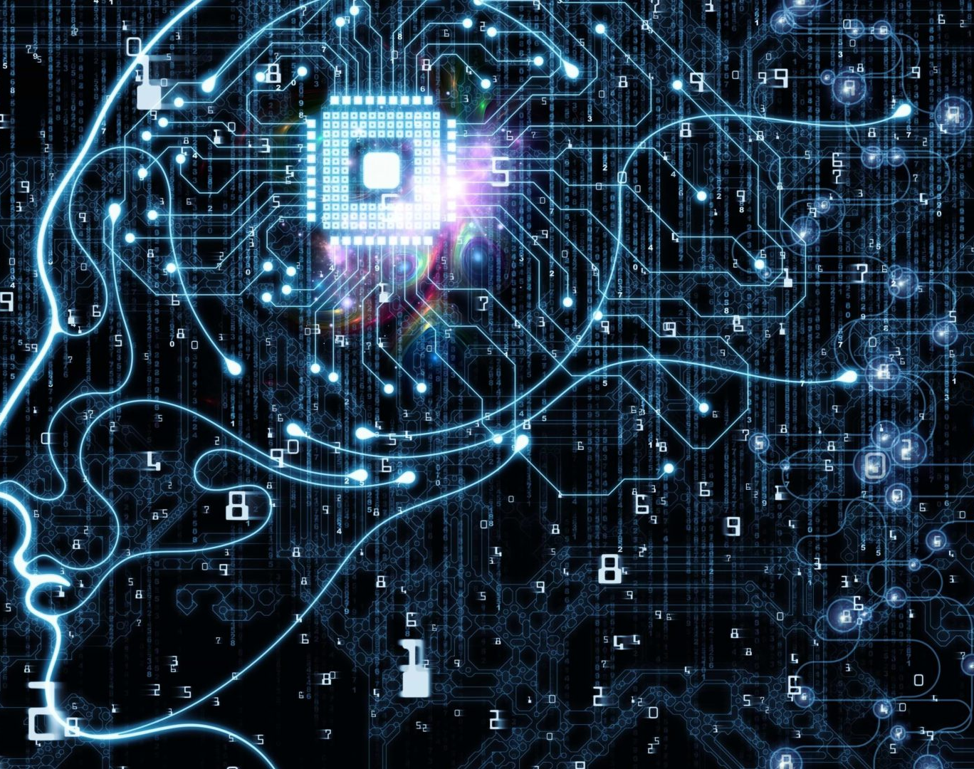
Applications of Personal Shopping Assistant AI
Personal shopping assistant AI is being used in a wide range of applications. It is being used in e-commerce websites to provide shoppers with personalized product recommendations and detailed product reviews. It is also being used in retail stores to help shoppers find the products they need and provide them with discounts and deals.
The technology is also being used in mobile apps to provide shoppers with a more convenient shopping experience. Additionally, it is being used in in-store kiosks to provide shoppers with product information and personalized recommendations.

Slide 6

Future of Personal Shopping Assistant AI
Personal shopping assistant AI is expected to become even more advanced in the future. It is expected to be able to provide more accurate and personalized recommendations to shoppers. Additionally, it is expected to be able to provide more detailed product reviews and help shoppers save more time and money.
The technology is also expected to be used in more applications, such as in-store kiosks, virtual reality shopping experiences, and even in autonomous vehicles. Finally, it is expected to become even more accessible, as it can be used on mobile devices, websites, and even in-store stocks.

Slide 7
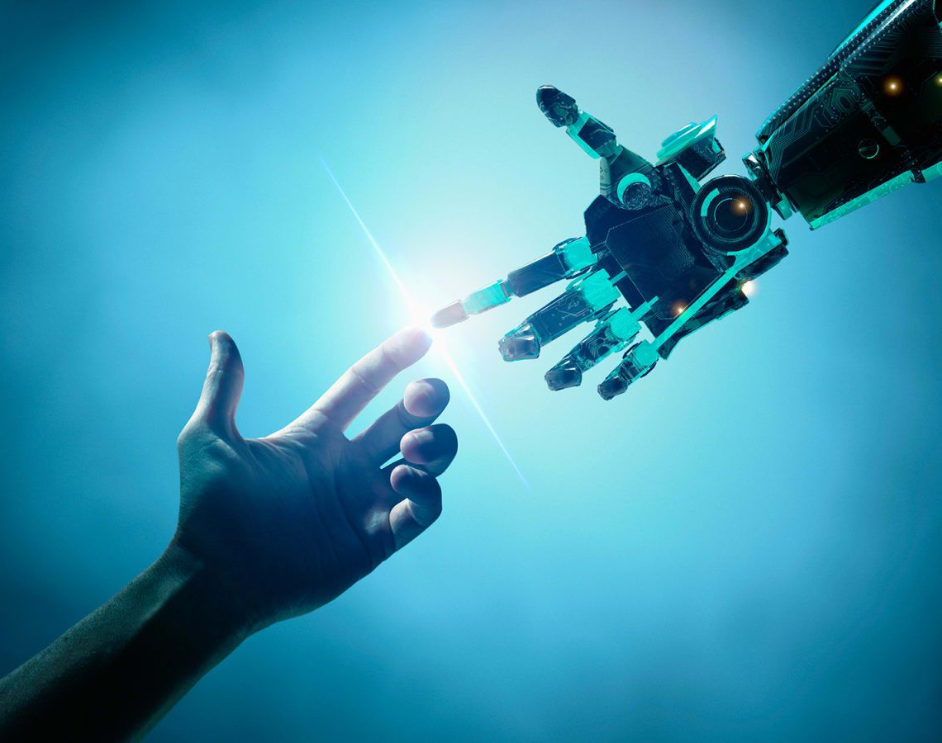
Conclusion
Personal shopping assistant AI is a technology that is becoming increasingly popular and accessible. It can provide shoppers with convenience, assistance, and savings. It is being used in a wide range of applications and is expected to become even more advanced in the future.
The technology is expected to provide shoppers with more accurate and personalized recommendations, more detailed product reviews, and more savings. Finally, it is expected to be used in more applications and become even more accessible

